Slide 1
Sharp Waiting-Time Bounds for Multiserver Jobs
Yige Hong & Weina Wang
Carnegie Mellon University
Mobihoc 2022

Slide 2

Datacenter and queueing models

Slide 3

What is a multiserver job?
👩🏻
requires 4 servers to run
👧🏻
“server need = 4”
😼
single-server job
👨🏻
multi-server job
servers

Slide 4



Why multiserver jobs?
Modern cloud clusters run workloads as containers (lightweight Virtual Machines)
container requires certain resources to run
→ multiserver job

Slide 5
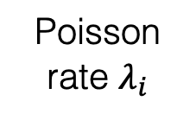
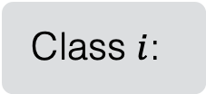



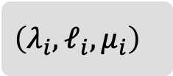
Model: $n$ servers, $K$ classes
hold for Exp($μ_{i}$) time
Class $i$:
$$\left(λ_{i}, ℓ_{i}, μ_{i}\right)$$
$n$ servers
❓
e.g., FCFS
K jobs classes
Servers idle when next job does not fit
Poisson rate $λ_{i}$
server need: $ℓ_{i}$

Slide 6

Model: $n$ servers, $K$ classes
Class $i$:
$$\left(λ_{i}, ℓ_{i}, μ_{i}\right)$$
$n$ servers
❓
e.g.,
prioritize
larger jobs
(best-fit)
K jobs classes
Poisson rate $λ_{i}$
server need: $ℓ_{i}$
service time ~ Exp($μ_{i}$)

Slide 7
Model: $n$ servers, $K$ classes
Class $i$:
$$\left(λ_{i}, ℓ_{i}, μ_{i}\right)$$
$n$ servers
❓
e.g., prioritize smaller jobs
K jobs classes
Poisson rate $λ_{i}$
server need: $ℓ_{i}$
service time ~ Exp($μ_{i}$)

Slide 8
Mean waiting times (averaged over all jobs)
How should we understand these different behaviors?

Slide 9
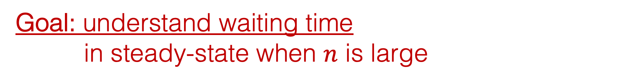

Goal: understand waiting time in steady-state when $n$ is large
Which scheduling policy minimizes waiting time?
❓
$n$ servers

Slide 10
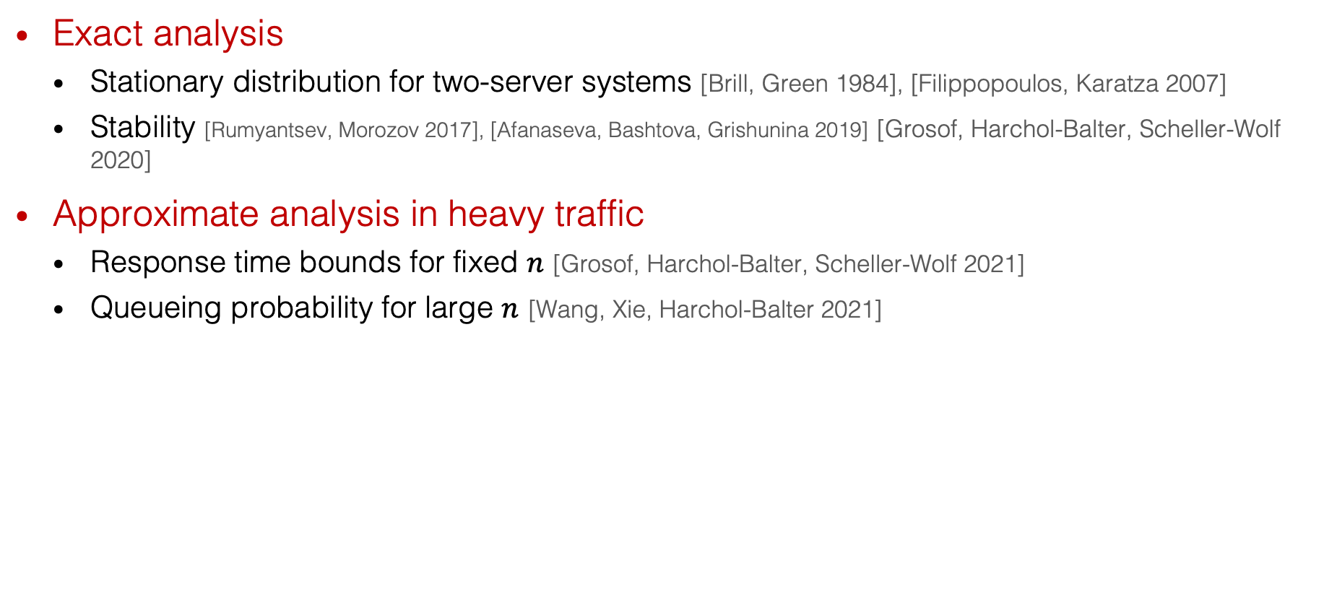
Related work
Exact analysis
Stationary distribution for two-server systems [Brill, Green 1984], [Filippopoulos, Karatza 2007]
Stability [Rumyantsev, Morozov 2017], [Afanaseva, Bashtova, Grishunina 2019] [Grosof, Harchol-Balter, Scheller-Wolf 2020]
Approximate analysis in heavy traffic
Response time bounds for fixed $n$ [Grosof, Harchol-Balter, Scheller-Wolf 2021]
Queueing probability for large $n$ [Wang, Xie, Harchol-Balter 2021]
Summary: limited understanding of waiting time of
multiserver jobs in large systems

Slide 11
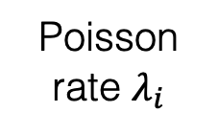
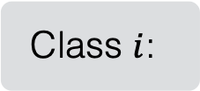

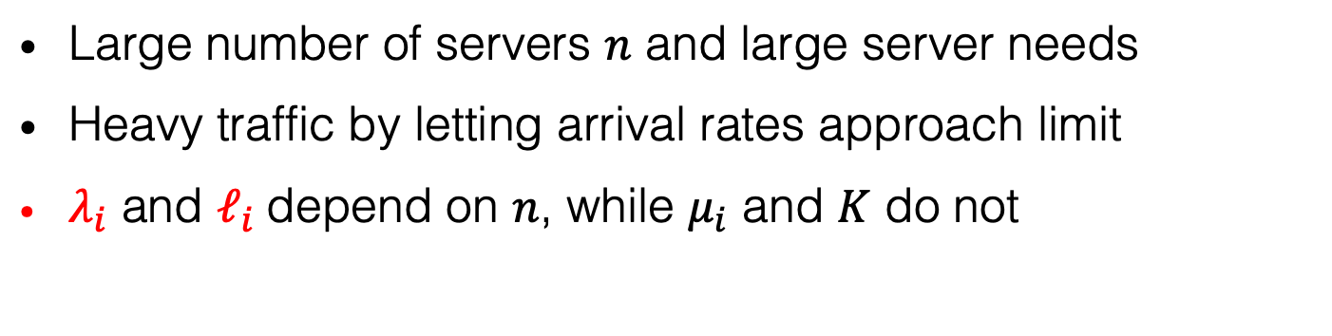
Scaling regimes with $n→∞$
Large number of servers $n$ and large server needs
Heavy traffic by letting arrival rates approach limit
$λ_{i}$ and $ℓ_{i}$depend on $n$, while $μ_{i}$ and $K$ do not
Class $i$:
$$\left(λ_{i}, ℓ_{i}, μ_{i}\right)$$
K jobs classes
Poisson rate $λ_{i}$
server need: $ℓ_{i}$
service time ~ Exp($μ_{i}$)
$n$ servers

Slide 12
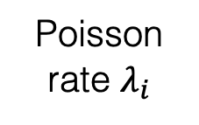
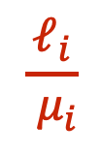
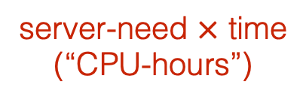
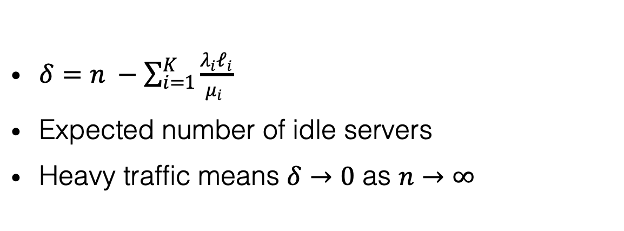

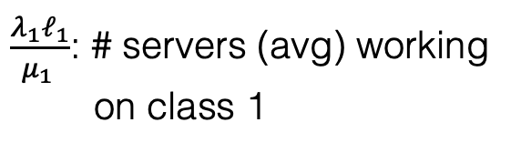
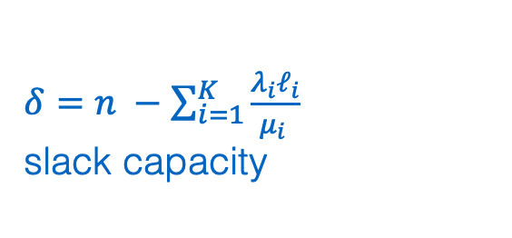
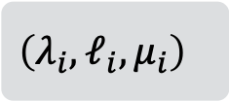
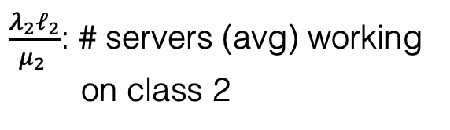
Slack capacity $δ$ and heavy traffic
$$\frac{ℓ_{i}}{ μ_{i}}$$
server-need $×$ time
(“CPU-hours”)
$δ=n −\sum_{i=1}^{K}{\frac{λ_{i}ℓ_{i}}{μ_{i} }}$
Expected number of idle servers
Heavy traffic means $δ→0$ as $n→∞$
$\frac{λ_{1}ℓ_{1}}{μ_{1} }$: # servers (avg) working
on class 1
Class $i$:
$$\left(λ_{i}, ℓ_{i}, μ_{i}\right)$$
$\frac{λ_{2}ℓ_{2}}{μ_{2} }$: # servers (avg) working
on class 2
K jobs classes
…
$δ=n −\sum_{i=1}^{K}{\frac{λ_{i}ℓ_{i}}{μ_{i} }}$
slack capacity
Poisson rate $λ_{i}$
server need: $ℓ_{i}$
service time ~ Exp($μ_{i}$)
$n$ servers

Slide 13
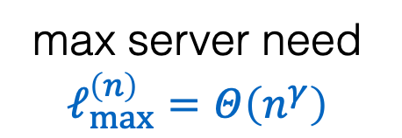

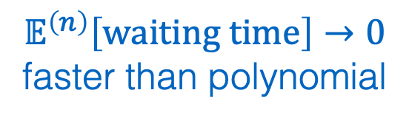
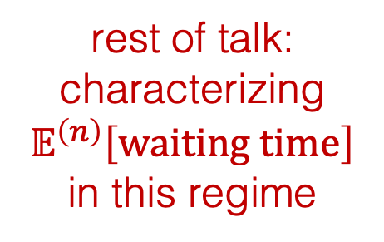



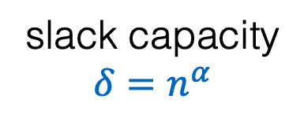
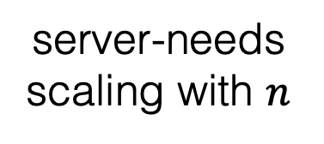
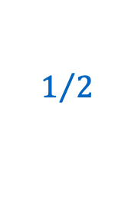
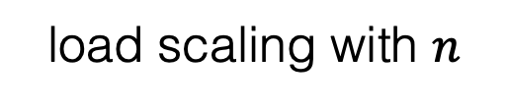

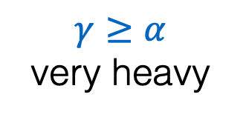
Results (simplified)
max server need $ℓ_{max}^{\left(n\right)}=Θ\left(n^{γ}\right)$
$$γ$$
Under “work-conserving” policies:
analogy for NDS
analogy for HW
$$1$$
$$𝔼^{\left(n\right)}\left[waiting time\right]→0$$
faster than polynomial
rest of talk:
characterizing $𝔼^{\left(n\right)}\left[waiting time\right]$ in this regime
$$γ≥α$$
very heavy
server-needs scaling with $n$
$$α$$
$$0$$
$$1/2$$
$$1$$
load scaling with $n$
slack capacity $δ=n^{α}$

Slide 14
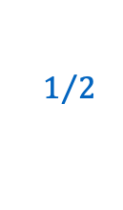


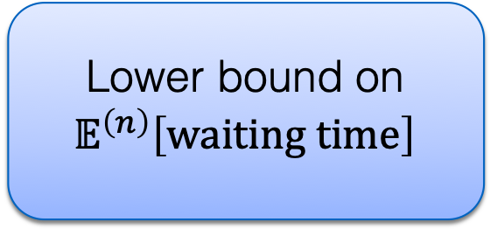

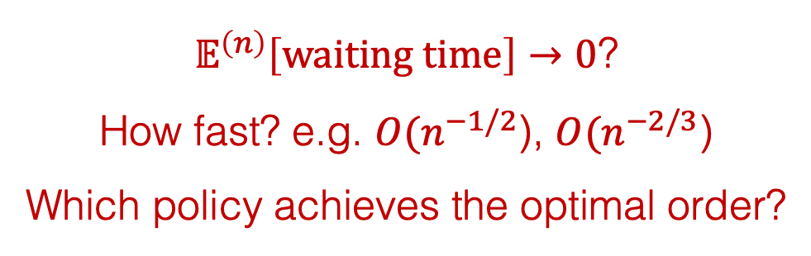




Results (simplified) cont’d
$𝔼^{\left(n\right)}\left[waiting time\right]→0$?
How fast? e.g. ${O(n}^{−1/2}$), ${O(n}^{−2/3}$)
Which policy achieves the optimal order?
$$γ$$
max server need $ℓ_{max}^{\left(n\right)}=Θ\left(n^{γ}\right)$
$$1$$
slack capacity $δ=n^{α}$
$$α$$
$$0$$
$$1/2$$
$$1$$
FCFS
Lower bound on $𝔼^{\left(n\right)}\left[waiting time\right]$
Optimal policy:
P-Priority

Slide 15

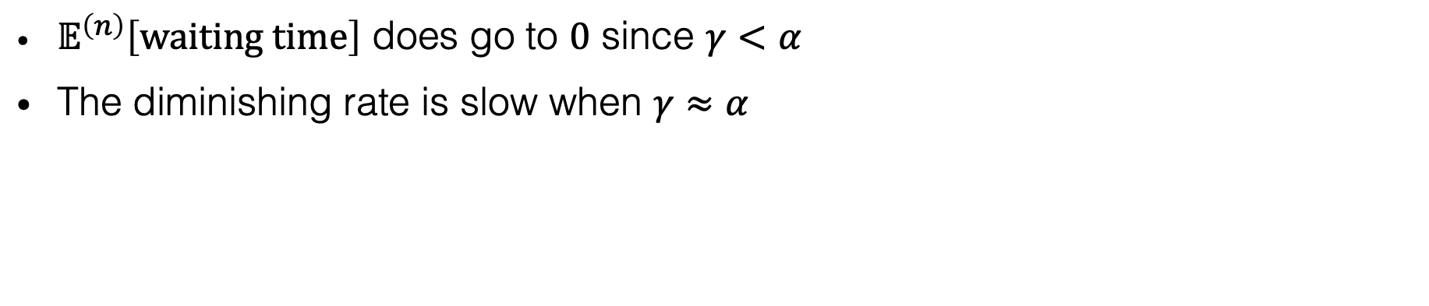





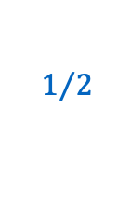
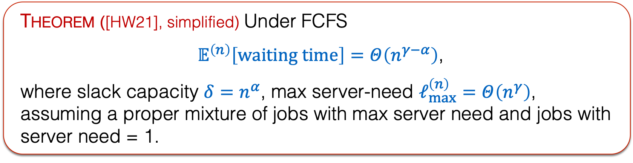

FCFS
Theorem ([HW21], simplified) Under FCFS
$𝔼^{\left(n\right)}\left[waiting time\right]=Θ\left(n^{γ−α}\right)$,
where slack capacity $δ=n^{α}$, max server-need $ℓ_{max}^{\left(n\right)}=Θ\left(n^{γ}\right)$, assuming a proper mixture of jobs with max server need and jobs with server need = 1.
$$γ$$
max server need $ℓ_{max}^{\left(n\right)}=Θ\left(n^{γ}\right)$
$𝔼^{\left(n\right)}\left[waiting time\right]$ does go to $0$ since $γ<α$
The diminishing rate is slow when $γ≈α$
$$1$$
slack capacity $δ=n^{α}$
$$α$$
$$0$$
$$1/2$$
$$1$$

Slide 16
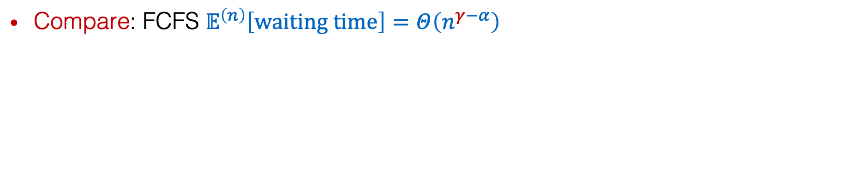
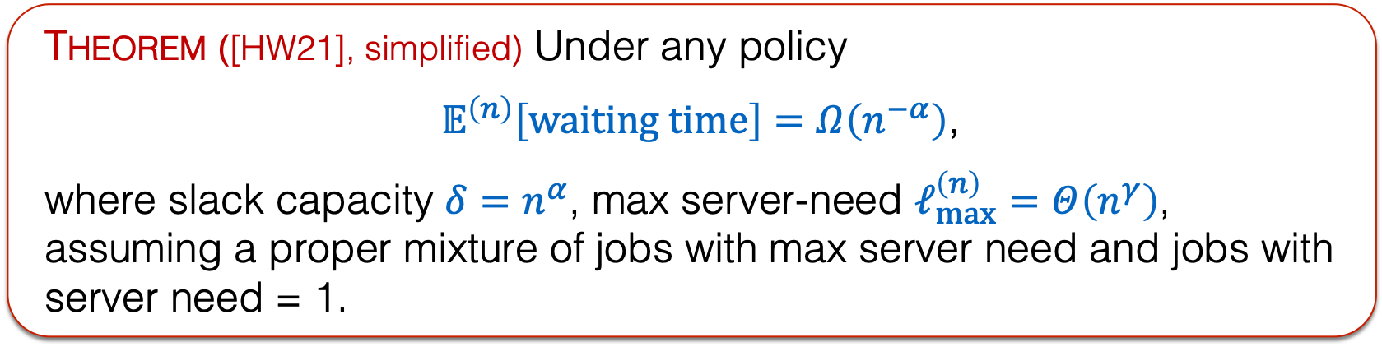
Lower bound
Theorem ([HW21], simplified) Under any policy
$𝔼^{\left(n\right)}\left[waiting time\right]=Ω\left(n^{−α}\right)$,
where slack capacity $δ=n^{α}$, max server-need $ℓ_{max}^{\left(n\right)}=Θ\left(n^{γ}\right)$,
assuming a proper mixture of jobs with max server need and jobs with server need = 1.
$$γ$$
max server need $ℓ_{max}^{\left(n\right)}=Θ\left(n^{γ}\right)$
Compare: FCFS $𝔼^{\left(n\right)}\left[waiting time\right]=Θ\left(n^{γ−α}\right)$
$$1$$
slack capacity $δ=n^{α}$
$$α$$
$$0$$
$$1/2$$
$$1$$

Slide 17
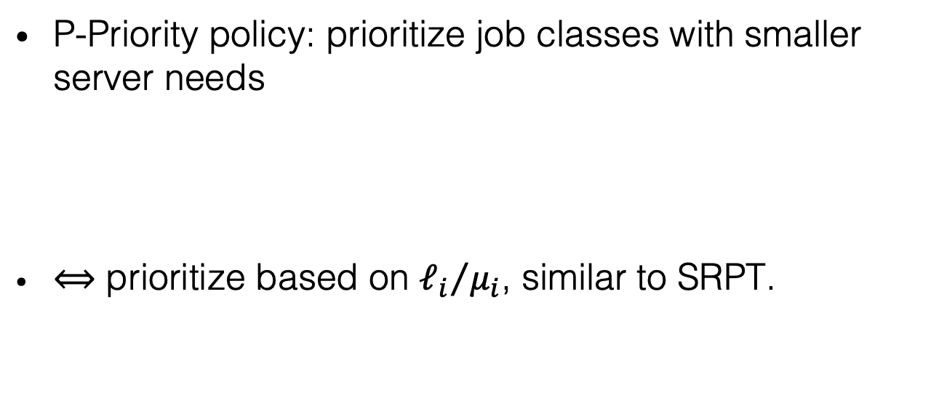
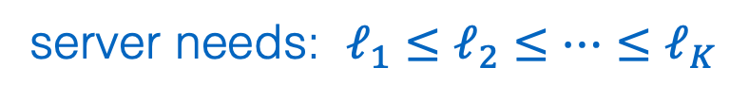
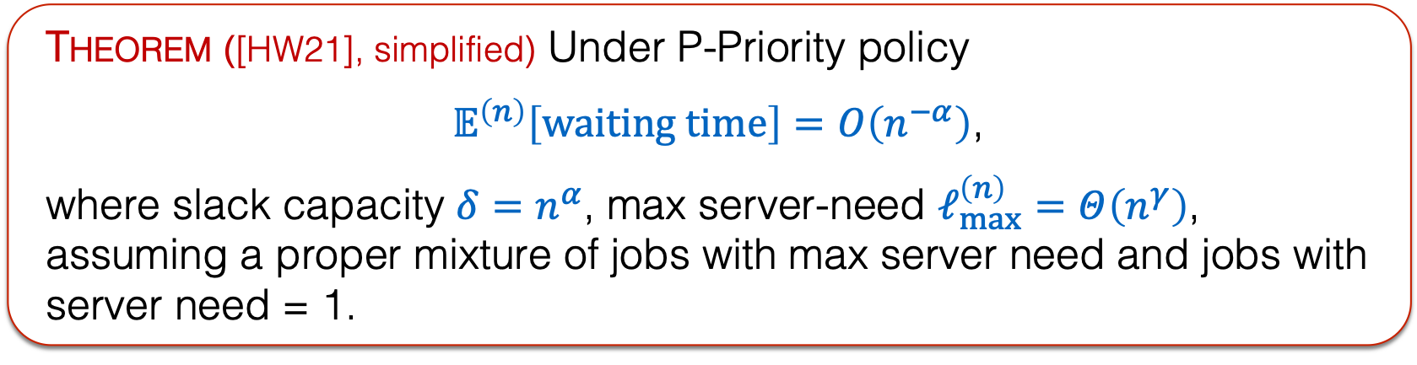
P-Priority
Theorem ([HW21], simplified) Under P-Priority policy
$𝔼^{\left(n\right)}\left[waiting time\right]=O\left(n^{−α}\right)$,
where slack capacity $δ=n^{α}$, max server-need $ℓ_{max}^{\left(n\right)}=Θ\left(n^{γ}\right)$,
assuming a proper mixture of jobs with max server need and jobs with server need = 1.
P-Priority policy: prioritize job classes with smaller server needs
$⟺$ prioritize based on ${ℓ_{i}}/{μ_{i}}$, similar to SRPT.
$$γ$$
max server need $ℓ_{max}^{\left(n\right)}=Θ\left(n^{γ}\right)$
$$1$$
server needs: $ℓ_{1}≤ℓ_{2}≤…≤ℓ_{K}$
high priority
low priority
slack capacity $δ=n^{α}$
$$α$$
$$0$$
$$1/2$$
$$1$$

Slide 18
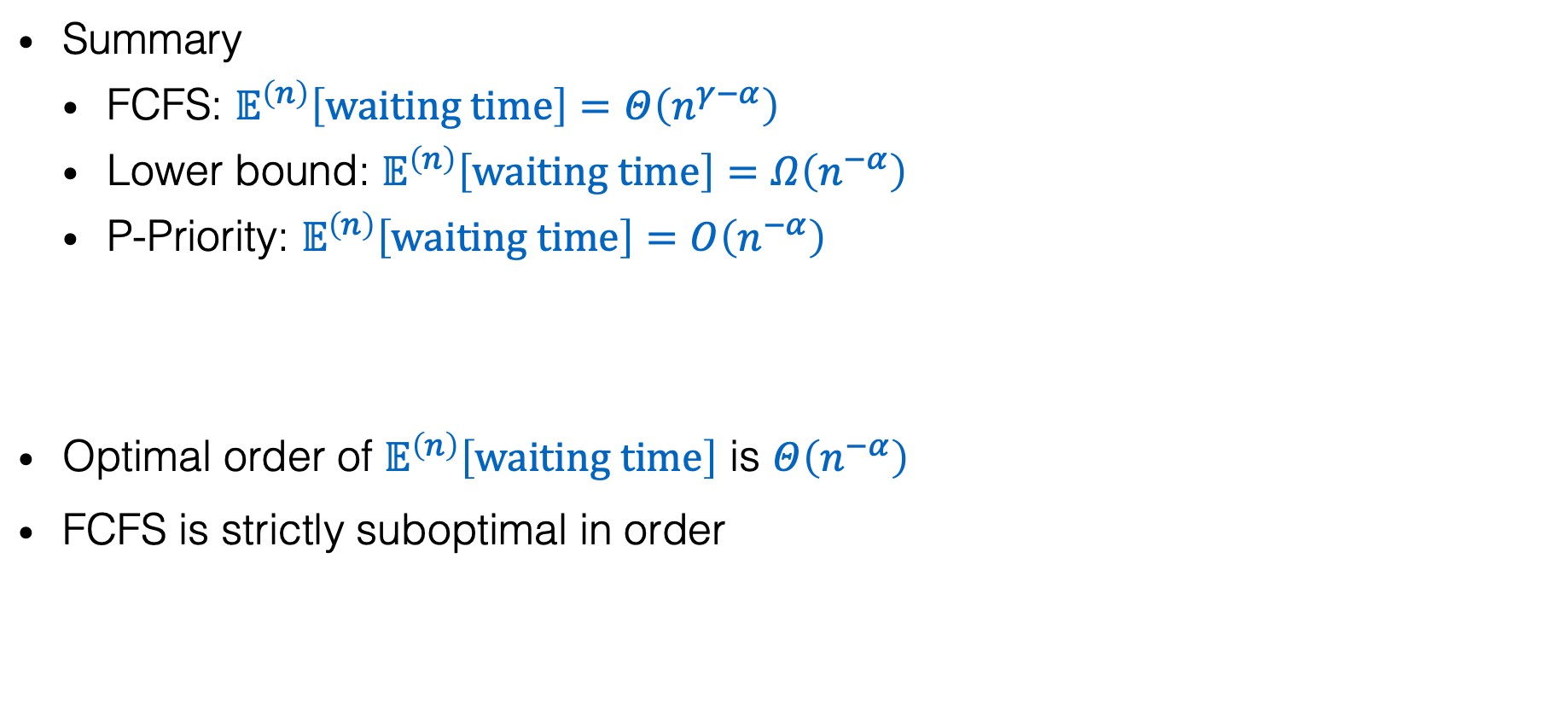
Optimal order
Summary
FCFS: $𝔼^{\left(n\right)}\left[waiting time\right]=Θ\left(n^{γ−α}\right)$
Lower bound: $𝔼^{\left(n\right)}\left[waiting time\right]=Ω\left(n^{−α}\right)$
P-Priority: $𝔼^{\left(n\right)}\left[waiting time\right]=O\left(n^{−α}\right)$
Optimal order of $𝔼^{\left(n\right)}\left[waiting time\right]$ is $Θ\left(n^{−α}\right)$
FCFS is strictly suboptimal in order
$$γ$$
max server need $ℓ_{max}^{\left(n\right)}=Θ\left(n^{γ}\right)$
$$1$$
slack capacity $δ=n^{α}$
$$α$$
$$0$$
$$1/2$$
$$1$$

Slide 19

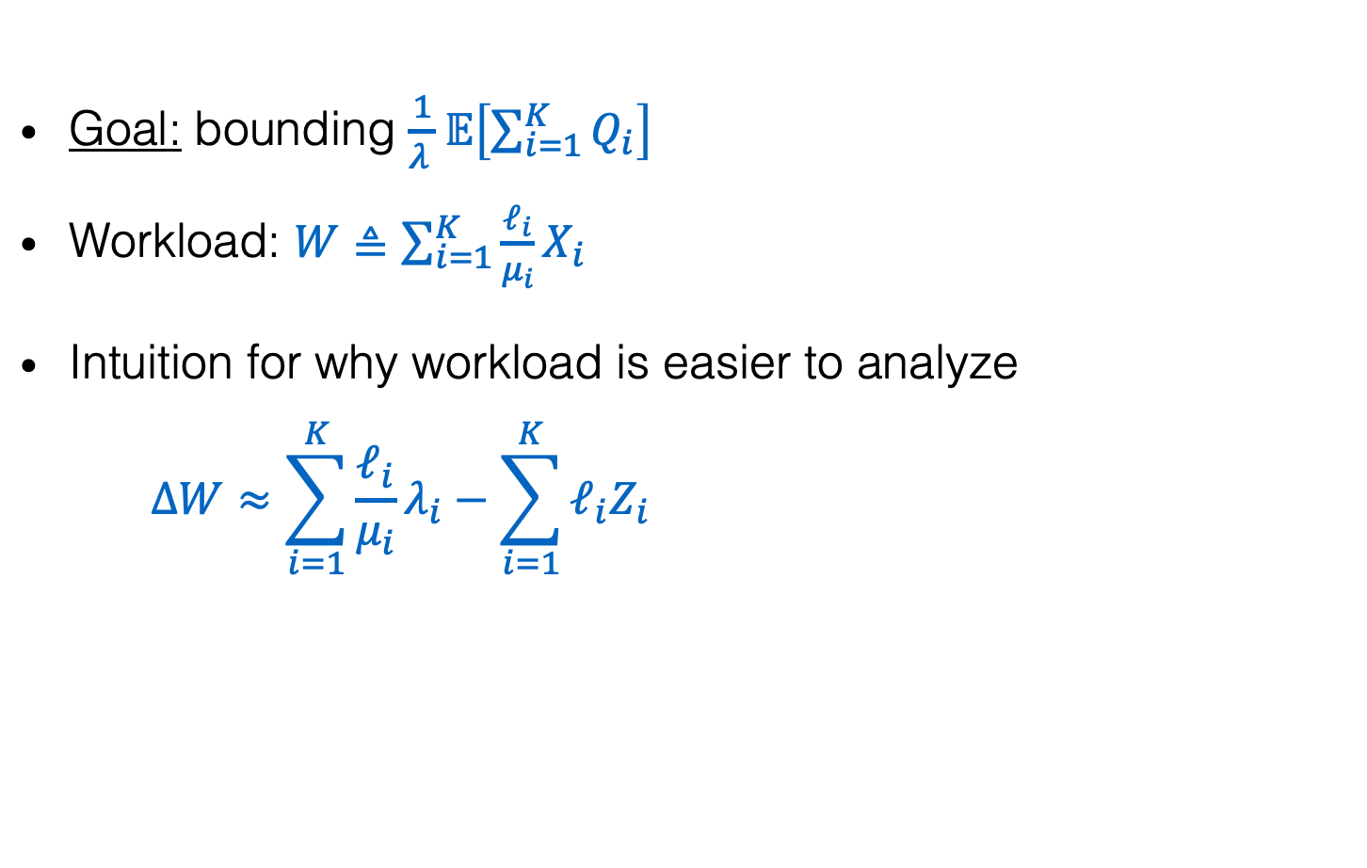
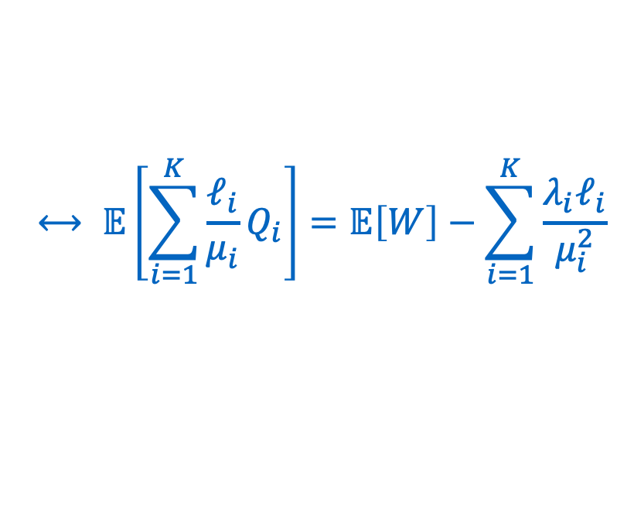


General proof plan
$Q_{i}$: # class $i$ jobs in queue
$X_{i}$: # class $i$ jobs in system
$Z_{i}$: # class $i$ jobs in service
$$Q_{i}=X_{i}−Z_{i}$$
Goal: bounding $\frac{1}{λ_{ }}𝔼\left[\sum_{i=1}^{K}{Q_{i}}\right]$
Workload: $W≜\sum_{i=1}^{K}{\frac{ℓ_{i}}{μ_{i}}X_{i}}$
Intuition for why workload is easier to analyze
$$ΔW≈\sum_{i=1}^{K}{\frac{ℓ_{i}}{μ_{i}}λ_{i}}−\sum_{i=1}^{K}{ℓ_{i}Z_{i}}$$
$$⟷ 𝔼\left[\sum_{i=1}^{K}{\frac{ℓ_{i}}{μ_{i}}Q_{i}}\right]=𝔼\left[W\right]−\sum_{i=1}^{K}{\frac{{λ_{i}ℓ}_{i}}{μ_{i}^{2}}}$$
when enough jobs
$$≤\left(n−δ\right)−\left(n−ℓ_{max}\right)=−\left(δ−ℓ_{max}\right)$$
“drift”
$$n−δ$$
total # busy servers
$$ΔW≥−δ$$
Policy independent!

Slide 20

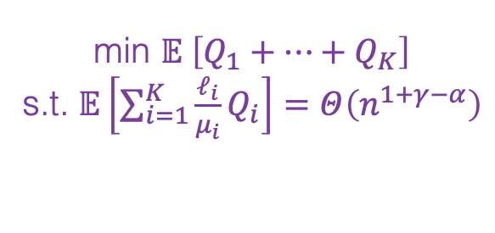

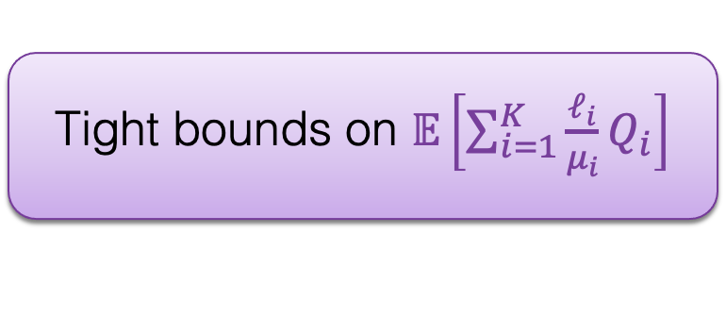
General proof plan
Tight bounds on $𝔼\left[\sum_{i=1}^{K}{\frac{ℓ_{i}}{μ_{i}}Q_{i}}\right]$
Subsystem for jobs of priority classes 1, 2, … i
$$Q_{i} approx.∝λ_{i}$$
min $𝔼 \left[Q_{1}+…+Q_{K}\right]$
s.t. $𝔼\left[\sum_{i=1}^{K}{\frac{ℓ_{i}}{μ_{i}}Q_{i}}\right]=Θ\left(n^{1+γ−α}\right)$
FCFS
Lower bound on $𝔼^{\left(n\right)}\left[waiting time\right]$
Optimal policy:
P-Priority

Slide 21
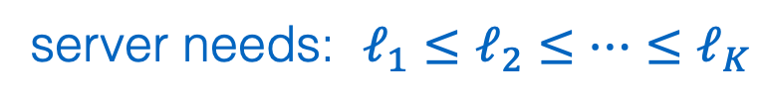
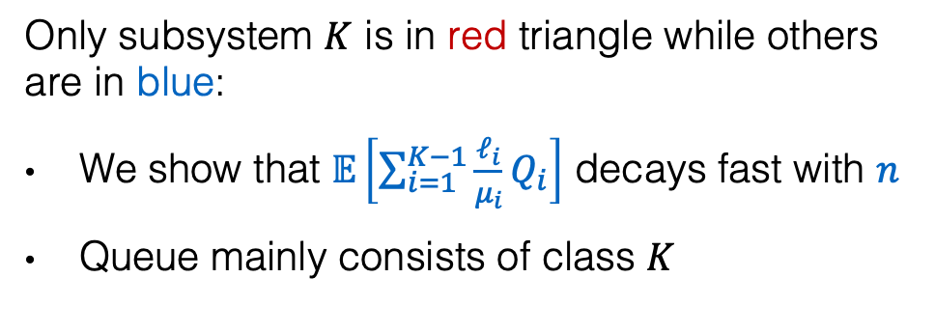
General proof plan
$$γ$$
max server need $ℓ_{max}^{\left(n\right)}=Θ\left(n^{γ}\right)$
$$1$$
Tight bounds on $𝔼\left[\sum_{i=1}^{K}{\frac{ℓ_{i}}{μ_{i}}Q_{i}}\right]$
slack capacity $δ=n^{α}$
$$α$$
Only subsystem $K$ is in red triangle while others are in blue:
We show that $𝔼\left[\sum_{i=1}^{K−1}{\frac{ℓ_{i}}{μ_{i}}Q_{i}}\right]$ decays fast with $n$
Queue mainly consists of class $K$
$$0$$
$$1/2$$
$$1$$
Different subsystems in different traffic regimes
server needs: $ℓ_{1}≤ℓ_{2}≤…≤ℓ_{K}$
Optimal policy:
P-Priority
high priority
low priority

Slide 22







Open problems
Order bounds under general arrival and departure processes?
Policies that degrade gracefully in even heavier traffic regimes?
Preemption or not?
Multi-dimensional resources?
Time-varying resource requirement?
…
$$γ$$
max server need $ℓ_{max}^{\left(n\right)}=Θ\left(n^{γ}\right)$
$$1$$
slack capacity $δ=n^{α}$
$$α$$
$$0$$
$$1/2$$
$$1$$

