Slide 1



Introduction to OR

Slide 2
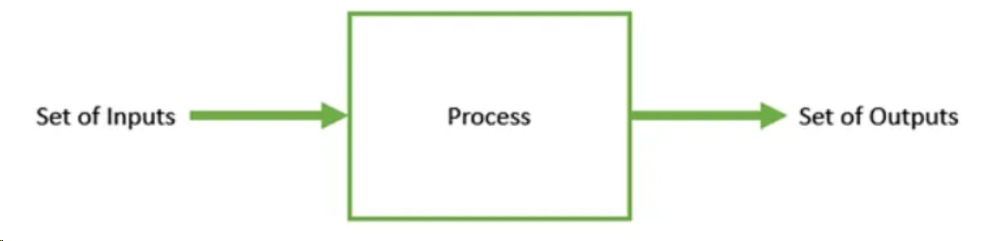
Optimization Problem
A problem in which we have to find the values of inputs (also called solutions or decision variables) from all possible inputs in such a way that we get the “best” output values.

Slide 3
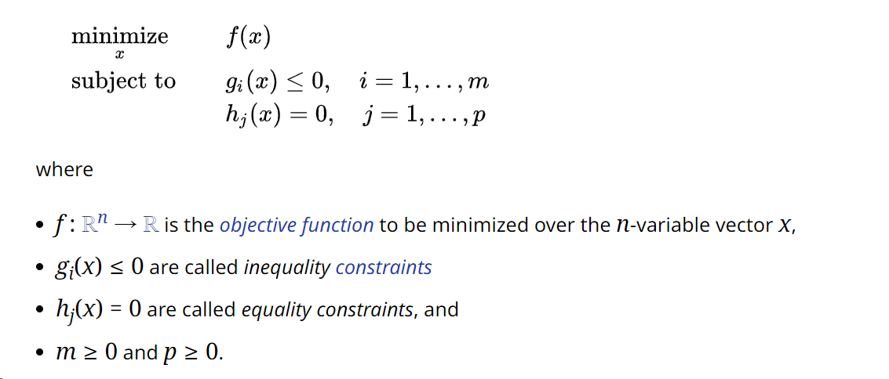
Optimization Problem

Slide 4
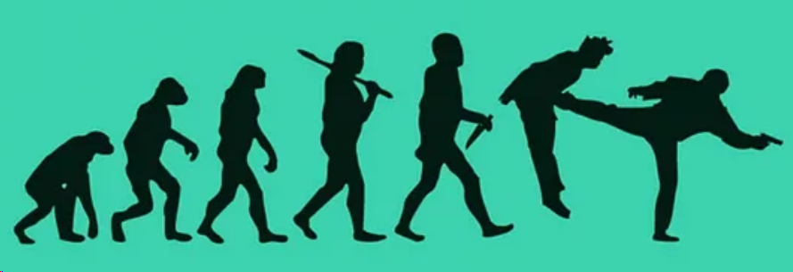
Genetic Algorithm
A genetic algorithm is a search heuristic that is inspired by Charles Darwin’s theory of natural evolution.

Slide 5
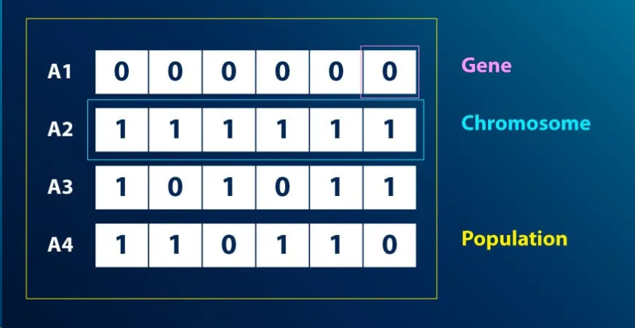
Genetic Algorithm- Representation

Slide 6
Genetic Algorithm- Process
Initial population
Fitness function
Selection
Crossover
Mutation

Slide 7
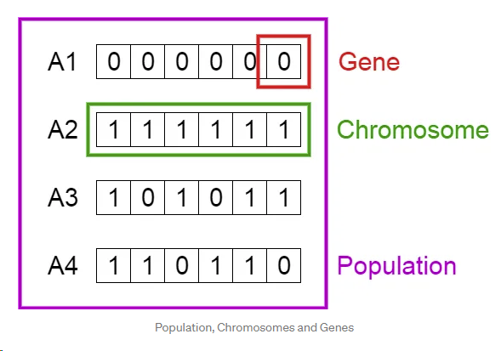
Genetic Algorithm – Initial Population
An individual is characterized by a set of parameters (variables) known as Genes. Genes are joined into a string to form a Chromosome (solution).

Slide 8
Genetic Algorithm – Fitness Function
The fitness function is the basis for determining each individual’s fitness in a population.
It returns a fitness score for each individual based on their performance and ability to compete with other individuals.

Slide 9
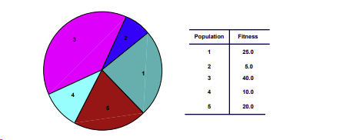
Genetic Algorithm - Selection

Slide 10
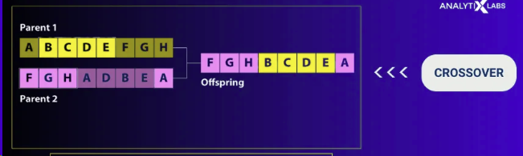
Genetic Algorithm -Crossover

Slide 11
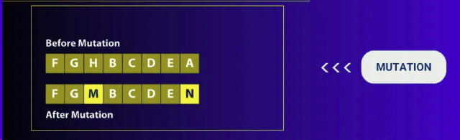
Genetic Algorithm -Mutation

Slide 12
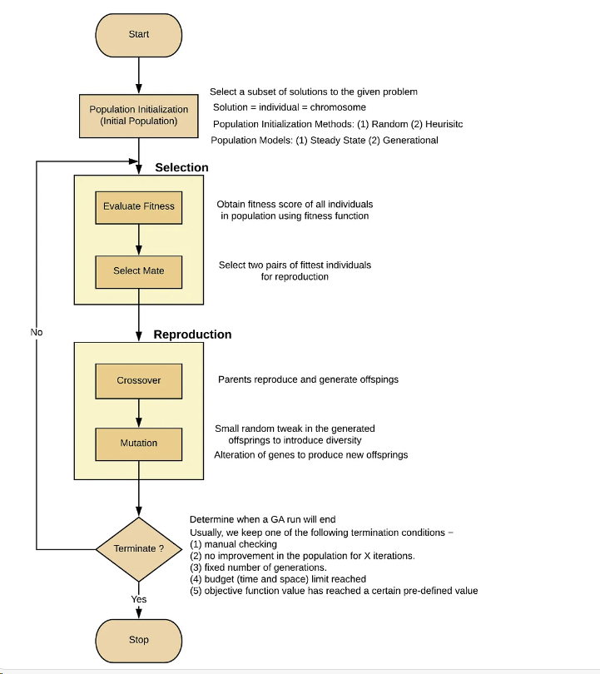
Genetic Algorithm -Summary

