Slide 1



Introduction to OR

Slide 2
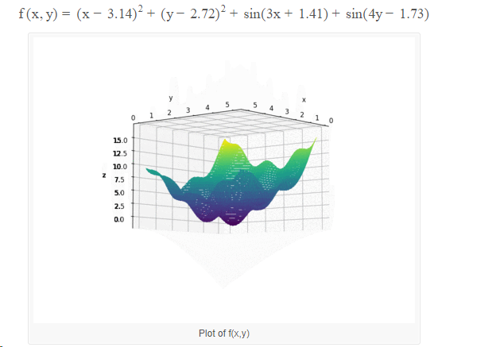
Optimization Problem

Slide 3

Particle Swarm Optimization Algorithm
PSO is stochastic optimization technique proposed by Kennedy and Eberhart.

Slide 4
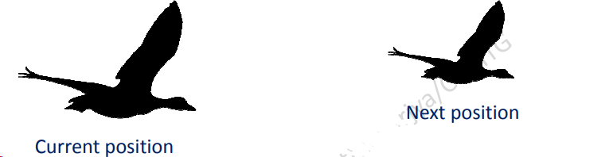
Particle Swarm Optimization Algorithm
A population based search method with position of particle is representing solution and Swarm of particles as searching agent.
PSO is a robust evolutionary optimization technique based on the movement and intelligence of swarms.
PSO finds the minimum value for the function.

Slide 5
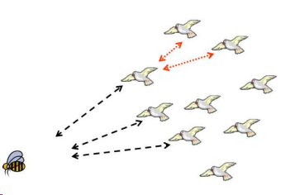
Particle Swarm Optimization Algorithm
The idea is similar to bird group searching for food.
Bird = a particle, Food = a solution
pbest = the best solution (fitness) a particle has achieved so far.
gbest = the global best solution of all particles within the swarm
The basic concept of PSO lies in accelerating each particle toward its pbest and the gbest locations, with a random weighted acceleration at each time.

Slide 6

PSO-Initalization
Particles are randomly distributed across the design space.
where Xmin and Xmax are vectors of lower and upper limit values respectively.

Slide 7
PSO-Fitness Calculation
Evaluate the fitness of each particle and store:
-particle best ever position
- best position in current swarm

Slide 8
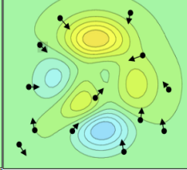

PSO-Velocity
At each time step, the velocity (both direction
and speed) of each particle is influenced + random.
Particles move over the search space with a
certain velocity.
Initial velocity is randomly generated.

Slide 9
PSO-Velocity
Velocity Update:
- provides search directions
- includes deterministic and probabilistic parameters
- combines effect of current motion, particle own memory,
and swarm influence.

Slide 10
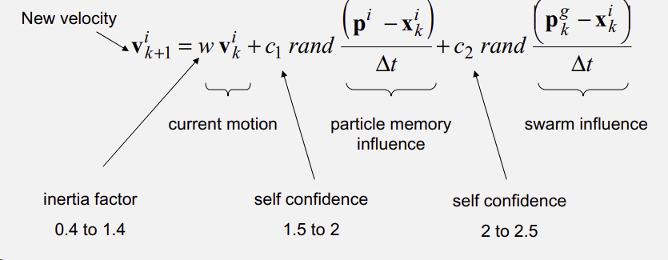
PSO-Velocity
Velocity Update:

Slide 11
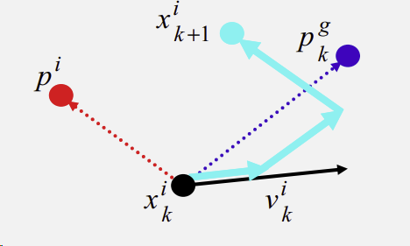

PSO-Position
Position Update:

Slide 12
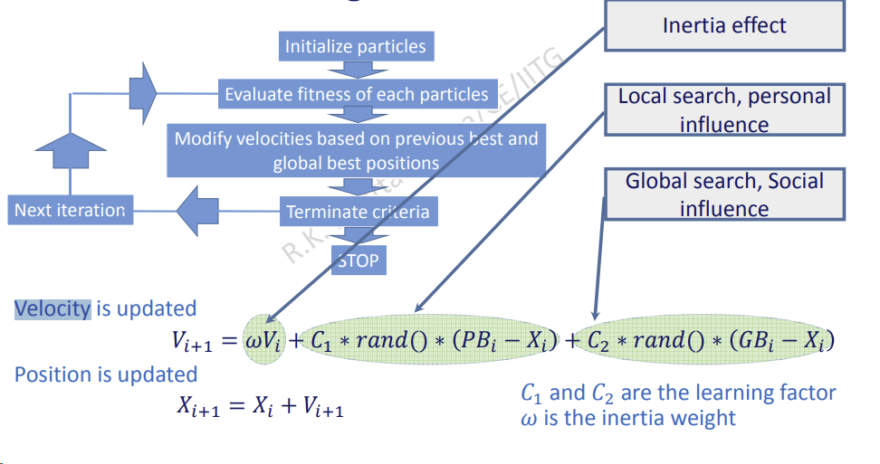
PSO-Flow Chart

