Slide 1



Introduction to OR

Slide 2
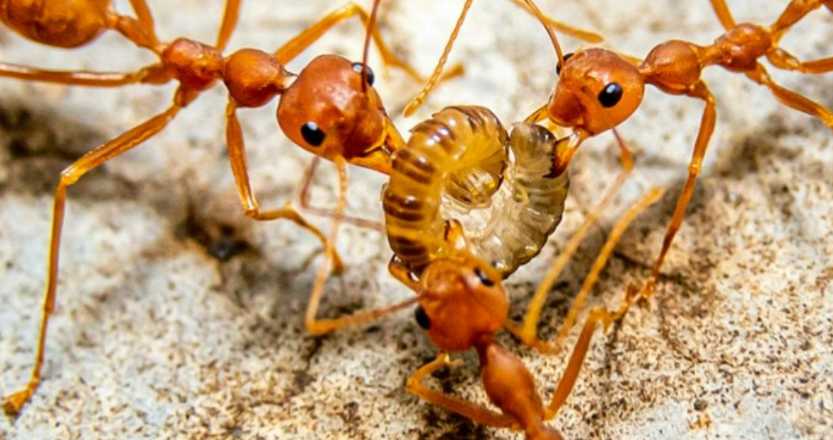
Ant Colony Optimization Algorithm
Ant colony optimization(ACO) was first introduced by Marco Dorigo in 1992. This algorithm is introduced based on the foraging behavior of an ant for seeking a path between their colony and source food.

Slide 3
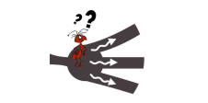
Ant Colony Optimization Algorithm
-An ant repeatedly hops from one place to another to find the food.
-Ants communicate with each other via pheromone trails.
-When an ant finds some amount of food it carries as much as it can carry.
-When returning it deposits pheromone on the paths based on the quantity and quality of the food. Ant can smell pheromone.
-So, other ants can smell that and follow that path.
-The higher the pheromone level has a higher probability of choosing that path and the more ants follow the path, the amount of pheromone will also increase on that path.

Slide 4
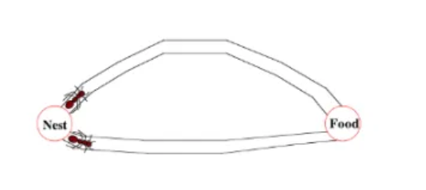
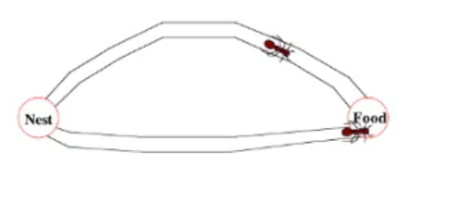
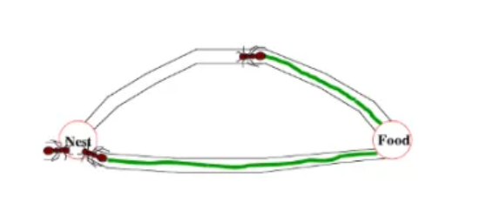
Ant Colony Optimization Algorithm

Slide 5
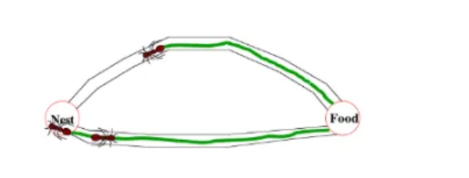
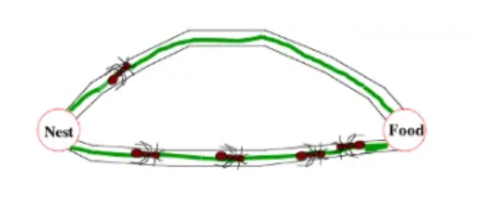
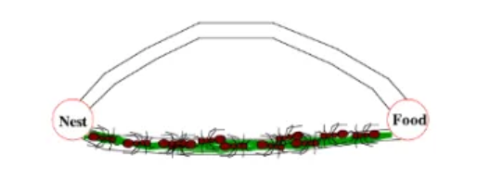
Ant Colony Optimization Algorithm

Slide 6

ACO-Initialization
Ants are randomly distributed across the design space.
where Xmin and Xmax are vectors of lower and upper limit values respectively.

Slide 7

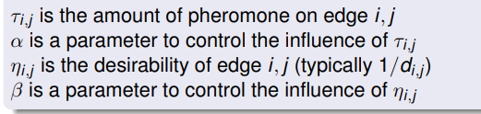
ACO-Move Probability
An ant will move from node i to node j with probability

Slide 8

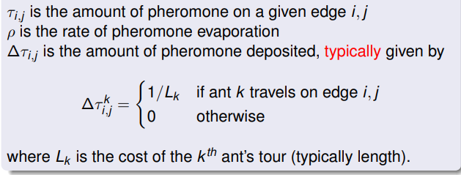
ACO-Pheromone Update
Amount of pheromone is updated according to the equation

Slide 9
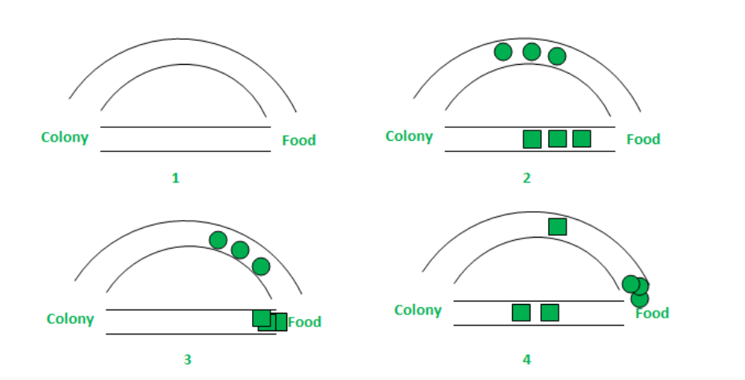
ACO-Steps
Stage 1: All ants are in their nest. There is no pheromone content in the environment.
Stage 2: Ants begin their search with equal (0.5 each) probability along each path.
Stage 3: The ants through the shorter path reaches food source earlier, but this time due to pheromone trail along the shorter path already available, probability of selection is higher.
Stage 4: More ants return via the shorter path and subsequently the pheromone concentrations also increase. Therefore, the whole colony gradually uses the shorter path in higher probabilities.

Slide 10
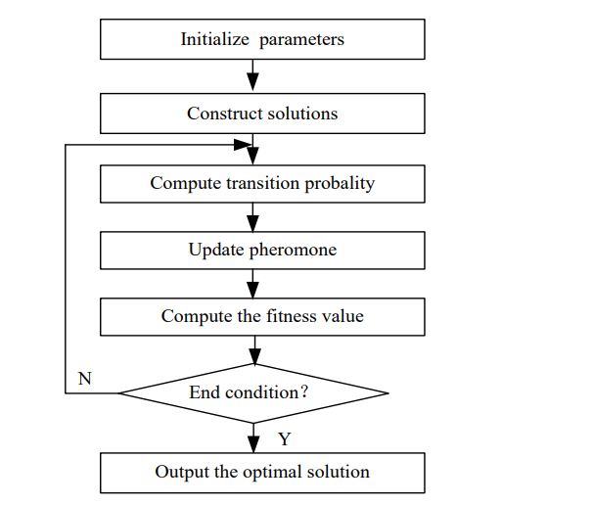
ACO-Flow Chart

