Slide 1




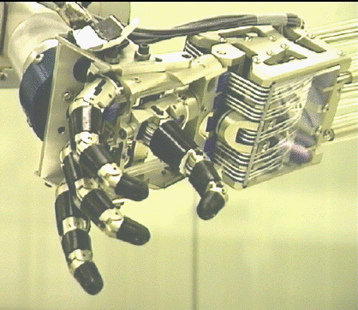
Introduction to Robotics

Slide 2
Temporal Difference Learning
Bootstraping: Bootstrapping refers to the process of updating a value estimate for a state (or state-action pair) using another value estimate instead of waiting for the final outcome of an episode.
Example:
Consider a game where a robot moves on a grid to reach a goal with a reward of +10+10 at the goal state.
Without Bootstrapping (Monte Carlo): The agent would complete the entire episode (e.g., moving through all states until the goal is reached) and then update the value of each visited state based on the total return from the episode.
With Bootstrapping (TD Learning): At each step, the agent updates the value of the current state using:The immediate reward for the current step (𝑅).The estimated value of the next state (𝑉(𝑠′)).
For instance, if the robot is at state S1, receives a reward R=-1, and predicts the value of the next state S2 as 5, if updates V(S1):
V(S1​)←V(S1​)+α[R+γV(S2​)−V(S1​)]

Slide 3
Temporal Difference Learning
TD Prediction Rule: The TD prediction rule provides a mechanism to update value estimates incrementally using bootstrapping.
Update Rule:
V(s)←V(s)+α⋅δ
Where:
𝑉(𝑠): Current value estimate of state 𝑠.
𝛼: Learning rate (controls the step size of updates).
𝛿: Temporal Difference (TD) error.
𝛿=𝑅+𝛾𝑉(𝑠′)−𝑉(𝑠)
R: Immediate reward for transitioning from 𝑠 to 𝑠′ .
𝑉(𝑠′): Current value estimate of next state s’.
𝛾: Discount factor for future rewards.

Slide 4
Temporal Difference Learning
TD Prediction Rule
Example:
States: S1,S2,S3
Reward: R(S1->S2)=-1
R(S2->S3)=10
Initial Value Estimates: V(𝑆1)=0
V(𝑆2)=0
V(S 3​ )=0
Discount Factor (γ): 0.9
Learning Rate (α): 0.1
Step 1: Agent starts at S1​ and moves to S2.
Reward R=−1
Current estimate V(S2)=0
Compute TD error: δ=R+γV(S2)−V(S1)=−1+0.9⋅0−0=−1
Update V(S1): V(S1)←V(S1)+α⋅δ=0+0.1⋅(−1)=−0.1
Step 2: At S2​, the agent moves to S3​.
Reward R=10
Current estimate V(S3)=0
Compute TD error: δ=R+γV(S3)−V(S2)=10+0.9⋅0−0=10
Update V(S2): V(S2)←V(S2)+α⋅δ=0+0.1⋅10=1

Slide 5
Prioritized Experience Replay
In RL, experience replay is a mechanism where past experiences (state, action, reward, next state) are stored in a replay buffer and reused during training to improve sample efficiency.
Prioritized Experience Replay (PER):
Concept: Instead of sampling experiences uniformly from the replay buffer, prioritize experiences that are more important for learning.
Importance Measure: Experiences with larger TD error are prioritized because they indicate a higher discrepancy between predicted and actual values, signaling areas where the agent can learn more.

Slide 6
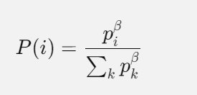
Prioritized Experience Replay
* Key Components of PER:
Prioritization Metric:
Each experience e in the replay buffer is assigned a priority p(e), often proportional to the absolute TD error:
p(e)=∣δ∣+ϵ
δ: Temporal Difference error.
ϵ: A small constant to ensure all experiences have non-zero priority
Sampling Distribution:
Experiences are sampled according to their priorities. The probability of sampling an experience i is:
β: Exponent controlling the degree of prioritization (β=0 for uniform sampling, higher values for stronger prioritization).

Slide 7
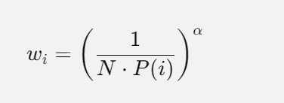
Prioritized Experience Replay
* Key Components of PER:
Importance Sampling (IS):
To correct for the bias introduced by non-uniform sampling, each sample is weighted by its importance sampling weight:
N: Size of the replay buffer.
α: Controls how much the importance weights affect updates.

Slide 8
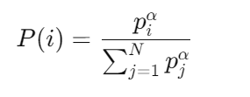
Prioritized Experience Replay
Example:
Replay buffer capacity: 𝑁=5
Experiences in the buffer:(𝑠1,𝑎1,𝑟1,𝑠1), (𝑠2,𝑎2,𝑟2,𝑠2′), (𝑠3,𝑎3,𝑟3,𝑠3′), (𝑠4,𝑎4,𝑟4,𝑠4′), (𝑠5,𝑎5,𝑟5,𝑠5′)
TD-errors for each experience: 𝛿1=0.5, 𝛿2=1.0, 𝛿3=2.0, 𝛿4=1.5, 𝛿5=0.1
Parameters:𝛼=0.6 (degree of prioritization), 𝛽=0.4 (importance sampling exponent), 𝜖=0.01(small constant).
Step 1: Compute Priorities
The priority 𝑝𝑖 for each experience is calculated as: 𝑝𝑖=∣𝛿𝑖∣+𝜖
𝑝1=0.5+0.01=0.51, 𝑝2=1.0+0.01=1.01, 𝑝3=2.0+0.01=2.01, 𝑝4=1.5+0.01=1.51, 𝑝5=0.1+0.01=0.11
Step 2: Compute Sampling Probabilities
p1^α​=(0.51)^0.6=0.659, p2^α​=(1.01)^0.6=1.005,
p3^α​=(2.01)0.6=1.515, p4^α​=(1.51)^0.6=1.301, p5^α​=(0.11)^0.6=0.252.
Sum=0.659+1.005+1.515+1.301+0.252=4.732.
P(1)=0.659/4.732=0.139, P(2)=1.005/4.732=0.212, P(3)=1.515/4.732=0.320,
P(4)=1.301/4.732=0.275, P(5)=0.252/4.732=0.05

Slide 9
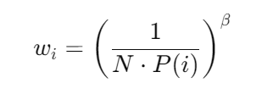
Prioritized Experience Replay
Example:
Step 3: Sample a Batch
Suppose we sample a batch of B=2 experiences using probabilities P(i):
Experience 3 is sampled (probability 0.320).
Experience 4 is sampled (probability 0.275).
Step 4: Compute Importance Sampling (IS) Weights
For Experience 3: w3=(1/5*0.320)^0.4=0.831
For Experience 4: w4=(1/5*0275)^0.4=0.860

