Slide 1
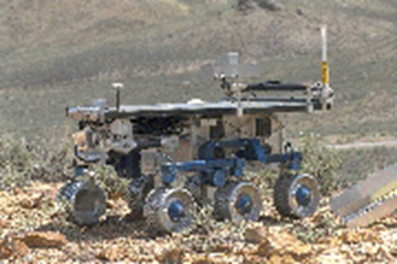
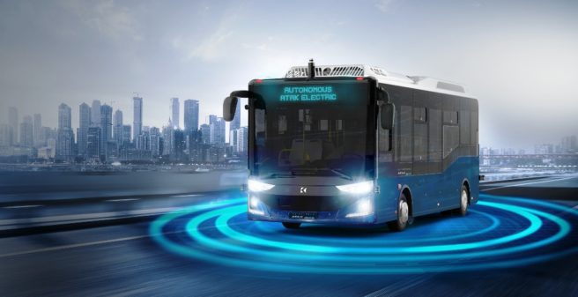

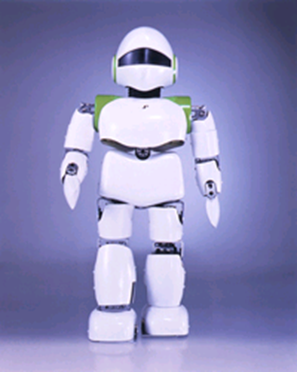
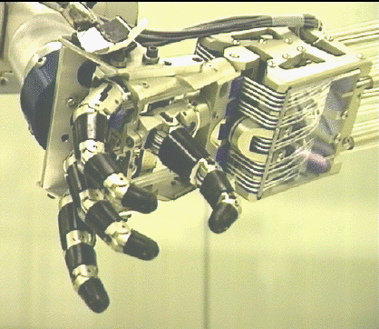
Introduction to Robot Operating System

Slide 2
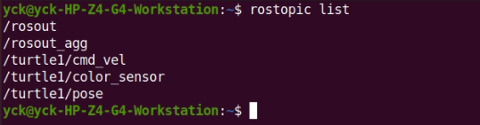
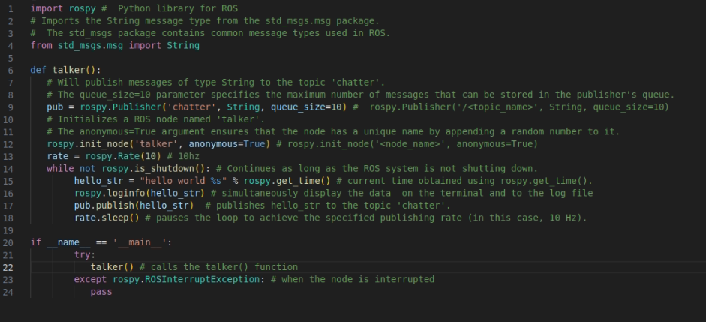
ROS Publisher-1 in Python

Slide 3
ROS Publisher-1 in Python

Slide 4
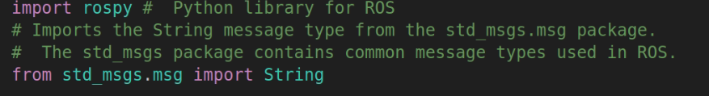
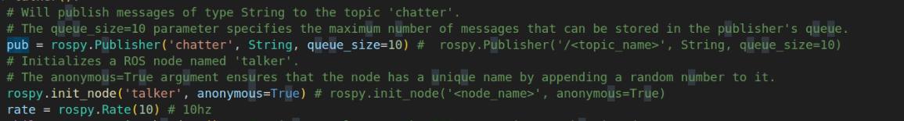
ROS Publisher-1 in Python
Kütüphaneler
Publisher

Slide 5
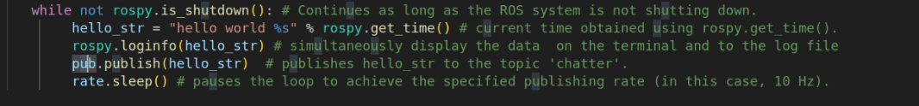
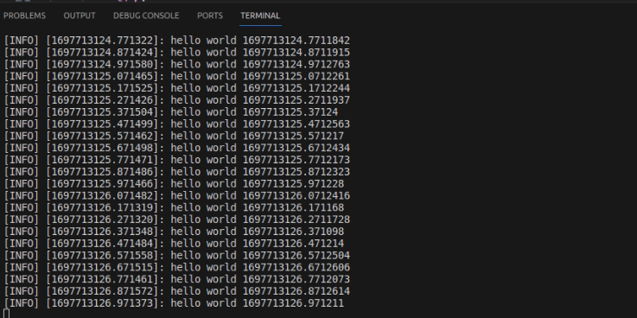
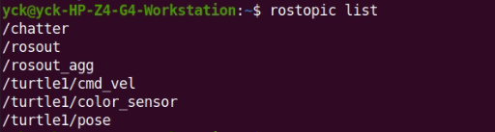
ROS Publisher-1 in Python
Döngü
Çıktı

Slide 6
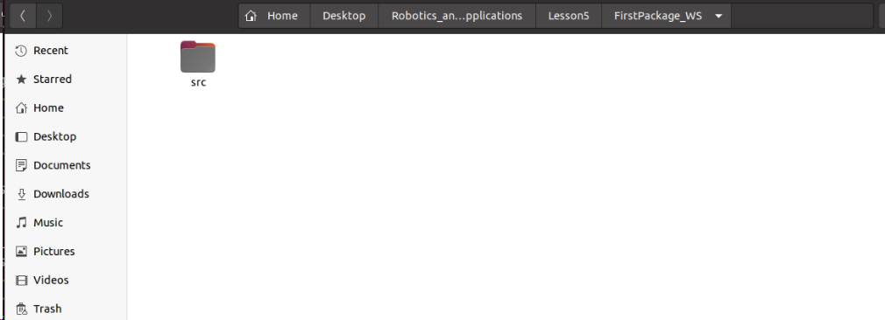
ROS Packages

Slide 7
ROS Packages/Create
dependency
The dependencies listed will be automatically stored in a package.xml and CMakeLists.txt files which the catkin_create_pkg command creates.
std_msgs as a dependency because the package will use standard message data types e.g float, int, string, etc. rospy states that the package will make use of python code for the nodes.

Slide 8
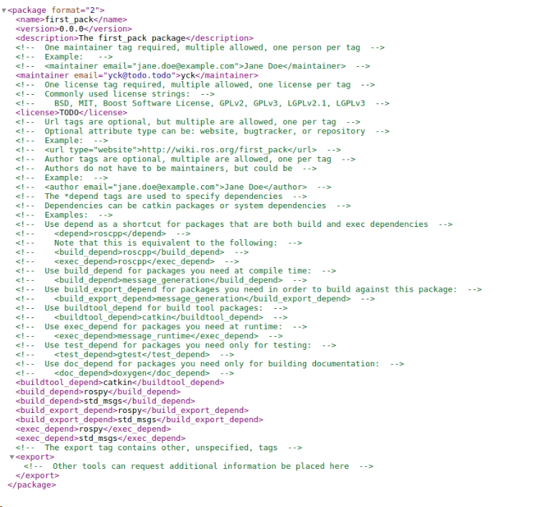
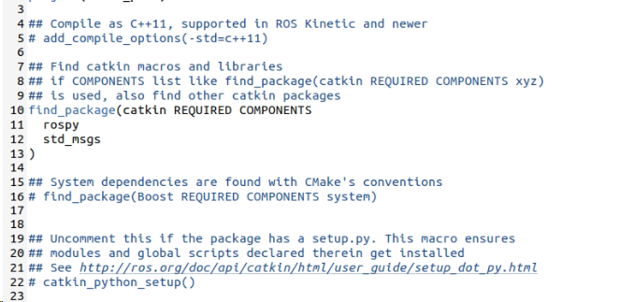
ROS Packages
package.xml
CMakeLists.txt

Slide 9
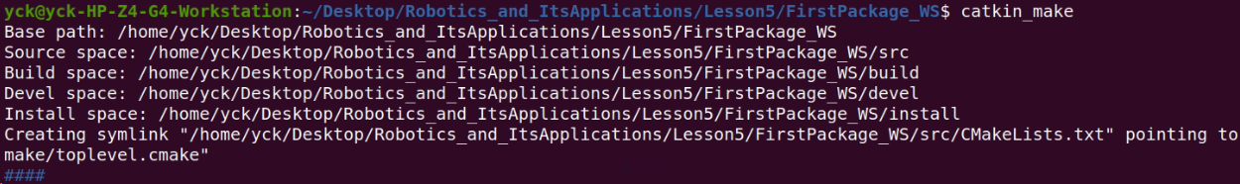
ROS Packages/Build
catkin_make:

Slide 10
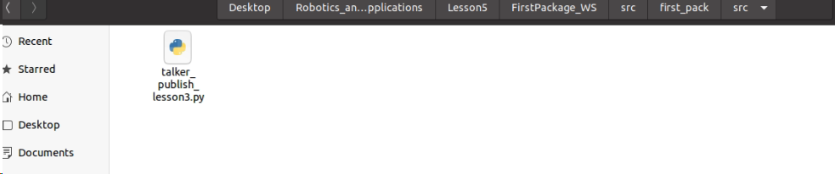
ROS Packages

Slide 11
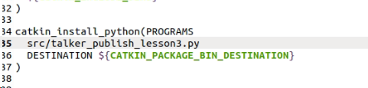
ROS Packages/CMake
All the scripts explictly using the special install function catkin_install_python in CMakeLists

Slide 12
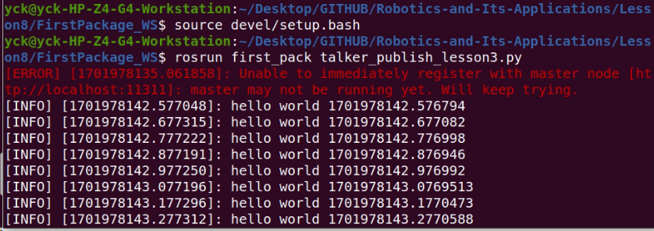
ROS Packages/Run

Slide 13
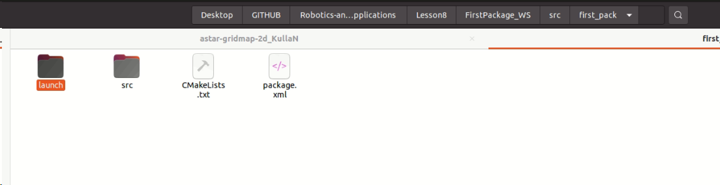
ROS Packages/Launch

Slide 14
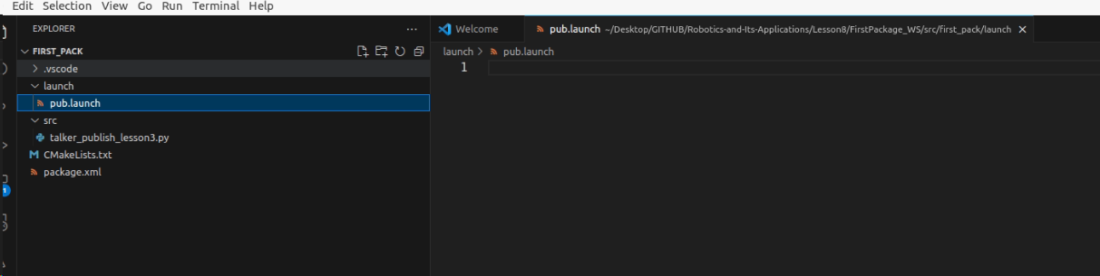
ROS Packages/Launch

Slide 15
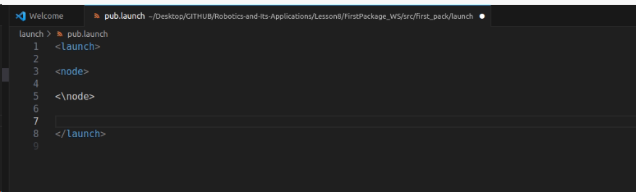
ROS Packages/Launch
TAGS

Slide 16
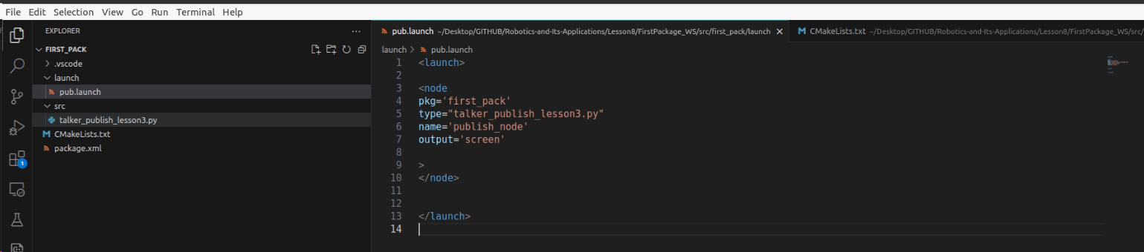
ROS Packages/Launch

Slide 17
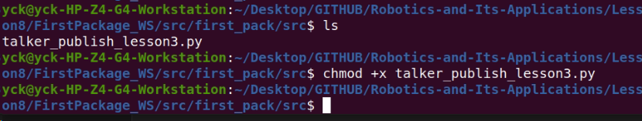
ROS Packages/Launch
Make Py file Executable

Slide 18
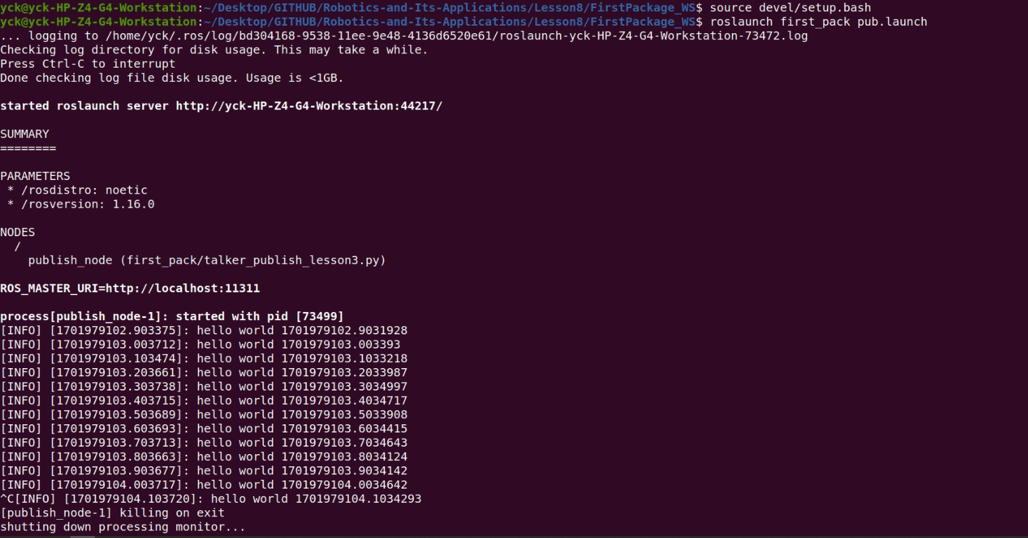
ROS Packages/Launch

