Slide 1
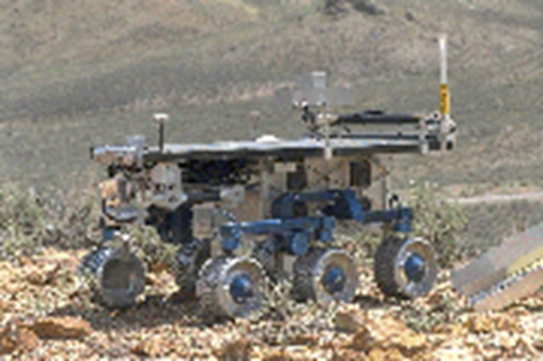
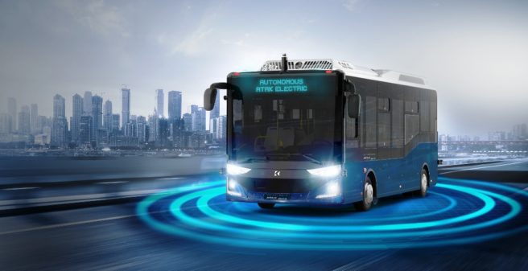

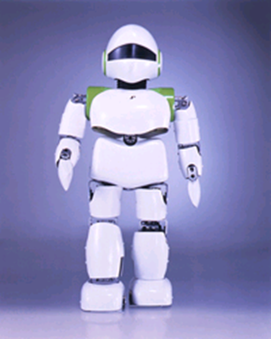
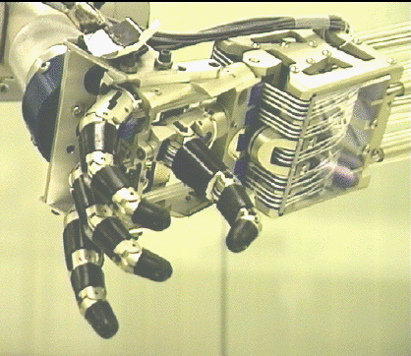
Introduction to Robot Operating System

Slide 2
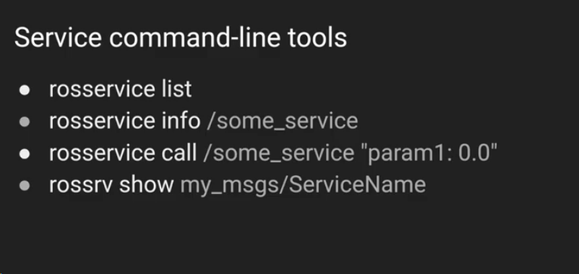
ROS Services

Slide 3
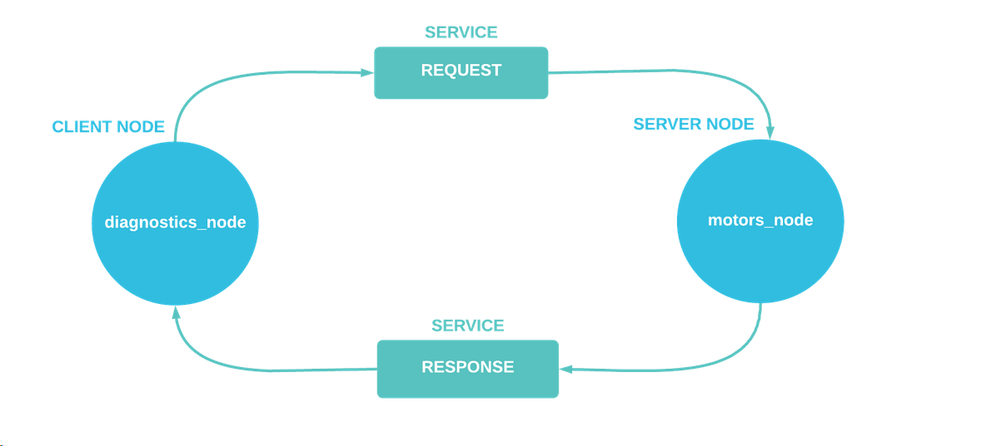
ROS Services

Slide 4


ROS Services
Create srv folder and .srv file inside this folder:

Slide 5
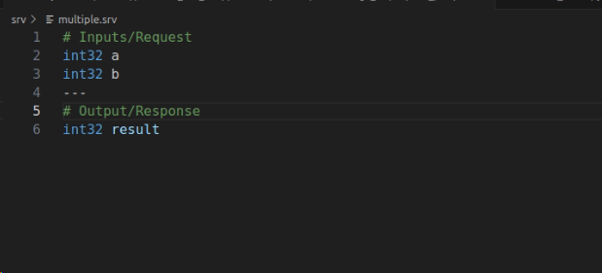
ROS Services

Slide 6
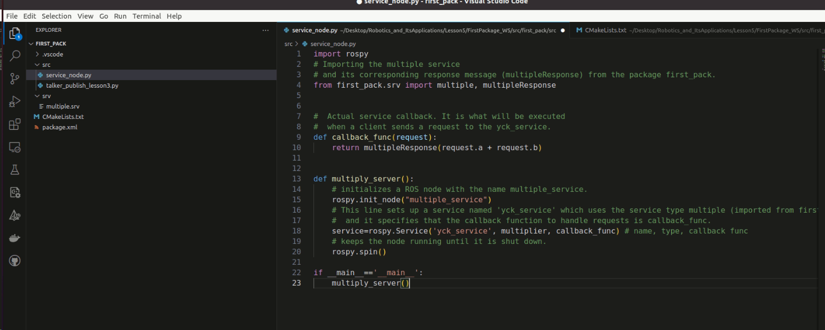
ROS Services

Slide 7


ROS Services
Main function
Callback function

Slide 8
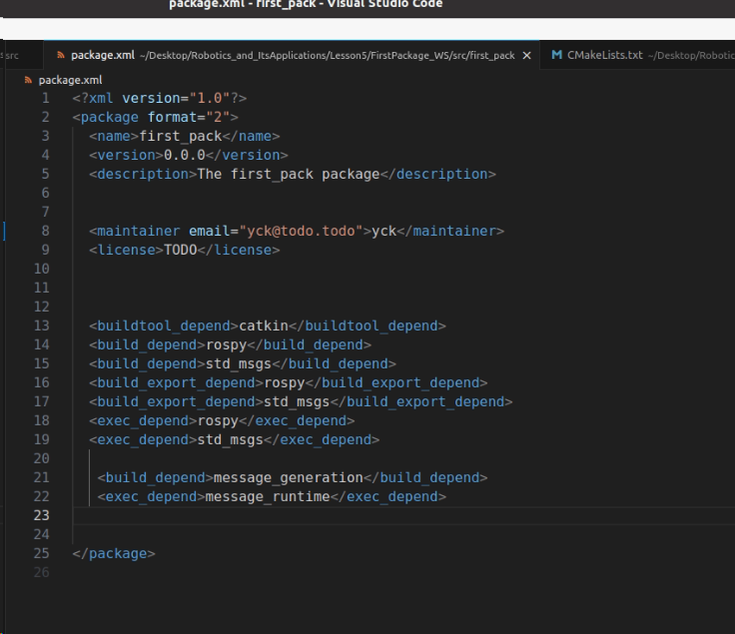
ROS Services /package.xml

Slide 9
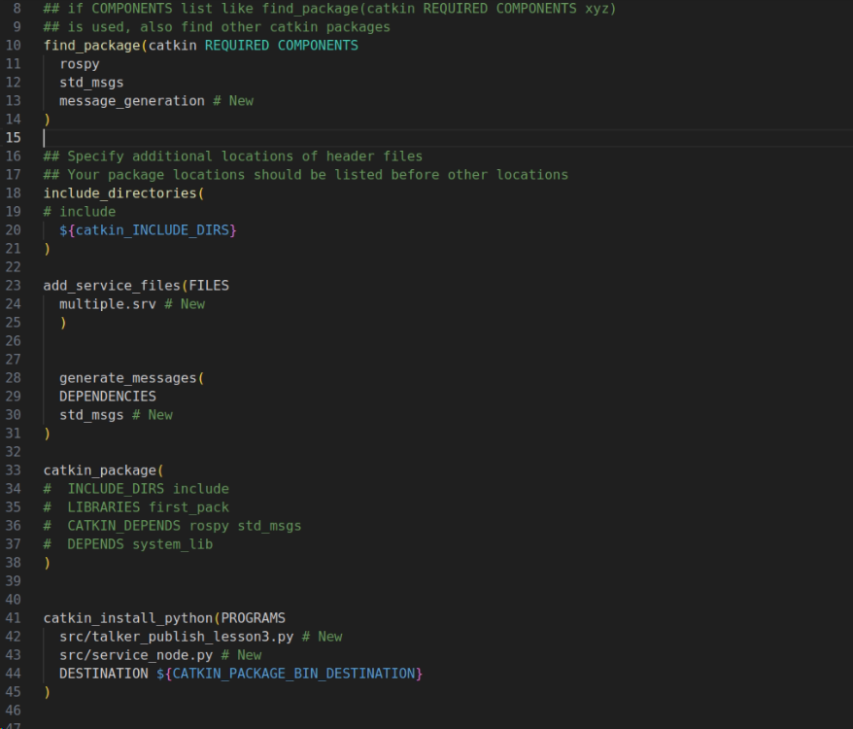
ROS Services /Cmake

Slide 10

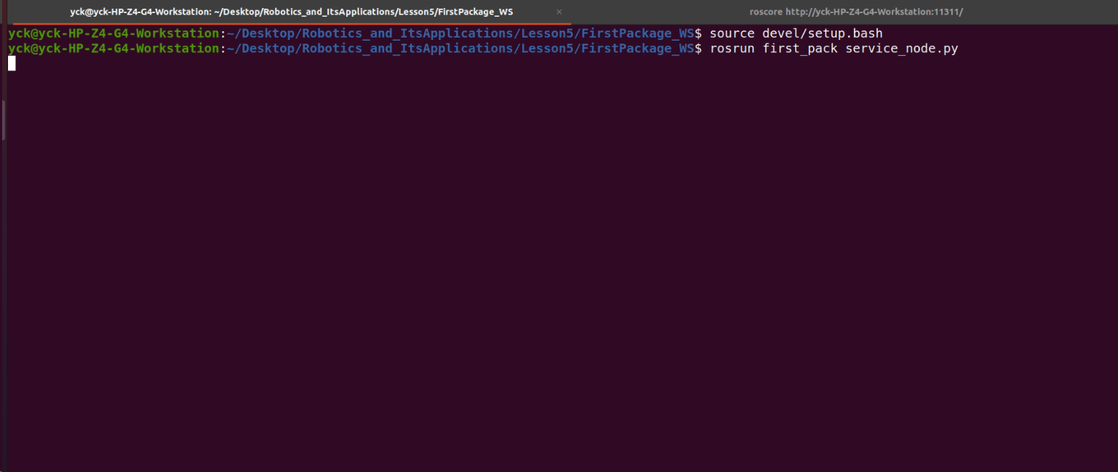
ROS Services /Build

Slide 11

ROS Services

Slide 12

ROS Services

