Slide 1
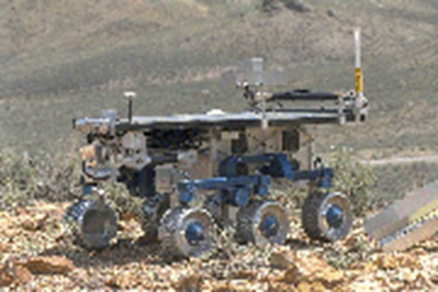



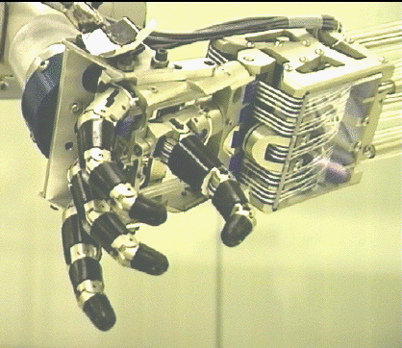
Introduction to Robot Operating System

Slide 2
Proje
3-4 kişilik gruplar, grup bulamayana ben proje vereceğim
Proje konusu siz belirleyeceksiniz, mutlaka ROS1 (Publisher veya Subscriber) içerecek (Son tarih: 3 Kasım 2023)
Vize: %40, Final: %60 + Proje Sunumu (0-20P, Bütünleme’dede geçerli)
Proje sunum ve kodlar son gönderim tarihi: 4 Aralık Pzt
Proje Sunumu + Çıktı Video (20 dakika+ 10 dakika soru)
Son 3-4 hafta sunumlar (Başlama tarihi: 15 Aralık Cuma)
yigitkuyu@uludag.edu.tr (Okul nosu ve isim/soyisim ile beraber grup ve proje konusu, mail başlığı: Robotik Proje)

Slide 3
Sunum Formatı
Giriş: Genel bir literatür hakkında bilgi
Method: Uygulanan method/methodlar hakkında bilgi
Problem: Ele alınan problem hakkında bilgi
Uygulama: Geliştirdiğin metodu nasıl uyguladın
Not: Tüm sunum sadece yazıdan oluşmayıp, görsellerle desteklenecektir.

Slide 4
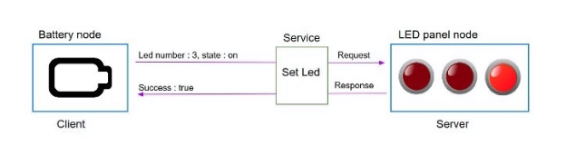
ROS Commands /Services
-A ROS service is a client/server system. (ROS Server / ROS Client)
-It is synchronous. The client sends a requests, and blocks until it receives a response from server. For example if you want to enable or disable an actuator, or any immediate action.
- Not like a topic, service is one-time communication

Slide 5
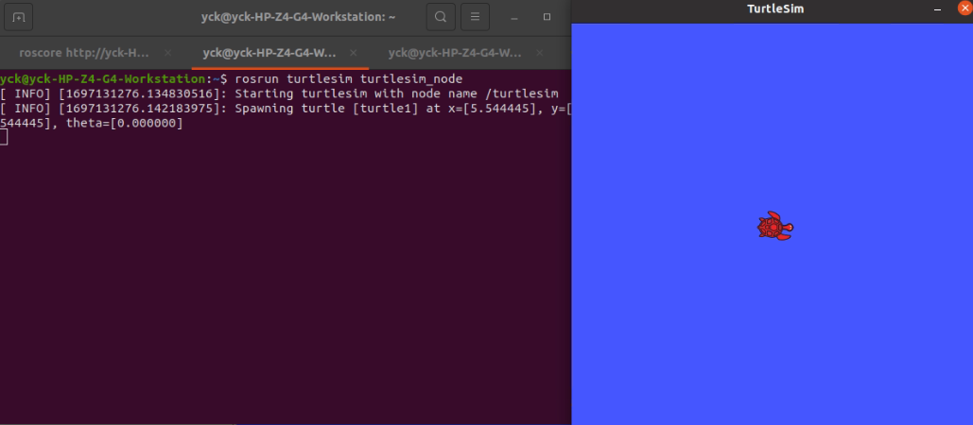
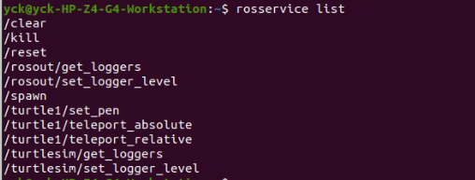
ROS Commands /Services

Slide 6
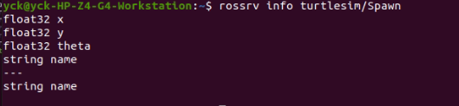
ROS Commands /Services

Slide 7
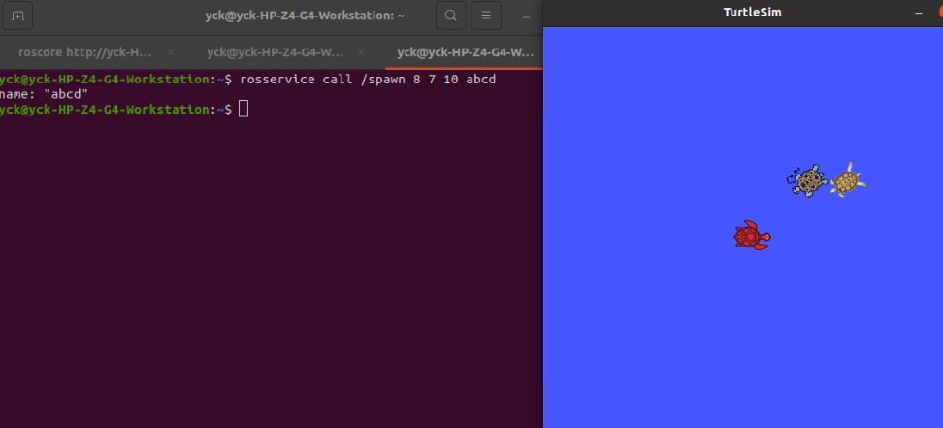
ROS Commands /Services

Slide 8
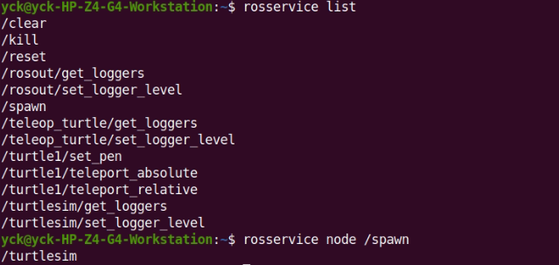
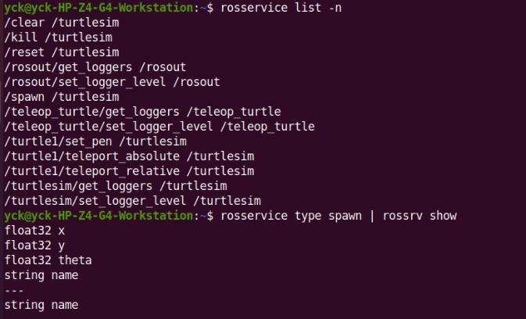
ROS Commands /Services

Slide 9
ROS Commands /ROS Param
rosparam is a command-line tool in ROS that allows you to interact with the ROS Parameter Server. The ROS Parameter Server is a central repository for managing configuration parameters across different nodes in a ROS system.
Here are some common uses for rosparam:
Setting and Getting Parameters: You can use rosparam to set and get parameter values. These parameters can be used to configure the behavior of various nodes in a ROS system.
Loading and Saving Parameters: rosparam allows you to load and save parameter values from and to YAML files. This is useful for storing configurations in a structured format.
Namespaces and Parameter Servers: rosparam can be used to manage parameters in different namespaces. This enables you to organize parameters hierarchically, making it easier to manage configurations for different parts of your robot.
Managing Parameter Launch Files: In ROS, launch files are used to start and configure nodes. Parameters can be set within these launch files using rosparam.

Slide 10
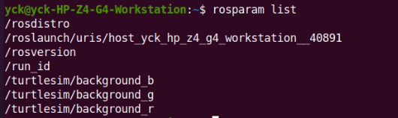
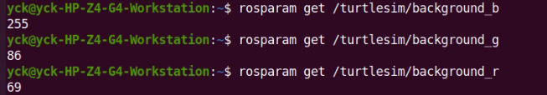
ROS Commands /ROS Param
Lists all of the currently active parameters.
Determine the value of the parameter

Slide 11
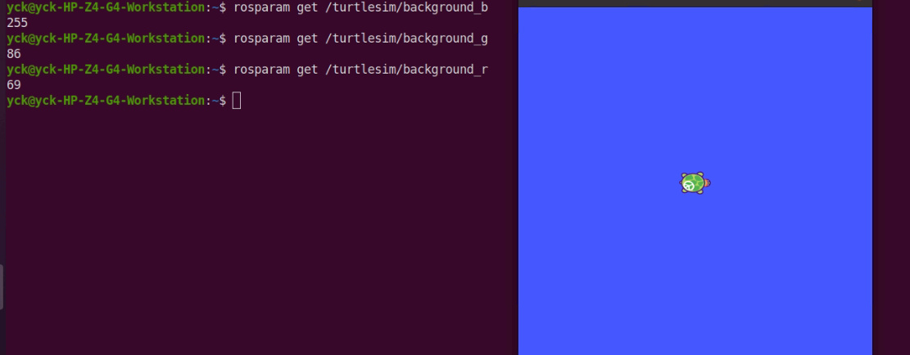
ROS Commands /ROS Param

Slide 12
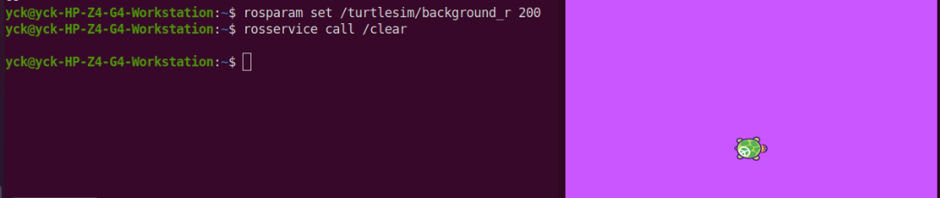
ROS Commands /ROS Param
Change a parameter using rosparam set

Slide 13
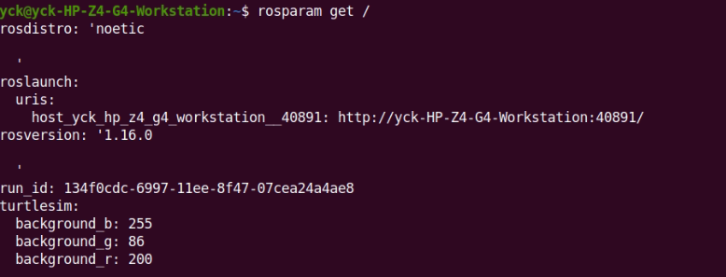
ROS Commands /ROS Param
Show us the contents of the entire Parameter Server.

Slide 14
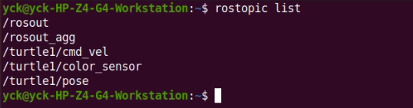
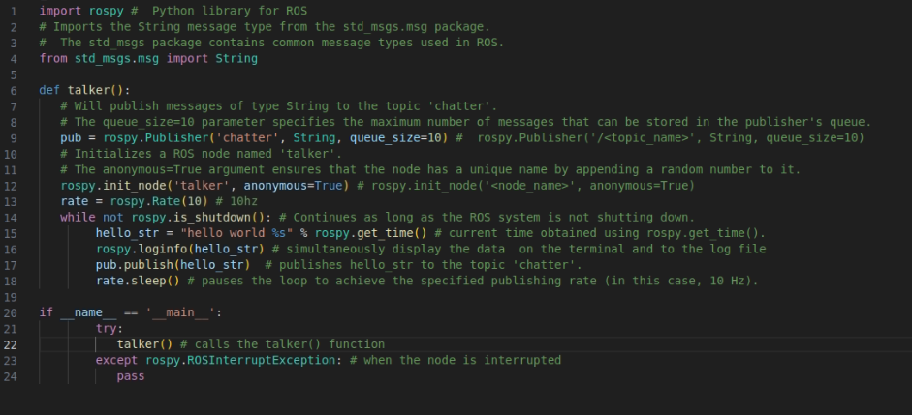
ROS Publisher-1 in Python

Slide 15
ROS Publisher-1 in Python

Slide 16
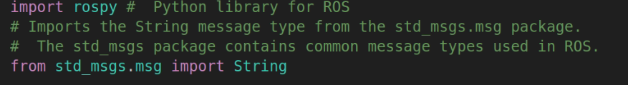
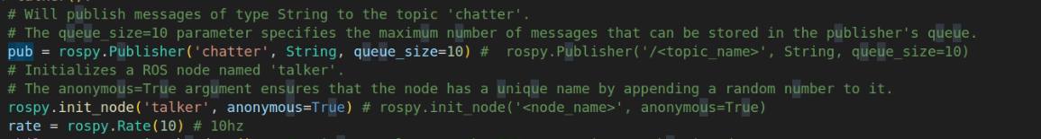
ROS Publisher-1 in Python
Kütüphaneler
Publisher

Slide 17
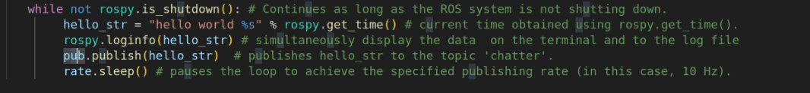
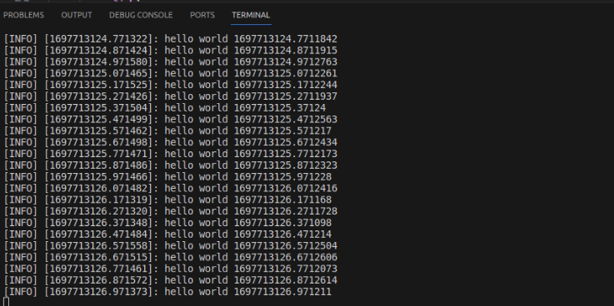
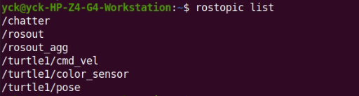
ROS Publisher-1 in Python
Döngü
Çıktı

Slide 18
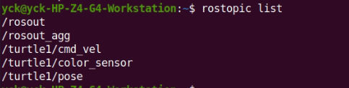
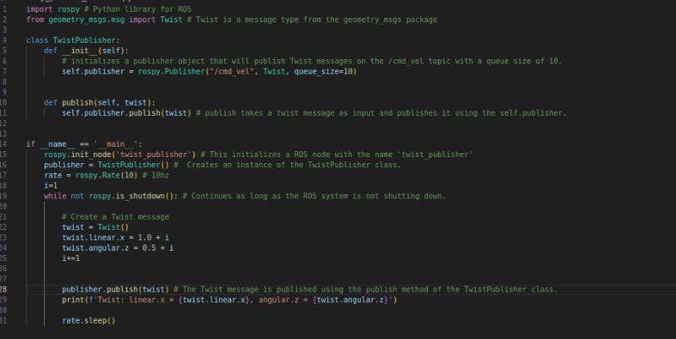
ROS Publisher-2 in Python

Slide 19
ROS Publisher-2 in Python
Kütüphaneler
Publisher

Slide 20
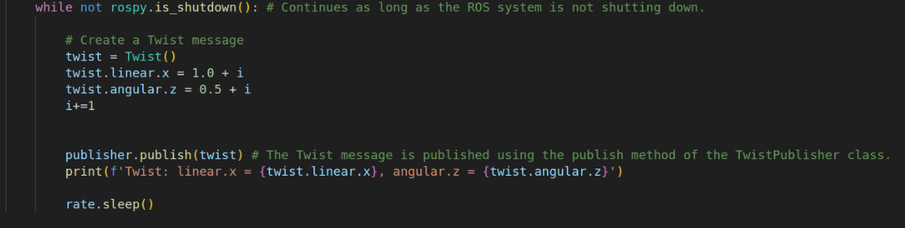
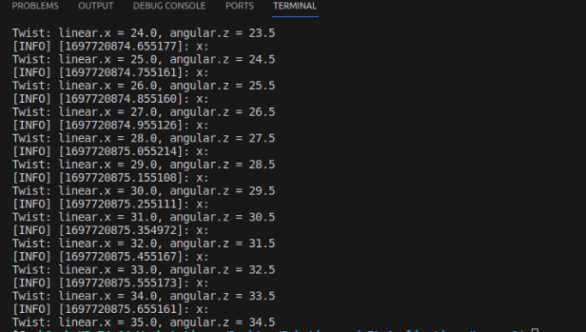
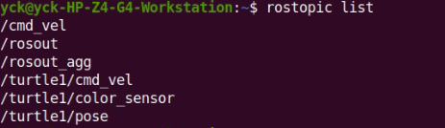
ROS Publisher-2 in Python
Döngü
Çıktı

