Slide 1
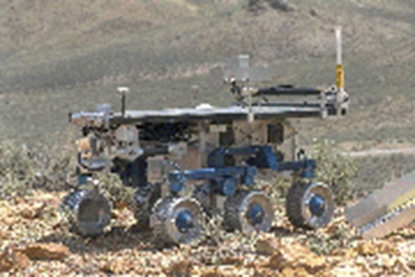
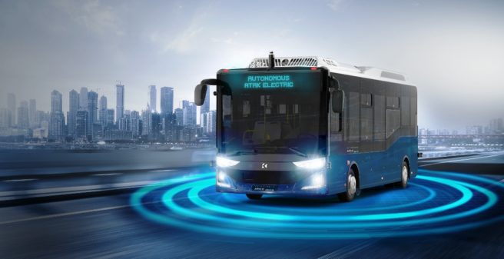

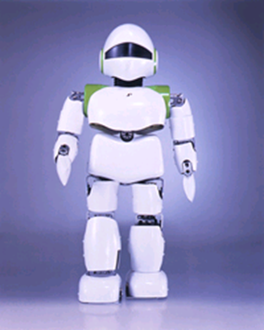
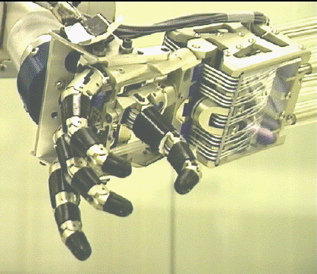
Introduction to Robot Operating System

Slide 2
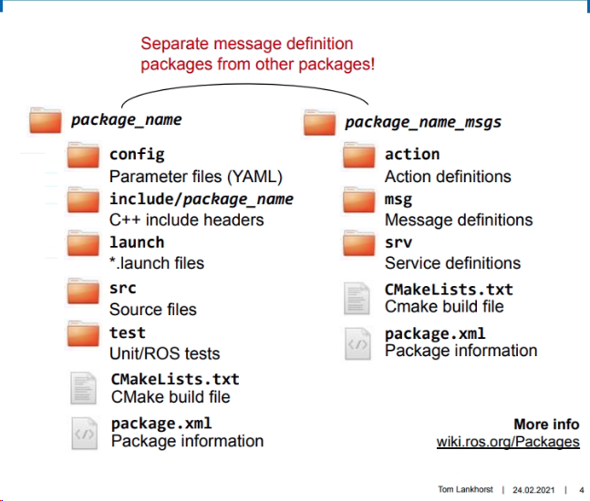
ROS Packages

Slide 3
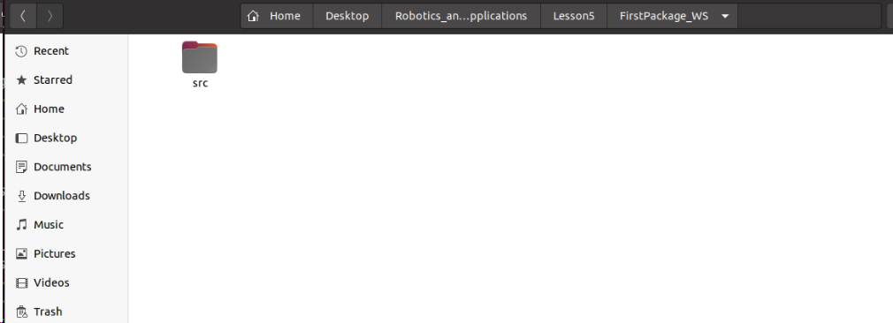
ROS Packages

Slide 4
ROS Packages/Create
dependency
The dependencies listed will be automatically stored in a package.xml and CMakeLists.txt files which the catkin_create_pkg command creates.
std_msgs as a dependency because the package will use standard message data types e.g float, int, string, etc. rospy states that the package will make use of python code for the nodes.

Slide 5
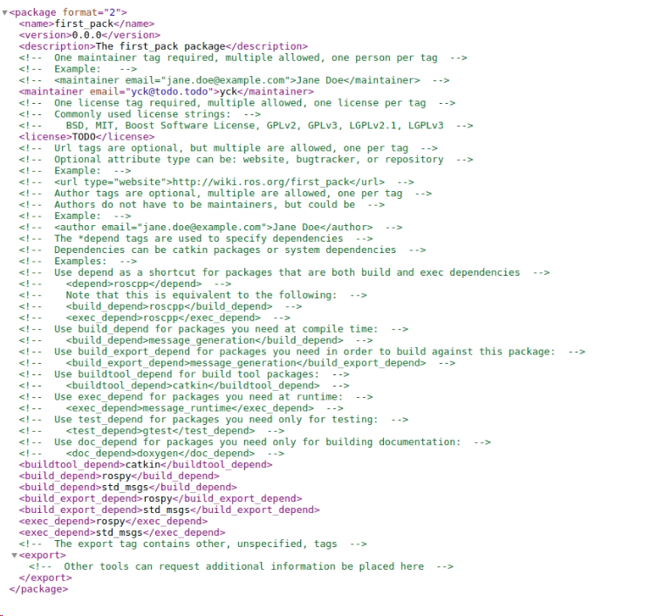
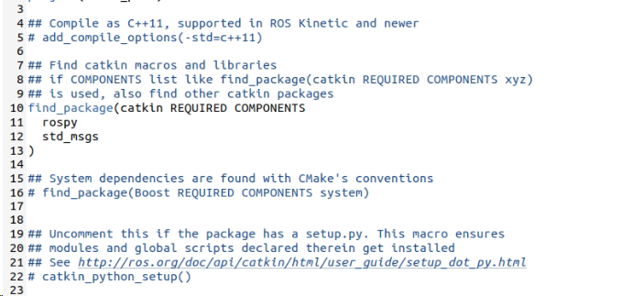
ROS Packages
package.xml
CMakeLists.txt

Slide 6
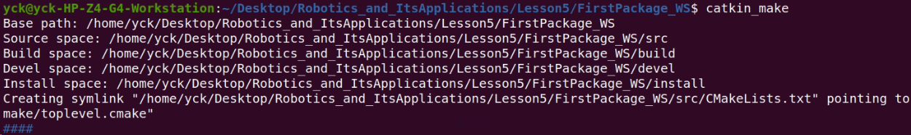
ROS Packages/Build
catkin_make:

Slide 7
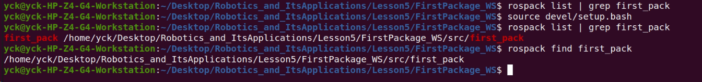
ROS Packages/Build
Find your package:

Slide 8
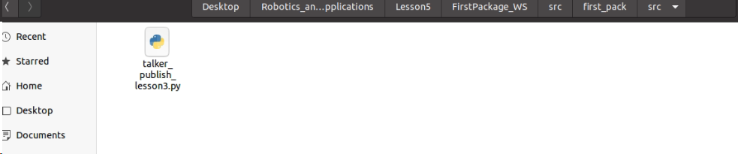
ROS Packages

Slide 9
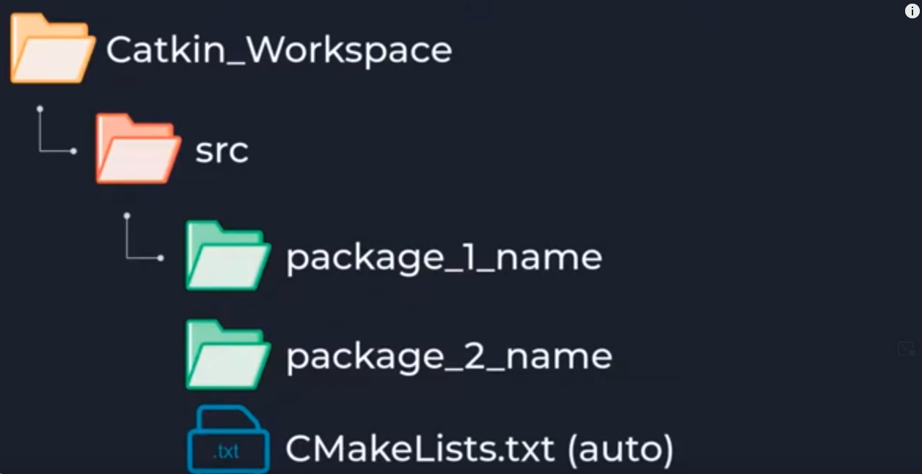
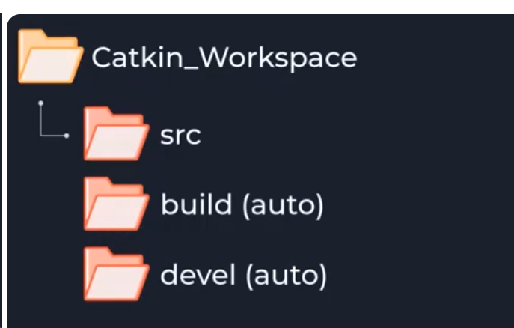
ROS Packages/CW

Slide 10
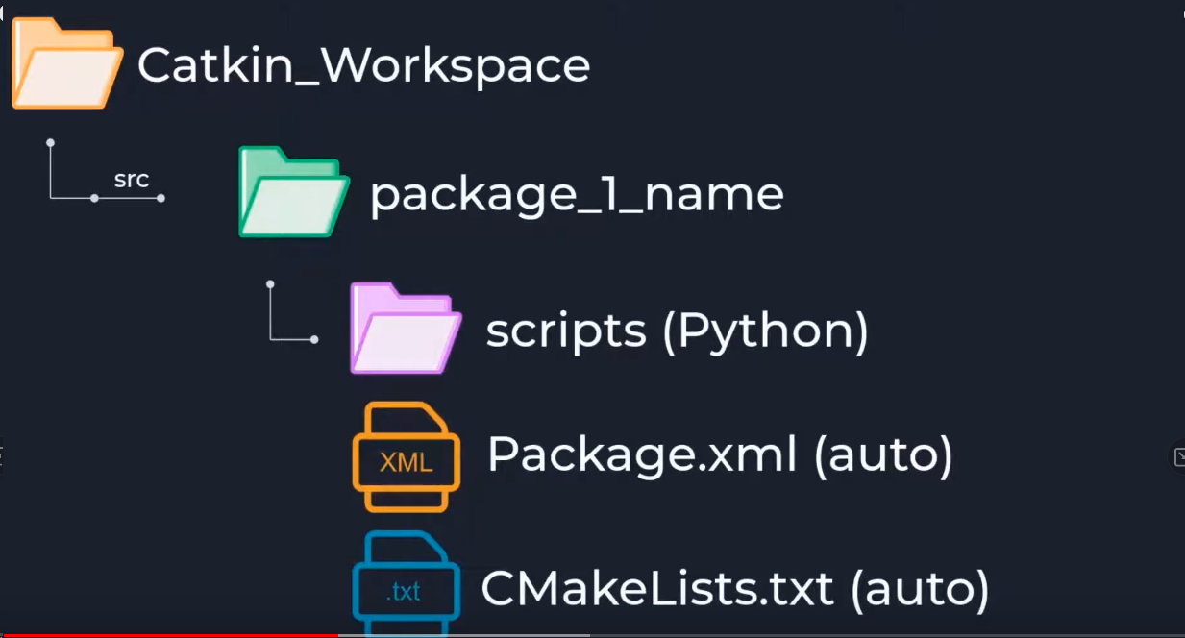
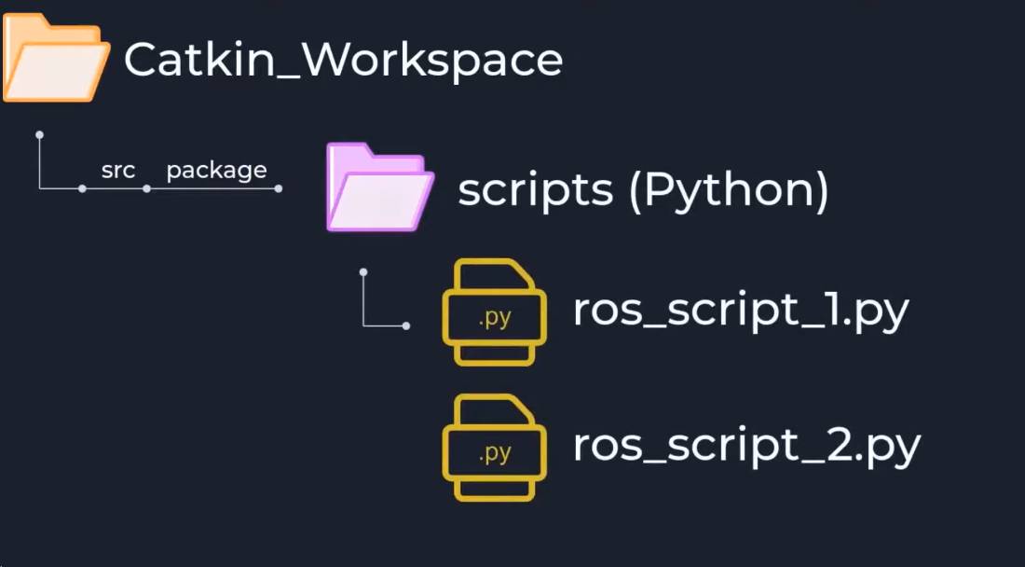
ROS Packages/CW

Slide 11
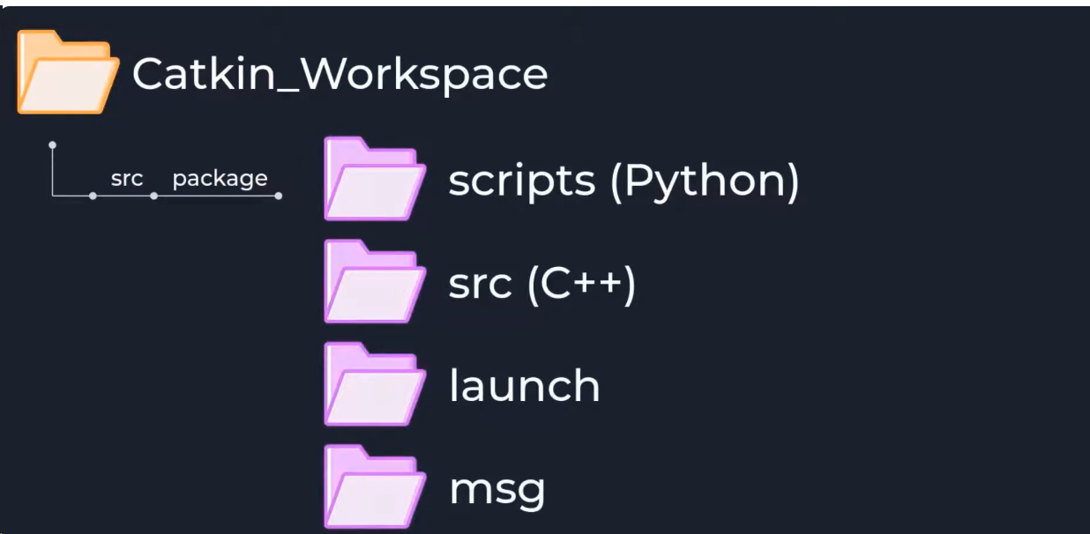
ROS Packages/CW

Slide 12
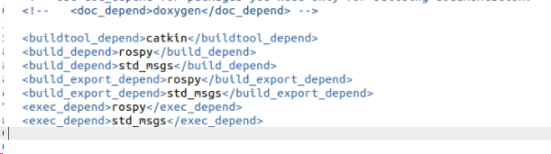
ROS Packages/package.xml
Build Dependencies specify which packages are needed to build this package.
Build Export Dependencies specify which packages are needed to build libraries against this package
Execution Dependencies specify which packages are needed to run code in this package.
Build Tool Dependencies specify build system tools which this package needs to build itself. Typically the only build tool needed is catkin.

Slide 13
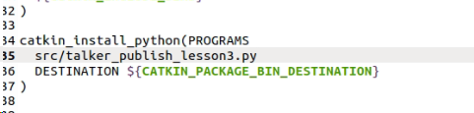
ROS Packages/CMake
All the scripts explictly using the special install function catkin_install_python in CMakeLists

Slide 14
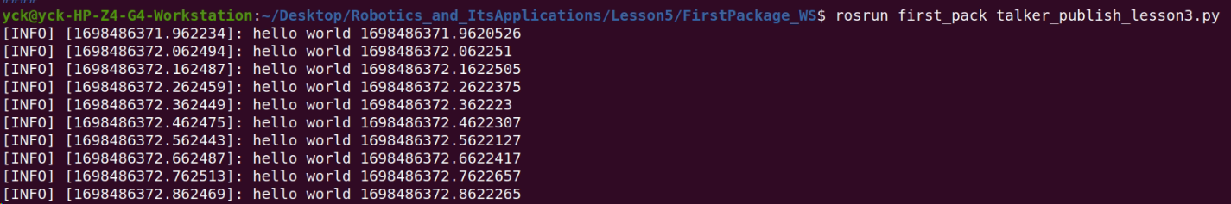
ROS Packages/Run

