Slide 1
Predictive Maintenance Using Machine Learning Models
Subtitles:
Logistic Regression, Decision Tree, Random Forest, and Bagging Models
Class Imbalance Handling, Overfitting Detection, and Model Performance Evaluation
Additional Information:
Prepared by: Yiğitcan Yardımcı, Berke Kaygısız
Date: June 10, 2024

Slide 2
Problem and Objective
Problem: Proactive maintenance strategies in steel production facilities are crucial for ensuring operational continuity, extending the lifespan of equipment, ensuring personnel safety, and reducing operational costs.
Objective: To predict failure events in order to increase efficiency and reduce maintenance costs.

Slide 3
Dataset Description
Variables:
UDI: Unique identifier number
Product ID: Product identifier
Type: Product type
Air temperature [K]: Air temperature (Kelvin)
Process temperature [K]: Process temperature (Kelvin)
Rotational speed [rpm]: Rotational speed (rpm)
Torque [Nm]: Torque (Newton meter)
Tool wear [min]: Tool wear time (minutes)
Target: Binary outcome variable (0 = No Failure, 1 = Failure)
Failure Type: Type of failure (if any)

Slide 4
Models to be Used
Logistic Regression Model
Decision Tree Model
Random Forest Model
Bagging Tree Model

Slide 5
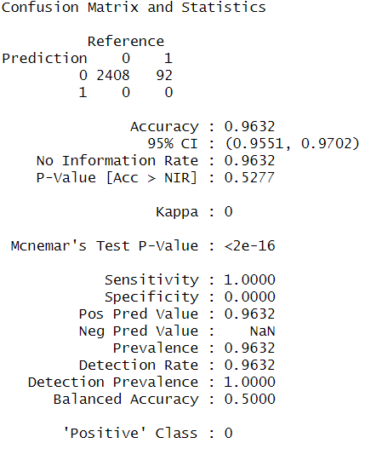
Logistic Regression Model
Performance:
The model perfectly predicts class 0 but fails to correctly predict class 1.
Conclusion:
Therefore, it is not a good model.

Slide 6
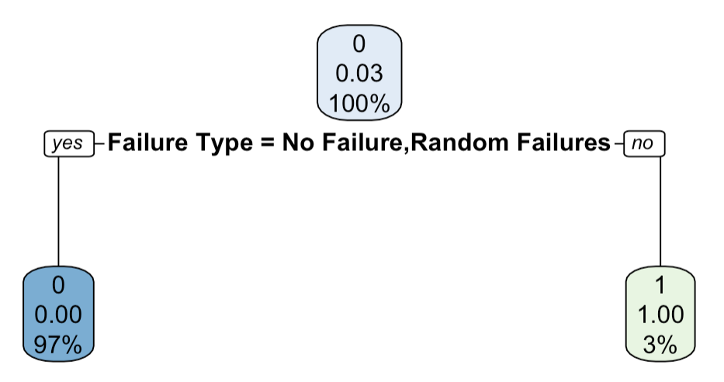
Decision Tree Model
Performance:
The "Yes" branch correctly predicts class 0 with 97% accuracy.
The "No" branch correctly predicts class 1 with 3% accuracy.
The model mainly predicts "No Failure" situations accurately but struggles with predicting "Random Failures."

Slide 7
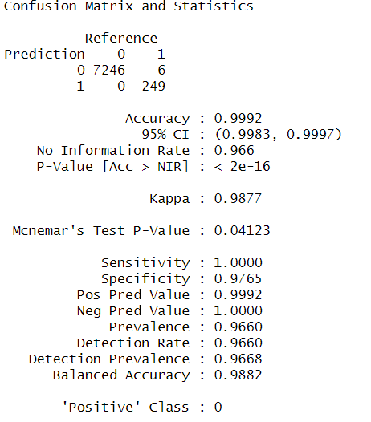
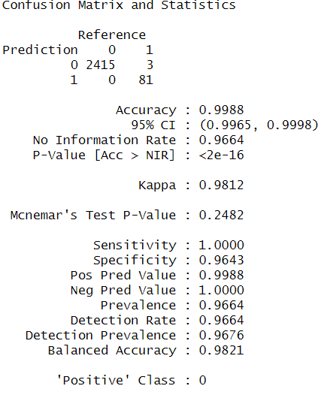
Comparison of Training and Test Set for Overfitting Control
Overfitting Check
Comparison of Training and Test Sets:
The model does not overfit and shows consistent high performance in both training and test data.
This indicates that the model has strong generalization capabilities and is likely to achieve similar success with real-world data.

Slide 8
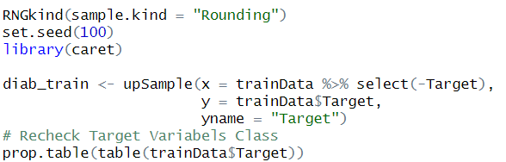

Imbalance Control and Solution
Class Imbalance:
The training set has an imbalanced class distribution: 7253 "no failure" (0) and only 247 "failure" (1) observations.
This means the model might struggle to accurately predict failures.
Solution: Up-sampling:
The up-sampling process successfully addressed the class imbalance in the dataset.
As a result, the model can now better recognize both classes.

Slide 9
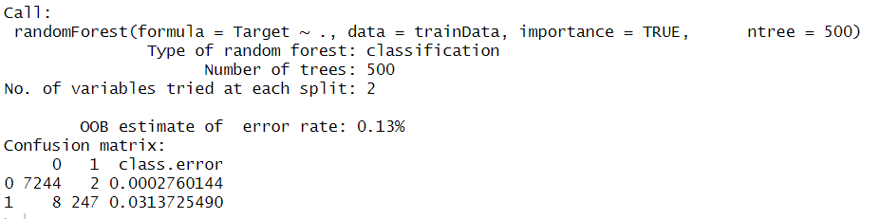
Random Forest Model
High Accuracy: The model classifies class 0 with high accuracy.
Low Error Rate:Both the overall error rate and class-specific error rates are very low.
Balance Issue:The error rate for class 1 may be slightly higher than for class 0, but the overall performance is still very high.

Slide 10
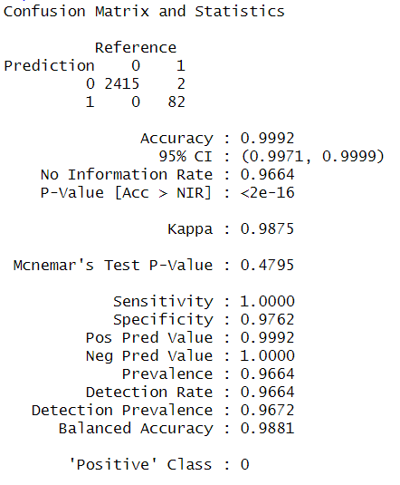
Random Forest Performance Evaluation
High Performance:
The model shows high performance in terms of both sensitivity and specificity.
Low Error Rate:
Errors are almost negligible, which increases the model's reliability.
Kappa Value:
The Kappa value is 0.9875, indicating that the model has nearly perfect classification performance.

Slide 11
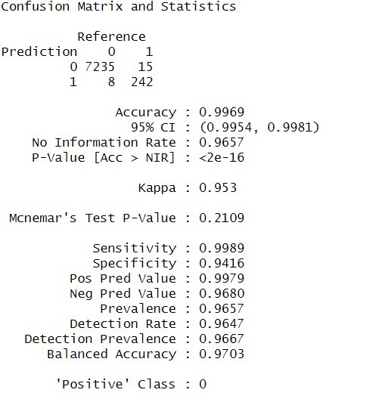
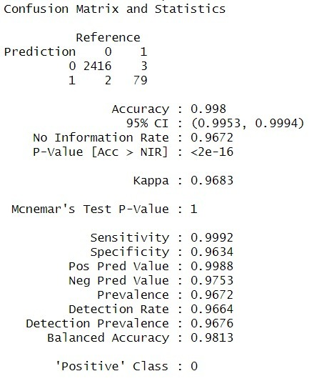
Comparison of Train and Test Set for Overfitting Control
The differences between training and test results are very small.
This indicates that the model does not overfit and has strong generalization ability.

Slide 12
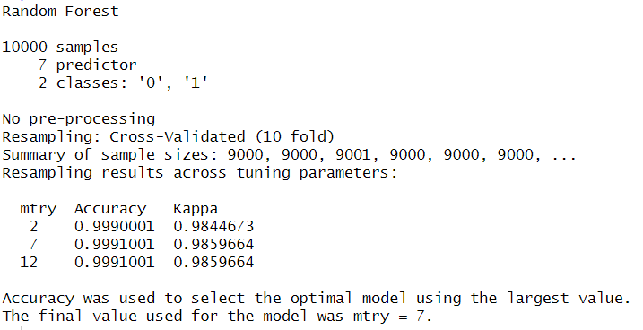
Cross Validation
Model Performance:
The model shows very high accuracy and Kappa values according to cross-validation results.
Optimal Hyperparameter:
The optimal performance is achieved with mtry = 7.
Generalization Ability:
Cross-validation results indicate that the model has strong generalization ability.

Slide 13
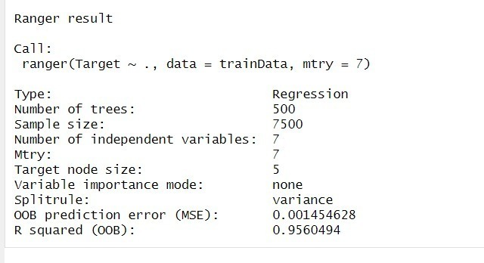
Bagging Tree
OOB Error Rate:
The model's OOB error rate is very low, indicating high prediction accuracy.
R² Value:
The R² value is 95.6%, showing that the model explains a large portion of the variance in the dataset.

Slide 14
Thank you for your attention and time.
For more details and to access the code, please visit the following GitHub repository:
https://github.com/Yigitcanyardimci
https://github.com/Berke-K

