Slide 1
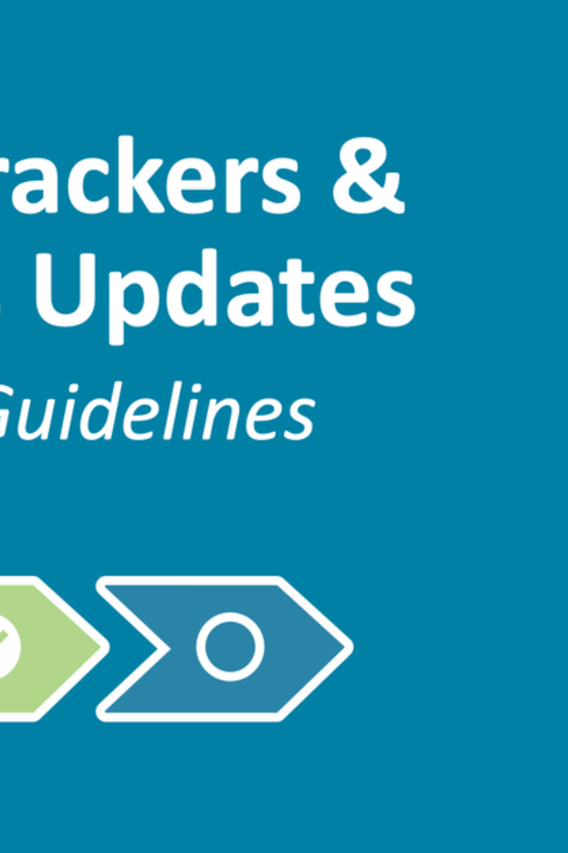
Project Execution
During the project execution phase, it is crucial to provide regular progress updates, address challenges faced, and manage changes in the project scope.

Slide 2

Progress Updates
1
Establishing Milestones
Define key milestones to measure progress and set expectations.
2
Regular Reporting
Provide detailed progress reports to stakeholders to keep them informed.
3
Monitoring and Adjusting
Monitor project progress and make necessary adjustments to stay on track.

Slide 3

Challenges Faced During Execution
1
Resource Constraints
2
Communication Breakdown
Overcoming resource limitations and managing dependencies that may arise.
Addressing miscommunication issues and improving collaboration between team members.
3
Risk Management
Identifying and mitigating risks that may impact project execution.

Slide 4

Changes in Project Scope
Scope Creep
Scope Reduction
Scope Freeze
Managing and controlling additional project requirements and their impact on the timeline and budget.
Dealing with changes that involve reducing the project scope and ensuring the delivery of essential features.
Handling situations where project scope cannot be modified mid-way and adapting the execution plan accordingly.

Slide 5



High Stakes: Project Execution Done Right
Successful Delivery
Team Cohesion
Recognition & Celebration
The satisfaction of delivering a project efficiently and effectively, meeting or exceeding client expectations.
The camaraderie and collaboration among team members, contributing to a positive work environment.
The acknowledgment and celebration of achievements that come with successful project execution.

Slide 6

Continuous Improvement
1
Post-Project Evaluation
Analyze the project execution, identify areas for improvement, and implement lessons learned.
2
Process Refinement
Regularly review and enhance project management processes to optimize execution efficiency.
3
Training & Development
Invest in continuous training programs to empower the team and keep skills up to date.

Slide 7

Key Takeaways
1
Transparent Communication
2
Adaptability
3
Continuous Learning
Be prepared to adapt to changes in project scope and adjust the execution plan accordingly.
Ensure clear and open communication channels to align expectations and address challenges promptly.
Prioritize continuous learning and improvement to enhance project execution capabilities.

Slide 8

Conclusion
Effective project execution is a critical driver of success. By providing progress updates, addressing challenges, managing scope changes, and embracing continuous improvement, projects can be delivered efficiently, meeting stakeholders' expectations.

