Slide 1
Parallel Implementation of K-means Clustering using CUDA
Group 7
Zifan Qian, A91086187
Yihan Hu, A53273512

Slide 2
Clustering and K-means
Clustering is a machine learning technique that partitions unlabeled data points into clusters
Unsupervised learning algorithm that groups data based on similarity instead of labels
K-means is a typical clustering algorithm that assigns data points according to the nearest mean
K = number of clusters
Iterative algorithm consisting of 2 steps:
Assignment step: Assign each sample to the cluster whose mean has the least Euclidean distance to the sample (nearest) among all means (centroids)
Update step: Calculate new means according to the updated labels

Slide 3
Assignment Step
For N data samples
For K clusters
Euclidean distance = norm( mean_{k} - sample )
Let d denote dimension
Complexity O(NKd)

Slide 4
Update Step
For K clusters
For N_{K} samples in the cluster
Mean_{K} = sum(N_{K} samples) / N_{K}
Complexity O(NKd)
Let t denote a fixed number of iterations
Overall Complexity O(tNKd)

Slide 5
Optimization: Parallel Label Assignment
assign_labels <<<N, DIMENSION>>> (d_data, d_means, d_label, d_count);
Shared memory
__shared__ float s_data[DIMENSION];
__shared__ float s_dist[DIMENSION];
Element(thread)-wise vector subtraction and square
s_dist[threadIdx.x] = (s_data[threadIdx.x] - d_means[i * DIMENSION + threadIdx.x]) * (s_data[threadIdx.x] - d_means[i * DIMENSION + threadIdx.x]);
Reduction
for (int stride = blockDim.x / 2; stride > 0; stride /= 2) {
if (threadIdx.x < stride) s_dist[threadIdx.x] += s_dist[threadIdx.x + stride];
__syncthreads();
}

Slide 6
Optimization: Parallel Mean Update
update <<<10, N/10>>> (d_means,d_data_T, d_label);
Coalesce Global memory access
Use two copies of data
atomicAdd(&d_mean[clabel*DIMENSION + i],d_data[dataid + i*N]);
divide <<<10, DIMENSION>>> (d_means, d_count);
Parallel division
Notes:
Gtx1060 10 sm -> 10 blocks, two copy : if we use original data, there is stride(DIMENSION) of 784
Division is parallelly compute.

Slide 7
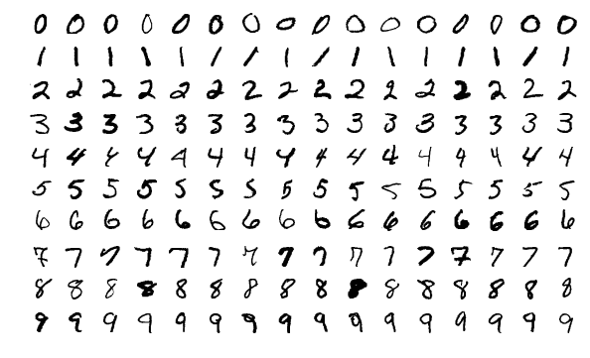
Comparison: Benchmark Dataset
MNIST Handwritten Digit Database
10000 samples of 28x28 images (784 dimensional)
K = 10 clusters: digit 0 - 9

Slide 8
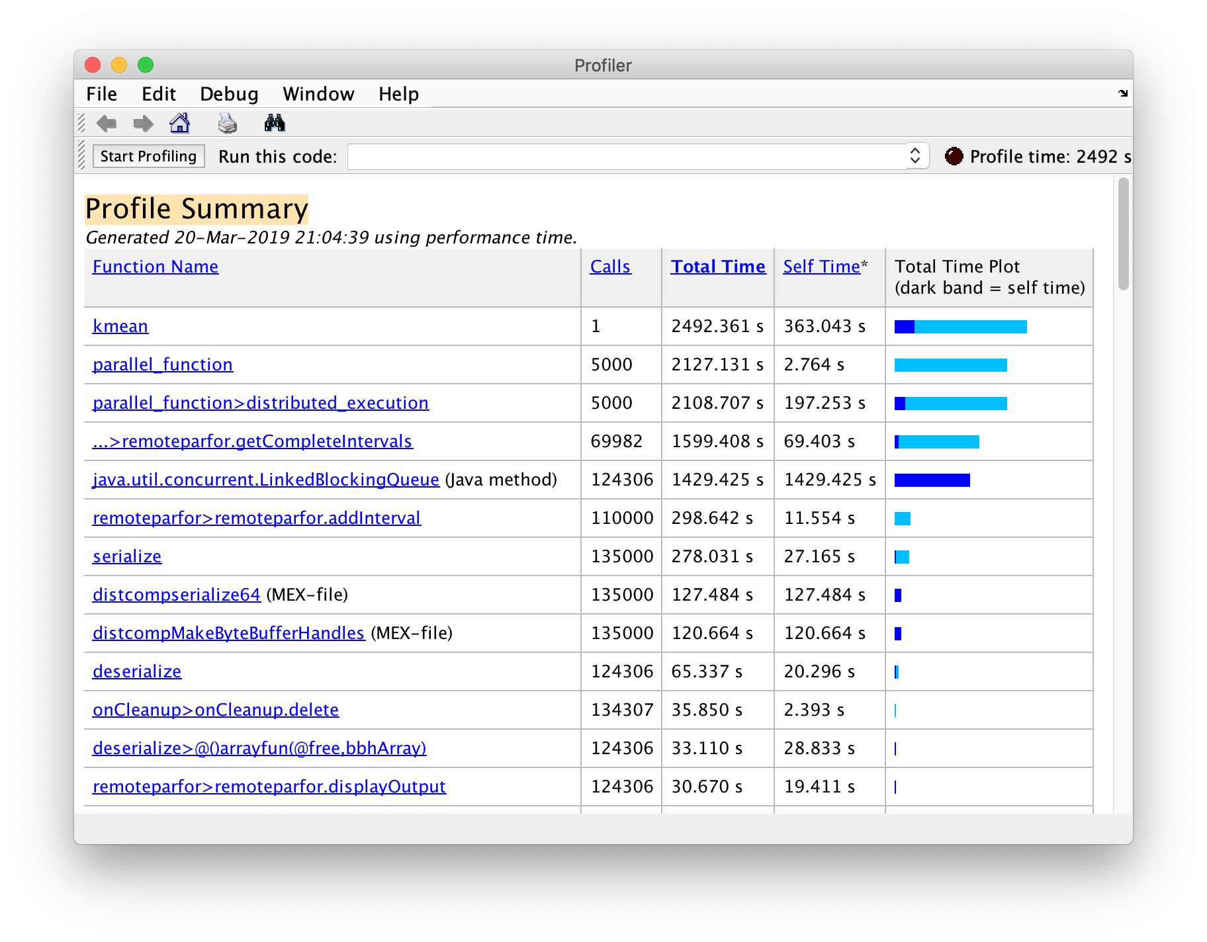
Comparison: Baseline
Serial K-means run on Matlab with the same dataset
5000 iterations
Multi-threads on CPU (4 cores)
2492 seconds

Slide 9
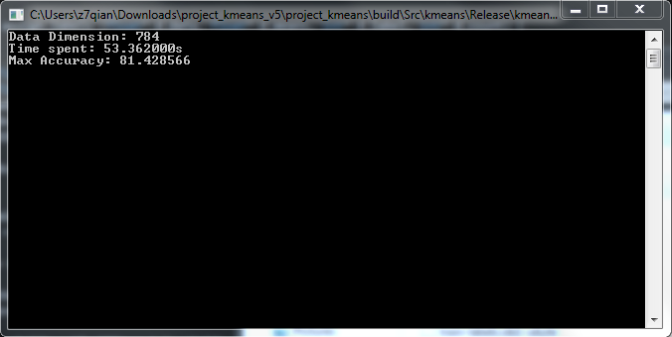
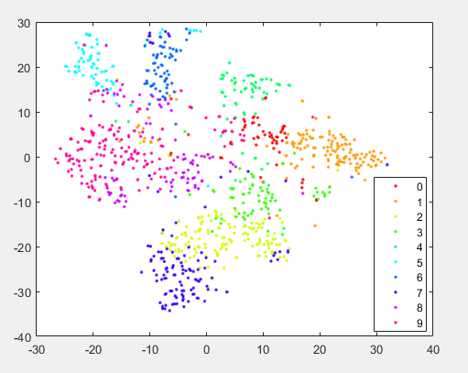
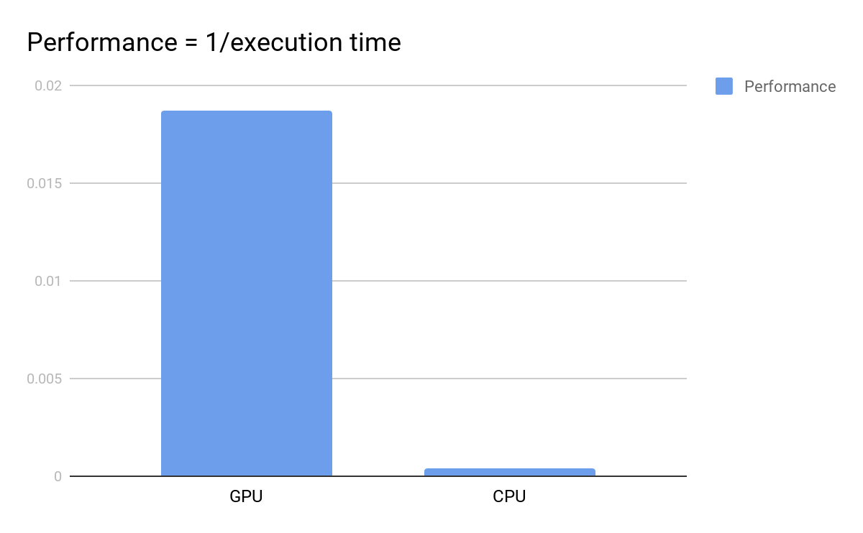
Comparison: Results
53.362s
81.4% Accuracy
47x Performance boost

