Slide 1
Penta Kill detection
Yihao Yang
Group 13

Slide 2
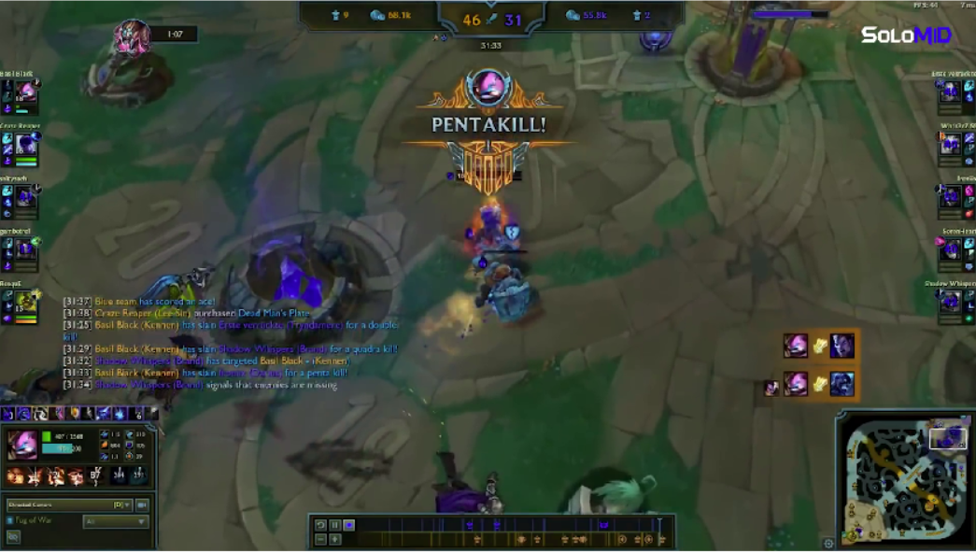
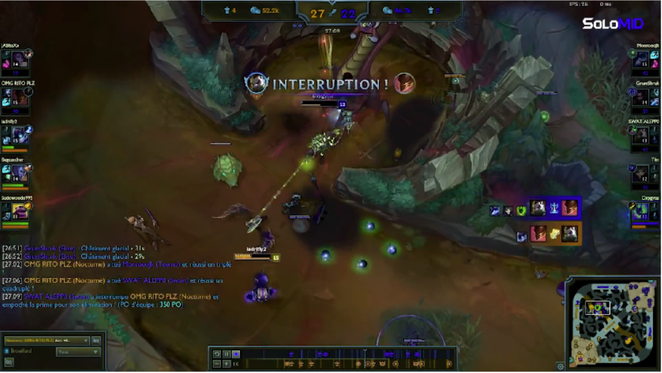
Task
Detect Penta kill frames in a League of Legend game record

Slide 3
Data
Around 65k hand annotated images
80 for training, 20 for testing
60% are Penta kill frames

Slide 4
Model
Name: Efficient Net

Slide 5
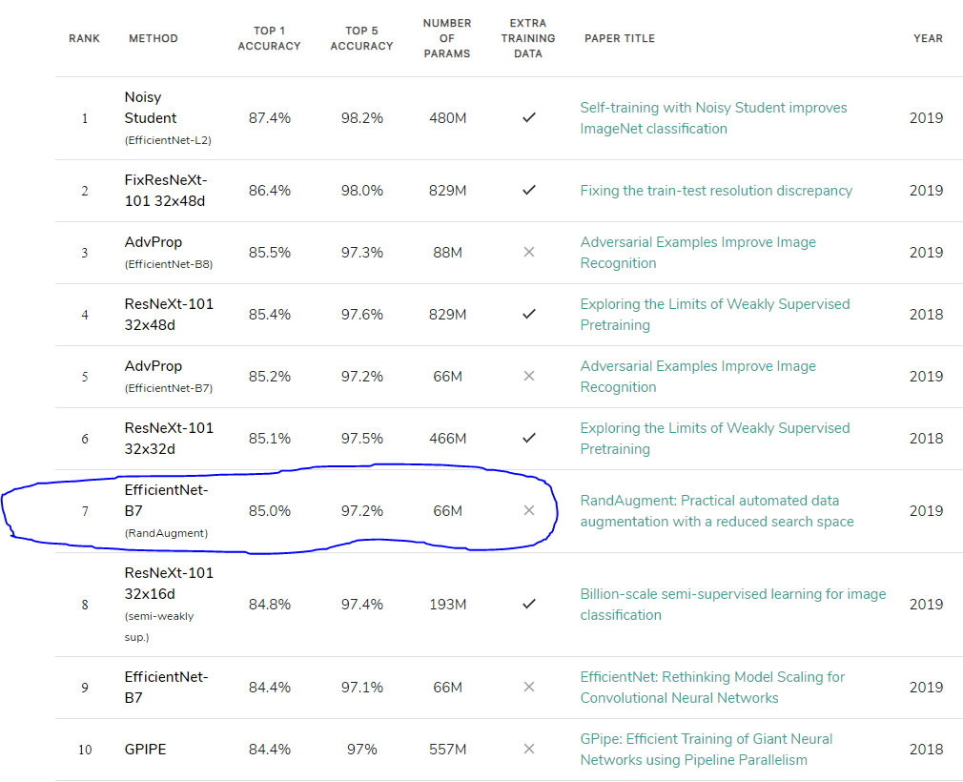

Slide 6
Preprocess

Slide 7
Training

Slide 8
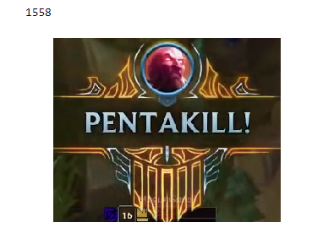

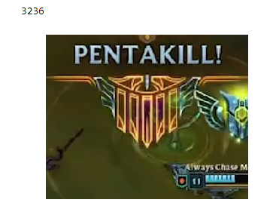
Result

Slide 9
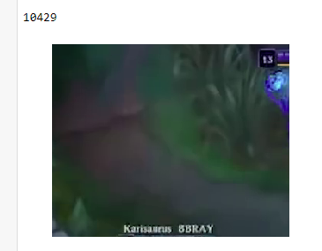
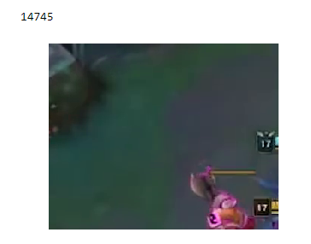
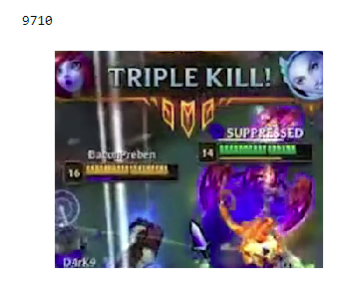

Slide 10
Reason
Continuous frames are similar → Not enough data
2M images to find a single Penta kill
2M × 1% = 20K

Slide 11
Stats
26 seconds to process 10 minutes video to predictable format.
1 seconds to predict the result.
27 seconds to predict 10 minutes video.
Average 35 minutes per game (including ban pick time)
Average 1500 games for 1 Penta kill
So, it needs 38 hours to find a single Penta kill.

Slide 12
Not doable

Slide 13
End..

