Slide 1
2017 .Net公益課程
.Net debugging and profiling in VS 2017
12-08-2017
台北/YouTube

Slide 2



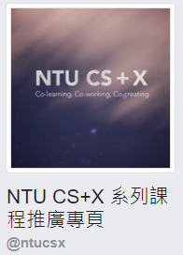
Acknowledgement (讓我打廣告)

Slide 3
大綱
Debugging/profiling tools
Debugging tips/tricks and diagnostic tool
Debugging your Task code (System.Threading.Tasks)
Intellitrace
Debugging/profiling your Azure App Services and VM

Slide 4
Useful tools in debugging
Call Stack
Breakpoints
Exception Settings
Immediate window
Locals
Autos
Watch/Quick Watch
WPF Live visual tree
Modules
Attach to Process dialog (Reattach)

Slide 5
Useful tools in profiling
Performance profiler
PerfView (standalone tool) - Not in this talk
Xperf (from Windows ADK) - Not in this talk

Slide 6
2. Debugging tips/tricks
F5 / Ctrl+F5
Return values (Auto window)
Set next (ctrl+shift+F10)
Click + set next statement
Step into specific
Run to cursor, Run to click
Edit and Continue
Step out (shift+F11)
Debugger display attribute
Conditional breakpoint
Data visualizers (xml,html,json,txt,dataset)
PerfTips
Better null reference exception helper

Slide 7
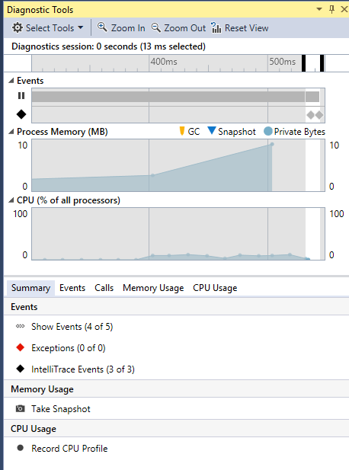
Diagnostic tool
Record CPU profile
Take memory snapshot
Evaluate between snapshots

Slide 8
3. Useful tools in debugging Task
Threads window
Tasks window
Parallel Stacks window
Parallel Watch window

Slide 9
4. Intellitrace
Only available in VS Enterprise edition
Only available for managed code
Setup Intellitrace events
Historical debugging

Slide 10
5. Debugging/profiling Azure App Services and VM
Remote debugging
Remote profiling
Log streaming
Attach to Process in App Services
Remote debugging to Azure Virtual Machine
Snapshot debugging in Azure web app (only for VS Enterprise 15.5 or later, and your App Service cannot be Free or Shared price tier)

Slide 11
References
VS debugging feature https://docs.microsoft.com/en-us/visualstudio/debugger/debugger-feature-tour
VS profiling feature https://docs.microsoft.com/en-us/visualstudio/profiling/profiling-feature-tour
PerfTips - https://blogs.msdn.microsoft.com/devops/2014/08/18/perftips-performance-information-at-a-glance-while-debugging-with-visual-studio/
7 lesser known hacks for debugging in Visual Studio - https://blogs.msdn.microsoft.com/visualstudio/2017/06/26/7-lesser-known-hacks-for-debugging-in-visual-studio/
7 Hidden Gems in Visual Studio 2017 - https://blogs.msdn.microsoft.com/visualstudio/2017/10/05/7-hidden-gems-in-visual-studio-2017/
Azure App Service Log Streaming with ASP.NET Core - https://dotblogs.com.tw/aspnetshare/2017/02/09/azureintegration
Snapshot debugger - https://docs.microsoft.com/en-us/visualstudio/debugger/debug-live-azure-applications

Slide 12
Resources
PerfView speech https://www.youtube.com/watch?v=eX644hod65s
Ignite 2017 Supercharge Your Debugging in Visual Studio https://www.youtube.com/watch?v=iil4Rn854Wk&t=3951s
Build 2017 Snapshot debugging + profiling in Azure https://www.youtube.com/watch?v=0oP73UQJL88
Ignite 2015 IntelliTrace in VS2015 https://channel9.msdn.com/events/Ignite/2015/BRK3716
IntelliTrace - https://docs.microsoft.com/en-us/visualstudio/debugger/intellitrace-features

