Slide 2


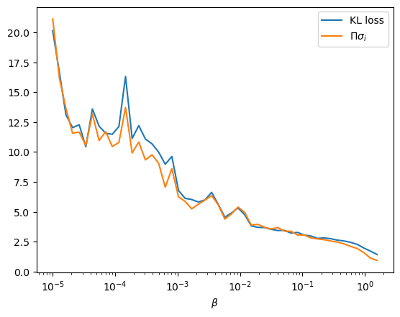
KL-Loss and
KL-loss and
versus β.

Slide 3
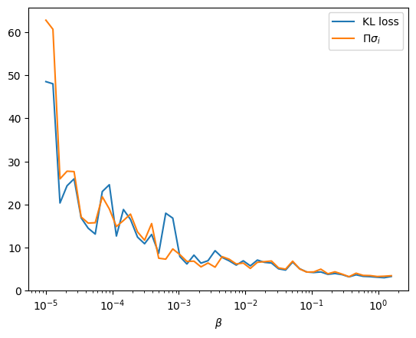
data points = 1e5, latent_dim=100

Slide 4
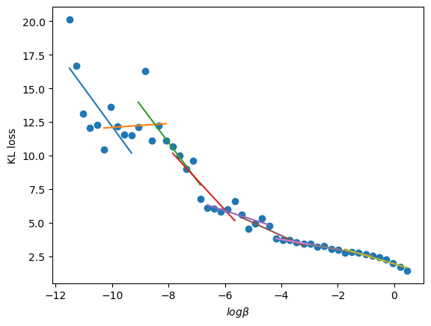

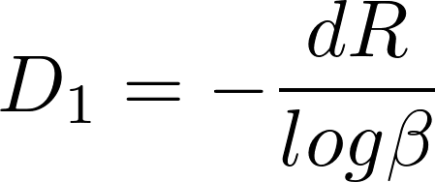

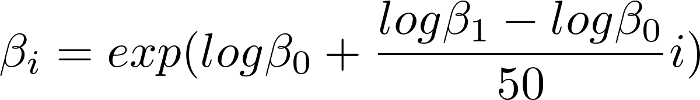

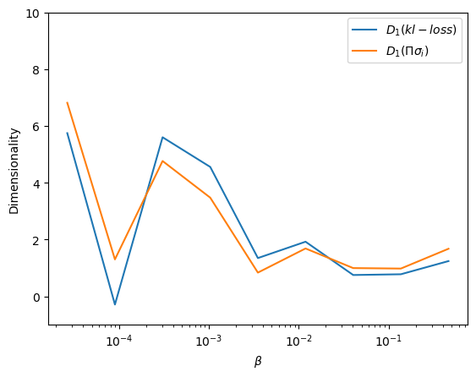
Dimensionality
, where
50 betas,
Used scipy.optimize.curve_fit.
data points = 1e4, latent_dim = 10

Slide 5
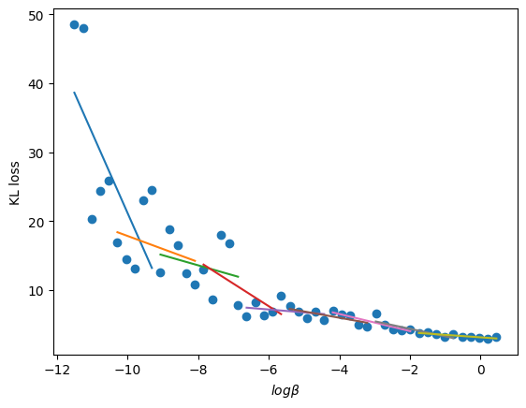
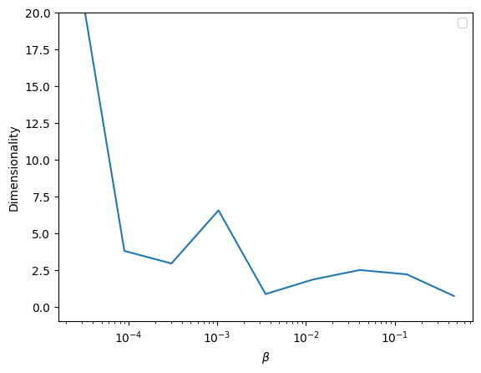
data points = 1e5, latent_dim=100

Slide 6
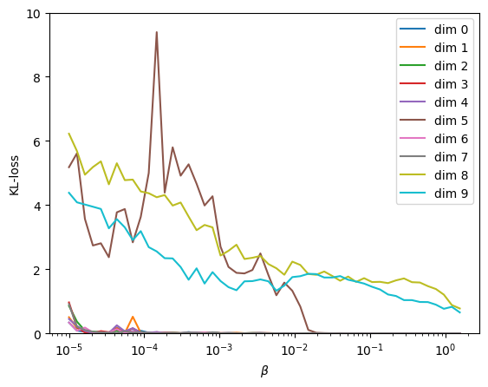
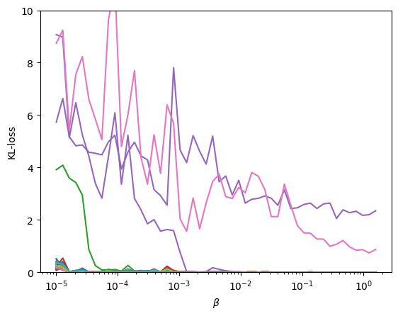
Dimensionality
Similar to Fig.7 in Collins paper.
data points = 1e4, latent_dim = 10 data_points = 1e5, latent_dim = 100

Slide 7
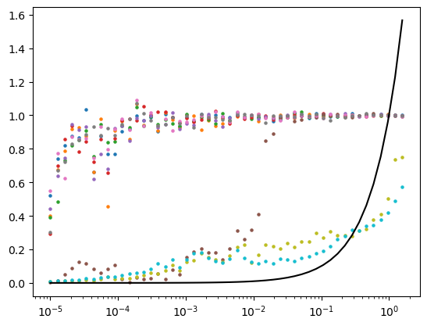
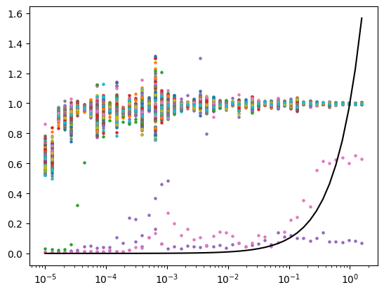

Data points: $σ_{i}$, solid line: $σ_{i}=β$

Slide 8

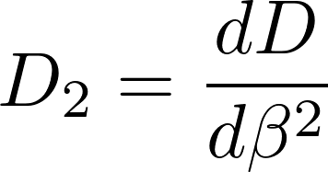

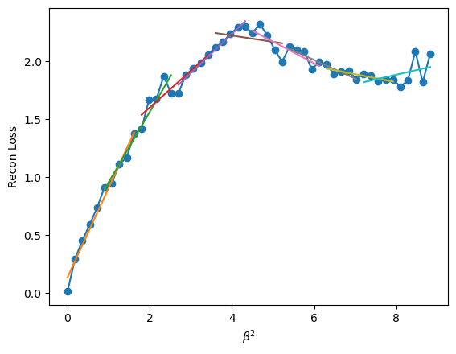
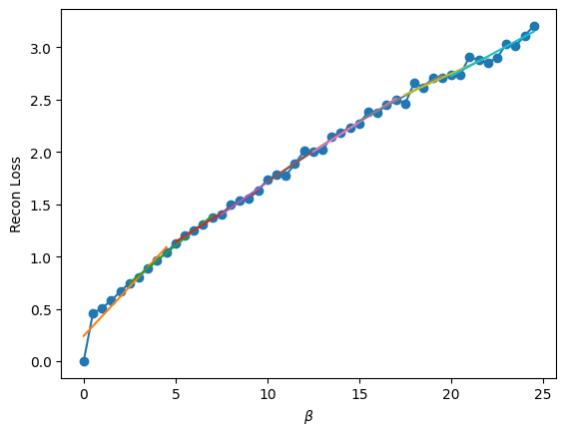

Dimensionality
, where
If $D_{2}=$reconstruction loss. Then
Reconstruction loss?

Slide 9
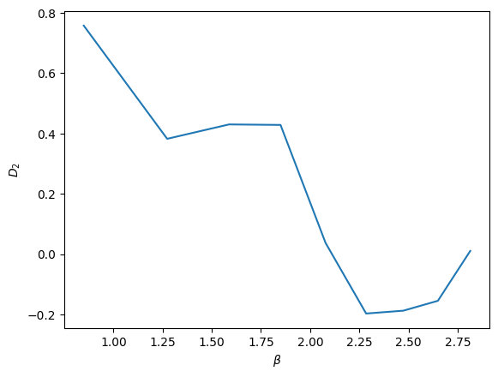
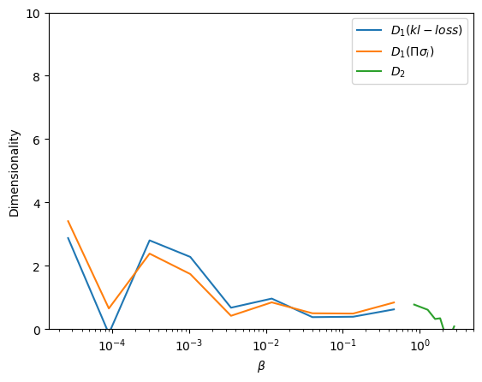


$D_{2}$ versus $β$
$D_{1},D_{2}$ versus $β$

