Slide 2

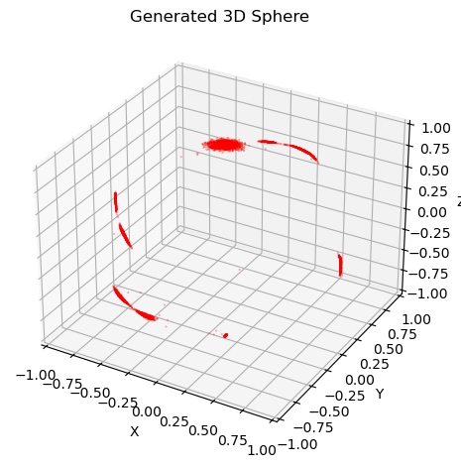
Check the representation of latent dimensions
Last time I checked the informative dimensions.
I used 2D sphere dataset.
But the model output 3 informative dimensions.
Repeat representation?
Separately representation?
Redundant representation?
num=1e4, ld=10, β=0.001. Generated data.

Slide 3
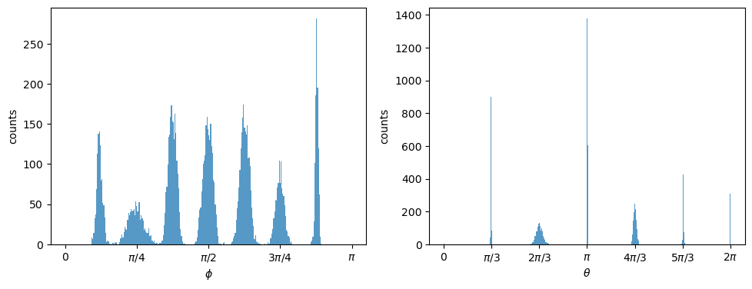
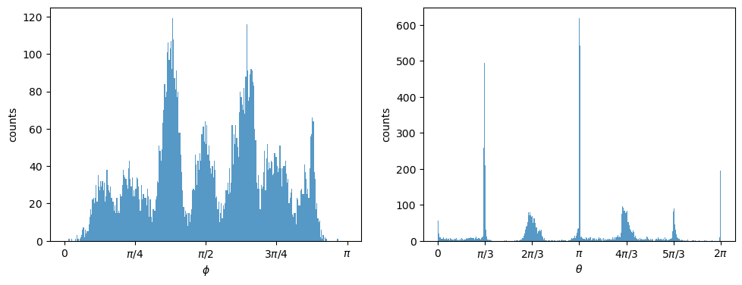
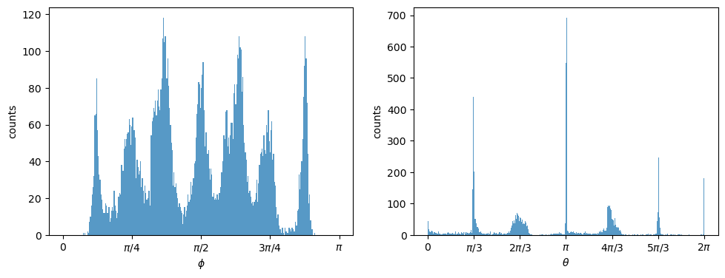
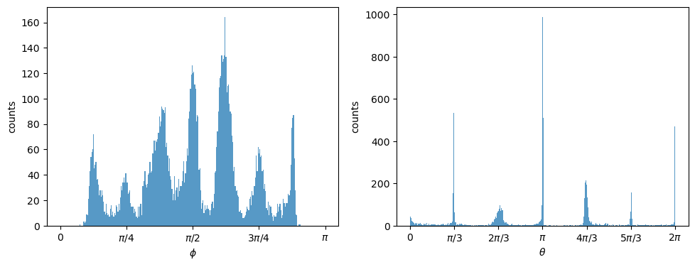

Slide 4
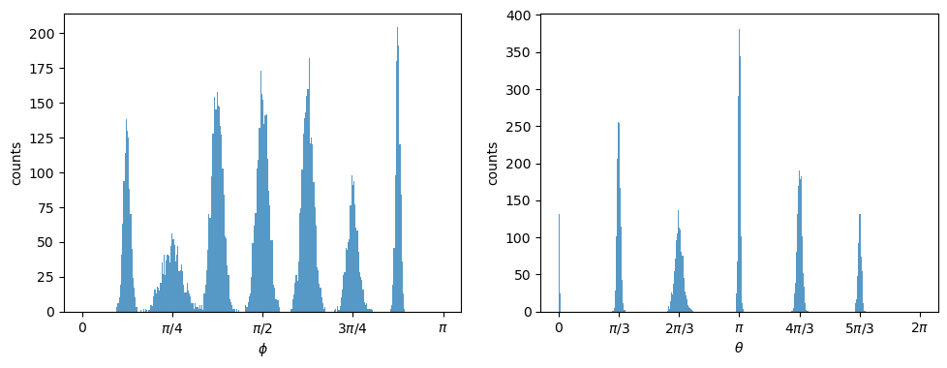

The distributions of θ and ϕ in original dataset
The distributions of θ and ϕ in the generated dataset
num=1e4, latent dimension=10, β=0.001.

Slide 5
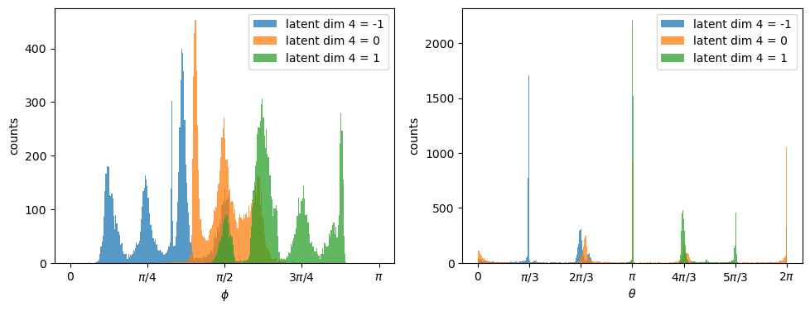
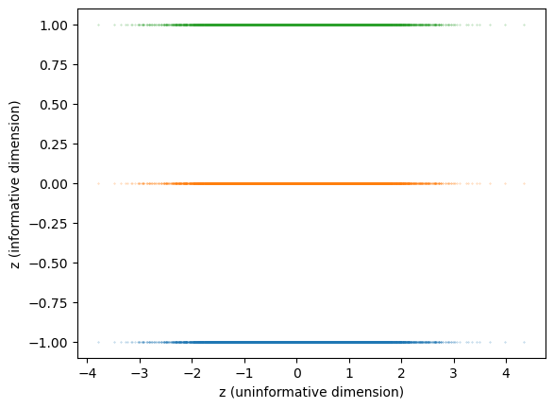
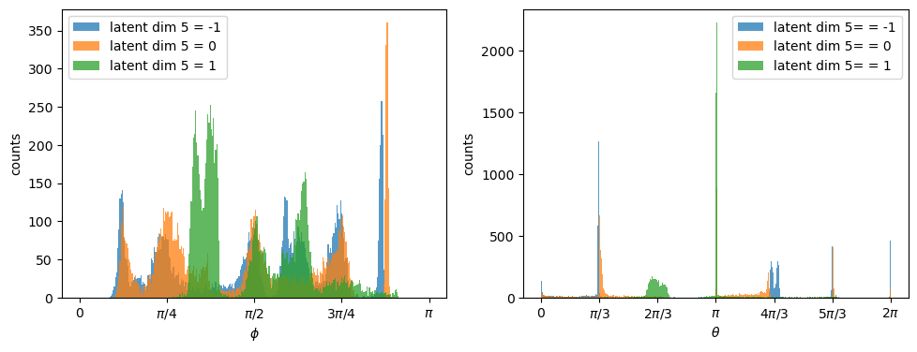
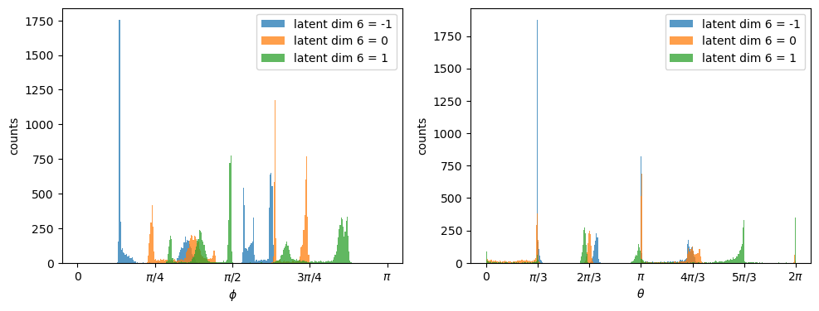
Check each informative dimension.
z in dimension = -1, 0, 1
Dimension 4, representing ϕ

Slide 6
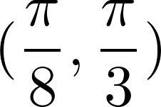
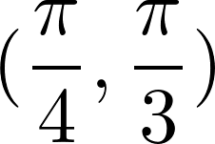
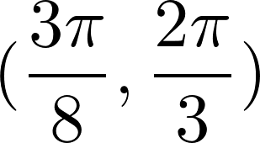
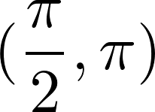
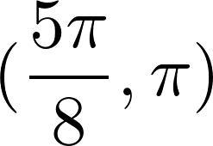
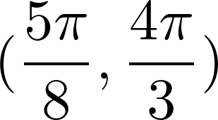
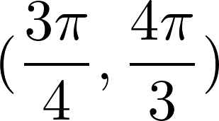
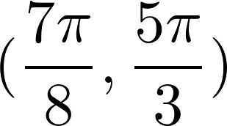
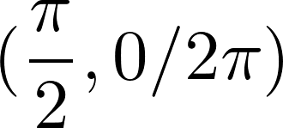
num=1e4, ld=10, β=0.001. Informative dimensions=3
(ϕ, θ) | Dim 1 (z) | Is repeated
 | -1
 | -1
 | -1
 | 0
 | 1
 | 1
 | 0
 | 1
 | 1
 | -1,0 | √
(ϕ, θ) | Dim 2 (z) | Is repeated
 | -1,0 | √
 | -1,0 | √
 | 1
 | 1
 | 1
 | 1
 | -1,0 | √
 | -1,0 | √
 | -1,0 | √
 | -1,0 | √
(ϕ, θ) | Dim 3 (z) | Is repeated
 | -1
 | 0
 | -1,0 | √
 | 1
 | 1,-1 | √
 | -1,0 | √
 | -1,0 | √
 | 0
 | 1
 | 1

Slide 7
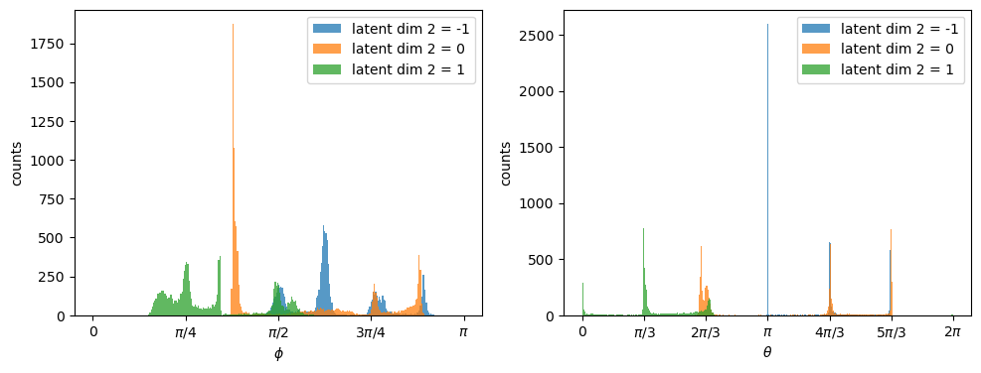
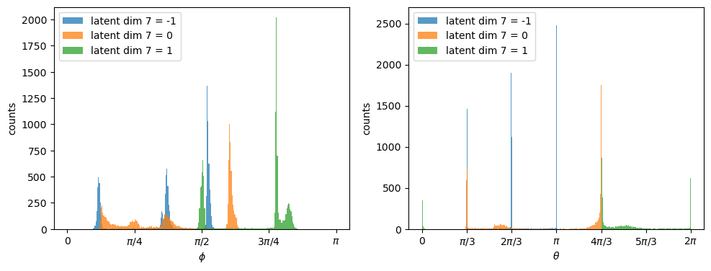
The same, but β=0.01 informative dimension=2
Less repeated representation

Slide 8
num=1e4, ld=10, β=0.01. Informative dimensions=2
(ϕ, θ) | Dim 1 (z) | Is repeated
 | -1,0 | √
 | 0
 | 0
 | -1
 | -1
 | -1
 | 0
 | 1
 | 1
 | 1
(ϕ, θ) | Dim 2 (z) | Is repeated
 | 1
 | 1
 | 1
 | 0
 | -1
 | -1
 | -1
 | -1,0 | √
 | -1,0 | √
 | 1

Slide 9
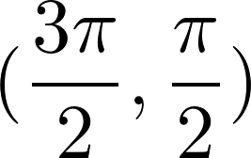
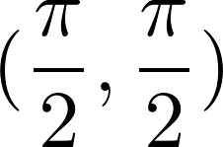

some simple examples on larger datasets
2 Gaussian distribution on sphere =
data=1e5, input latent dim=100, β=0.01.
2 informative dimensions, 1 represents θ, 1 represents ϕ

Slide 10
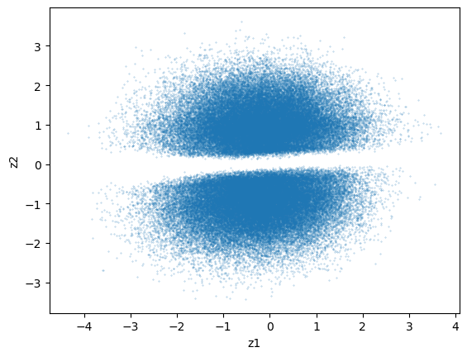
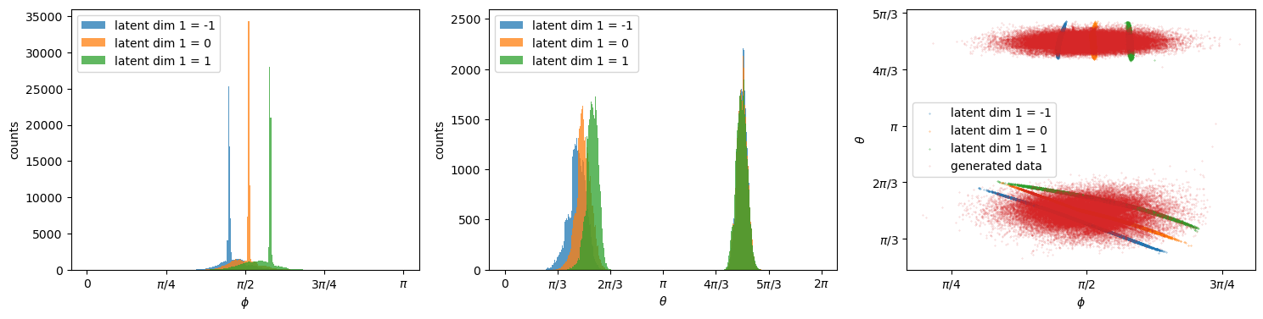
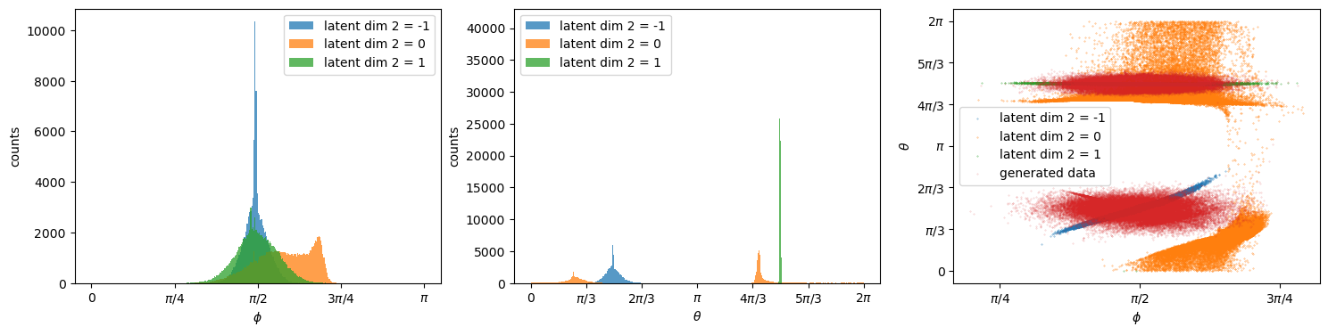


represents distribution of ϕ.
There is a gap near 0 in the distribution of z2.
z2>0, represents θ~
z2<0, represents θ~
represents distribution of θ.

Slide 11
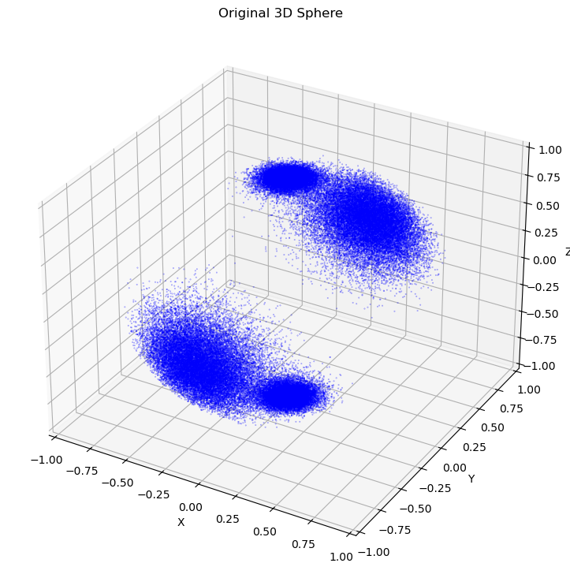
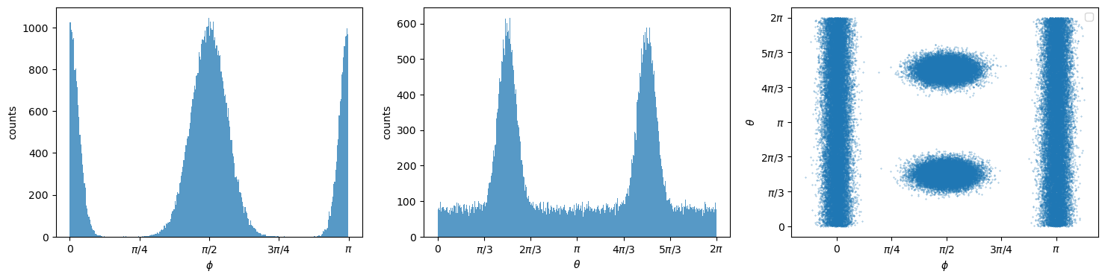
4 Gaussian distribution on sphere = and on north pole, south pole.
data_num=1e5, input latent dim=100, β=0.01. 3 informative dimensions, 1
represents θ ,1 represents ϕ but has overlap, 1 represents
data_num=1e5, input latent dim=100, β=0.1. 2 informative dimensions, 1
represents θ (but doesn't seem have much effect), 1 represents the location
of distributions.

Slide 12
β=0.01

Slide 13
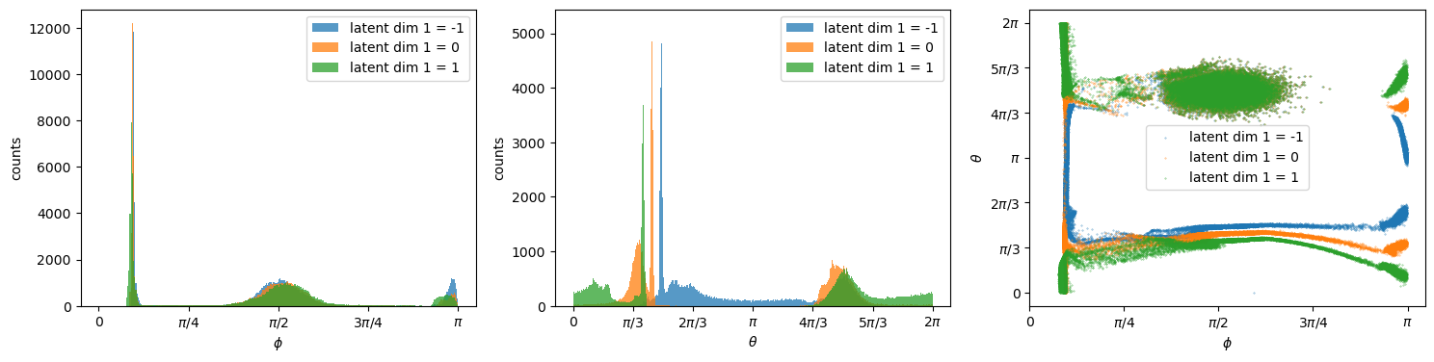

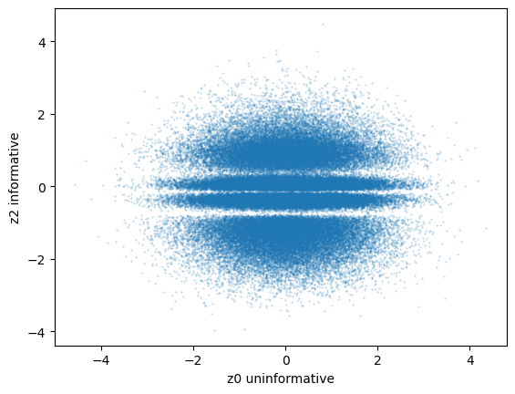
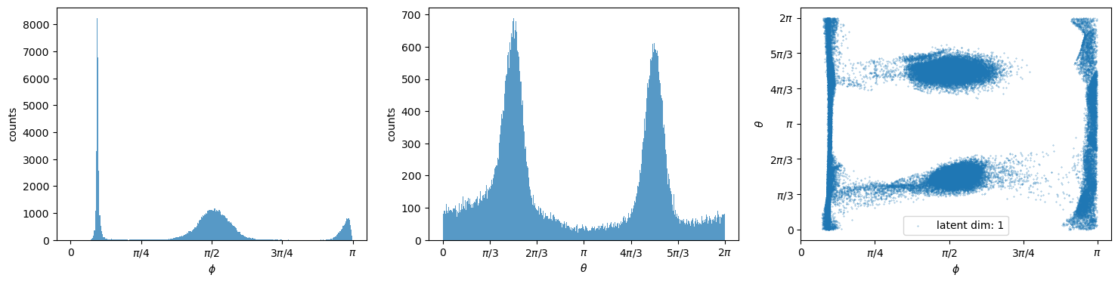
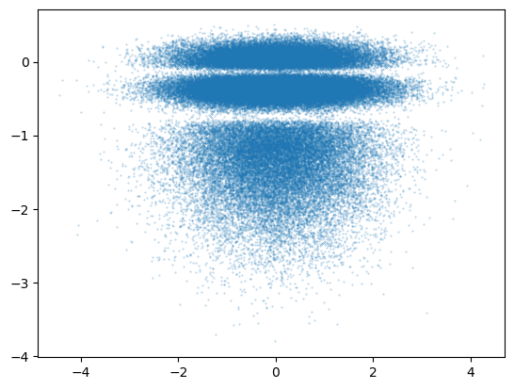
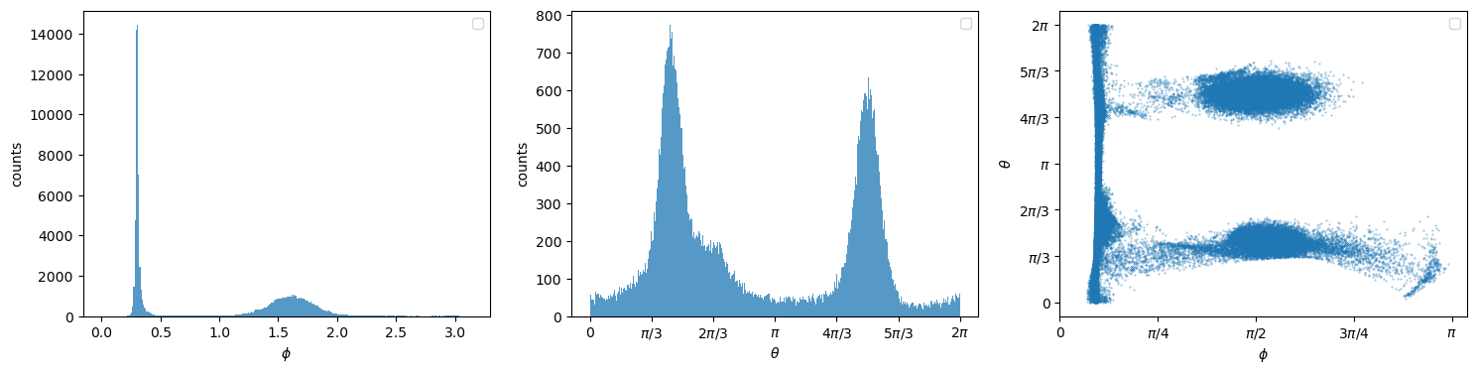
β=0.1
informative dimension 1
blue (near θ= )
orange (middle)
green (far away)
4 clear area.
The generated data from z.
I remove the up area of z2, then generated data, it lose the distribution of south pole.

