Slide 2
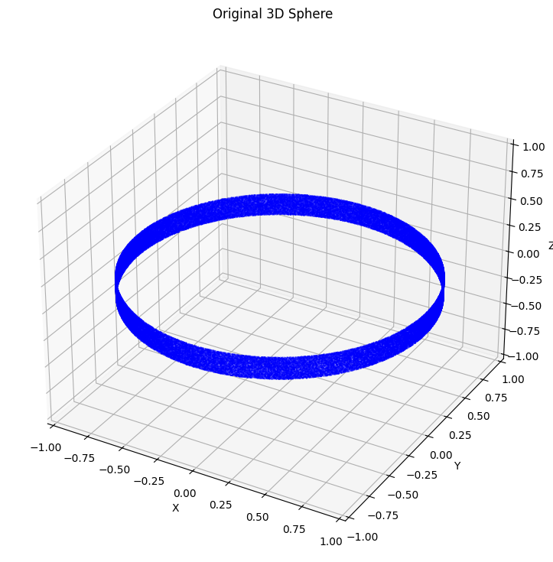
Some simple examples
Rings: data number=1e5, β=0.01, latent_dim=100
The informative latent dimension is 2.
One dimension learnt the chord of circle (x-y plane) and the height of rings.
One dimension learnt the Arc one the circle and height of rings.

Slide 3
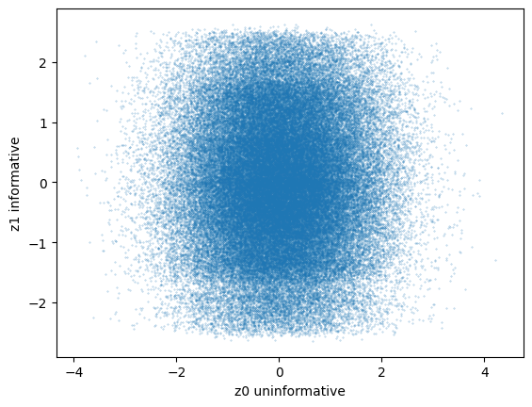
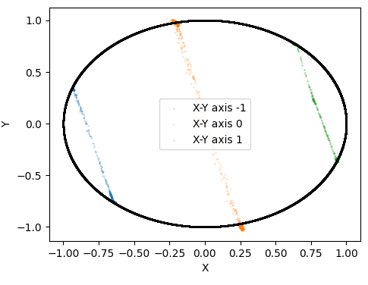
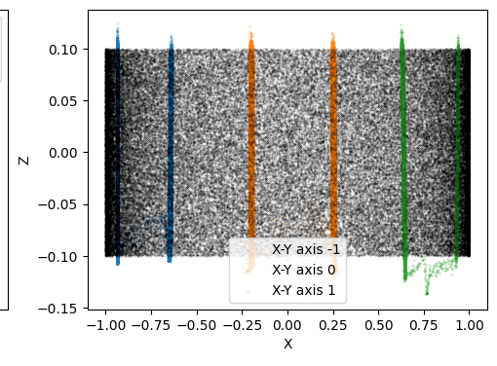
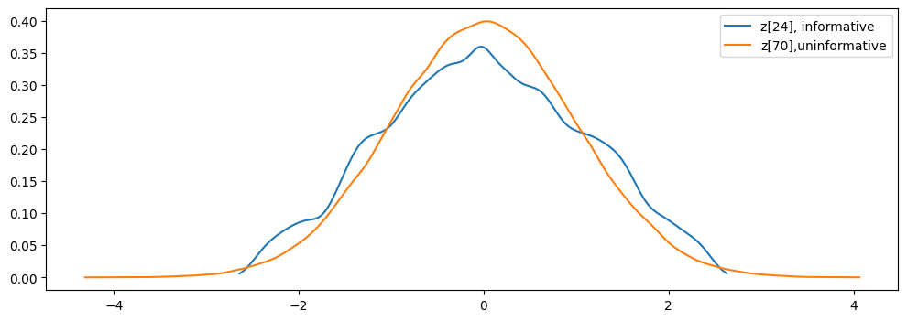
Z1
I set z1=-1,0,1 to encode and generated the data, they present me the chord on the ring on X-Y plane, and the height of ring.
The distribution of z1 versus an uninformative dimension

Slide 4
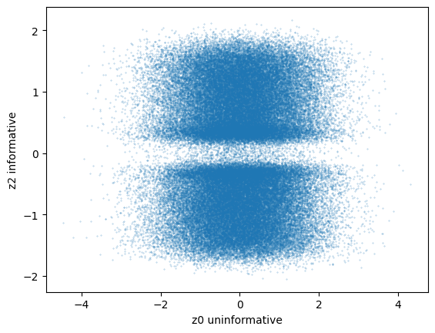
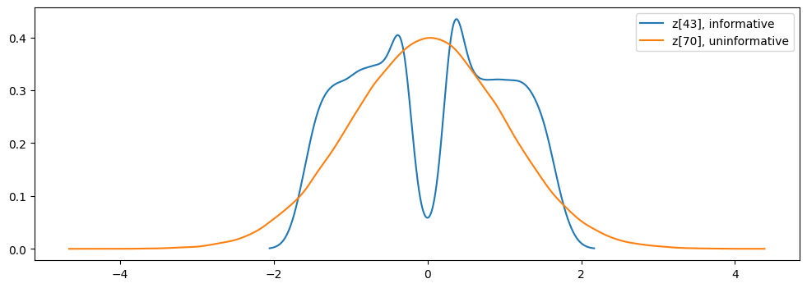
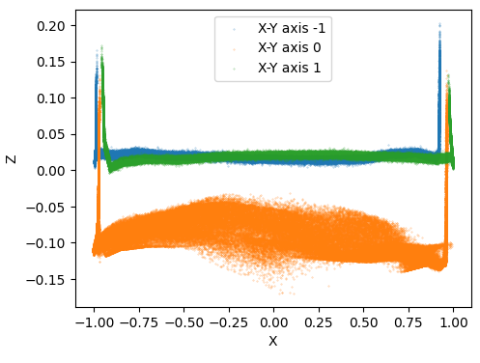
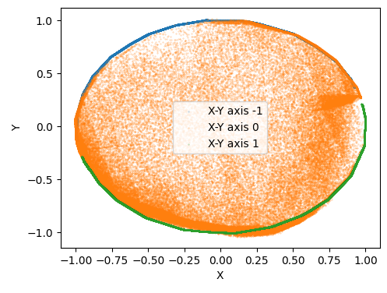
Z2
There is a missing when z2~0, in the decoded data, Z2~0 represents the fill in the ring.
I set z2=-1,0,1 to encode and generated the data, they present me the Arc on the ring on X-Y plane, and the height of ring.
The distribution of z2 versus an uninformative dimension

Slide 5
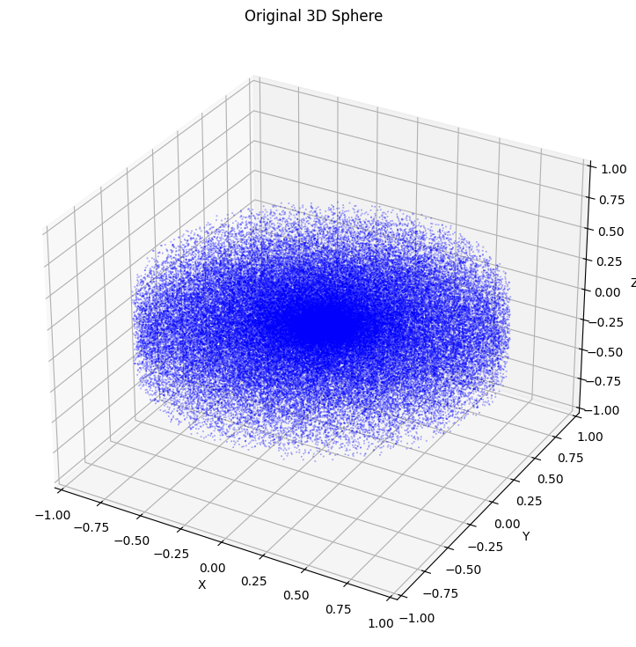
‘accretion disk’
Accretion disk: data number=1e5, β=0.01, latent_dim=100
The informative latent dimension is 3.
One dimension learnt the slice vertical on the X-Y plane facing X-axis .
One dimension learnt the slice vertical on the X-Y plane facing Y-axis .
One dimension learnt the structure of slice about Z-axis.

Slide 6
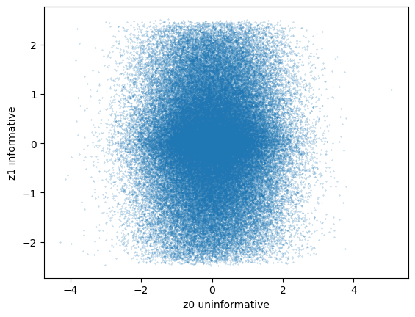
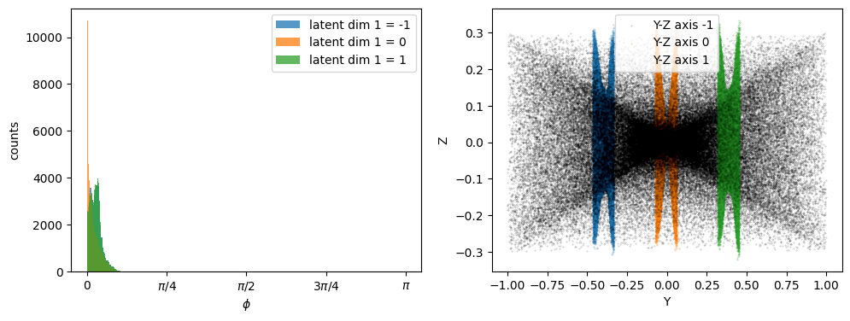
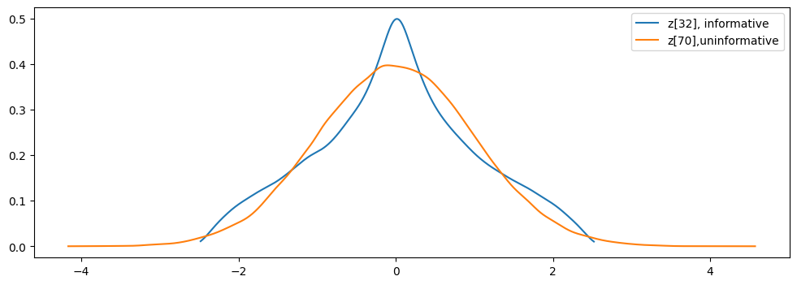
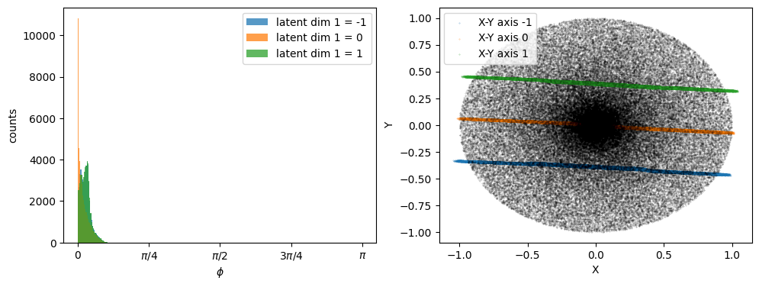
Z1

Slide 7
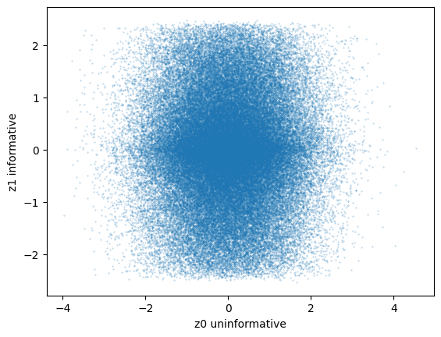
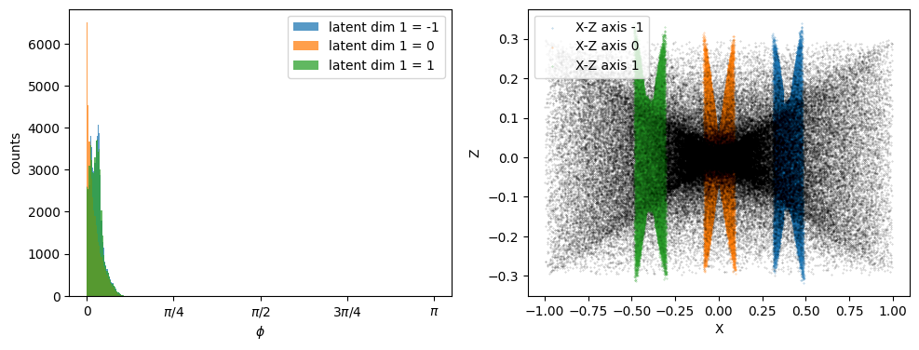
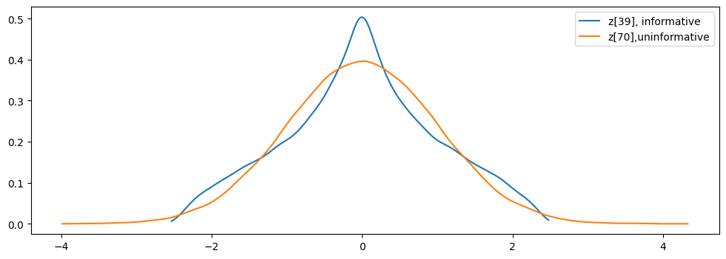
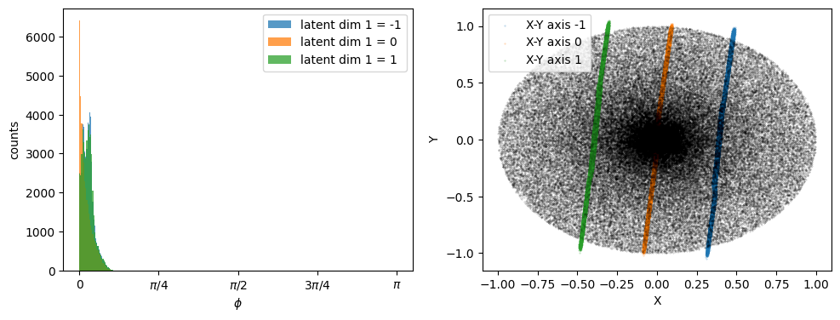
Z2

Slide 8
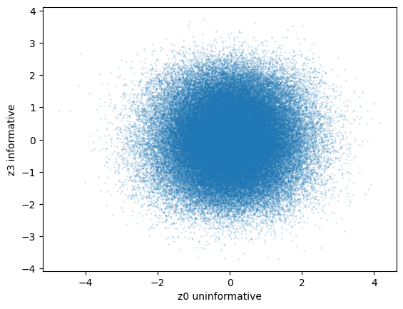
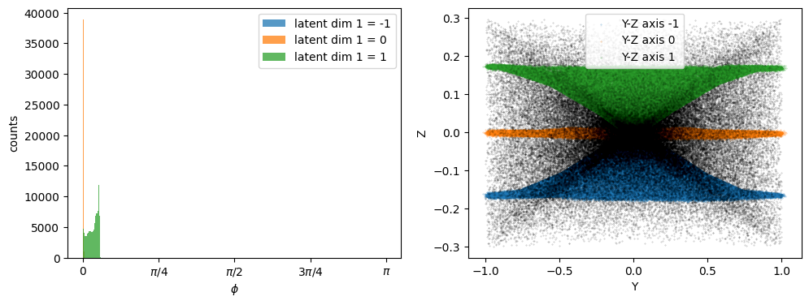
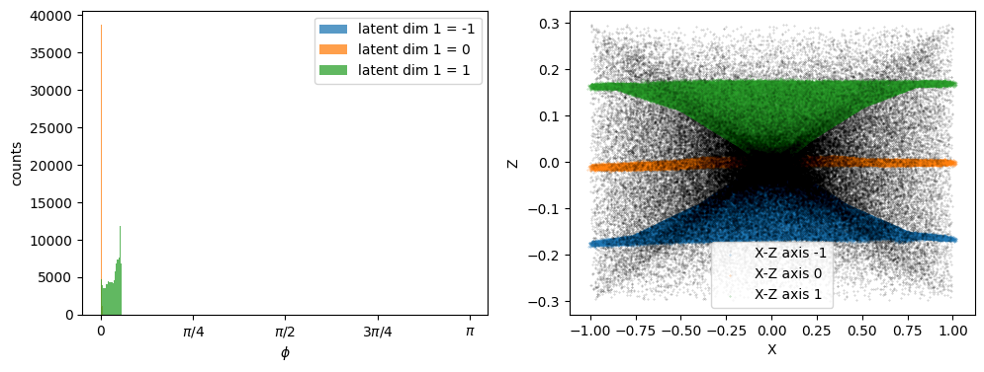
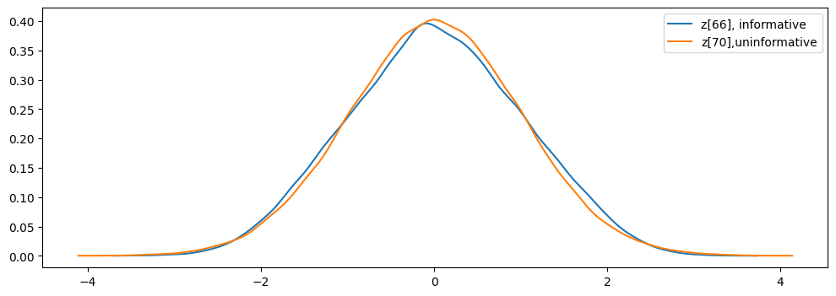
Z3

