Slide 1
量子力學專題
報告者：楊泓翊、張晉豪、莊益豪
報告日期：2020/04/17

Slide 2
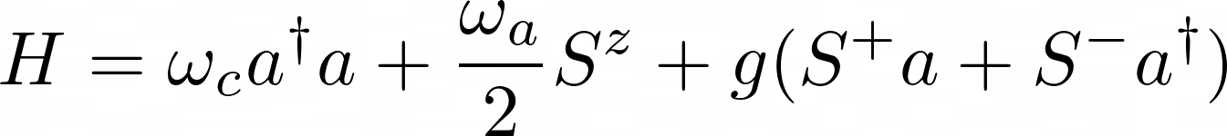
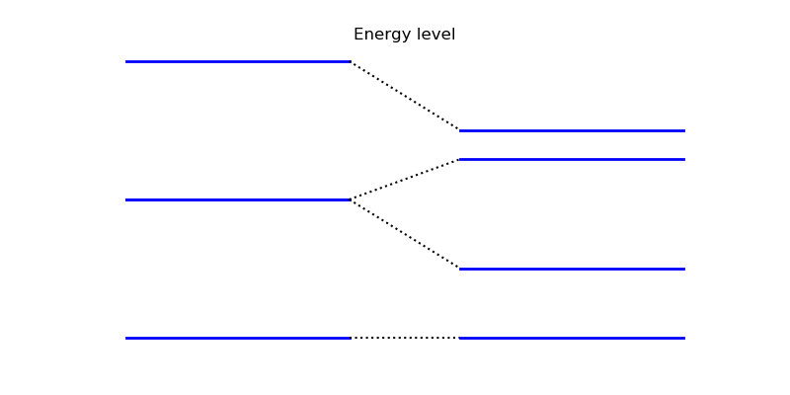
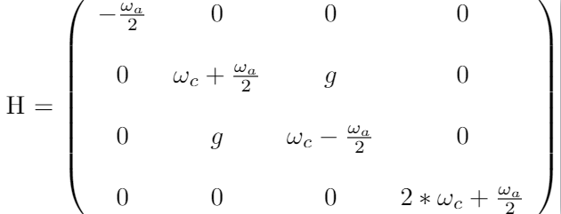
|2>
|2,g>
|1, e>
|1>
|1, g>
|0>
|0, g>

Slide 3
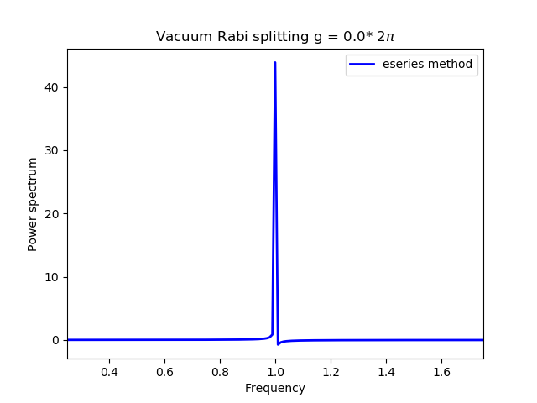
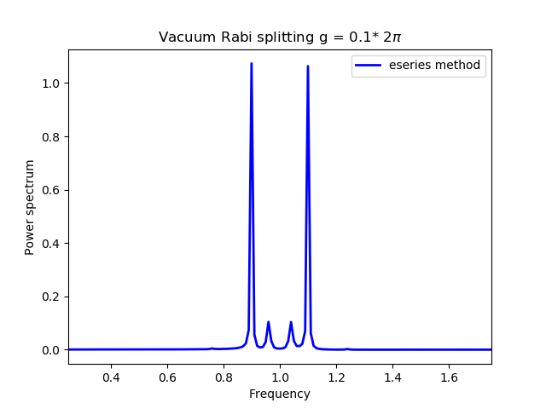
In resonance
Off resonance

Slide 4

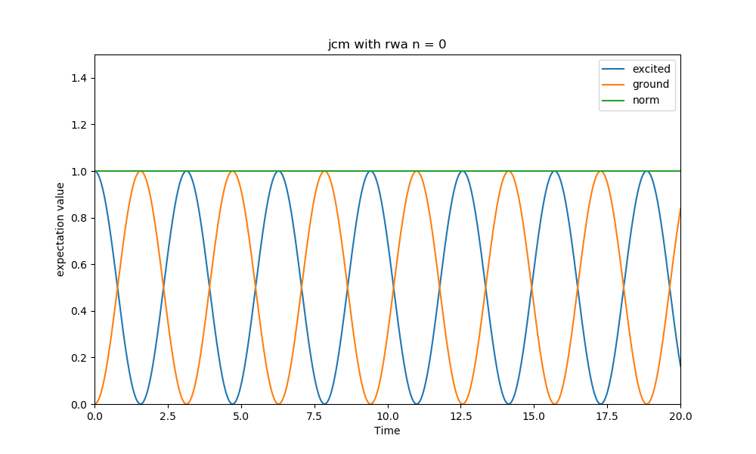

Slide 5
Proposal
Add loss

