Slide 1
Comp1710/6780
Assignment Part 2

Slide 2
Assessment: 30 + 30 + 40
Assignment (in 3 components) on Web site construction: 30 marks
Web site appearance design: 10 marks
Website is developed: 10 marks
Full website with advanced components developed: 10 marks
The assignments are based on the labs, approximately every 3 labs is one assignment
Communication skills: 30 marks
Active participation (forum and in person): 15 marks
based on course content
A report on user centred design: 15 marks
based on participation in human centred computing and psychology experiments or reading task
Experiment participation as submitted in the report is a hurdle assessment
Examination: 40 marks
On-line quizes: 15 marks
Mid-semester test (on-line): 10 marks
aimed for week 9
Final exam (on-line) exam in June: 15 marks
You can bring 1 sheet A4
Printed/Handwritten both sides ok
Can have microscopic print

Slide 3
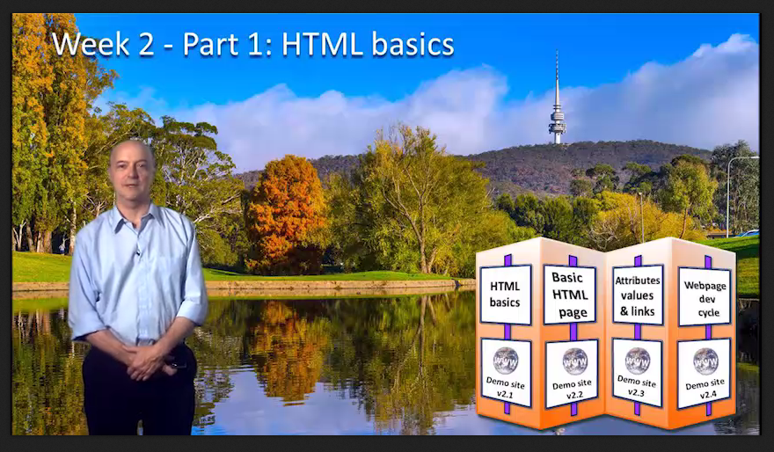
Lab activity (id:1.3)
Lab activity:
1 | JS Bin | If you have never registered for JS Bin before, register now. Login and open the demo website for this part.
2 | Text editor | Review the text editors discussed in the video lesson for this part, or others in which you may be interested, and choose your preferred text editor. Don't worry, you can change at any time. Familiarise yourself with the layout and functionality of your text editor

Slide 4
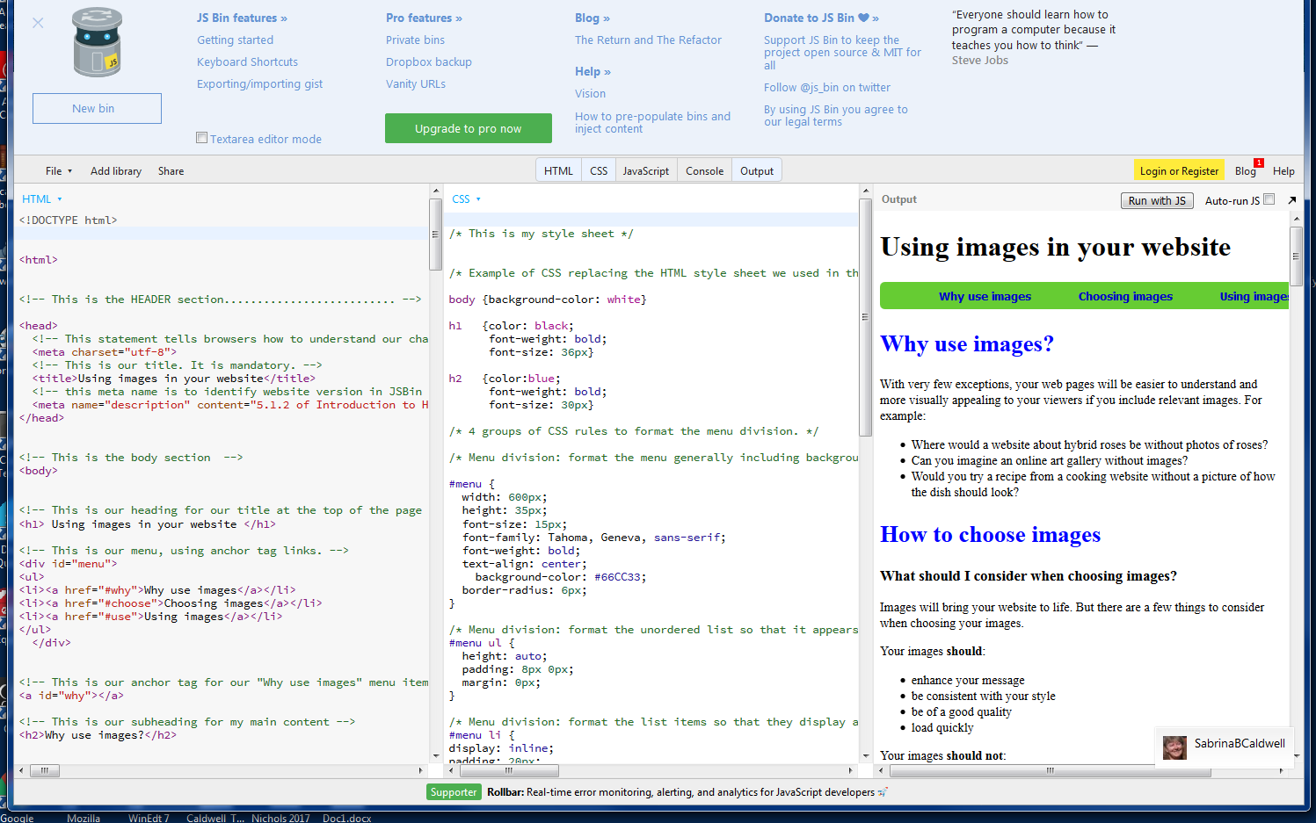

Slide 5
Comp1710/6780 – Assignment Part 1
Worth 1 mark
From assignment.html Your Me and My Passion
Replace this line with your URL link to this element in your website. Notes: Provide any notes you may have about this element here.
From Assignment Spec:
Introduce yourself and/or your passion, interest or hobby etc. Write a mission statement or list of goals similar to the idea of a brief statement of the mission and list of goals in chapter 1 of the Unusually Useful Web Book. This section should probably take 200-400 words or so.

Slide 6
Comp1710/6780 – Assignment Part 1
Worth 1 mark for CSS
From assignment.html CSS
Replace this line with your URL link to this element in your website.
Notes: Provide any notes you may have about this element here.
From Assignment Spec:
Create an external (separate) CSS file. Use at least 10 CSS rules. Make sure your CSS includes comments that would be useful to someone taking over the maintenance of your site, things like the purpose of each rule, exceptions to its use and the choice you made as to which selector you specified. If you create more than one CSS make sure they are deployed in a Cascading manner, i.e. there should be at least one default CSS that will be applied to all the pages in your site, with specialised CSS then being applied to specific pages of the web site.

Slide 7
Comp1710/6780 – Assignment Part 1
Worth 1 mark
From assignment.html Site Map
Replace this line with your URL link to this element in your website.
Notes: Provide any notes you may have about this element here.
From Assignment Spec:
This page should clearly depict the organisation/structure of the web site, possibly using a table or links (or both) or an image map. Make sure you update the site map as you expand your web site in Parts 2 and 3.

Slide 8
Comp1710/6780 – Assignment Part 1
Worth 1 mark
From assignment.html Source Log
Replace this line with your URL link to this element in your website.
Notes: Provide any notes you may have about this element here.
From Assignment Spec:
You will need to keep a log. A typical log describes the list of sources you used for your project and the modifications you applied to them. The origin of the source should be given in enough detail to ensure the marker can access the source whenever it is possible (URL, ISBN etc). Make sure you update the source log as you expand your web site in Parts 2 and 3.

Slide 9
Comp1710/6780 – Assignment Part 1
Worth 1 mark
From assignment.html Feedback Form
Replace this line with your URL link to this element in your website.
Notes: Provide any notes you may have about this element here.
From Assignment Spec:
Create a page which takes feedback from visitors to your site via a form.

Slide 10
Comp1710/6780 – Assignment Part 1
Worth 1 mark
Coherence
We will be looking some sense of flow and unbroken links in your site. This is only part 1 so your site is still young, but you should have some colour scheme, some similar usage of fonts, your subject should be obvious and your pages should work together.

Slide 11
Comp1710/6780 – Assignment Part 1
Worth 1 mark
Quality
Even in a young site the elements can be visually appealing. We will be looking for appropriate colour schemes and font strategies, harmonious use of space, a few relevant and interesting images if appropriate for your site, etc..

Slide 12
Comp1710/6780 – Assignment Part 1
Worth 1 mark
Coding
We will be looking at your html and css coding. We want to see well structured, clear coding with appropriate use of indenting and especially good commenting.

Slide 13
Comp1710/6780 – Assignment Part 1
Worth 1 mark
Creativity
Although later (assignment part 3) we will be expecting to see good creativity in your website, even as a young site we expect to see some of the reason why you chose the subject you chose. We will look for your use of creativity in presenting the subject (so far) to us.

Slide 14
Comp1710/6780 – Assignment Part 1
Worth 1 mark
Submission
Just submitting your assignment part 1 is an important achievement. If you have submitted your assignment properly (ie we don’t find only a zip file or just your student directory with no index.html) and it is on time you will get this full mark.

Slide 15
Comp1710/6780 – Assignment Part 1
Worth 6 marks
From assessment.html Student Forum Participation
Replace this line with your UR link to 1st of 3 nominated 'best posts.'
Replace this line with your UR link to 2nd of 3 nominated 'best posts.'
Replace this line with your UR link to 3rd of 3 nominated 'best posts.'
From Assignment Spec:
Active Participation: Provide URL links to your three best Piazza posts..

Slide 16
Comp1710/6780
Assignment Part 2

Slide 17
Task 2.1: Image Map
Comp1710/6780 – Assignment Part 2
Worth 2.5 marks
From assignment.html
Replace this line with your URL link to this element in your website.
Notes: Provide any notes you may have about this element here.
From Assignment Spec:
Create a page which displays one or more image maps. Make sure that there are at least 3 links, with proper labels in your image map.
What we will be looking for: Excellent imagemap with 3 or more well-formed links and proper labelling

Slide 18
Task 2.2: Photo Gallery
Comp1710/6780 – Assignment Part 2
Worth 2.5 marks
From assignment.html
Replace this line with your URL link to this element in your website.
Notes: Provide any notes you may have about this element here.
From Assignment Spec:
Take or select at least 10 relevant photographs. Convert the photographs to *.png format. Use a template or a suitable tool like Galerie to present them with appropriate titles and any comments you wish to make. Your photo gallery should have the same look and feel as the rest of the web site. The easiest way to achieve this is to ensure it uses the same CSS. Or it may be appropriate for you to link to content stored elsewhere on the internet.
What we will be looking for: Excellent photo gallery with 10+ photographs - integrated into website look and feel – well labelled/commented

Slide 19
Task 2.3: Storyboard
Comp1710/6780 – Assignment Part 2
Worth 2.5 marks
From assignment.html
Replace this line with your URL link to this element in your website.
Notes: Provide any notes you may have about this element here.
From Assignment Spec:
Create a storyboard for your video as a comic (see the relevant lab). The key thing is to present your plan of how you intend your video (see 3.1) to look after editing.
The comic and the video (see next task) should represent the same story. It should be possible to understand the video by reading the comic, and understand the comic by watching the video.
What we will be looking for: Excellent storyboard that strongly supports the video

Slide 20
Task 2.4: Video
Comp1710/6780 – Assignment Part 2
Worth 2.5 marks
From assignment.html
Replace this line with your URL link to this element in your website.
Notes: Provide any notes you may have about this element here.
From Assignment Spec:
Shoot (or collect) and edit a video and present it on the website. The video (i.e. about your subject, its the same video) should contain at least one title and one transition. It will be inlined within a web page. Use your creativity and originality to do something interesting, useful or just funny. (More on this in Assignment and Report Specification)
What we will be looking for: Excellent inline creative video relevant to website with high quality titles/transitions

Slide 21
Comp1710/6780 – Assignment Part 2
Comp1710/6780 – Assignment Part 2
Worth 4 marks
From assignment.html Student Forum Participation
Replace this line with your UR link to 1st of 2 nominated 'best posts.'
Replace this line with your UR link to 2nd of 2 nominated 'best posts.’
(Obviously no repeats with the 3 posts you nominated for Assignment Part 1)
From Assignment Spec:
Links to two more Piazza posts go here.

Slide 22
Comp1710/6780
Assignment Part 3

Slide 23
Comp1710/6780 – Assignment Part 3
Worth 1.25 marks
3.1 Reflections
Replace this line with your URL link to this element in your website.
Notes: Provide any notes you may have about this element here.
3.1 Provide a reflective "About my site" page
This should be a couple of paragraphs reflecting on what you have learnt about website design while actually doing it. E.g. are there things which if you had realised earlier you would have done different?

Slide 24
Comp1710/6780 – Assignment Part 3
Worth 1.25 marks
3.2 Alternative CSS
Replace this line with your URL link to this element in your website.
Notes: Provide any notes you may have about this element here.
3.2 Provide an alternative CSS page
Create at least one extra CSS page which transforms the appearance of your website, either in an interesting way or into a more printer-friendly format.

Slide 25
Comp1710/6780 – Assignment Part 3
Worth 1.25 marks
3.3 Social Networking Button(s)
Replace this line with your URL link to this element in your website.
Notes: Provide any notes you may have about this element here.
3.3 Provide a Social Networking button
Your site could do with more exposure, or at least once you release it into the wild beyond the ANU limited space of partch/liskov. Please provide a working button for a social networking or similar site such as done in the lab or lecture related to this topic. If your theme is such that none of this is relevant then please link to this from your assignment.html file, and of course mention why it was not relevant for you.

Slide 26
Comp1710/6780 – Assignment Part 3
Worth 1.25 marks
3.4 RSS Feed
Replace this line with your URL link to this element in your website.
Notes: Provide any notes you may have about this element here.
3.4 Provide a RSS feed
Apply the RSS feed technology you have learnt about in the relevant lab. Use Yahoo Pipes to do a feed mashup, or Dapper to convert some other content to a feed, or show me some other similar technology.

Slide 27
Comp1710/6780 – Assignment Part 3
Worth 1.25 marks
3.5 CSS and HTML Validation
Replace this line with your URL link to this element in your website.
Notes: Provide any notes you may have about this element here.
3.5 Validate your CSS and your HTML pages
Run your CSS and HTML pages through the W3C validation service. Create a page (or another photo gallery) showing some screenshots (if you're not sure how to take screenshots - google it) of the validation report. If you need to leave some validation errors to achieve the look you want, make a comment in your assignment.html file to explain.

Slide 28
Comp1710/6780 – Assignment Part 3
Worth 2.5 marks
3.6 Something Original
Replace this line with your URL link to this element in your website.
Notes: Provide any notes you may have about this element here.
3.6 Provide something original
Get creative and add a component or content which differs from the tasks listed above. It might be an extra page presenting some interesting content you made or wrote yourself, or which provides links to sites you have found useful while making the site, or which are about related or relevant subjects. or it might be something made with a tool you have researched and learnt to use yourself. Don't get stressed - this is meant to allow you to be creative in some way, and get marks for it.

