Slide 1

Restaurant’s Longevity Prediction Using Random Forest
Name : Yadi Chen, Yihui Cao

Slide 2
Problem Statement
Description: Different hotels have many attributes in common, but the longevity of the hotel is related to many factors, and we wanted to build a model to quantitatively analyze.
Mission: Using random forest model to find some valuable information.

Slide 3
Explain
Train-Test Set split: Split the set into two parts including train set (80%) and test set (20%) .
Data preprocessing : 1. Save the features: is_open, latitude, longitude, review_count, stars, Alcohol, BikeParking, BusinessAcceptsCreditCards, OutdoorSeating, GoodForKids . 2. Reset the index. 3. Convert the type of feature from object to num. 4. Normalize each feature.
Build model : Build RF models for features.
Evaluate performance: Use accuracy as metric to evaluate the performance of model.

Slide 4
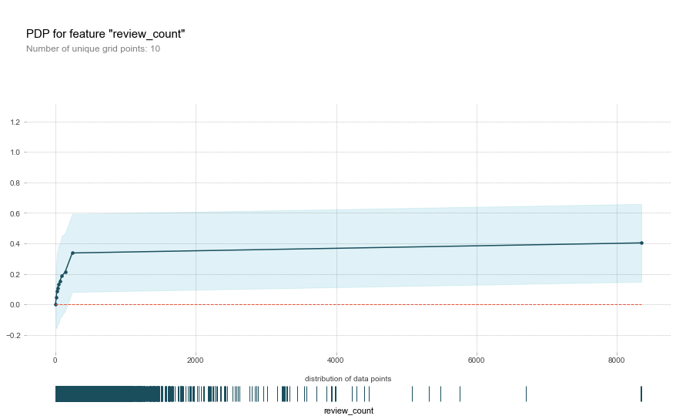
Result
The number of review counts has a positive impact on the likelihood of a restaurant being open. This positive impact is especially when the number of review counts is below 200.

Slide 5
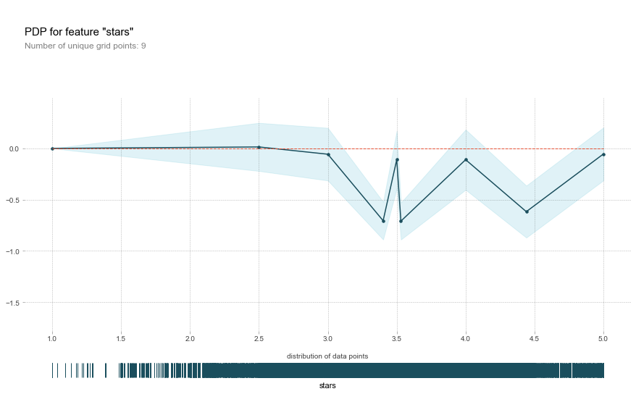
Result
The number of stars has a negative impact on the likelihood of a restaurant being open. This negative impact is especially when the number of starts is from 3.0 to 3.5, 4.0 to 4.5 .

Slide 6
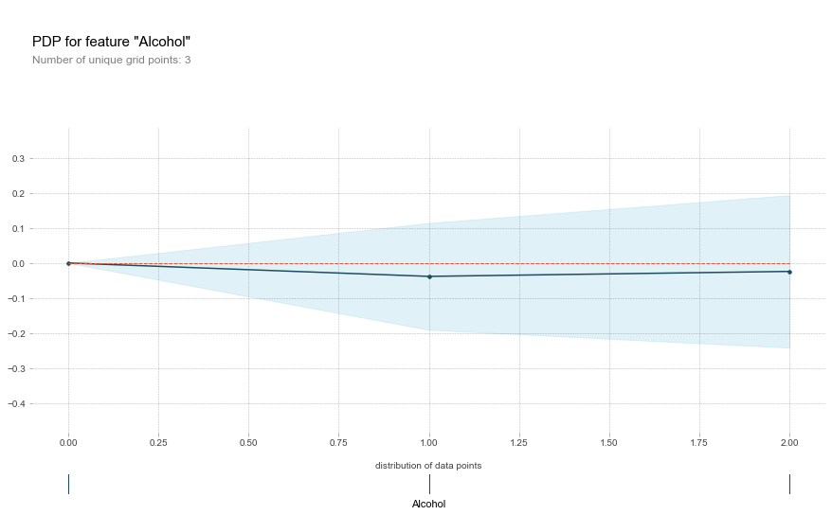
Result
The number of Alcohol has a negative impact on the likelihood of a restaurant being open. This negative impact is especially when the number of Alcohol is equal to 1(beer and wine).

Slide 7
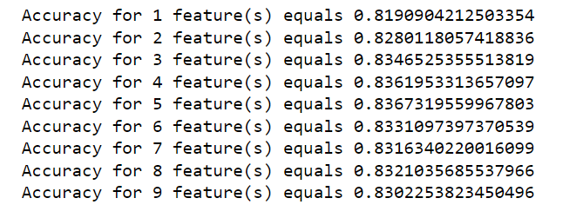
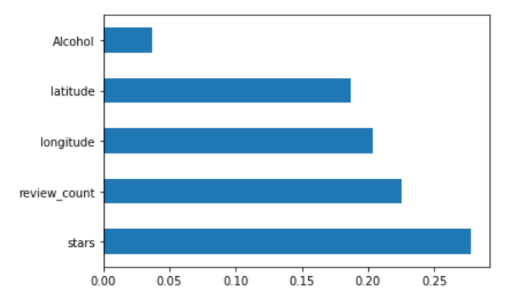
Result
Identify the best random forest model and plot the features importance scores for the best random forest model. We can see that when the max_features is equal to 5, the accuracy is 0.8367.

Slide 8
Thanks for Your Watching!
Data from:
https://www.kaggle.com/datasets/yelp-dataset/yelp-dataset/versions/6?select=yelp_business_attributes.csv
https://www.kaggle.com/datasets/yelp-dataset/yelp-dataset/versions/6?select=yelp_business.csv
Concept from:
Jiawei Han, Micheline Kamber, and Jian Pei. Data Mining: Concepts and Techniques. Morgan Kaufmann, 3rd ed., 2011
https://www.youtube.com/watch?v=cIbj0WuK41w

