Slide 1

Python Programming: An Introduction To Computer Science
Lecture 6 Python FIles
YUKSEL

Slide 2
What is a file?
A file is a collection of data that is stored on secondary storage like a disk or a thumb drive accessing a file means establishing a connection between the file and the program and moving data between the two.

Slide 3
Two types of files
Files come in two general types:
Text files: Files where control characters such as “\n" are translated. This are generally human readable
Binary files: All the information is taken directly without translation. Not readable and contains non-readable info.

Slide 4
File Objects or stream
When opening a file, you create a file object or file stream that is a connection between the file information on disk and the program.
The stream contains a buffer of the information from the file, and provides the information to the program

Slide 5
Figure 6.1 Input-output streams.

Slide 6
Buffering
Reading from a disk is very slow. Thus the computer will read a lot of data from a file in the hopes that, if you need the data in the future, it will be buffered in the file object.
This means that the file object contains a copy of information from the file called a cache.

Slide 7
Making a file object
my_file = open("my_file.txt", "r")
my_file is the file object. It contains the buffer of information.
The open function creates the connection between the disk file and the file object.
The first quoted string is the file name on disk, the second is the mode to open it (here,"r" means to read)

Slide 8
close
- When the program is finished with a file, we close the file
- Flush the buffer contents from the computer to the file
- Tear down the connection to the file
close is a method of a file object.
file_obj.close()
All files should be closed!

Slide 9
Where is the disk file?
When opened, the name of the file can come in one of two forms:
"file.txt" assumes the file name is file.txt and it is located in the current program directory
"c:\bill\file.txt" is the fully qualified file name and includes the directory information

Slide 10
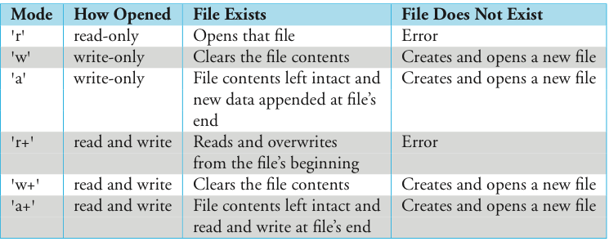
Different modes
Table 6.1 File modes.

Slide 11
Careful with write modes
Be careful if you open a file with the 'w' mode. It sets an existing file’s contents to be empty, destroying any existing data.
The 'a' mode is nicer, allowing you to write to the end of an existing file without changing the existing contents

Slide 12
Text files use strings
If you are interacting with text files remember that everything is a string
Everything we read is a string
If you write to a file, you can only write a string

Slide 13
Writing to a file
Once you have created a file object, opened for reading, you can use the print command
you add file=file to the print command

Slide 14
Reading from a file
Let’s say we have a file phonebook.txt
Yuksel: 9171111111
Smith: 6461111111
Johnson: 2121111111

Slide 15
Reading from a file
Let’s say we have a file phonebook.txt
Yuksel: 9171111111
Smith: 6461111111
Johnson: 2121111111
phonebook= open(“phonebook.txt”,”r”)
print(phonebook.read())
Yuksel: 9171111111
Smith: 6461111111
Johnson: 2121111111

Slide 16
Reading from a file
phonebook= open(“phonebook.txt”,”r”)
print(phonebook.readline())
Yuksel: 9171111111
print(phonebook.readline())
Smith: 6461111111
print(phonebook.readline())
Johnson: 2121111111

Slide 17
Reading from a file
phonebook= open(“phonebook.txt”,”r”)
print(phonebook.readlines())
['Yuksel: 9171111111\n', 'Smith: 6461111111\n', 'Johnson: 2121111111']

Slide 18
Reading from a file
Let’s try this one more time.
print(phonebook.read())
‘ ‘
Why?
We are in the end of the file after using read() method.
We need to rewind the file.
phonebook.seek(0) zeroth byte of the file.
phonebook.tell() tells us where we are in the file, bytewise

Slide 19
Making changes in the files
with open(”phonebook.txt", "a") as f:
f.write(“\nThompson: 2122222222”)

Slide 20
Making changes in the files
with open(”phonebook.txt", "a") as f:
f.write(“\nThompson: 2122222222”)
Now our file is:
Yuksel: 9171111111
Smith: 6461111111
Johnson: 2121111111
Thompson: 2122222222

Slide 21
Making changes in the files
What if we want to make a change in the beginning of the file?
Such as:
Jackson: 2122221222
Yuksel: 9171111111
Smith: 6461111111
Johnson: 2121111111
Thompson: 2122222222

Slide 22
Making changes in the files
with open(”phonebook.txt", “r+") as f:
data1 = f.read()
f.seek(0)
f.write(“Jackson: 2122221222\n”+data1)

Slide 23
Making changes in the files
with open(”phonebook.txt", “r+") as f:
data1 = f.read()
f.seek(0)
f.write(“Jackson: 2122221222\n”+data1)
Now our file is:
Jackson: 2122221222
Yuksel: 9171111111
Smith: 6461111111
Johnson: 2121111111
Thompson: 2122222222

Slide 24
More on print() function.
>>> print("http://", "www.", "google.", "com")
>>> print("http://", "www.", "google.", "com", sep=" ”)
>>> print("U", "S", "A”, sep=".")
U.S.A
>>> print("one","two","three",sep=" sheep jumped over over the fence \n")
one sheep jumped over over the fence
two sheep jumped over over the fence
three

Slide 25
More on print() function.
>>> print(“N”, “Y”, sep=“none”)
N Y ?
>>> print(“N”, “Y”, sep=?)
NY
>>> print(“Today is Tuesday”, end="\n")
Today is Tuesday
print("today is Tuesday", end=".");print("tomorrow is Wednesday.")
today is Tuesday.tomorrow is Wednesday

Slide 26
More on print() function
If we want, we can print something to a file by using print() function.
>>> file1= open(”file1.txt", "w")
>>> print(“My name is Python, Monty Python!”, file=file1)
>>> file1.close()

Slide 27
More on print() function
>>> f = open(”private_information.txt", "w")
>>> print(“Very private information 1”, file=f)
>>> print(“Very private information 2”, file=f)
>>> print(“Very private information 3”, file=f)
Now check if your file contains these lines..

Slide 28
More on print() function
>>> f = open(”private_information.txt", "w")
>>> print(“Very private information 1”, file=f)
>>> print(“Very private information 2”, file=f)
>>> print(“Very private information 3”, file=f)
Now check if your file contains these lines..
It does not. Until you close the file.
>>> f.close()

Slide 29
More on print() function
>>> f = open("private_information.txt", "w")
>>> print("Very private information 1", file=f)
>>> print("Very private information 2", file=f)
>>> print("Very private information 3", file=f)
Now check if your file contains these lines..
It does not. Until you close the file.
>>> f.close()
However, if you do not want to open-close file continuously;

Slide 30
More on print() function
>>> print(“Very private information”, file=f, flush=True)
Now the file will contain this line above without closing the file.
Please note that flush is False by default.

Slide 31
More on print() function
So
print(“A horse, a horse! My kingdom for a horse!”)
Is actually:
print("A horse, a horse! My kingdom for a horse!", sep=" ", end="\n", file=sys.stdout)

Slide 32
More on print() function
N
E
W
Y
O
R
K
N E W Y O R K M E T S

Slide 33
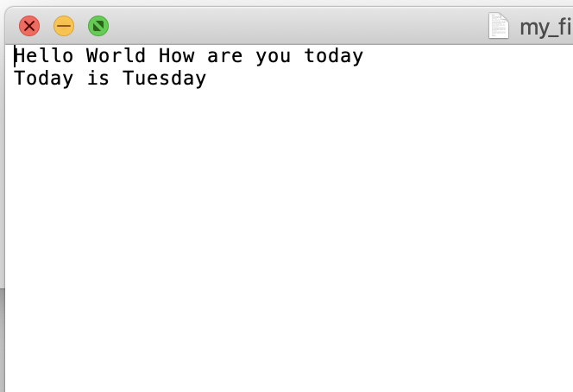
Exercise
Make a list for each line of a file, where each element of a list is a word of the text file.

Slide 34
Exercise Time

Slide 35
Word Puzzle
The following listings show how one might solve the following puzzle:
Look through a file of words, one word per line, and identify any English word that has all the vowels in order, with only one example of each vowel.
For example, “abstemious”, “facetious”, “abstentious”

Slide 36
Hints
You can consider strings as character sets, and files as word sets for FOR loops, and IF statements;
# if character in string
# for character in string
To measure the length of a string; len(string)
To concatenate strings you can use + operator
You can consider every word contains lowercase letters. If not, you should convert them to lowercase letters.
Some useful string methods:
string.lower() convert all characters to lowercase.
string.strip() #removes leading and ending white space

