Slide 1
Materials: sklearn
Zehao Dou
2018.5.20

Slide 2
1. Installation
http://scikit-learn.org/stable/install.html
pip install –U scikit-learn 或 pip install scikit-learn
如果想要安装全部的内容:
pip install scikit-learn[alldeps]

Slide 3
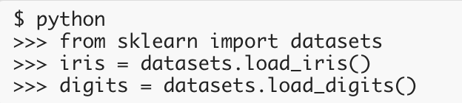
2. Introduction
Scikit-learn package is used for various machine learning algorithms, which range from classification, regression to clustering
Scikit-learn has a few standard datasets, for example the iris and digits for classification and the boston house prices dataset for regression.

Slide 4

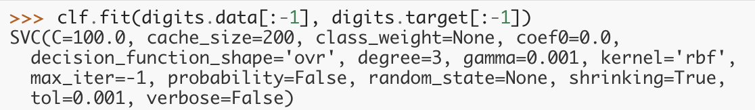

3. Examples of SVM algorithm
Using SVM to classify hand-writing digits
Import svm and set parameters
Fit data and labels
Predict

Slide 5
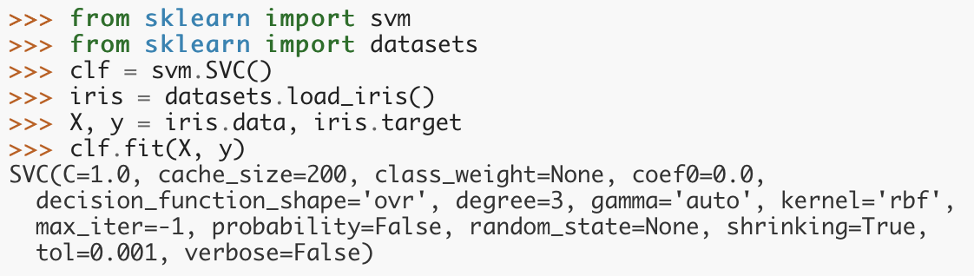
For iris dataset, we can do the same

Slide 6
4. Save our models
However, when we are dealing with huge amount of data, joblib is more efficient than pickle
Save our model to a file
Load our model back

Slide 7
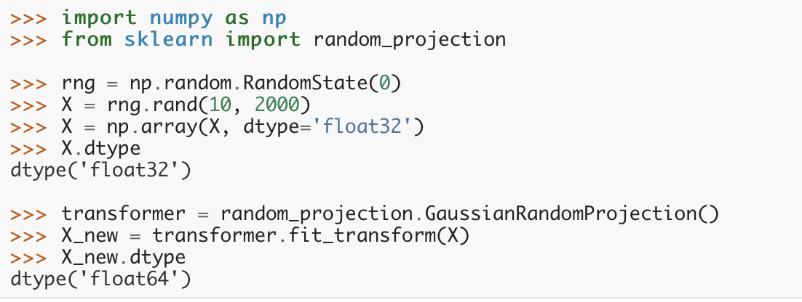
5. Some conventions
All the input will be cast to float64 unless otherwise specified
If our input is of other type, we need to transform it.
***

Slide 8
5. Some conventions
If we fit our model twice, the previous learned model will be overwritten.
Pay attention to the function“set_params”which can be used to set parameters different from the previously set one

Slide 9
