Slide 1
DataBuster Team 04
Alyssa Cheong, Shannon Kwok, Vanisha Muthu, Wang Yifei

Slide 2
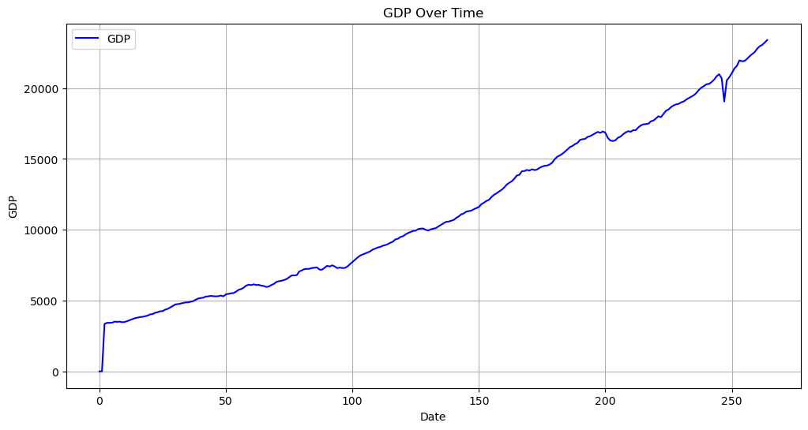
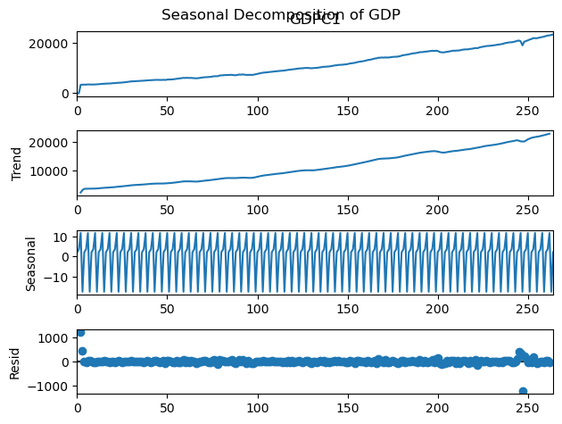
Descriptive statistics
GDP shows a growing trend.
The strong periodic fluctuations suggest a significant seasonal effect in GDP, possibly due to quarterly or yearly economic cycles.
Residuals or noises after removing trend and seasonality centered at 0.
GDP needs to be stationarised before building of our model.

Slide 3
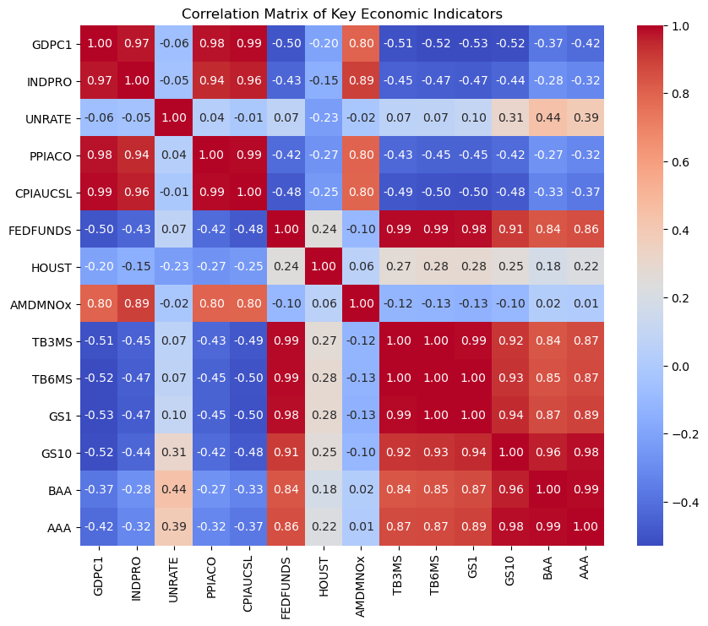
Descriptive statistics
We selected a variables including unemployment rate, Industrial Production index and Housing Starts Total and plotted heat map to explore the correlation between them.
For variables such as GS1, GS10, BAA and AAA are closely correlated with each other.
However, some of the variables do not show strong correlation to GDP.
These suggest that transformation of variables is necessary before deeper analysis.

Slide 4
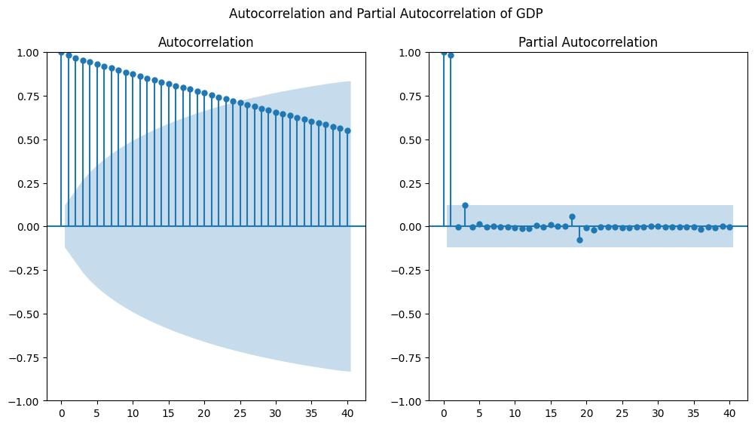
Descriptive statistics
The left Autocorrelation measures the correlation between GDP and its past lags.
The plot shows a slow decay in autocorrelation values, however the values are highly positive, which suggests that GDP is non-stationary.
The right partial autocorrelation function shows the direct effect of past values on the present GDP.
It shows that the first and second lags are highly significant, meaning GDP at time t is strongly affected by the immediate past values.

Slide 5

Descriptive Statistics for x-variables
Variable | GDPC1 | UNRATE | PPIACO | CPIAUCSL | FEDFUNDS
Count | 132 | 132 | 132 | 132 | 132
mean | 0.046220 | 0.022980 | 0.045775 | 0.045846 | 6.924649
std | 0.434571 | 0.401909 | 0.524388 | 0.524239 | 3.459914
min | -0.020820 | -0.833400 | -0.049000 | -0.014591 | 1.000000
25% | 0.003073 | -0.200000 | -0.005837 | -0.002008 | 4.171650
50% | 0.008312 | -0.033300 | -0.000006 | 0.000000 | 6.365000
75% | 0.015784 | 0.133400 | 0.007674 | 0.003472 | 8.950825
max | 5.000000 | 2.000000 | 6.000000 | 6.000000 | 17.780000
Notes:
Descriptive Statistics
Count: We have data for 132 observations across all variables.
Mean: Shows the average value for each variable over the period.
Standard Deviation: Indicates the extent of variability or dispersion in the data.
Minimum and Maximum: Highlight the range within which the observations fall.
Percentiles (25th, 50th, 75th): Offer insights into the distribution of data points, dividing them into quarters.

Slide 6
Descriptive Statistics for x-variables
Variable | HOUST | AMDMNOx | TB3MS | TB6MS | GS1
Count | 132 | 132 | 132 | 132 | 132
mean | 0.034408 | 157471.230705 | 6.247524 | 0.032803 | 0.033208
std | 0.445484 | 42581.596191 | 2.827154 | 0.868122 | 0.903193
min | -0.231094 | 1.000000 | 1.000000 | -3.633300 | -3.650000
25% | -0.066859 | 130465.836850 | 4.227500 | -0.354125 | -0.358275
50% | 0.005946 | 166869.148000 | 5.711650 | 0.081650 | 0.101700
75% | 0.061114 | 193355.084750 | 7.750025 | 0.438350 | 0.467525
max | 5.000000 | 226344.007000 | 15.053300 | 3.910000 | 3.703300

Slide 7
Descriptive Statistics for x-variables
Variable | GS10 | BAA | AAA
Count | 132 | 132 | 132
mean | 0.045076 | 0.051616 | 0.050430
std | 0.553594 | 0.468701 | 0.456963
min
25% | -0.296700 | -0.265800 | -0.247450
50% | 0.021700 | -0.035000 | -0.068350
75% | 0.220000 | 0.176700 | 0.179125
max | 1.016600 | 1.633300 | 0.840000

Slide 8
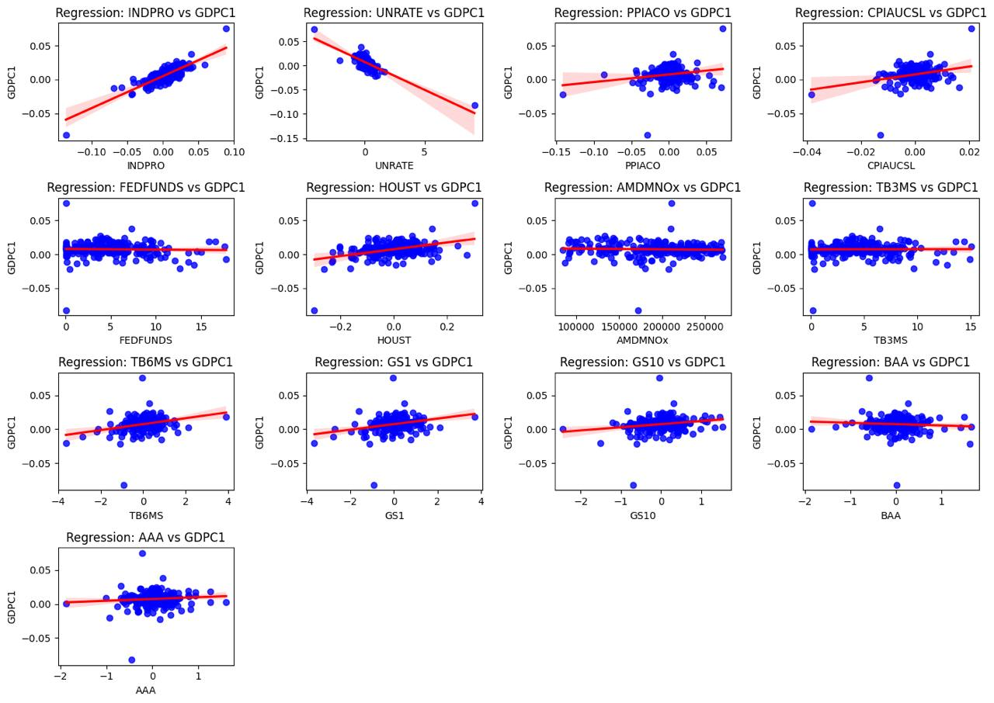
Scatter Plots of GDPC1 against x-variables (Quarterly)

Slide 9
Modelling methods:
Data filtering and Data selection (Quarterly)
1. Data Filtering and Feature Selection
Selected Variables: We filtered the dataset to include key economic indicators:
Real GDP (GDPC1)
Industrial Production (INDPRO)
Unemployment Rate (UNRATE)
Producer Price Index (PPIACO)
Consumer Price Index (CPIAUCSL)
Federal Funds Rate (FEDFUNDS)
Housing Starts (HOUST)
Manufacturing New Orders (AMDMNOx)
Interest Rates (TB3MS, TB6MS, GS1, GS10)
Corporate Bond Yields (BAA, AAA)
These variables were chosen based on their relevance to economic contractions and their correlations with GDP growth.

Slide 10
Modelling methods:
Data filtering and Data selection (Monthly)
1. Data Filtering and Feature Selection
Selected Variables: We filtered the dataset to include key economic indicators:
Industrial Production (INDPRO)
Unemployment Rate (UNRATE)
Consumer Price Index (CPIAUCSL)
Federal Funds Rate (FEDFUNDS)
Housing Starts (HOUST)
Manufacturing New Orders (AMDMNOx)
Interest Rates (TB3MS, TB6MS, GS1, GS10)
Corporate Bond Yields (BAA, AAA)
In monthly dataset, there is no GDPC1 and PPIACO. Hence, we retained all the other variables used for quarterly analysis except for these two.

Slide 11
Modelling methods:
Change of model (Monthly)
Due to the absence of the GDPC1 variable in the monthly data, we chose another variable which is INDPRO to be our y-variable, as we found that it is more closely correlated with GDPC1, compared to our other selected x-variables.
We then plan to use the INDPRO y-variable to predict whether there is an economic downturn in the short-term within the 3 quarters.
Notes:
Positive linear relationship with GDPC1 → shows the same trend

Slide 12
Modelling methods:
Autoregressive Distributed Lag (ADL)
Why ADL?
ADL models are well-suited for capturing dynamic relationships between economic variables over time.
They allow for both lagged dependent variables (e.g., past GDP) and lagged independent variables (e.g., unemployment rate, inflation).
Optimal Lag Selection:
Used the Bayesian information criterion (BIC) to determine the optimal number of lags.
We implemented BIC on each variable and found that the optimal number of lags for all the variables is 1.
We chose BIC over AIC because when dealing with large datasets, BIC is preferred due to its tendency to select simpler models with fewer parameters, reducing the risk of overfitting.

Slide 13
Modelling methods:
Root Mean Squared Forecast Error (RMSFE)
Evaluation Metric:
RMSFE was calculated to assess the accuracy of our forecasts.
It is a measure of the magnitude of a forecasting mistake.
We selected RMSFE instead of MSFE because the error provided is in the same units as the original GDP variable, allowing for easier interpretation.
We obtained a RMSFE of 0.00195, which is quite small compared to the values of the GDP, hence the model is relatively accurate.

Slide 14
Modelling methods:
Future Improvements
Recursive cross-validation
A time-series validation technique where the model is trained on an expanding window of data and tested on a fixed horizon.
Better simulates real-world forecasting, where models are updated as new data becomes available.

Slide 15
Key results
Best AIC (Quarterly): -1990.53
Best BIC (Quarterly): -1868.57
Best lag for GDP from BIC (Quarterly): 1
Best lag for x-variables from BIC (Quarterly): 1
RMSFE: 0.00195

Slide 16
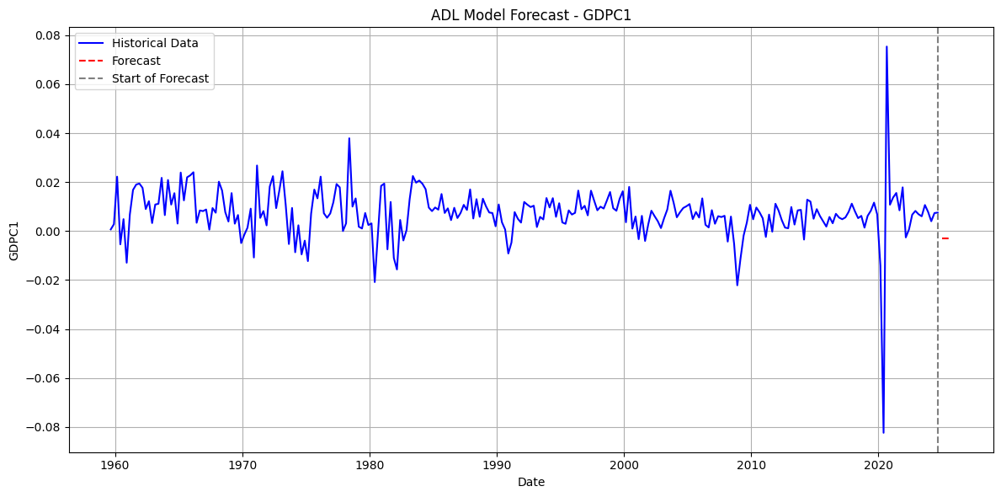
Key results
Forecasted value for Q1, 2025: -0.29% (log difference: -0.002909)
Forecasted value for Q2, 2025: -0.29% (log difference: -0.002909)
Forecasted value for Q4, 2025: -0.29% (log difference: -0.002909)
We conclude that an economic contraction is likely to occur at all of the above forecast horizons.

