Slide 1
Statistics with Spa ows
Lecture 11-b
Julia Schroeder
Julia.schroeder@imperial.ac.uk

Slide 2
Outline
Linear models – going big
Categorical and continuous predictors

Slide 3
Multiple linear models
lm(response~explanatory)

Slide 4
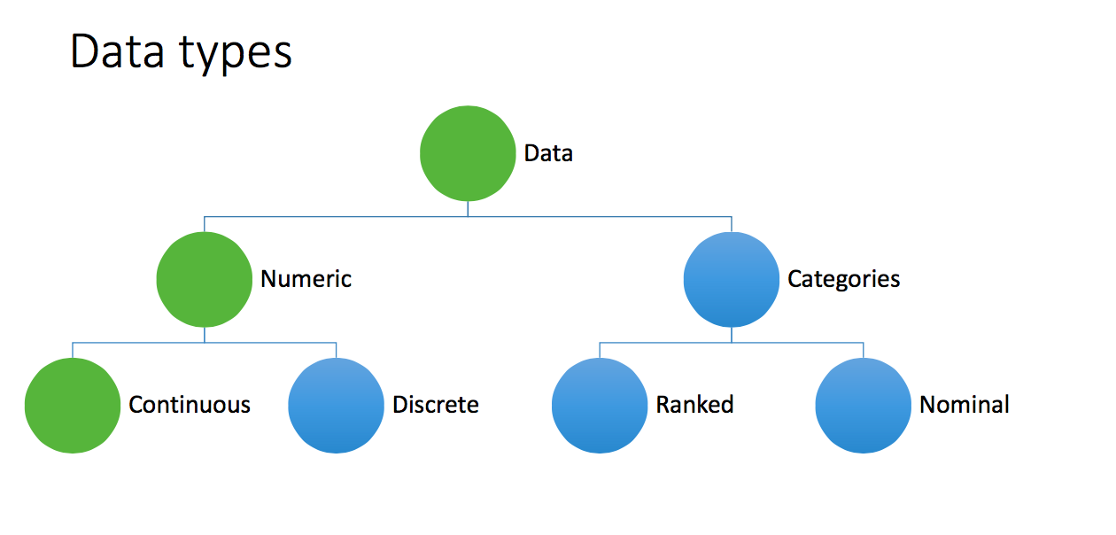
Multiple linear models
lm(response~explanatory)

Slide 5
Multiple linear models
Response y:
Continuous
Explanatory x:
Continuous (tarsus, wing, mass)
Categorical (Sex, Year, Observer, BirdID)
lm(response~explanatory)

Slide 6
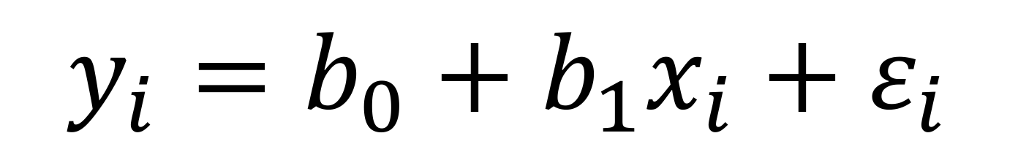
Multiple linear models
Response y:
Continuous
Explanatory x:
Continuous (tarsus, wing, mass)
Categorical (Sex, Year, Observer, BirdID)
lm(response~explanatory)
$$y_{i}=b_{0}+b_{1}x_{i}+ε_{i}$$

Slide 7
Multiple linear models
Response y:
Continuous
Explanatory x:
Continuous (tarsus, wing, mass)
Categorical (Sex, Year, Observer, BirdID)
lm(response~explanatory)
$$y_{i}=b_{0}+b_{1}x_{i}+ε_{i}$$
$$y_{i}=b_{0}+b_{1}x_{i0}+b_{2}x_{i1}+b_{3}x_{i2}+ε_{i}$$

Slide 8
Multiple linear models
Response y:
Continuous
Explanatory x:
Continuous (tarsus, wing, mass)
Categorical (Sex, Year, Observer, BirdID)
lm(response~explanatory)
We can have more than one explanatory variable!
$$y_{i}=b_{0}+b_{1}x_{i0}+b_{2}x_{i1}+b_{3}x_{i2}+ε_{i}$$

Slide 9
Multiple linear models
Response y:
Continuous
Explanatory x:
Continuous (tarsus, wing, mass)
Categorical (Sex, Year, Observer, BirdID)
lm(response~explanatory)
We can have more than one explanatory variable!
We can even mix continuous and factorial explanatory variables!
$$y_{i}=b_{0}+b_{1}x_{i0}+b_{2}x_{i1}+b_{3}x_{i2}+ε_{i}$$

Slide 10
Let’s try this
b₀ = intercept
b₁ = estimates effect of continuous variable x₀
b₂ = estimates effect of 2-level factor x₁
$$y_{i}=b_{0}+b_{1}x_{i0}+b_{2}x_{i1}+ε_{i}$$

Slide 11
Let’s try this
b₀ = intercept
b₁ = estimates effect of continuous variable x₀ (tarsus)
b₂ = estimates effect of 2-level factor x₁ (sex)
$$y_{i}=b_{0}+b_{1}x_{i0}+b_{2}x_{i1}+ε_{i}$$

Slide 12
Let’s try this
b₀ = intercept
b₁ = estimates effect of continuous variable x₀ (tarsus)
b₂ = estimates effect of 2-level factor x₁ (sex)
Sex will be re-coded internally. Females are 0 (and blue).
$$y_{i}=b_{0}+b_{1}x_{i0}+b_{2}x_{i1}+ε_{i}$$

Slide 13
Let’s try this
$$y_{i}=b_{0}+b_{1}x_{i0}+b_{2}x_{i1}+ε_{i}$$

Slide 14
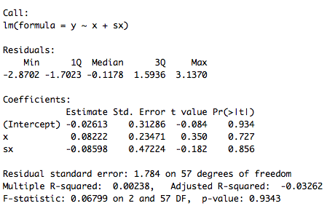
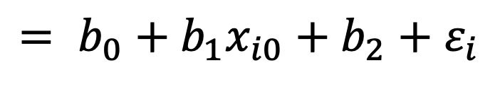
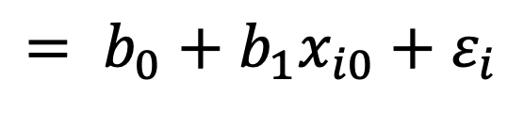
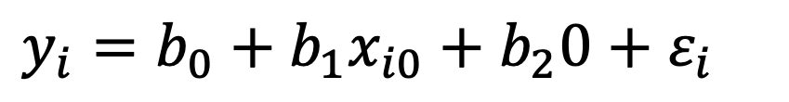
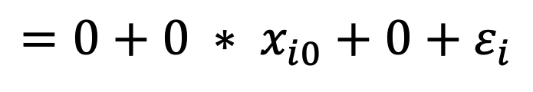
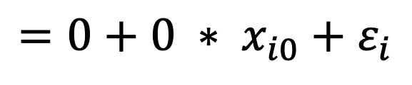
$$y_{i}=b_{0}+b_{1}x_{i0}+b_{2}x_{i1}+ε_{i}$$
Sex:
Female (x_{i2} = 0)
Male (x_{i2} = 1)
$$y_{i}=b_{0}+b_{1}x_{i0}+b_{2}0+ε_{i}$$
$$= b_{0}+b_{1}x_{i0}+ε_{i}$$
$$= b_{0}+b_{1}x_{i0}+b_{2}+ε_{i}$$
$$y_{i}=b_{0}+b_{1}x_{i0}+b_{2}∗1+ε_{i}$$
Female (x_{i2} = 0)
Male (x_{i2} = 1)
$$=0+0 ∗ x_{i0}+ε_{i}$$
$$=0+0 ∗ x_{i0}+0+ε_{i}$$

Slide 15
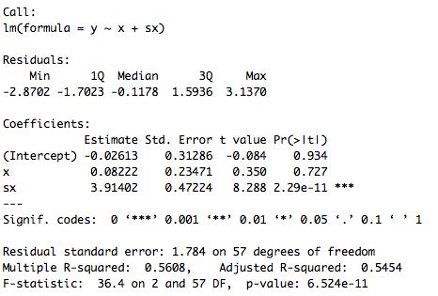
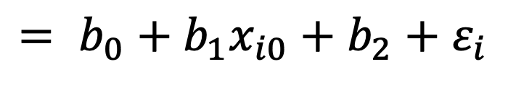
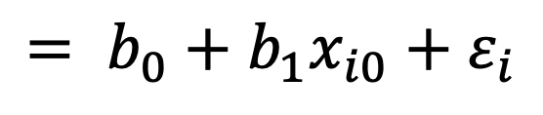
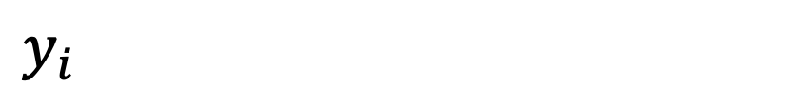
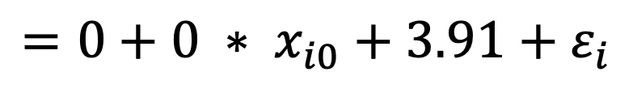
Sex:
Female (x_{i2} = 0)
Male (x_{i2} = 1)
$$y_{i}$$
$$= b_{0}+b_{1}x_{i0}+ε_{i}$$
$$y_{i}$$
$$= b_{0}+b_{1}x_{i0}+b_{2}+ε_{i}$$
Female (x_{i2} = 0)
Male (x_{i2} = 1)
$$=0+0 ∗ x_{i0}+ε_{i}$$
$$=0+0 ∗ x_{i0}+3.91+ε_{i}$$

Slide 16
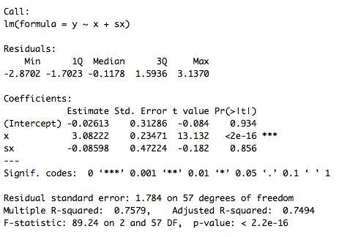
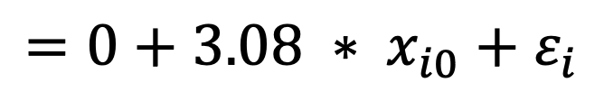
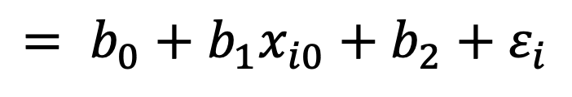
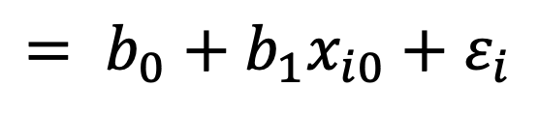
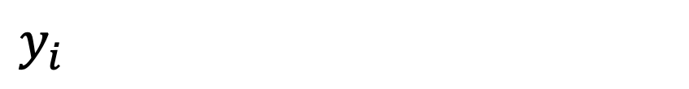
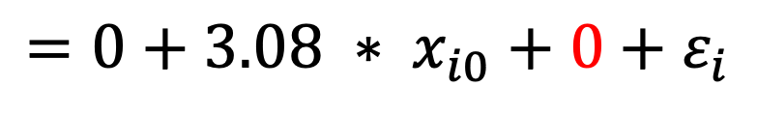
Sex:
Female (x_{i2} = 0)
Male (x_{i2} = 1)
$$y_{i}$$
$$= b_{0}+b_{1}x_{i0}+ε_{i}$$
$$= b_{0}+b_{1}x_{i0}+b_{2}+ε_{i}$$
$$y_{i}$$
Female (x_{i2} = 0)
Male (x_{i2} = 1)
$$=0+3.08 ∗ x_{i0}+ε_{i}$$
$$=0+3.08 ∗ x_{i0}+0+ε_{i}$$

Slide 17
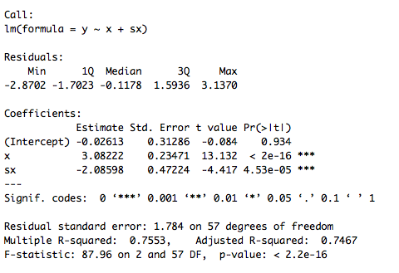
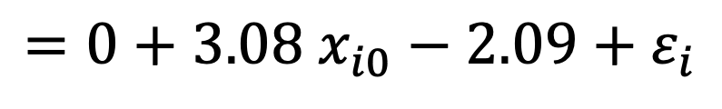
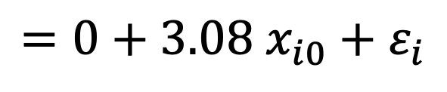
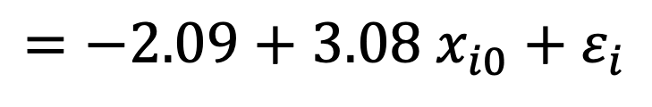
Sex:
Female (x_{i2} = 0)
Male (x_{i2} = 1)
$$y_{i}$$
$$= b_{0}+b_{1}x_{i0}+ε_{i}$$
$$= b_{0}+b_{1}x_{i0}+b_{2}+ε_{i}$$
$$y_{i}$$
Female (x_{i2} = 0)
Male (x_{i2} = 1)
$$=0+3.08 x_{i0}+ε_{i}$$
$$=0+3.08 x_{i0}−2.09+ε_{i}$$
$$=−2.09+3.08 x_{i0}+ε_{i}$$

Slide 18
Ok
We can estimate two different intercepts
We can estimate one slope and two intercepts
How can we estimate a separate slope for each sex?

Slide 19
Interactions of terms:
$$y_{i}=b_{0}+b_{1}x_{i0}+b_{2}x_{i1}+ε_{i}$$
$$y_{i}=b_{0}+b_{1}x_{i0}+b_{2}x_{i1}+b_{3}x_{i0}x_{i1}+ε_{i}$$
interaction between sex and tarsus
one more parameter estimate
one more degree of freedom
but not more variables

Slide 20
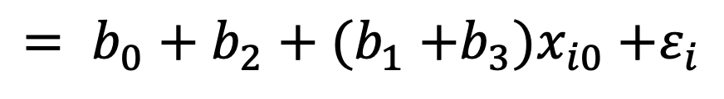
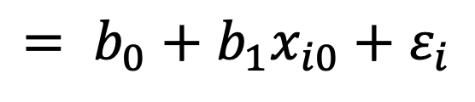
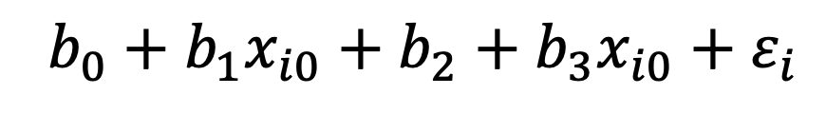
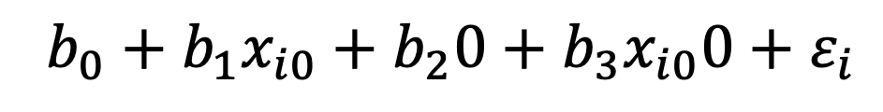
Sex:
Female (x_{i2} = 0)
Male (x_{i2} = 1)
$$y_{i}=b_{0}+b_{1}x_{i0}+b_{2}x_{i1}+b_{3}x_{i0}x_{i1}+ε_{i}$$
$$b_{0}+b_{1}x_{i0}+b_{2}0+b_{3}x_{i0}0+ε_{i}$$
$$= b_{0}+b_{1}x_{i0}+ε_{i}$$
$$b_{0}+b_{1}x_{i0}+b_{2}+b_{3}x_{i0}+ε_{i}$$
$$= b_{0}+b_{2}+(b_{1}{+b_{3})x}_{i0}+ε_{i}$$

Slide 21
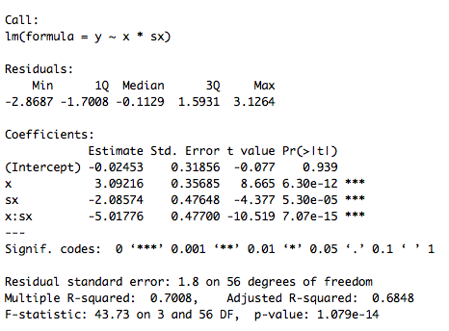
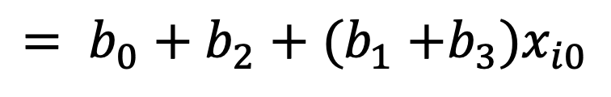
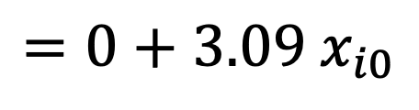
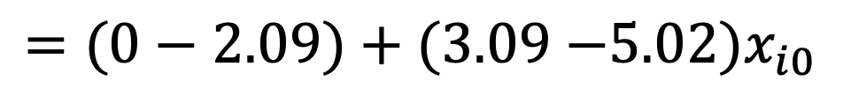
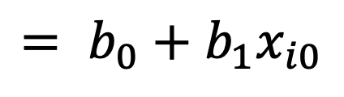
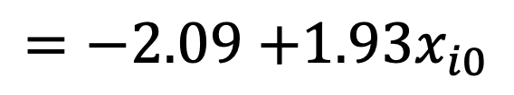
$$y_{i}=b_{0}+b_{1}x_{i0}+b_{2}x_{i1}+b_{3}x_{i0}x_{i1}+ε_{i}$$
Female (x_{i2} = 0)
Male (x_{i2} = 1)
$$= b_{0}+b_{1}x_{i0}$$
$$=0+3.09 x_{i0}$$
$$= b_{0}+b_{2}+(b_{1}{+b_{3})x}_{i0}$$
$$=(0−2.09)+(3.09{−5.02)x}_{i0}$$
$$=−2.09{+1.93x}_{i0}$$

Slide 22
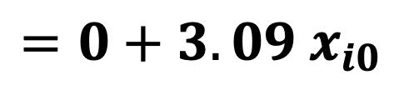
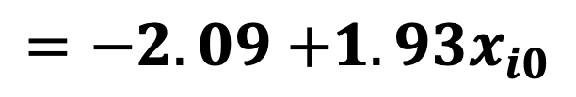
$$y_{i}=b_{0}+b_{1}x_{i0}+b_{2}x_{i1}+b_{3}x_{i0}x_{i1}+ε_{i}$$
Female (x_{i2} = 0)
Male (x_{i2} = 1)
$$= b_{0}+b_{1}x_{i0}$$
$$=0+3.09 x_{i0}$$
$$= b_{0}+b_{2}+(b_{1}{+b_{3})x}_{i0}$$
$$=(0−2.09)+(3.09{−5.02)x}_{i0}$$
$$=−2.09{+1.93x}_{i0}$$

Slide 23
Let’s try this
$$y_{i}=b_{0}+b_{1}x_{i0}+b_{2}x_{i1}+b_{3}x_{i0}x_{i1}+ε_{i}$$
Intercept: b₀ reference group, b₂: difference of group 1 to reference
Slope: b₁ slope of reference group, b3 difference of slope of group 1 to reference
Do not interpret estimates by themselves!

Slide 24
$$y_{i}=b_{0}+b_{1}x_{i0}+b_{2}x_{i1}+b_{3}x_{i0}x_{i1}+ε_{i}$$
plot | a | b | c | d | e
Intercept
b₁ (sex) | 0 | + | 0 | + | +
b₂ (tarsus) | 0 | 0 | + | + | +
b₃ (tarsus x sex) | 0 | 0 | 0 | 0 | -
a
b
c
d
e

Slide 25
What else?
Interactions between continuous variables and categorical predictors with more than 2 levels
Multiple continuous predictors
Interactions between categorical predictors
→ hand outs!
Avoid (at all costs):
Interactions between 2 continuous predictors
3- or more-way interactions

Slide 26
Take home: categorical predictors:
Interpreting categorical x continuous predictor interactions
When interaction terms are present – never interpret the estimates in isolation
You will need to do some math's to interpret your results

