Slide 1
Statistics with Spa ows
Lecture 13
Julia Schroeder
Julia.schroeder@imperial.ac.uk

Slide 2
Outline
Repeatability
Pitfalls

Slide 3
Repeatability
How consistent something is within a group, compared to the whole sample

Slide 4
Repeatability
How consistent something is within a group, compared to the whole sample
Sounds familiar?

Slide 5

Repeatability
How consistent something is within a group, compared to the whole sample
Sounds familiar?
$$R= \frac{σ_{A}^{2}}{σ_{T}^{2}}$$

Slide 6
Repeatability
How consistent something is within a group, compared to the whole sample
Sounds familiar?
It’s the ratio of among-group variance over the total variance
$$R= \frac{σ_{A}^{2}}{σ_{T}^{2}}$$

Slide 7

Repeatability
How consistent something is within a group, compared to the whole sample
Sounds familiar?
It’s the ratio of among-group variance over the total variance
It’s got lots of interesting uses in biology.
$$R= \frac{σ_{A}^{2}}{σ_{A}^{2}+σ_{W}^{2}}$$

Slide 8
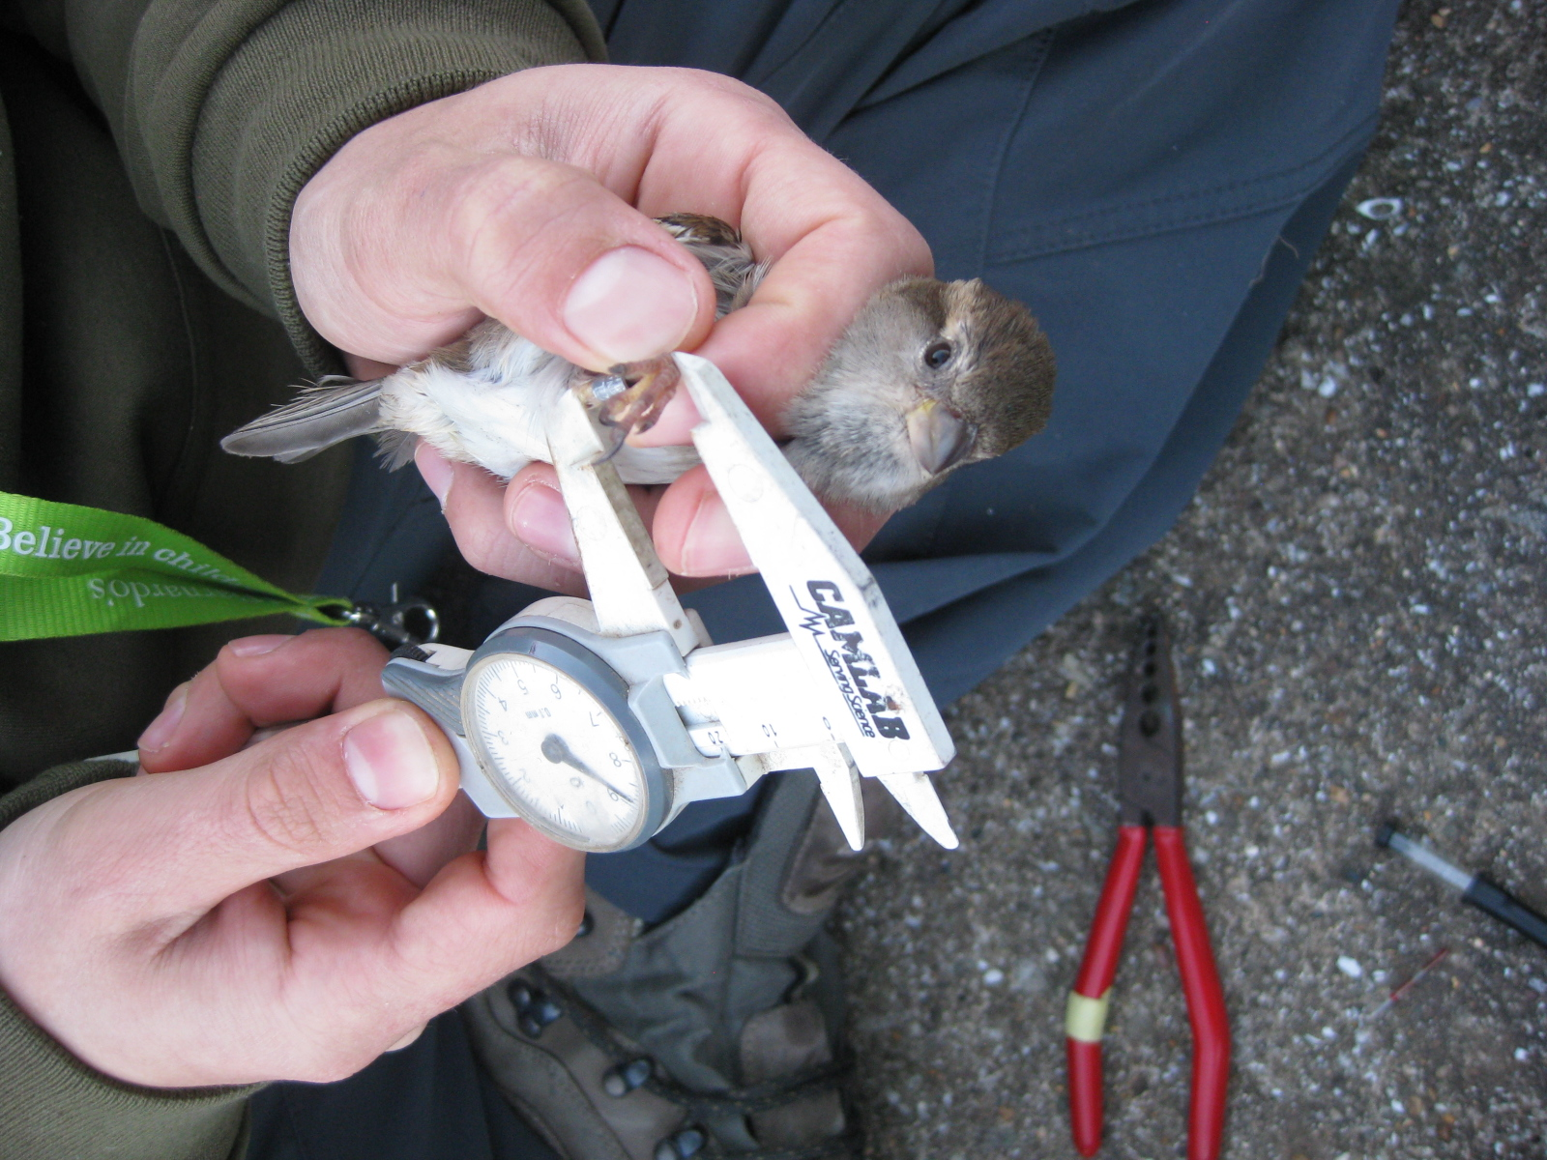
Observer repeatability
Measuring tarsus consistently is not easy
Some people measure it 3 times and take the mean
Are observers consistent in their measures?

Slide 9
Individual behaviour - personality
Do birds always behave the same way?
Different from others?

Slide 10
Ecology
If you calculate diversity indices, are the one in one region more alike than those between regions?

Slide 11
Ecology
If you calculate diversity indices, are the one in one region more alike than those between regions?
Is earthworm abundance consistent between day in the same plots?

Slide 12
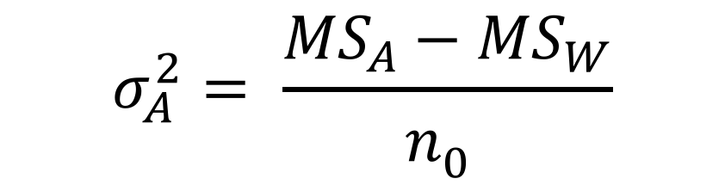
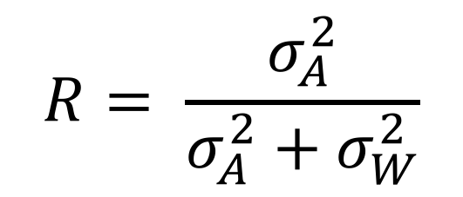

Repeatability calculated from ANOVA output
$$R= \frac{σ_{A}^{2}}{σ_{A}^{2}+σ_{W}^{2}}$$
$$σ_{A}^{2}= \frac{{MS}_{A}−{MS}_{W}}{n_{0}^{}}$$
$$σ_{W}^{2}={MS}_{W}$$

Slide 13
Repeatability calculated from ANOVA output
$$R= \frac{σ_{A}^{2}}{σ_{A}^{2}+σ_{W}^{2}}$$
$$σ_{A}^{2}= \frac{{MS}_{A}−{MS}_{W}}{n_{0}^{}}$$
$$σ_{W}^{2}={MS}_{W}$$

Slide 14
Repeatability calculated from ANOVA output
N₀ not sample size
Among-group variance difficult to compute (we’ve had trouble with SS before, remember!)

Slide 15
Repeatability calculated from ANOVA output
N₀ not sample size
Among-group variance difficult to compute (we’ve had trouble with SS before, remember!)
Balanced dataset
a_{i} =1,1,2,1,1,1
b_{i} =3,3,4,3,3,3
c_{i} =5,5,4,5,5,1

Slide 16
Repeatability calculated from ANOVA output
N₀ not sample size
Among-group variance difficult to compute (we’ve had trouble with SS before, remember!)
Unbalanced dataset
Heterogeneous dataset
a_{i} =1,1,2,1,1,1
b_{i} =3,3,4,3,3,3,4,2,5,5,7
c_{i} =5,5

Slide 17
Repeatability calculated from ANOVA output
N₀ not sample size
Among-group variance difficult to compute (we’ve had trouble with SS before, remember!)
Unbalanced dataset
Heterogeneous dataset
In ecology we have those often. In exact sciences less so (medicine, any planned experiments)
a_{i} =1,1,2,1,1,1
b_{i} =3,3,4,3,3,3,4,2,5,5,7
c_{i} =5,5

Slide 18
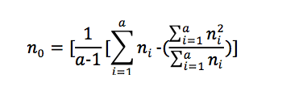
Repeatability calculated from ANOVA output
N₀ not sample size
Among-group variance difficult to compute (we’ve had trouble with SS before, remember!)
a = number of groups
n_{i} = sample size in each group i

Slide 19
LMMs
Linear mixed models
Combine linear models and variance analysis

Slide 20
Nested data structure
Repeated measures
Offspring in families
…

Slide 21
LMMs
$$y_{i,j}=b_{0}+b_{1}x_{i,j}+{α_{j}+ε}_{i,j}$$

Slide 22
LMMs
$$y_{i,j}=b_{0}+b_{1}x_{i,j}+{α_{j}+ε}_{i,j}$$
Linear model bit that we know
Estimates FIXED intercept, covariates and factors

Slide 23
LMMs
$$y_{i,j}=b_{0}+b_{1}x_{i,j}+{α_{j}+ε}_{i,j}$$
Random factor for a group j (i.e. BirdID)
Estimate variance component AMONG BIRDS

Slide 24
LMMs
$$y_{i,j}=b_{0}+b_{1}x_{i,j}+{α_{j}+ε}_{i,j}$$
Residual variance

Slide 25
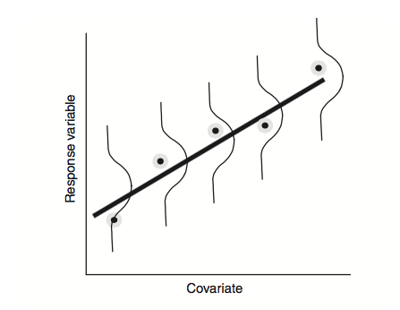
LMMs

Slide 26
LMMs
Estimate variance components and fixed parameter estimates simultaneously

Slide 27
LMMs
Estimate variance components and fixed parameter estimates simultaneously
Complicated but very useful

Slide 28
LMMs
Estimate variance components and fixed parameter estimates simultaneously
Complicated but very useful
Better than ANOVA

Slide 29
LMMs
Estimate variance components and fixed parameter estimates simultaneously
Complicated but very useful
Better than ANOVA

Slide 30
Linear mixed models:
Can deal with heterogenous datasets (unbalanced groups)
Estimates variance components and fixed effects at the same time

Slide 31
Comparing ANOVA vs Linear mixed model
multiple students measuring the tarus of one bird
→ observer repeatability describes how much variation is explained by different observers
Measurement of methodological precision
R = variance explained by student ID/total variance

Slide 32
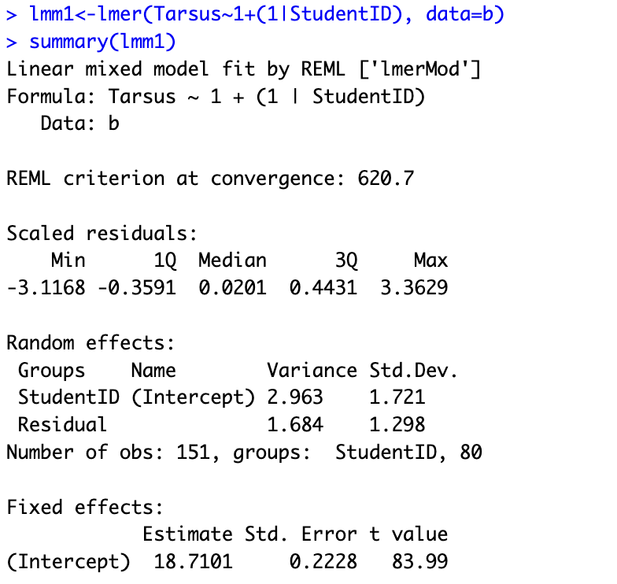
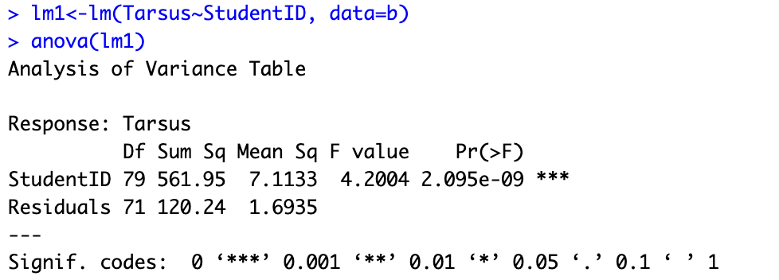
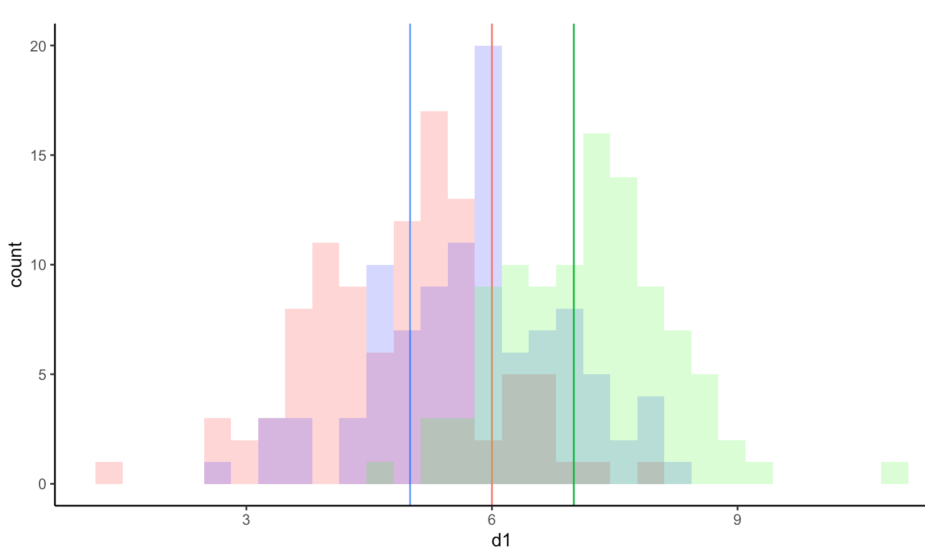
ANOVA vs. LMM
?
Sum
or
Var(Tarsus)

Slide 33

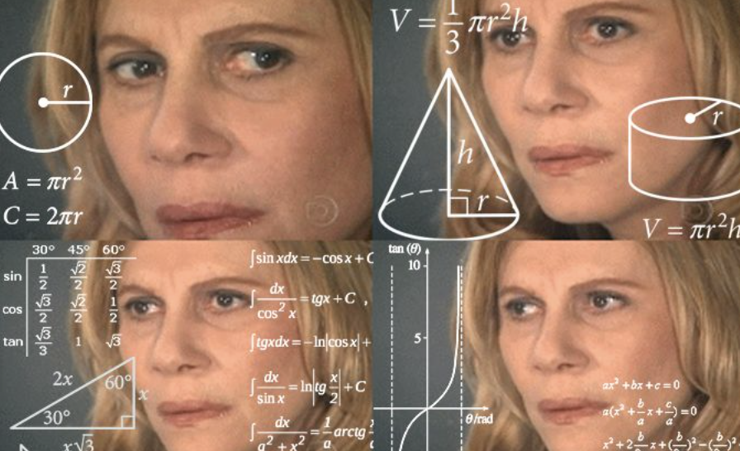

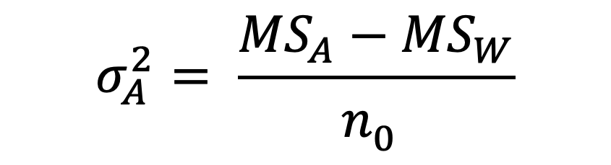
ANOVA
Repeatability:
$$R= \frac{σ_{A}^{2}}{σ_{A}^{2}+σ_{W}^{2}}$$
$$σ_{A}^{2}= \frac{{MS}_{A}−{MS}_{W}}{n_{0}^{}}$$
?

Slide 34
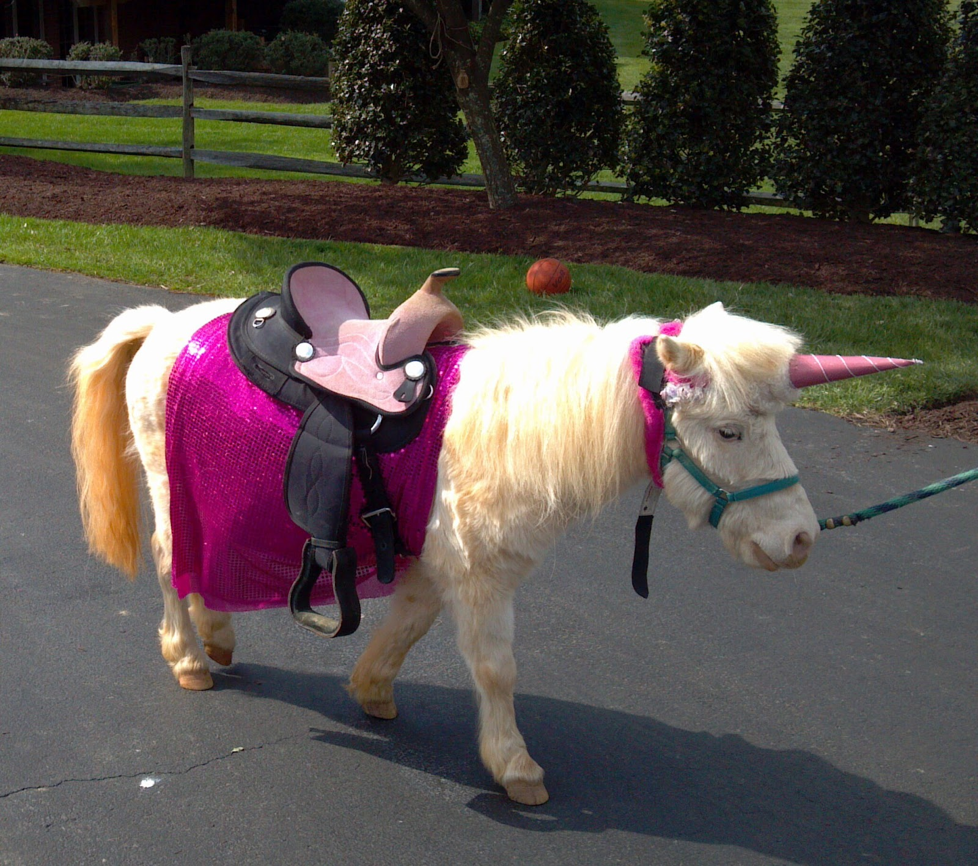
LMM
Repeatability: Var_{Among}/Var_{T}
2.96/(2.96+1.68) = 0.638
64% of variance in tarsus length is explained by differences in student measuring
Sum
or
Var(Tarsus)
This Photo by Unknown Author is licensed under CC BY

Slide 35
Learning aim
Repeatability is intra-class correlation coefficient
Ratio of how much variance is explained by groups
N₀ is horrible
Linear mixed models are better at estimating variance components than ANOVA

