Slide 1
Statistics with Spa ows
Lecture 14
Julia Schroeder
Julia.schroeder@imperial.ac.uk

Slide 2
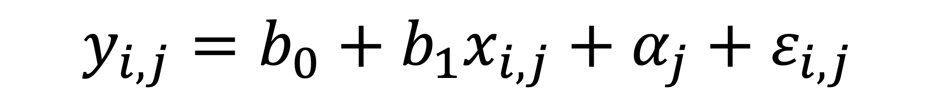
Linear mixed models
$$y_{i,j}=b_{0}+b_{1}x_{i,j}+{α_{j}+ε}_{i,j}$$

Slide 3
Linear mixed models – data structure
$$y_{i,j,k}=b_{0}+b_{1}x_{i,j,k}+{α_{1j}+α_{2k}+ε}_{i,j,k}$$
k
Year
Plot1
Obs
Obs
Plot 2
Plot 3
Obs
Obs
Obs
Year
Obs
Plot 4
Plot 5
Obs
Plot 6
Obs
j
i

Slide 4
Linear mixed models – data structure
$$y_{i,j,k}=b_{0}+b_{1}x_{i,j,k}+{α_{1j}+α_{2k}+ε}_{i,j,k}$$
k
Year
Plot1
Obs
Obs
Plot 2
Plot 3
Obs
Obs
Obs
Year
Obs
Plot 4
Plot 5
Obs
Plot 6
Obs
j
i

Slide 5
Linear mixed models – data structure
$$y_{i,j,k}=b_{0}+b_{1}x_{i,j,k}+{α_{1j}+α_{2k}+ε}_{i,j,k}$$
k
Year
Plot1
Obs
Obs
Plot 2
Plot 3
Obs
Obs
Obs
Year
Obs
Plot 4
Plot 5
Obs
Plot 6
Obs
j
i

Slide 6
Data structure:
Can cloak patterns
Can lead to wrong answers
→ need to describe data, and data structure first
Summary (mean, variances)
Repeated measures
Grouping factors

Slide 7
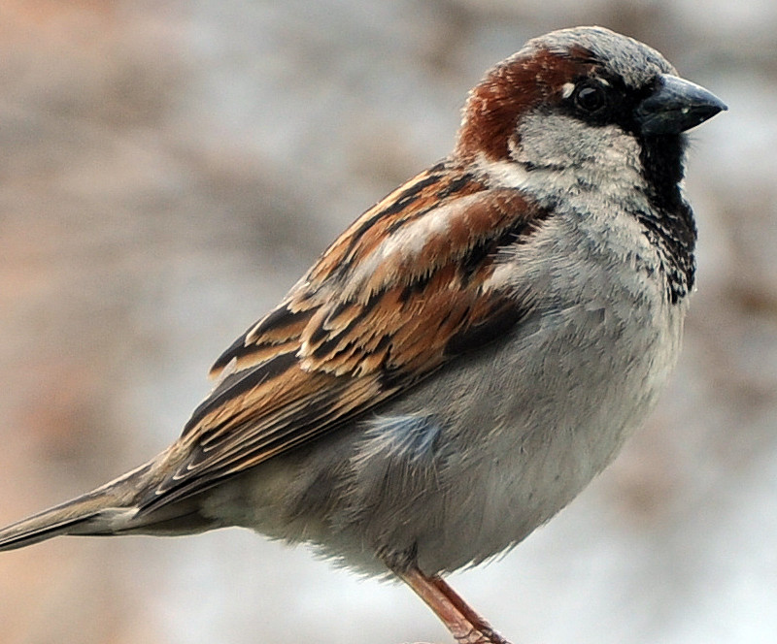
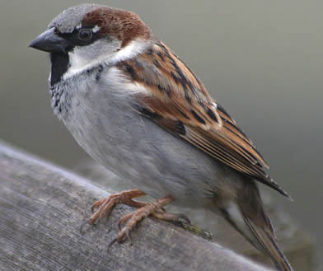
House sparrow ornament: increases with age

Slide 8
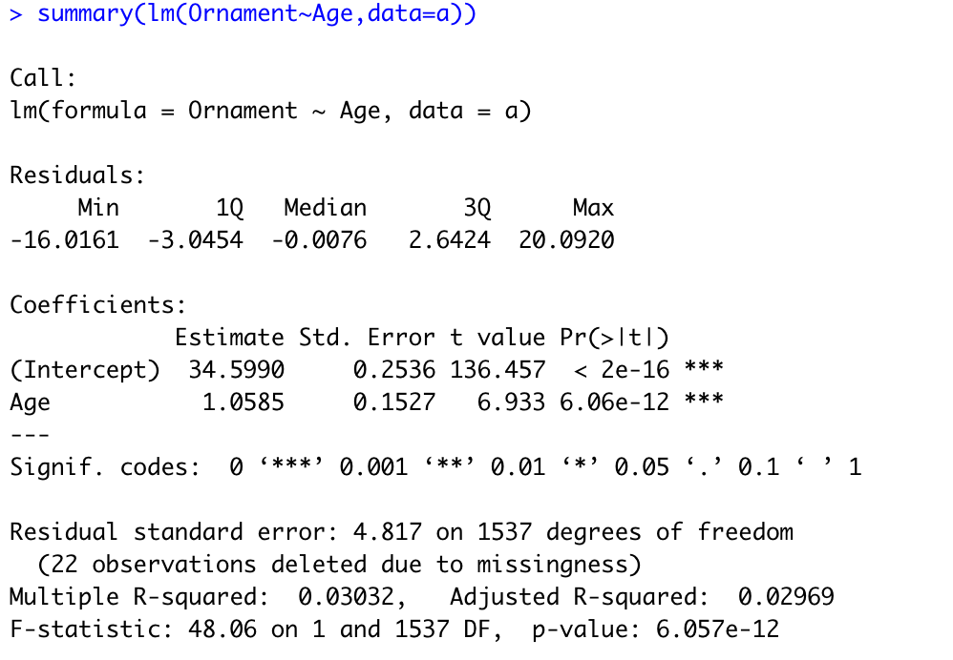
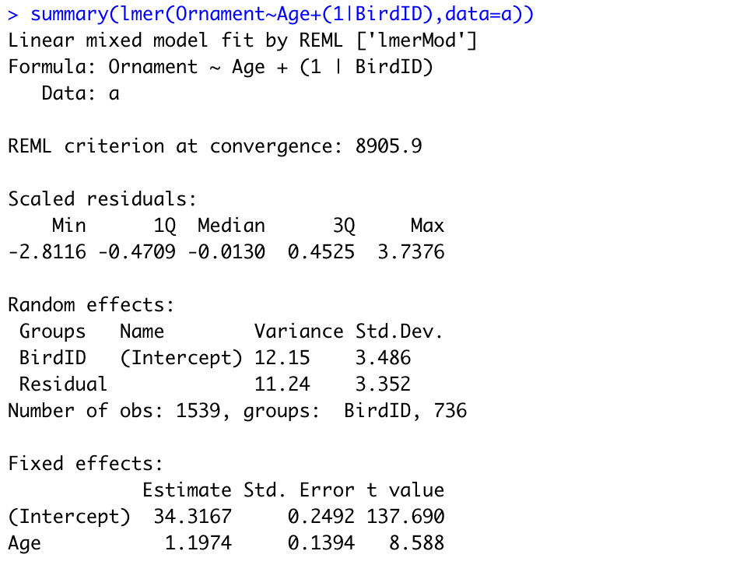

Slide 9
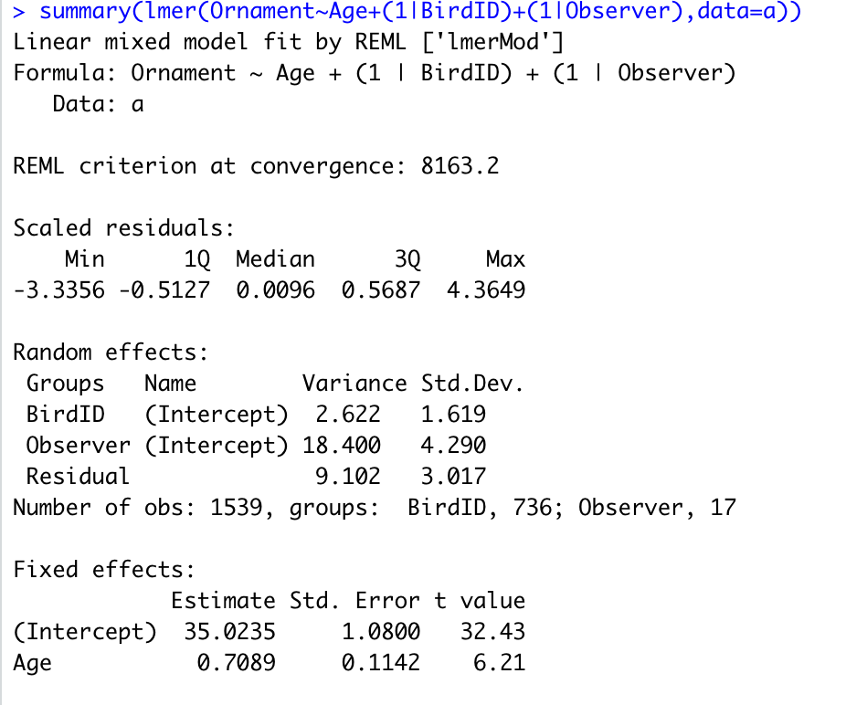

Slide 10
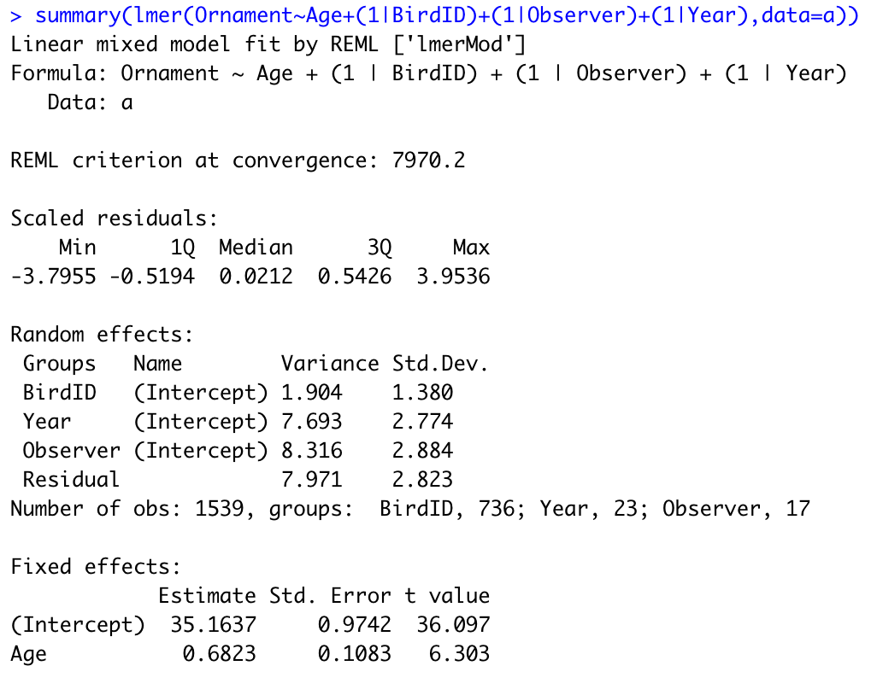

Slide 12
When is something random and fixed?
Rules of thumb:
Random effects are factors!
Are you interested in means (fixed) or variance (random)?
Do you want to correct for a factorial effect but it’s not in your questions specifically? -> random
More than 5 levels: random
LMM use only with large N (>50)

