Slide 1
Statistics with Spa ows
Lecture 2
Julia Schroeder
Julia.schroeder@imperial.ac.uk

Slide 2
Outline
Basic statistical concepts
Describing distributions
Describing sampling precision

Slide 3
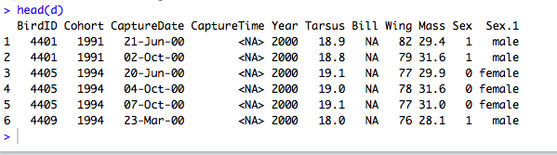
Basic statistical concepts

Slide 4
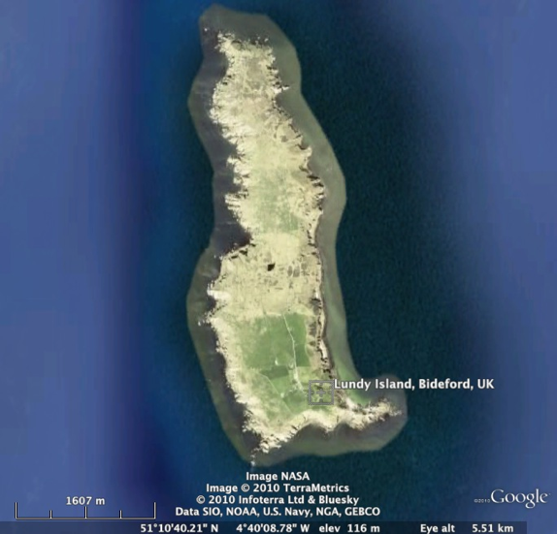

Lundy Sparrows
Griffith et al., 2000,
Nakagawa et al., 2007, Cleasby et al., 2010, Schroeder et. al 2011, 2013, 2015
Notes:
But, we have: the Lundy sparrows ☺

Slide 5
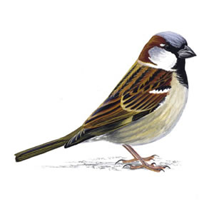

Slide 6
Complete population

Slide 8
Sample population

Slide 9
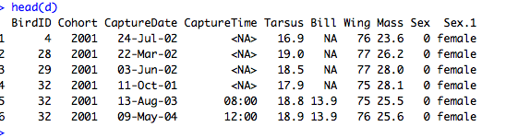
Basic statistical concepts

Slide 10
Estimate
Any parameter measured and computed from a sample is an estimate
As such, it is not perfectly precise – there is unknown error
We want to know how precise, and how reliable the parameter is

Slide 11
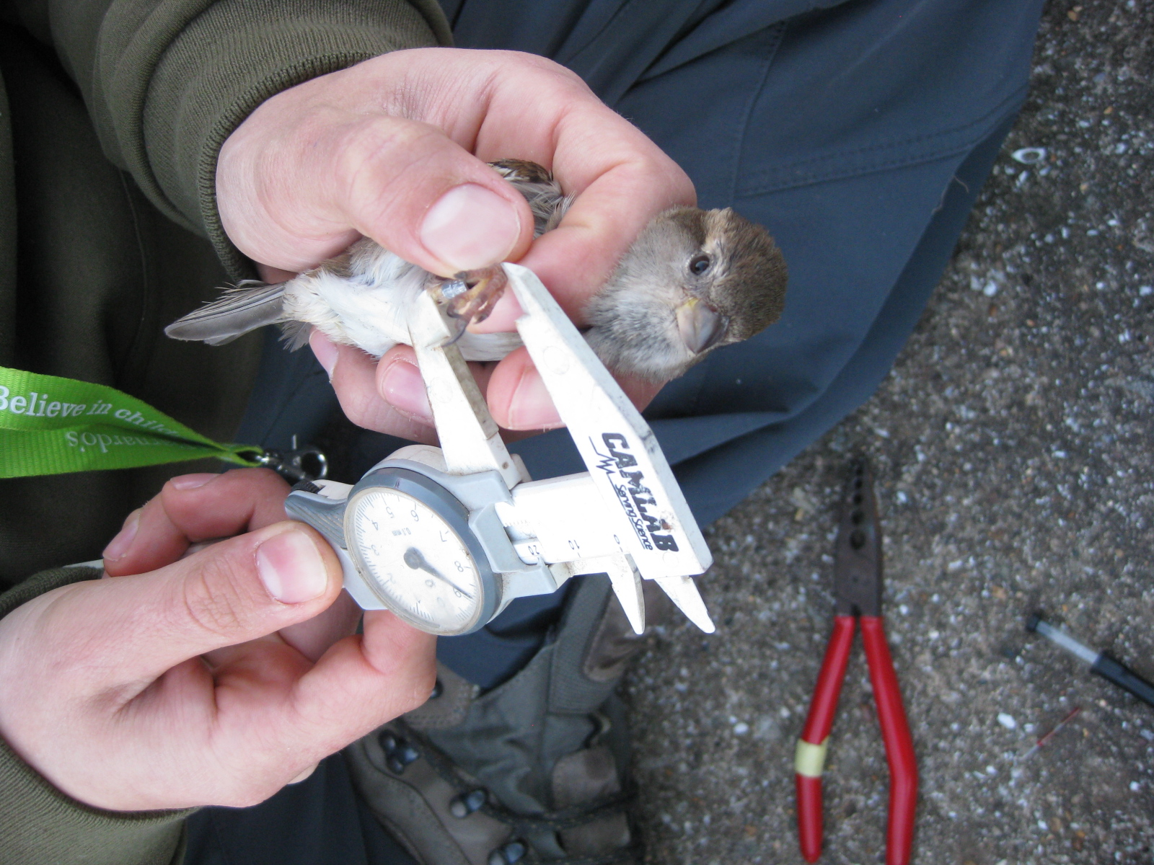

Slide 12
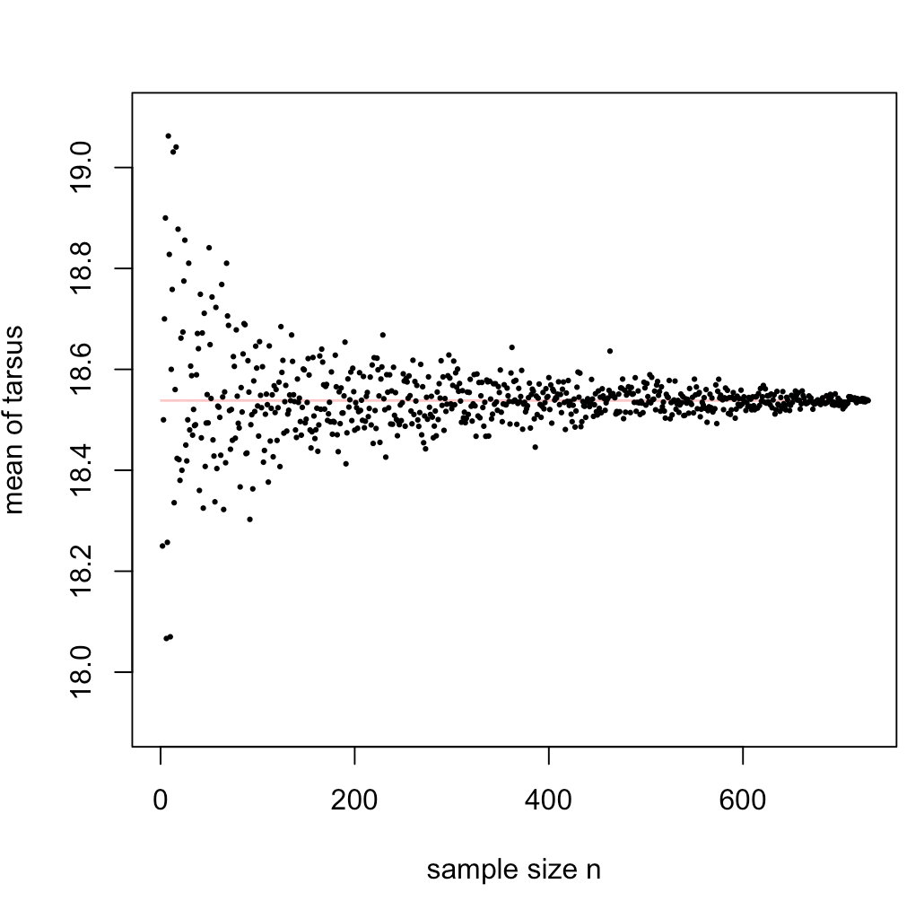

Slide 14
Describe data:
Centrality
Spread

Slide 15
Describe data:
Centrality
Spread
WHERE is the MIDDLE?

Slide 17
Describe data:
Centrality
Mean
Median
Mode
Spread
Range (min/max)
Variance
x_{i}

Slide 18
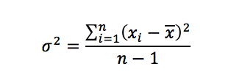
x
VARIANCE
Y_{i}

Slide 19
x_{i}
VARIANCE
x_{i}

Slide 20
x_{i}
VARIANCE
x_{i}

Slide 21
VARIANCE

Slide 22
VARIANCE

Slide 23
VARIANCE

Slide 24
VARIANCE

Slide 25
Standard deviation:
stdev video

Slide 27
Learning aims
Difference between population and sample
Centrality: Mean, median, mode
Spread: Range, quantiles, variance, standard deviation
Sum of squares

Slide 28
Exercise – DO IT NOW – HO 2
Calculate mean, variance and standard deviation of
Bill length
Body mass
Wing length in R.
Plot all four histograms in a multi-panel figure
What does it mean when statisticians talk about the “sum of squares” (often abbreviated to SS)?

Slide 29
Exercise – DO IT NOW
What are NA?
How can we deal with missing values? There are two ways!
Why are there odd gaps in the histogramms when we set breaks to larger numbers?
What do these gaps tell us about how precise we should report results?
Explain the warnings we got for mlv(d2$Tarsus)
What is the variance of normally distributed data with a mean of 0 and a standard deviation of 1?
What is the function in R to z-standardize data?
Explain what quantiles are
What are the boxes, whiskers and circles in a boxplot?
Explain the terms: sums of squares, mean of sum of squares

