Slide 1
Statistics with Spa ows
Lecture 5
Julia Schroeder
Julia.schroeder@imperial.ac.uk

Slide 2
Outline
Check-in: 95CI
T-test
Conventions: how to report t-test?

Slide 3
What are statistics?
We want to know if a null hypothesis is rejected
Most of the time, we want to know if data is distributed according to what we believe it should be distributed, given what we know

Slide 4
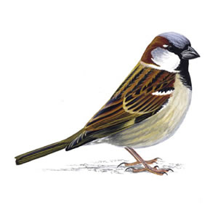
What are statistics?
We want to know if a null hypothesis is rejected
Most of the time, we want to know if data is distributed according to what we believe it should be distributed, given what we know
We will test is the mean of the
2001 data truthfully represents the
complete population.

Slide 5
What are statistics?
We want to know if a null hypothesis is rejected
Most of the time, we want to know if data is distributed according to what we believe it should be distributed, given what we know
We will test is the mean of the
2001 data truthfully represents the
complete population.
We will test if 2001 mean is within
a certain range of values

Slide 6
Hypothesis testing
H0 = true mean is equal to mean of 2001
H1 = true mean is not equal to mean of 2001

Slide 7
We accept every mean within 95% of the distribution
That means from
2.5%-97.5% cumulative%

Slide 8
We accept every mean within 95% of the distribution
That means from
2.5%-97.5% cumulative%
This is the 95% interval.

Slide 9
We accept every mean within 95% of the distribution
That means from
2.5%-97.5% cumulative%
This is the 95% interval.
Or an Error of 5%
How to calculate it?

Slide 10
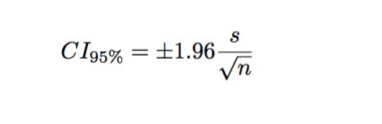

Slide 11
It is the mean plus/minus 1.96 times the standard deviation divided by the square root of the sample size

Slide 12
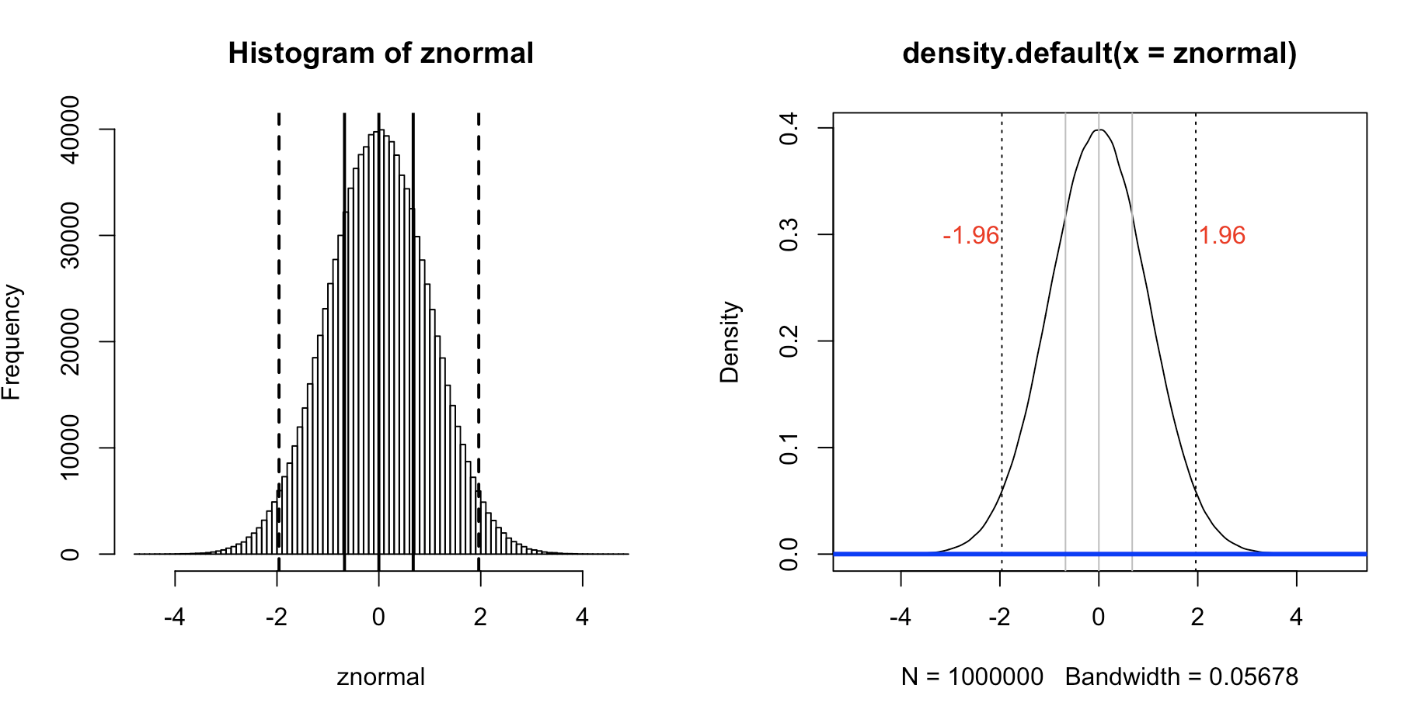

Slide 13
Looks familiar?

Slide 14
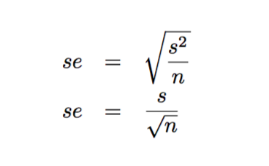
Looks familiar?
Rule-of-thumb:
Twice the SE!

Slide 15
Remember:
 | Tarsus | Tarsus 2001
Variance | 0.74 | 0.72
Standard deviation | 0.86 | 0.85
N | 1685 | 168
Standard error | 0.02 | 0.07
Mean | 18.52 | 18.19

Slide 16
Remember:
 | Tarsus | Tarsus 2001
Variance | 0.74 | 0.72
Standard deviation | 0.86 | 0.85
N | 1685 | 168
Standard error | 0.02 | 0.07
Mean | 18.52 | 18.19
Is the sample from 2001
representative of the whole
population?
Does the mean of 2001 fall within all possible means of the true distribution? We allow an error of 5%.

Slide 18
 | Tarsus | Tarsus 2001
N | 1685 | 168
Standard error | 0.02 | 0.07
Mean | 18.52 | 18.19
~95%CI Mean+- (2*SE)
Let’s test this!

Slide 19
 | Tarsus | Tarsus 2001
N | 1685 | 168
Standard error | 0.02 | 0.07
Mean | 18.52 | 18.19
~95%CI Mean+- (2*SE) |  | 18.05 – 18.33
Let’s test this!

Slide 20
 | Tarsus | Tarsus 2001
N | 1685 | 168
Standard error |  | 0.07
Mean | 18.52 | 18.19
~95%CI Mean+- (2*SE) | DOES NOT SPAN 18.52 | 18.05 – 18.33
Let’s test this!
NO! We reject H₀!

Slide 21
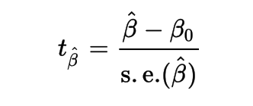
T-test
H0 = true mean is equal to 18.5
H1 = true mean is not equal to 18.5
Sample size is 168, thus df = 167

Slide 22
T-test
 | Tarsus | Tarsus 2001
N | 1685 | 168
Standard error |  | 0.07
Mean | 18.52 | 18.19
~95%CI Mean+- (2*SE) | DOES NOT SPAN 18.52 | 18.05 – 18.33
H0 = true mean is equal to 18.5
H1 = true mean is not equal to 18.5
Sample size is 168, thus df = 167

Slide 23
T-test
 | Tarsus | Tarsus 2001
N | 1685 | 168
Standard error |  | 0.07
Mean | 18.52 | 18.19
~95%CI Mean+- (2*SE) | DOES NOT SPAN 18.52 | 18.05 – 18.33
H0 = true mean is equal to 18.5
H1 = true mean is not equal to 18.5
Sample size is 168, thus df = 167
18.19 – 18.5
0.07

Slide 24
T-test
H0 = true mean is equal to 18.5
H1 = true mean is not equal to 18.5
Sample size is 168, thus df = 167
18.19 – 18.5
t = -4.42
0.07

Slide 25
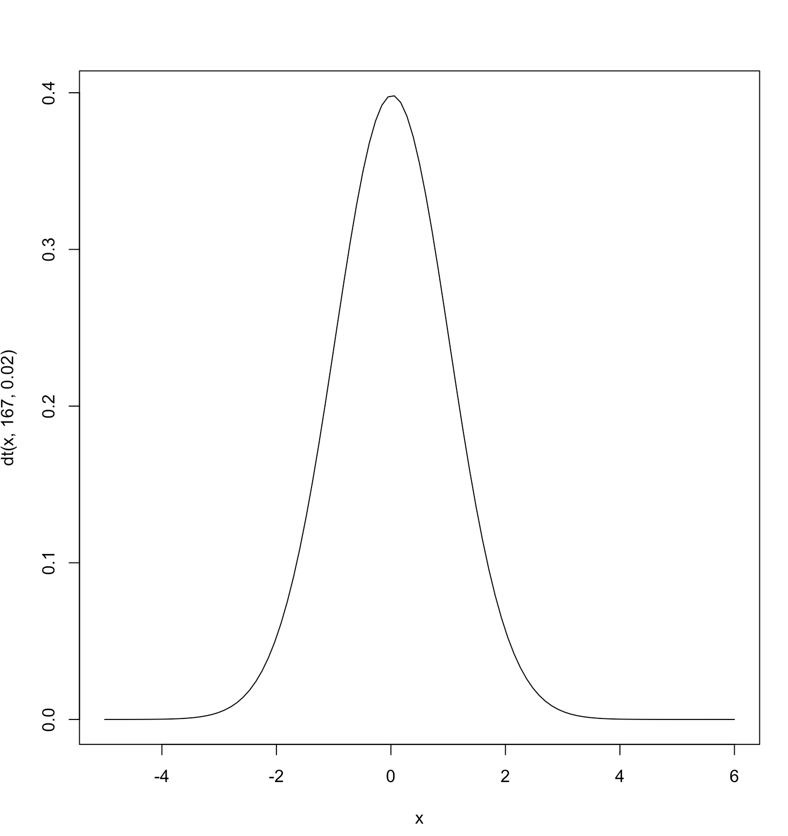
T-test
H0 = true mean is equal to 18.5
H1 = true mean is not equal to 18.5
Sample size is 168, thus df = 167
18.19 – 18.5
t = -4.42
0.07

Slide 26
T-test
H0 = true mean is equal to 18.5
H1 = true mean is not equal to 18.5
Sample size is 168, thus df = 167
18.19 – 18.5
t = -4.42
0.07
p-value

Slide 27
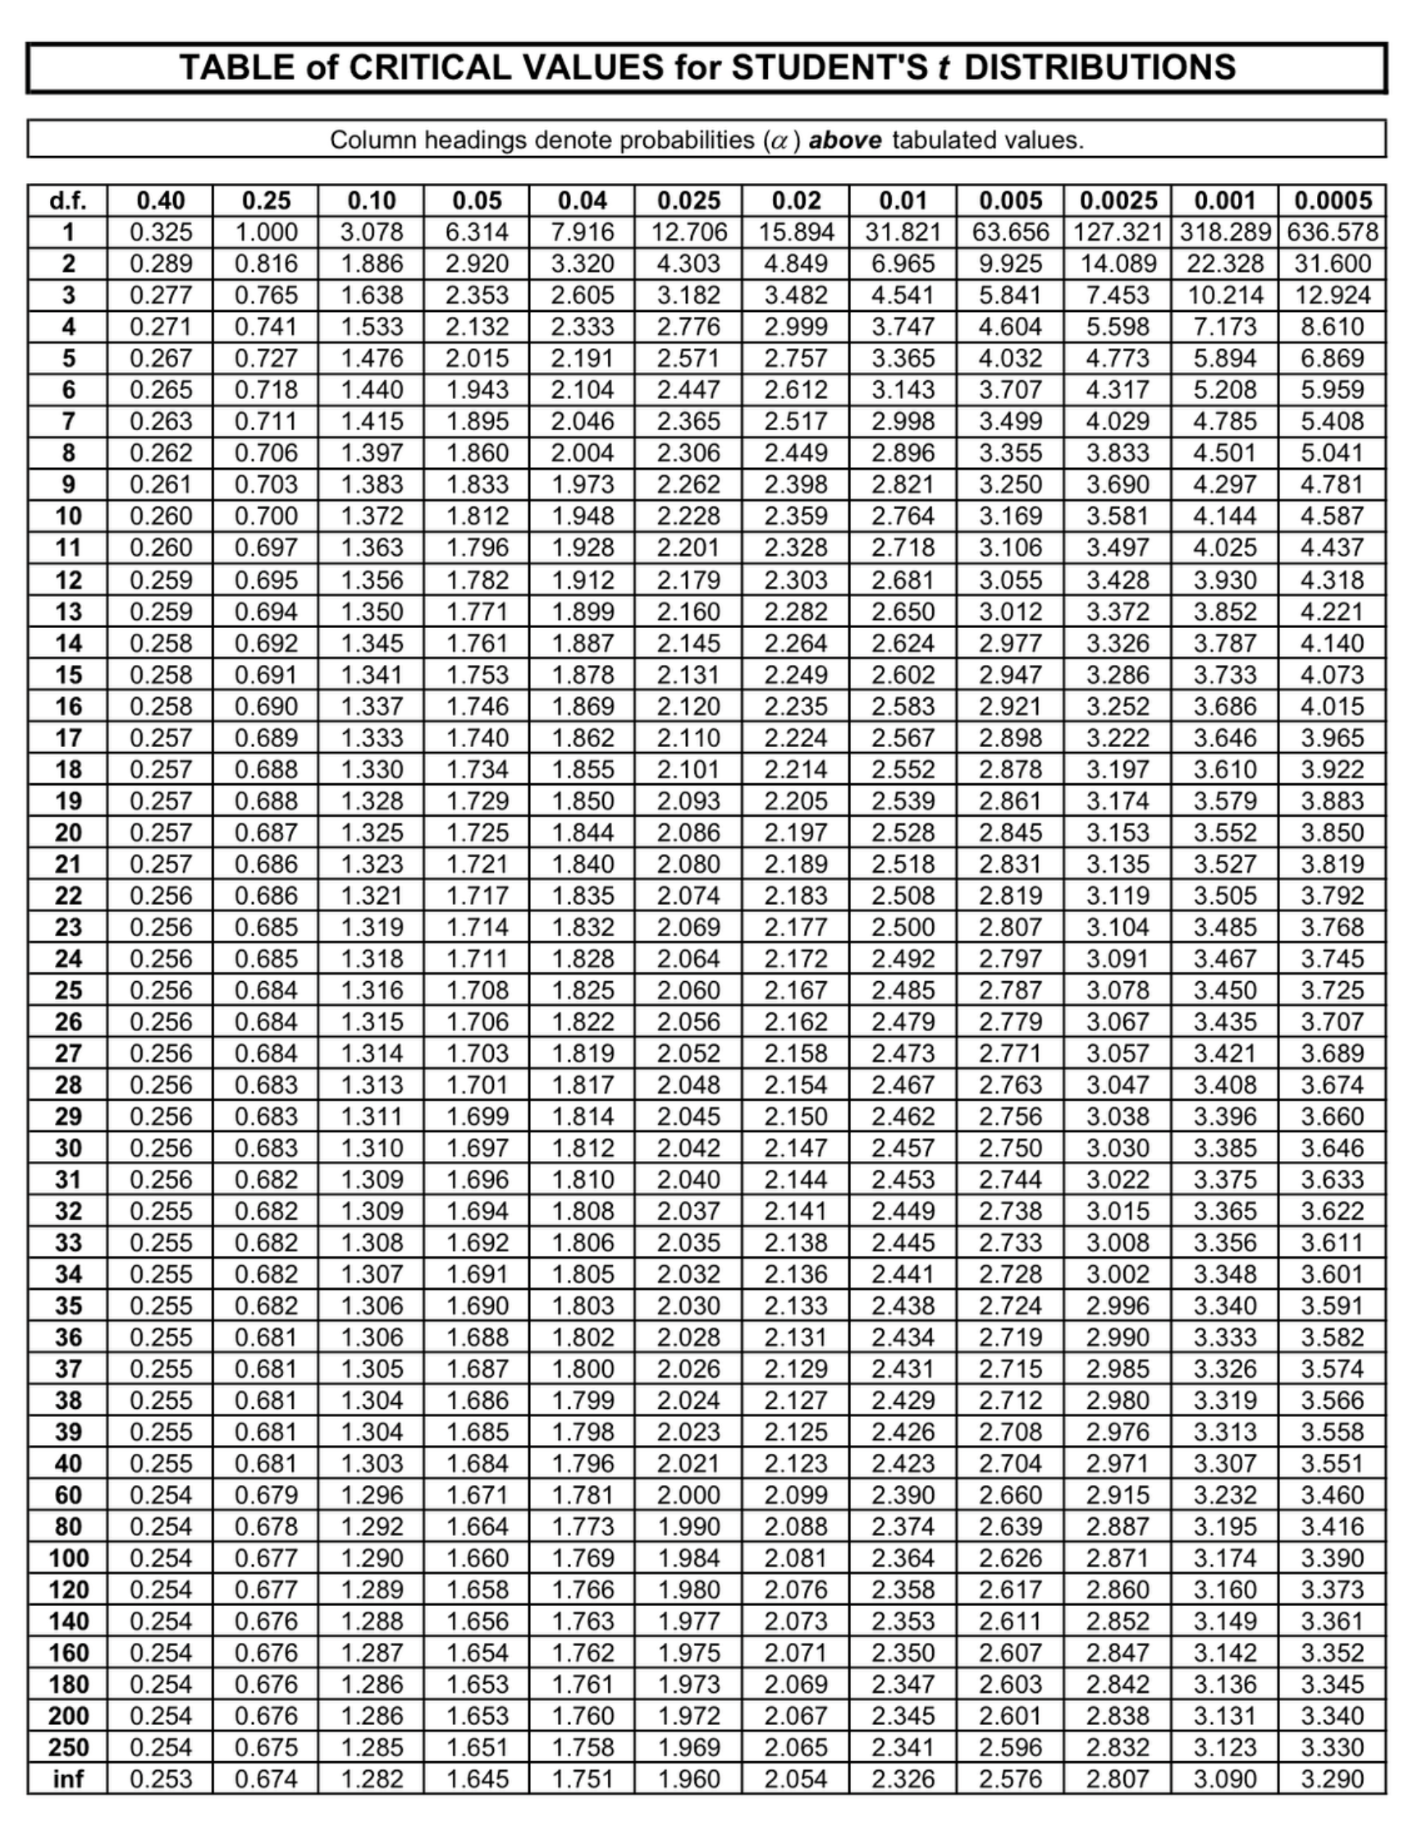
T-test
H0 = true mean is equal to 18.5
H1 = true mean is not equal to 18.5
Sample size is 168, thus df = 167
18.19 – 18.5
t = -4.42
0.07
p-value

Slide 28
T-test
H0 = true mean is equal to 18.5
H1 = true mean is not equal to 18.5
Sample size is 168, thus df = 167
18.19 – 18.5
t = -4.42
0.07
p-value

Slide 29
T-test
H0 = true mean is equal to 18.5
H1 = true mean is not equal to 18.5
Sample size is 168, thus df = 167
18.19 – 18.5
t = -4.42
0.07
p-value

Slide 30
T-test
P-value: statistical significance
We accept alternative hypothesis with a probability of p=0.000003961 to be wrongly accepted

Slide 31
T-test
P-value: statistical significance
We accept alternative hypothesis with a probability of p=0.000003961 to be wrongly accepted
We consider p<0.05 (5%) as statistically significant
That’s a convention, there is no real reason for why that’s better than p<0.04 or 0.06

Slide 32
T-test – hypothesis testing
H0 = true mean is equal to 18.5
H1 = true mean is not equal to 18.5
d1<-subset(d, d$YEAR==2001)
t.test(d1$Tarsus,mu=18.5,na.rm=TRUE)

Slide 33
T-test – hypothesis testing
H0 = true mean is equal to 18.5
H1 = true mean is not equal to 18.5
d1<-subset(d, d$YEAR==2001)
t.test(d1$Tarsus,mu=18.5,na.rm=TRUE)

Slide 34
T-test – hypothesis testing
H0 = true mean is equal to 18.5
H1 = true mean is not equal to 18.5
d1<-subset(d, d$YEAR==2001)
t.test(d1$Tarsus,mu=18.5,na.rm=TRUE)

Slide 35
T-test – hypothesis testing
H0 = true mean is equal to 18.5
H1 = true mean is not equal to 18.5
d1<-subset(d, d$YEAR==2001)
t.test(d1$Tarsus,mu=18.5,na.rm=TRUE)

Slide 36
T-test – hypothesis testing
H0 = true mean is equal to 18.5
H1 = true mean is not equal to 18.5
d1<-subset(d, d$YEAR==2001)
t.test(d1$Tarsus,mu=18.5,na.rm=TRUE)

Slide 37
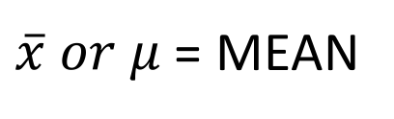
T-test – hypothesis testing
H0 = true mean is equal to 18.5
H1 = true mean is not equal to 18.5
d1<-subset(d, d$YEAR==2001)
t.test(d1$Tarsus,mu=18.5,na.rm=TRUE)
$\overline{x} or μ$ = MEAN

Slide 38
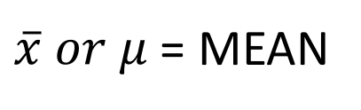
T-test – hypothesis testing
H0 = true mean is equal to 18.5
H1 = true mean is not equal to 18.5
d1<-subset(d, d$YEAR==2001)
t.test(d1$Tarsus,mu=18.5,na.rm=TRUE)
$\overline{x} or μ$ = MEAN

Slide 39
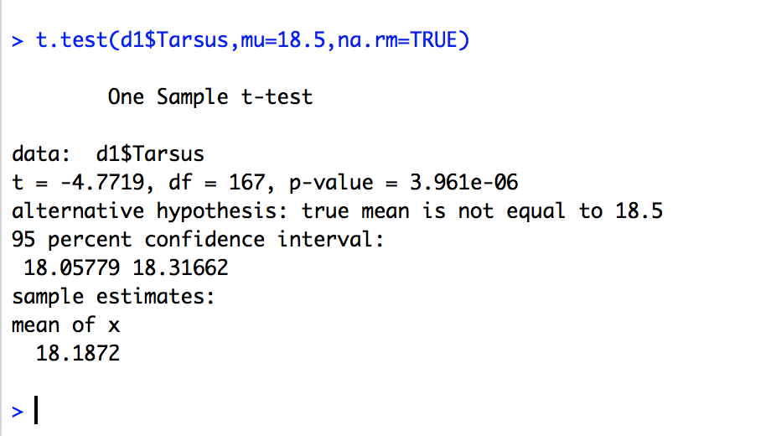
T-test – hypothesis testing
H0 = true mean is equal to 18.5
H1 = true mean is not equal to 18.5
d1<-subset(d, d$YEAR==2001)
t.test(d1$Tarsus,mu=18.5,na.rm=TRUE)

Slide 40
T-test – hypothesis testing
H0 = true mean is equal to 18.5
H1 = true mean is not equal to 18.5
d1<-subset(d, d$YEAR==2001)
t.test(d1$Tarsus,mu=18.5,na.rm=TRUE)

Slide 41
T-test – hypothesis testing
H0 = true mean is equal to 18.5
H1 = true mean is not equal to 18.5
d1<-subset(d, d$YEAR==2001)
t.test(d1$Tarsus,mu=18.5,na.rm=TRUE)

Slide 42
T-test – hypothesis testing
H0 = true mean is equal to 18.5
H1 = true mean is not equal to 18.5
d1<-subset(d, d$YEAR==2001)
t.test(d1$Tarsus,mu=18.5,na.rm=TRUE)

Slide 43
T-test – hypothesis testing
H0 = true mean is equal to 18.5
H1 = true mean is not equal to 18.5
d1<-subset(d, d$YEAR==2001)
t.test(d1$Tarsus,mu=18.5,na.rm=TRUE)

Slide 44
T-test – hypothesis testing
H0 = true mean is equal to 18.5
H1 = true mean is not equal to 18.5
d1<-subset(d, d$YEAR==2001)
t.test(d1$Tarsus,mu=18.5,na.rm=TRUE)

Slide 45
T-test – hypothesis testing
H0 = true mean is equal to 18.5
H1 = true mean is not equal to 18.5
d1<-subset(d, d$YEAR==2001)
t.test(d1$Tarsus,mu=18.5,na.rm=TRUE)

Slide 46
T-test – hypothesis testing
H0 = true mean is equal to 18.5
H1 = true mean is not equal to 18.5
d1<-subset(d, d$YEAR==2001)
t.test(d1$Tarsus,mu=18.5,na.rm=TRUE)
 | Tarsus | Tarsus 2001
N | 1685 | 168
Standard error |  | 0.07
Mean | 18.52 | 18.19
~95%CI Mean+- (2*SE) | DOES NOT SPAN 18.52 | 18.05 – 18.33

Slide 47
We can also use t to test for differences in mean:
H0 = males and females have equal mean
H1 = male and female mean is not equal

Slide 48
We can also use t to test for differences in mean:
H0 = males and females have equal mean
H1 = male and female mean is not equal
→ testing if the difference is
equal to testing for zero

Slide 49
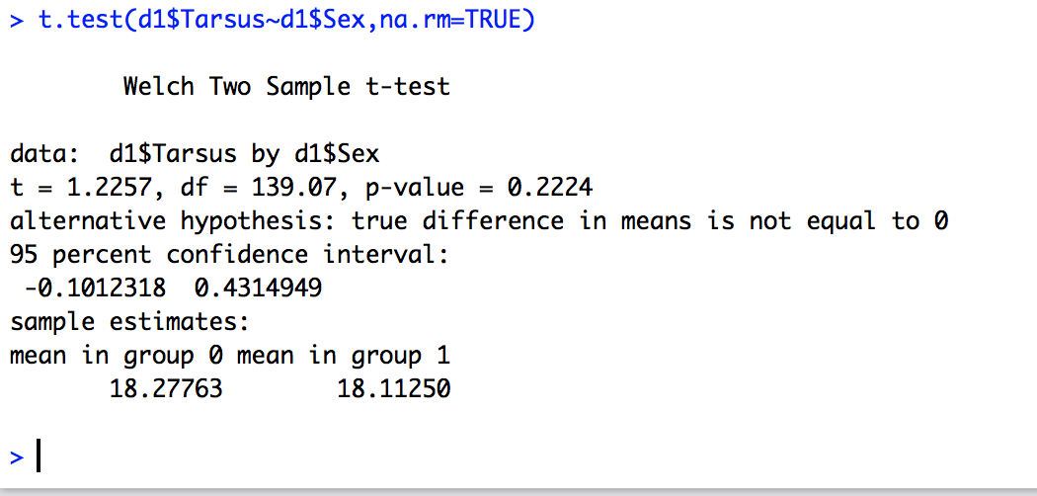
We can also use t to test for differences in mean:
H0 = males and females have equal mean
H1 = male and female mean is not equal

Slide 50
We can also use t to test for differences in mean:
H0 = males and females have equal mean
H1 = male and female mean is not equal

Slide 51
We can also use t to test for differences in mean:
H0 = males and females have equal mean
H1 = male and female mean is not equal

Slide 52
We can also use t to test for differences in mean:
H0 = males and females have equal mean
H1 = male and female mean is not equal

Slide 53
We can also use t to test for differences in mean:
H0 = males and females have equal mean
H1 = male and female mean is not equal
→ testing if the difference is
equal to testing for zero

Slide 54
t-distribution: dependent on degrees of freedom
Means that the bigger the sample size,
the more likely we will find statistical differences!

Slide 55
Convention – reality check
How to report results from a t-test?

Slide 56
Convention – reality check
How to report results from a t-test?
In text:
Male and female tarsi did not differ in size between male and females (mean: 18.18, two sample t-test: t=1.23, df=139, p<0.22).
(t_{df=139}=1.23, p<0.001).

Slide 57
Convention – reality check
How to report results from a t-test?
In text:
In a table
Male and female tarsi did not differ in size (mean: 18.18, two sample t-test: t=1.23, df=139, p=0.22).
(t_{df=139}=4.23, p<0.001).
Variable | Mean females±SE | N females | Mean males±SE | N males | t | df | p
Tarsus | 18.27±0.09 |  | 18.11±0.13 |  | 1.23 | 139 | 0.22
Wing
Ect

Slide 58
DO IT NOW– HO 5
Test if wing length in 2001 differs from the grand-total mean in wing length
Test if male and female wing length differ in 2001
Test if male and female wing length differ in the full dataset
Report in a table, don’t forget the N’s!
Report in text

Slide 59
Exercise – discussion
What did you notice happened when you took smaller samples?
Why did the precision go down?
How many sparrows do you have to sample to get the correct answer?

