Slide 1

Exploring Dijkstra's Algorithm: Unveiling the Shortest Paths
CS 5002 Final Project
Yijia Zhan

Slide 2


Let’s start with one of my daily habits!
Digital map
Shows you directions
Help you to find the best route to your destination
https://www.istockphoto.com/vector/roadtrip-poster-with-a-stylized-map-with-points-of-interest-and-sighseeing-for-gm831307002-135171967

Slide 3
How？
How these digital maps determine the shortest path?
How to find the shortest distance between your current location and your destination on Maps through Dijkstra's Algorithm?

Slide 4
Dijkstra's Algorithm
Conceived by computer scientist Edsger W. Dijkstra in 1956
Finds the shortest path between a given node and all other nodes in a graph
It picks the unvisited vertex with the smallest distance, calculates the distance through it to each unvisited neighbor, and updates the neighbor's distance if it is smaller.

Slide 5
How does it work for Map?
How maps enable users to find the shortest distance between their current locations and their destinations through Dijkstra's Algorithm?

Slide 6
How to analyze？
Data from Shanghai map (['Shanghai Tower', 'Nanjing Road', 'The Bund', 'Xintiandi', 'Jingan Temple', 'Pearl Tower', 'Yu Garden'])
Randomness: let users to set their current location and destination
Analyze the shortest path between nodes and weighted edges by Djkstra’s algorithm through networkx and matplotlib
Visualize paths using the matplotlib and networkx
Comparison: introducing Depth-first search(DFS) and Breadth-first search(BFS)
DFS/BFS show the traversals

Slide 7
BFS and DFS
BFS stands for Breadth First Search
Before going on to the nodes at the next depth level, it investigates every node at the current depth starting with the tree root.
DFS stands for Depth First Search
The algorithm begins at the root node (in the case of a graph, it chooses an arbitrary node to be the root node), and explores as far as possible along each branch before backtracking

Slide 8
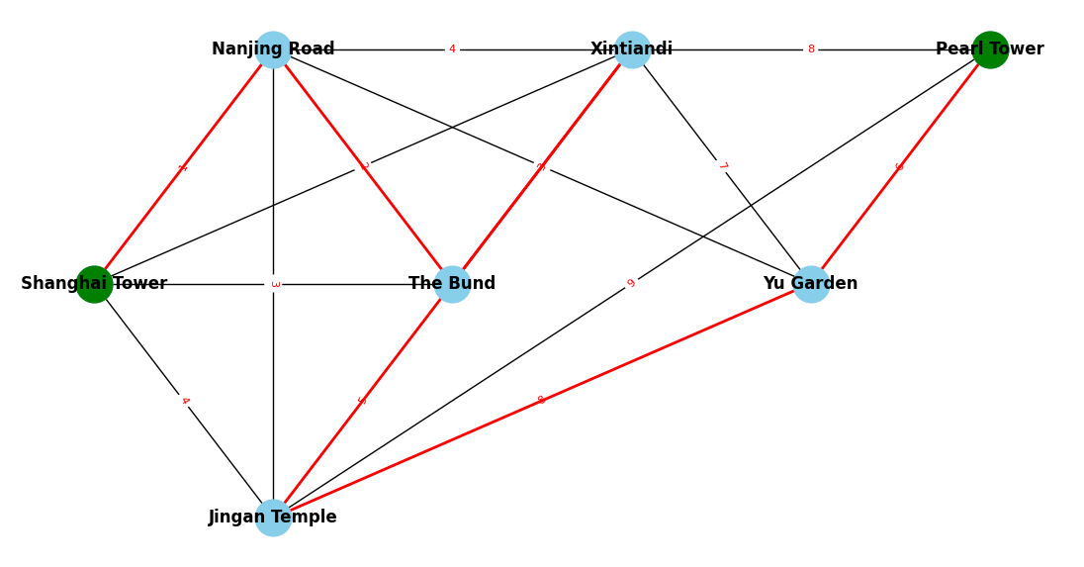
BFS
BFS Traversal Order: ['Shanghai Tower', 'Nanjing Road', 'The Bund', 'Xintiandi', 'Jingan Temple', 'Yu Garden', 'Pearl Tower']

Slide 9
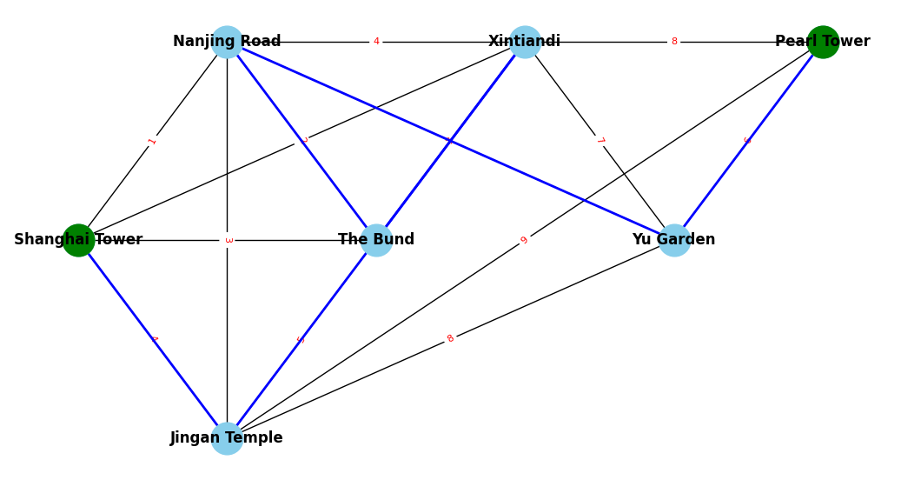
DFS
DFS Traversal Order: ['Shanghai Tower', 'Jingan Temple', 'Xintiandi', 'The Bund', 'Nanjing Road', 'Yu Garden', 'Pearl Tower']

Slide 10
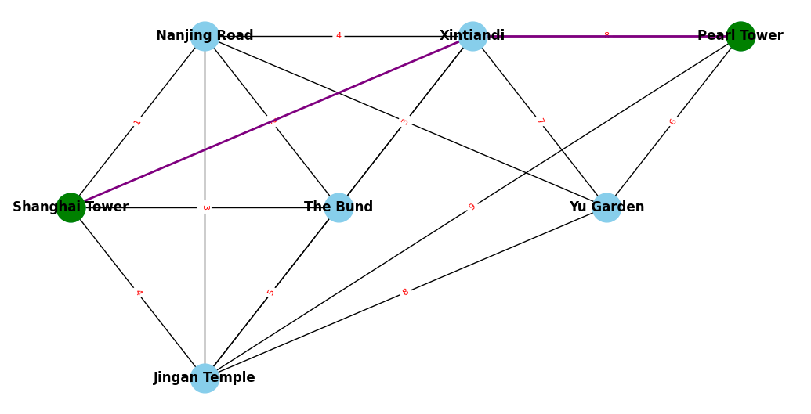
the Shortest Paths From Shanghai Tower to Pearl Tower
Shortest Path: ['Shanghai Tower', 'Xintiandi', 'Pearl Tower']
Shortest Distance: 10 units

Slide 11
Results, Limitation and feature Improvement
Compared with BFS and DFS, Dijkstra's Algorithm indeed provides us the shortest pathway
Limitation: a manually constructed graph representing a simplified map of Shanghai
Improvement: incorporating real-time data from mapping APIs

Slide 12
Thank you For Watching!

Slide 13
Reference
Fell, H. (2017). In Discrete structures (pp. 195–212). essay, Cognella academic publishing.

