Slide 1
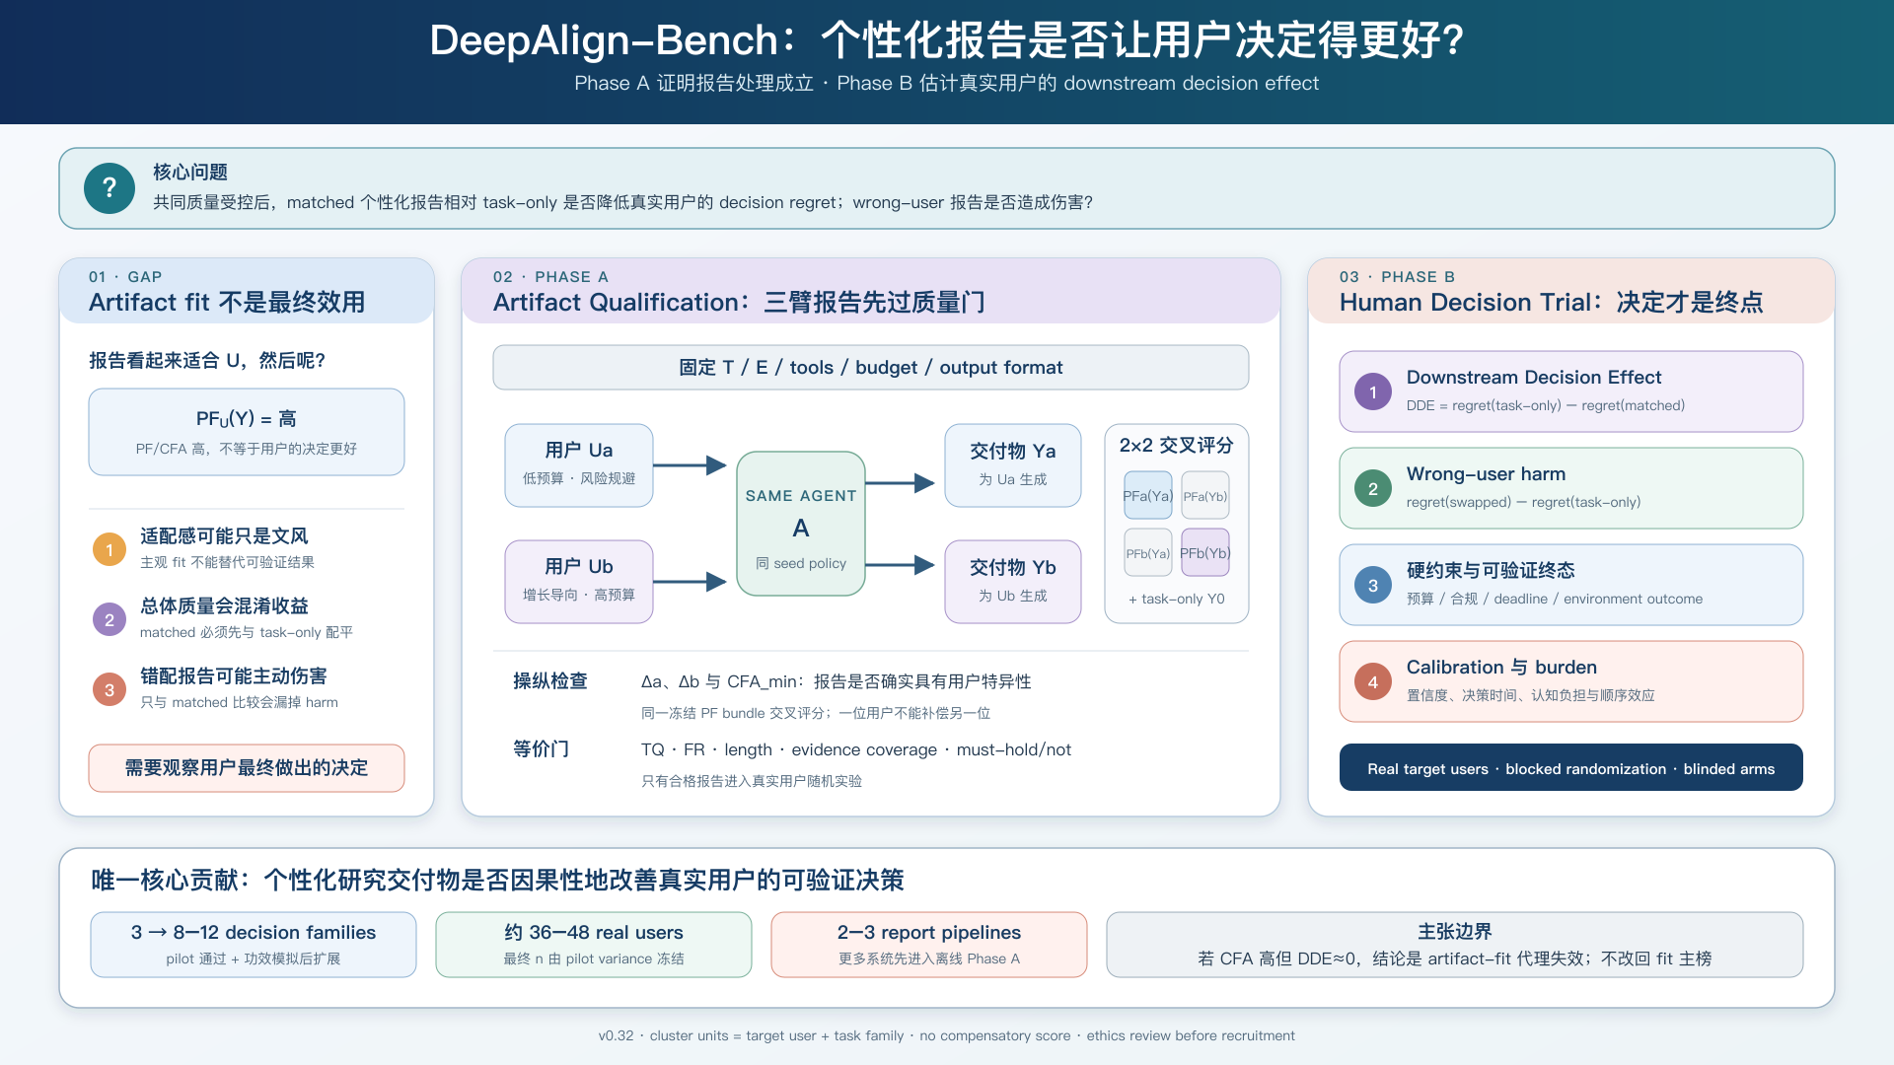
Notes:
讲法：先指出 absolute fit 不能识别用户特异性；再讲 Ua/Ub crossover；最后逐项解释四重成立门。
[Sources]
DeepAlign-Bench v0.30 proposal and metric-binding schema (project sources, 2026-08-08).
Towards Personalized Deep Research: Benchmarks and Evaluations — https://arxiv.org/abs/2509.25106
Language Models Don't Know What You Want: Evaluating Personalization in Deep Research Needs Real Users — https://aclanthology.org/2026.acl-long.723/
Preference-Aware Rubric Learning for Personalized Evaluation — https://arxiv.org/abs/2605.31545
v0.32 讲法：Phase A 只确认报告处理成立；Phase B 把报告作为处理，主测真实用户 decision regret。若 CFA 高而 DDE≈0，说明 artifact-fit 不是充分代理。
[Sources]
Project figure — proposal_assets/DeepAlign-Bench_主图.png
Literature map — proposal/DeepAlign-Bench_相关论文全景与方向收敛.md
Formal methods — proposal/DeepAlign-Bench_研究Proposal.md

