Slide 1
Workflows of Manual Analysis Helper (MAH)
Yijian ZHOU
2022-01 V0

Slide 2
Outline
Manual phase picking
Source spectrum analysis
CC clustering

Slide 3
1. Manual Phase Picking
Input
fctlg: catalog file, just rough location would be enough
data_dir: directory of continuous waveform
Output
fpha & fpha_hyp

Slide 4
Input | Operation | Output | Notes
fctlg & fsta | ctlg2pha.py | fpha_org | predicted phase arrival, need manual pick
fpha_org | cut events | events/[event_name] /[net.sta.chn].SAC
 | SAC ppk P/S/N in t0/1/2 |  | only use wh!
events & fpha_org | head2pha.py | fpha
fpha | cut events | events/[event_name] /[net.sta.chn].SAC | may repeat the manual picking process
fpha | event location | fpha_hyp | use Hypo-Interface-Py

Slide 5
2. Source Spectrum Analysis
Input
fctlg_all: catalog that contains all candidate EGF events
fsta: station file
data_dir: directory of continuous data
Output

Slide 6
2.1 Prepare Target Event Data
Input | Operation | Command | Output | Notes
fctlg_tar & fsta | make phase file | ctlg2pha.py | fpha_tar_org | predicted phase arrival, need manual re-pick
fpha_tar_org | cut Target events | cut_events.py | events_tar
 | SAC ppk | head2pha.py | fpha_tar | mark P/S/N in t0/1/2, only use wh
fpha_tar | cut Target events | cut_events.py | events_tar | optional
fpha_tar | event location |  | fpha_tar_hyp | optional
Notes:
i.e., manual picking process

Slide 7
2.2 Prepare EGF Event Data
Input | Operation | Command | Output | Notes
fctlg_all & fsta | select EGF | select_egf-phase.py | fpha_egf_org | predicted phase arrival, need manual pick
fpha_egf_org | inspect event waveform | plot_waveform-events.py | event_name.pdf | check overall SNR of each candidate EGF
fpha_egf_org | cut EGF events | cut_events.py | events_egf | low SNR events are dropped
 | SAC ppk | head2pha.py | fpha_egf | mark P/S/N in t0/1/2, only use wh
fpha_egf | cut EGF events | cut_events.py | events_egf | optional
events_tar & events_egf | CC selection of EGF | plot_egf-cc.py | egf_cc.pdf | only for PLD

Slide 8
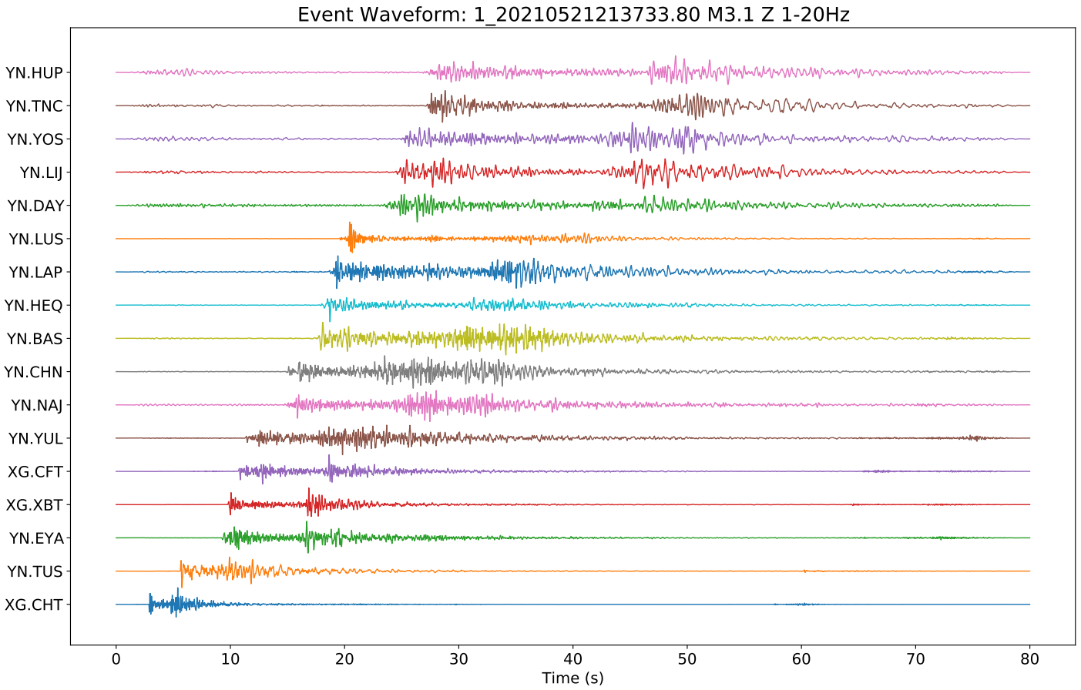

Slide 9
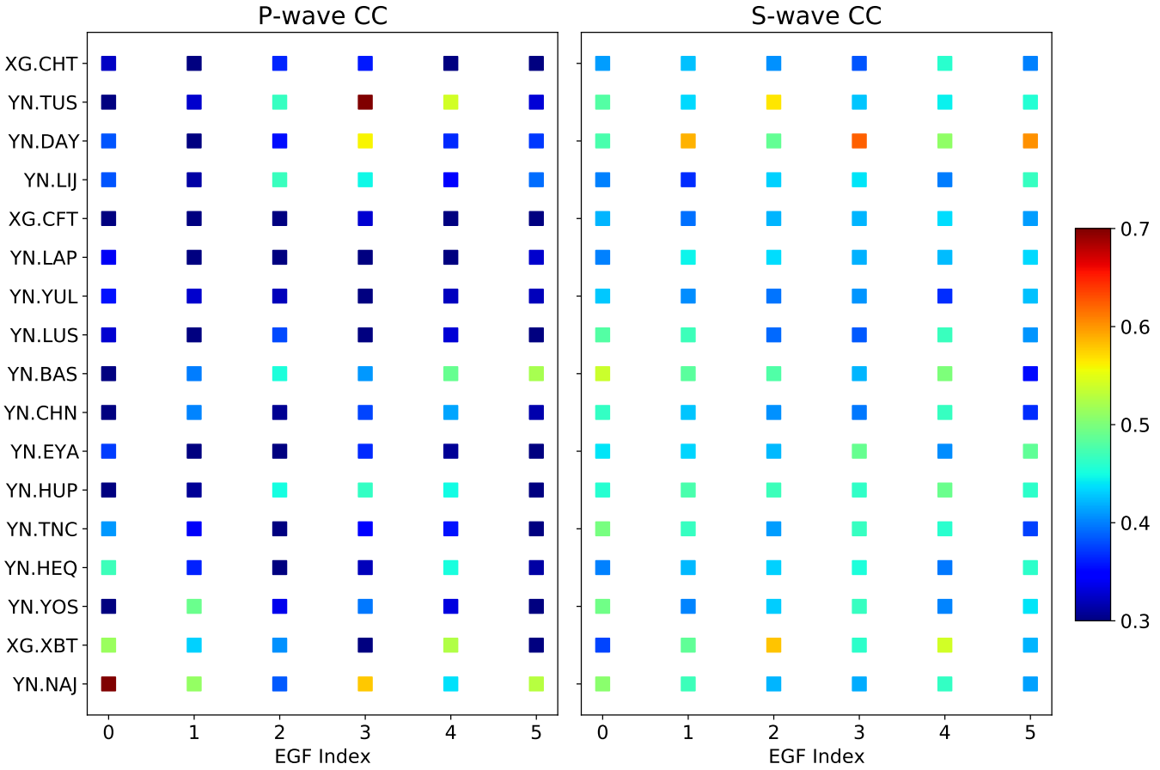

Slide 10
2.3

