Slide 1
Cue
W1
W2
W3
W4
W5
C1
C2
C3
C4
C5
20 | 5 | 5 | 5 | 5
5 | 20 | 5 | 5 | 5
5 | 5 | 20 | 5 | 5
5 | 5 | 5 | 20 | 5
5 | 5 | 5 | 5 | 20
20 | 5 | 5 | 5 | 5
5 | 20 | 5 | 5 | 5
5 | 5 | 20 | 5 | 5
5 | 5 | 5 | 20 | 5
5 | 5 | 5 | 5 | 20
W1
C1
W2
C2
Target
W3
C3
W4
C4
W5
C5
Expected stimuli
Unexpected stimuli

Slide 2
Example stage
Practice stage
Test stage
Timeline
Block1
Block2

Slide 3
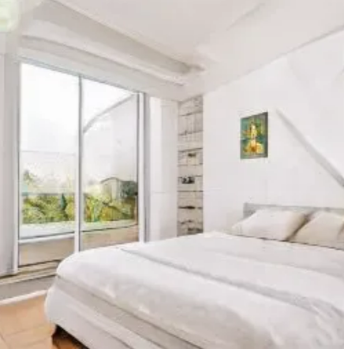
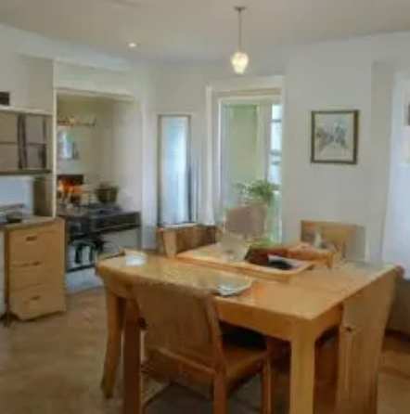
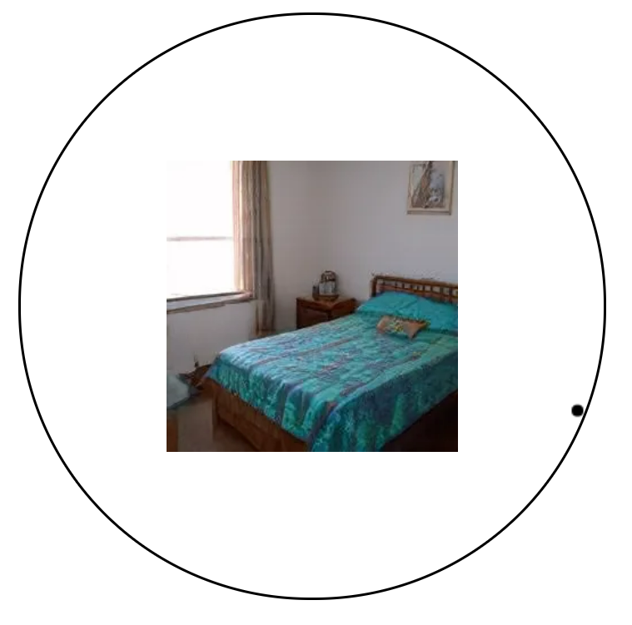
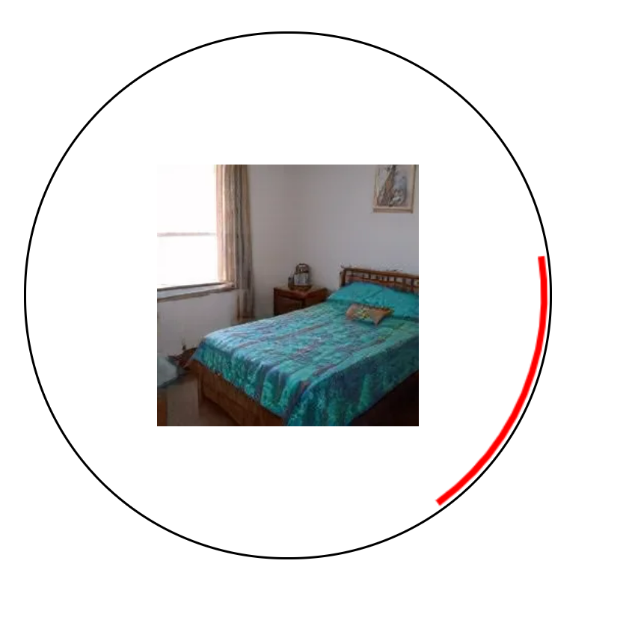

Expected
+
Bedroom
Unexpected
+
Fixation
200ms
Cue
200ms
一致 不一致
Fixation
200ms
Target
200ms
Categorization
2000ms
Recall
正确/错误
Confidence
Feedback
500ms
Test stage

Slide 4
Expected
+
Green
Unexpected
+
Fixation
200ms
Cue
200ms
一致 不一致
Fixation
200ms
Target
200ms
Categorization
2000ms
Recall
正确/错误
Confidence
Feedback
500ms
Test stage

