Slide 1
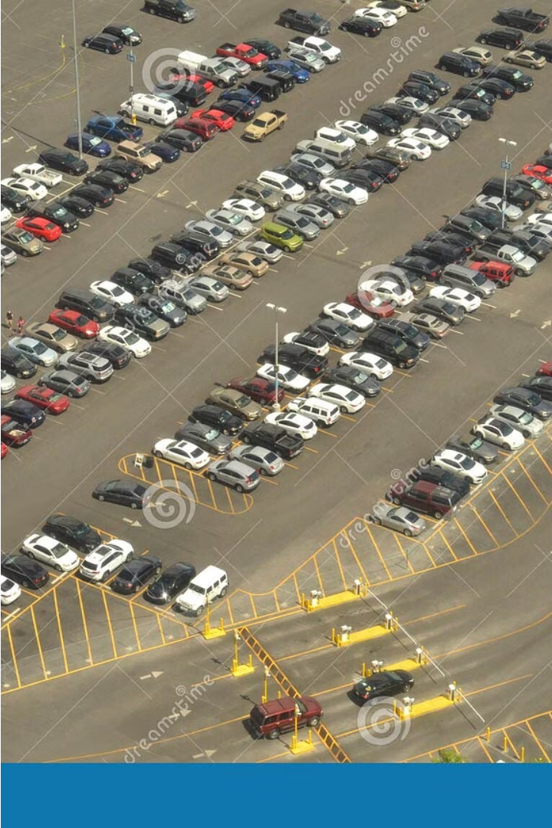
Parking Lot Monitor
Oversees and manages a busy parking lot, ensuring efficient use of space and compliance with regulations.

Slide 2
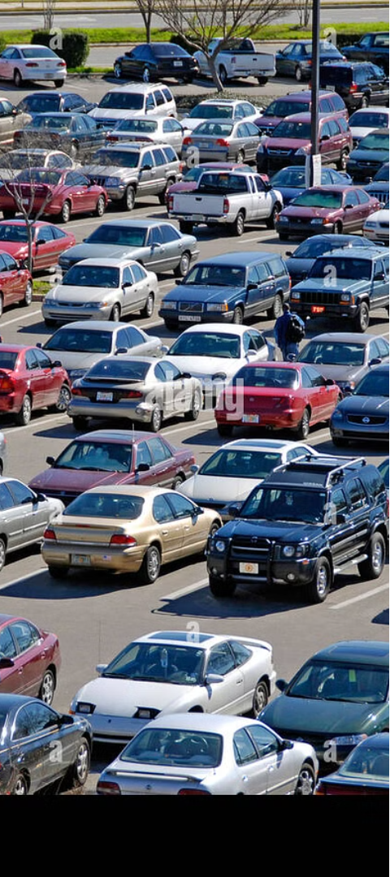
Motivation
1
Optimizing Space
2
Enhancing Safety
Ensure parking spots are fully utilized during peak hours.
Monitor for any hazards or security concerns.
3
Customer Service
Assist drivers with finding available spaces.

Slide 3
Overview
CNN Model
Pre-processing
Training
The implementation uses a CNN that processes 224x224 pixel color images of parking lots to detect if spaces are occupied.
Images are resized and normalized to prepare for processing by the CNN.
The model is trained on the PKLot dataset, with careful adjustment of learning rates and use of Dropout to prevent overfitting.
Data augmentation techniques like rotation and flipping are used to enhance the model's ability to handle different environmental conditions and variations in the dataset.
The architecture includes convolutional layers for feature extraction and fully connected layers for making predictions.
Performance is monitored using accuracy and loss metrics, with adjustments made to optimize the model’s predictive accuracy.

Slide 4
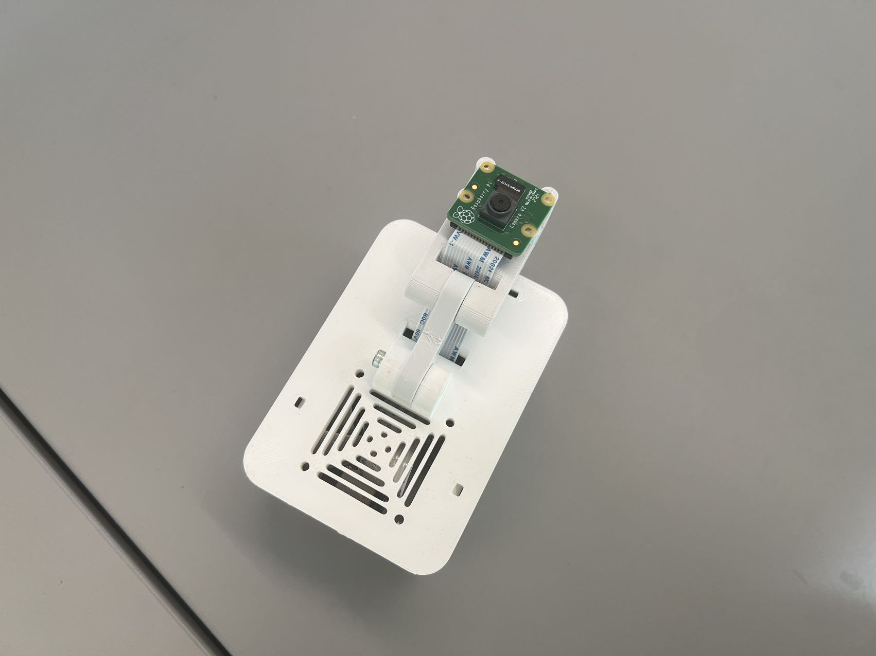
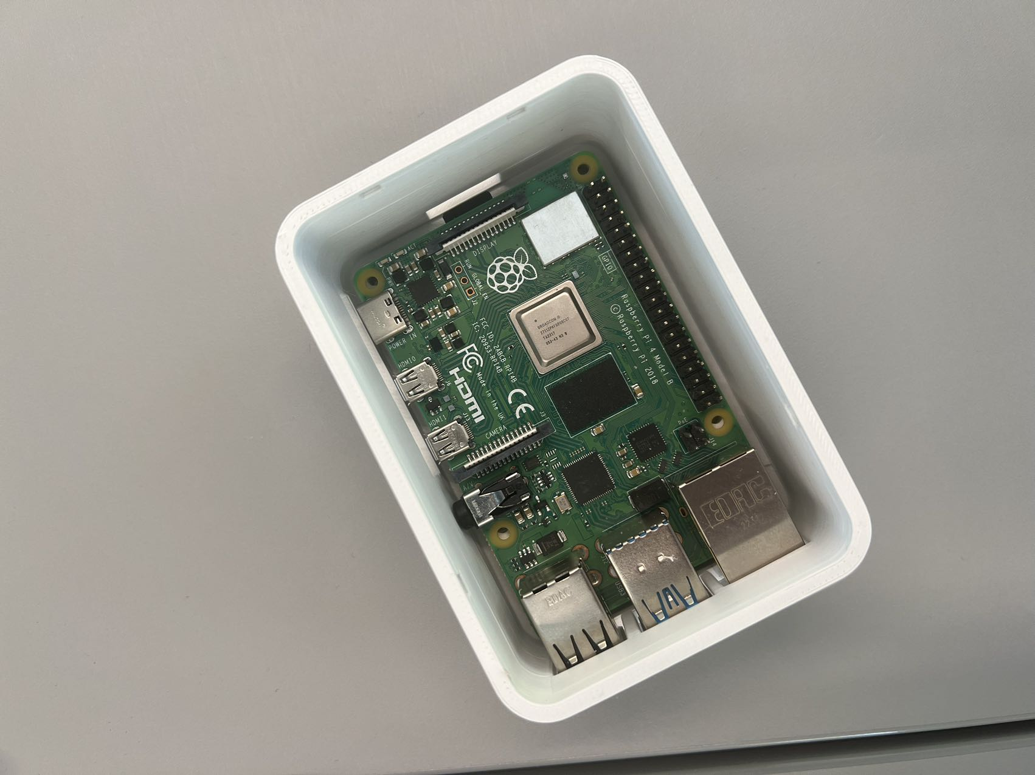
Closure

Slide 5
Reflection
Model Performance
Complexity
The model's effectiveness depends greatly on the diversity and quality of the training data, with challenges evident under varying conditions like poor lighting.
Balancing model complexity and practical application is crucial; more extensive networks need more data and computational power, but not fit for microcontroller.
Data Augmentation
Future Improvements
Properly adjusted data augmentation enhances model robustness, but excessive use can introduce misleading training scenarios.
Expanding the dataset, testing more advanced network architectures, and integrating object detection could significantly refine and enhance the model's accuracy and applicability.

