Slide 1
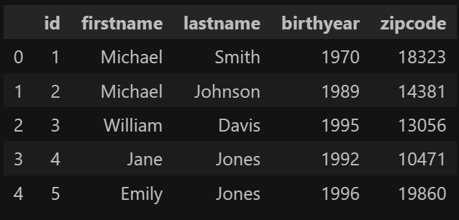
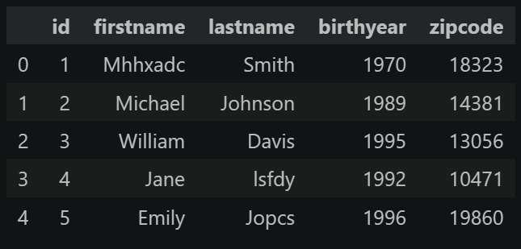
Why Record Linkage

Slide 2
Step 1 Data Simulation

Slide 3
Step 2 Data Matching
Deterministic Matching
Probabilistic Matching
- Python: ECM
- R: fastLink

Slide 4
Matching Tips: Blocking

Slide 5
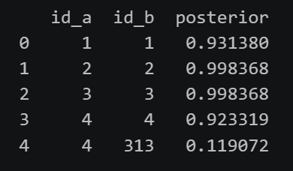
Threshold for Posterior Probability

Slide 6
Last Step:
The relationship between Threshold and Matching Counts & Matching Quality
High threshold -> ↓ counts & ↑quality & ↑false negatives
Low threshold -> ↑ counts & ↓ quality & ↑false positives

