Slide 1
CATEGORIES OF PERSONAL COMPUTER HARDWARE
BTO2101 Hardware of Informatics Systems
Week 2
Dr. M. Fatih ERKOÇ

Slide 2
Computers
All types of computers follow the same basic logical structure and perform the following five basic operations for converting raw input data into information useful to their users.
S.No. | Operation | Description
1 | Take Input | The process of entering data and instructions into the computer system.
2 | Store Data | Saving data and instructions so that they are available for processing as and when required.
3 | Processing Data | Performing arithmetic, and logical operations on data in order to convert them into useful information.
4 | Output Information | The process of producing useful information or results for the user, such as a printed report or visual display.
5 | Control the workflow | Directs the manner and sequence in which all of the above operations are performed.

Slide 3
A Computer System
A computer system consist of two fundemental component:
Hardware
the physical equipment such as the case, storage drives, keyboards, monitors, cables, speakers, and printers
Software
includes the operating system and programs.
Notes:
The operating system instructs the computer how to operate. These operations may include identifying, accessing, and processing information. Programs or applications perform different functions. (Windows, Unix, Linux, MacOS, Android, iOS etc. )
Programs vary widely, depending on the type of information that is accessed or generated.
For example, instructions for balancing a checkbook are very different from instructions for simulating a virtual-reality world on the Internet.

Slide 4
Computer Architecture
A computer’s hardware consists of three basic components:
Input Unit
This unit contains devices with the help of which we enter data into the computer. This unit creates a link between the user and the computer.
CPU (Central Processing Unit)
CPU is considered as the brain of the computer. CPU performs all types of data processing operations. It stores data, intermediate results, and instructions (program). It controls the operation of all parts of the computer.
Output Unit
The output unit consists of devices with the help of which we get the information from the computer.

Slide 5
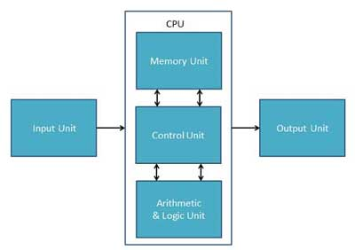
Computer Architecture…

Slide 6
Six Categories of Hardware: 1. Input Devices
Input devices used to enter information and commands.
An input device is any hardware device that sends data to a computer, allowing you to interact with and control it.
Keyboard
Mouse
Joy Stick
Light pen
Stylus
Track Ball
Scanner
Graphic Tablet
Microphone
Sensors (Xbox Kinect, Ultrasonic etc. )
Magnetic Ink Card Reader(MICR)
Optical Character Reader(OCR)
Bar Code Reader
Optical Mark Reader(OMR)

Slide 7
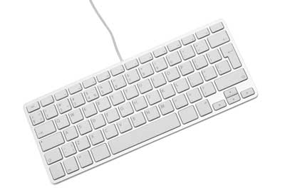
Keyboard
Keyboard is the most common and very popular input device which helps to input data to the computer.

Slide 8
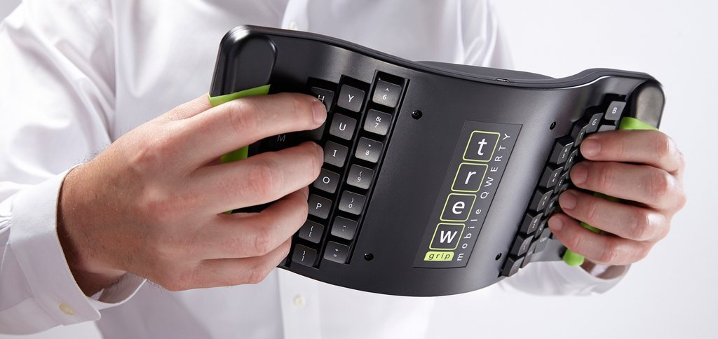
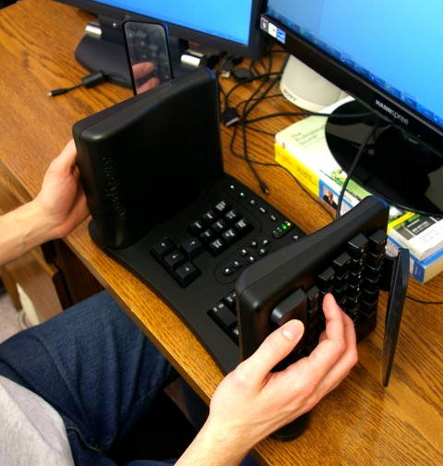
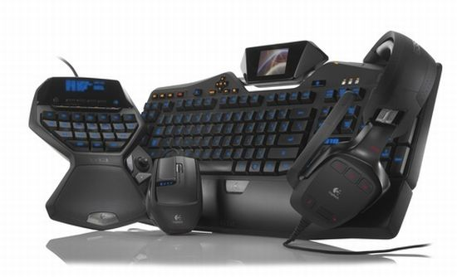
Keyboard

Slide 9
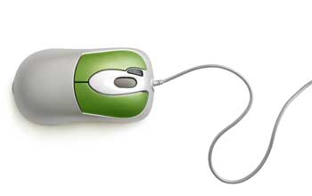
Mouse
Mouse is the most popular pointing device. It is a very famous cursor-control device having a small palm size box with a round ball at its base, which senses the movement of the mouse and sends corresponding signals to the CPU when the mouse buttons are pressed.

Slide 10
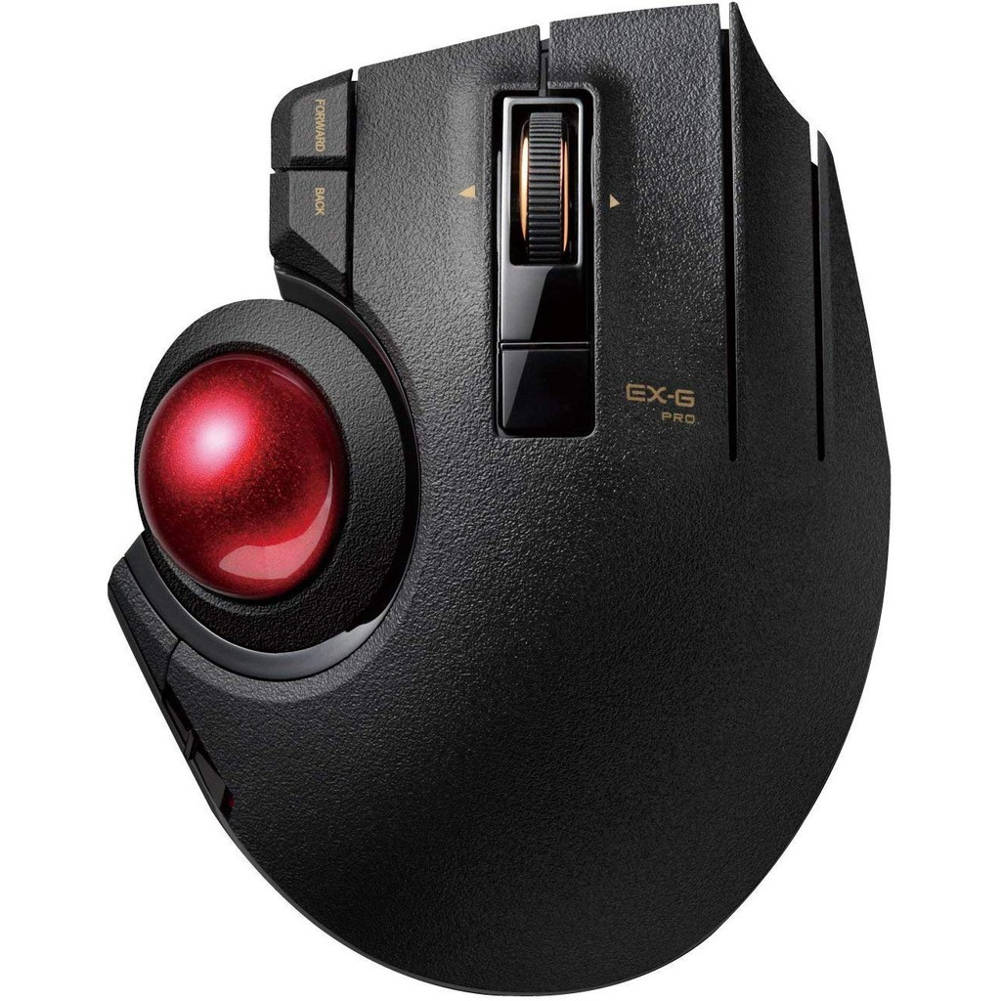
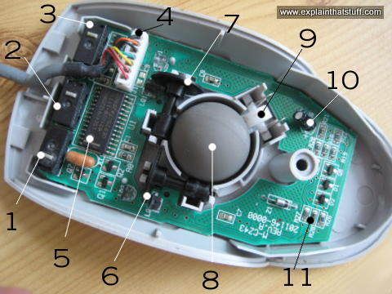
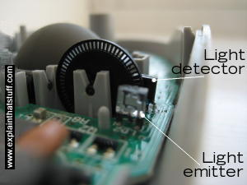
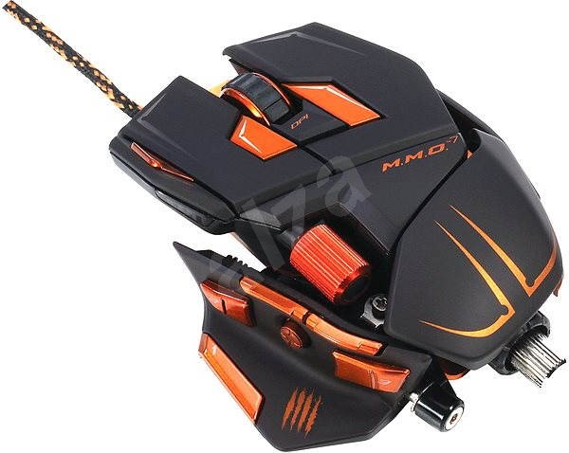
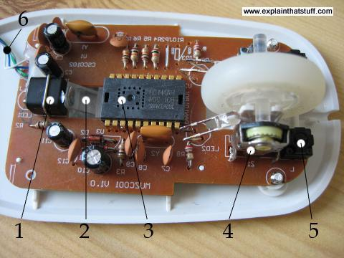
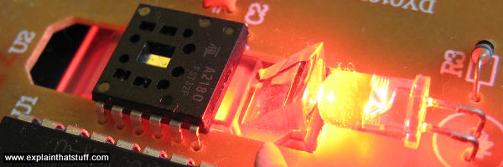
Mouse

Slide 11
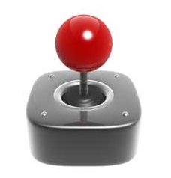
Joystick
Joystick is also a pointing device, which is used to move the cursor position on a monitor screen.
It is mainly used in Computer Aided Designing (CAD) and playing computer games.

Slide 12
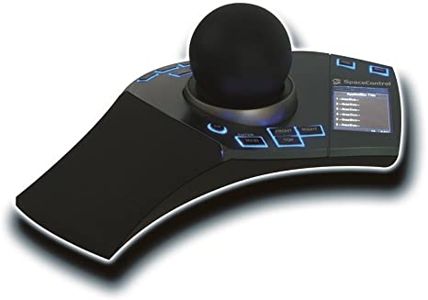
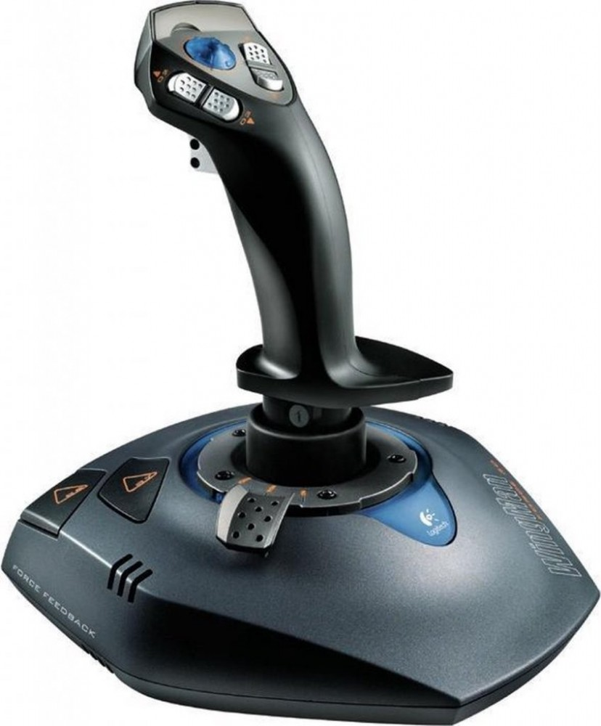
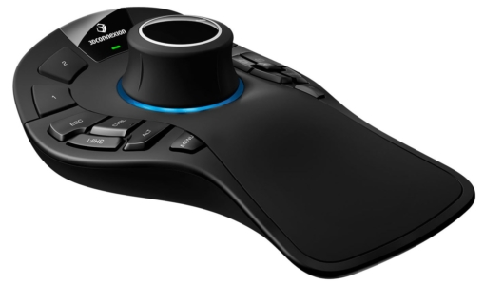
Joystick

Slide 13
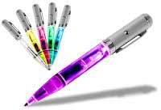
Light Pen
Light pen is a pointing device similar to a pen. It is used to select a displayed menu item or draw pictures on the monitor screen.
It consists of a photocell and an optical system placed in a small tube.

Slide 14
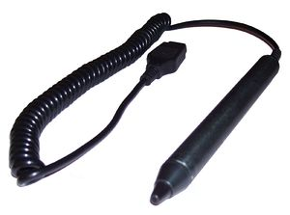
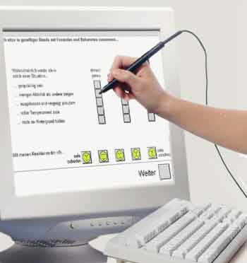
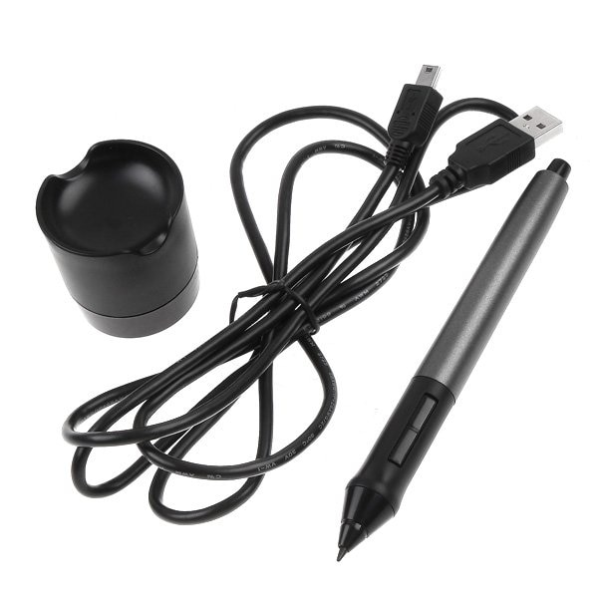
Light Pen

Slide 15
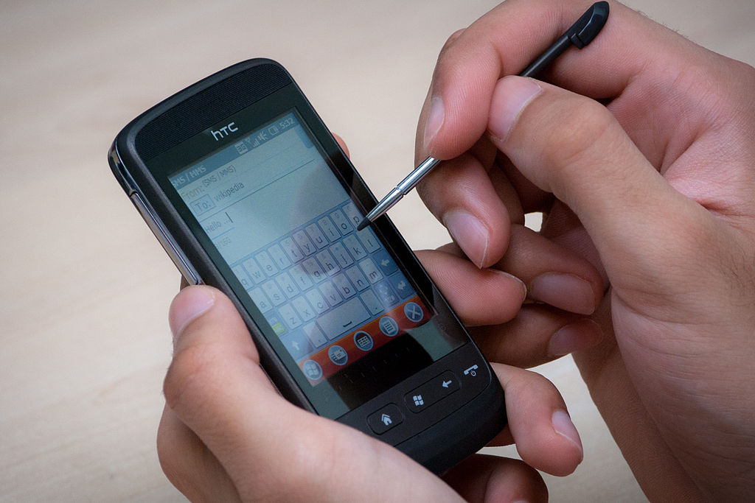
Stylus
A stylus (or stylus pen) is a small pen-shaped instrument that is used to input commands to a computer screen, mobile device or graphics tablet.

Slide 16
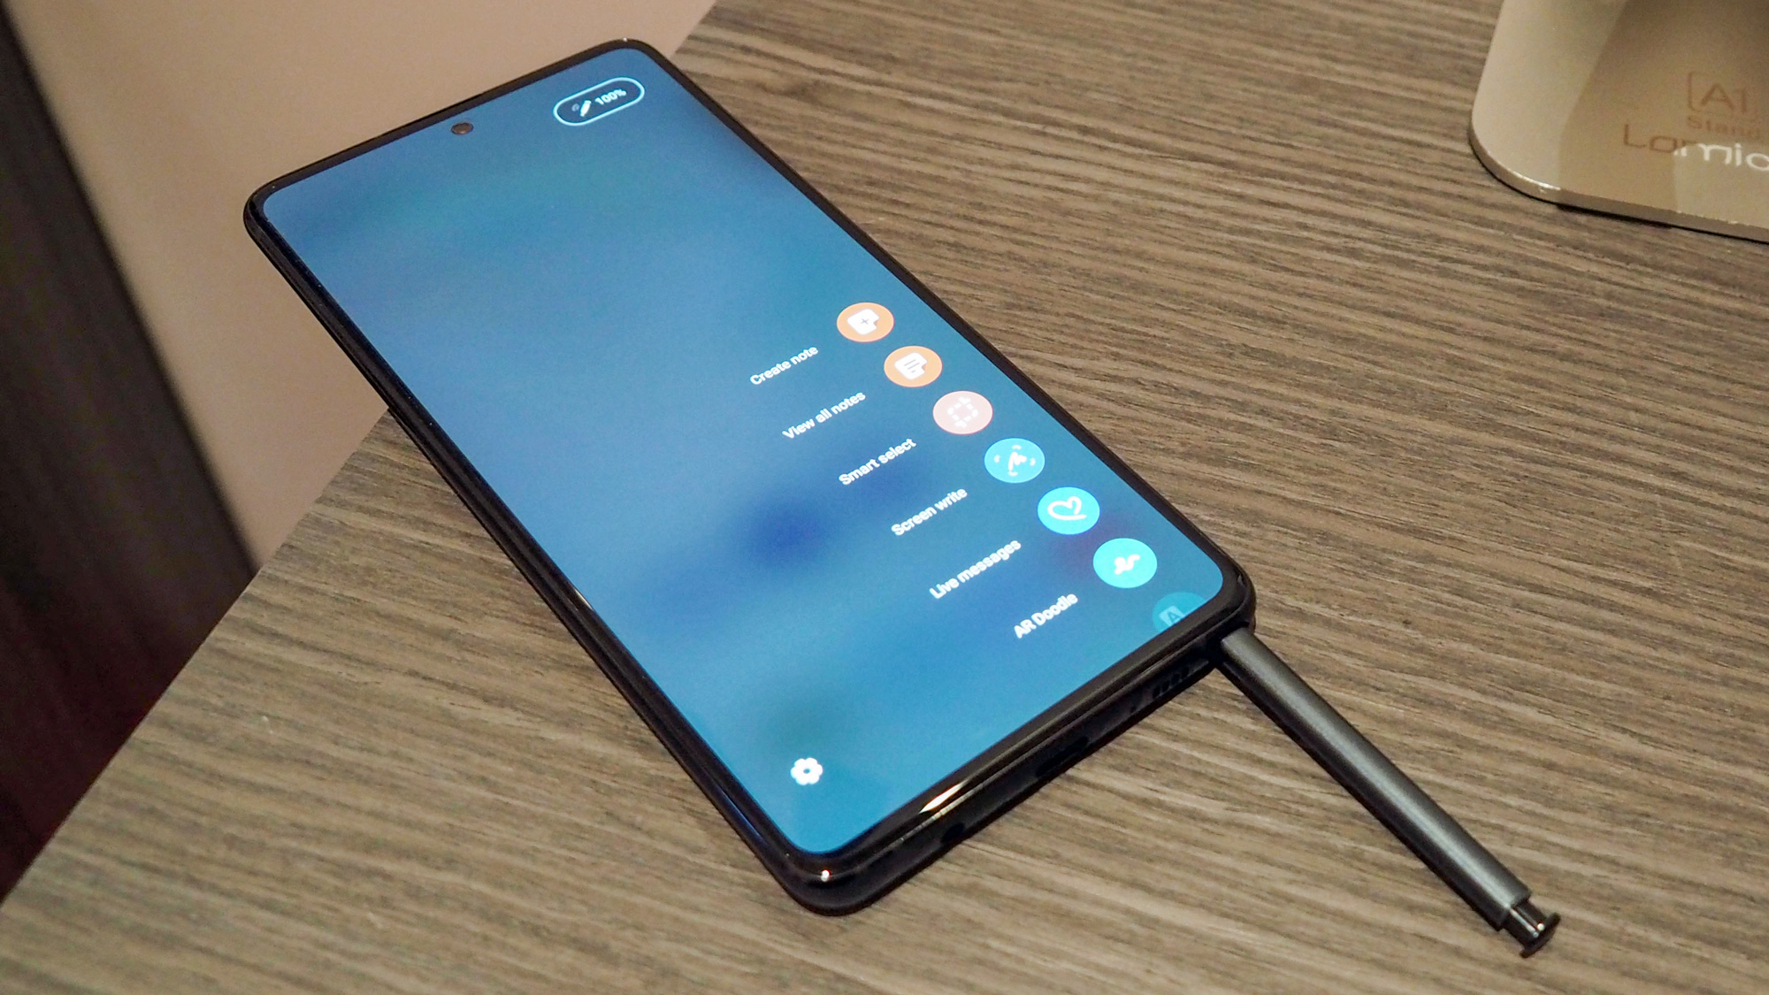
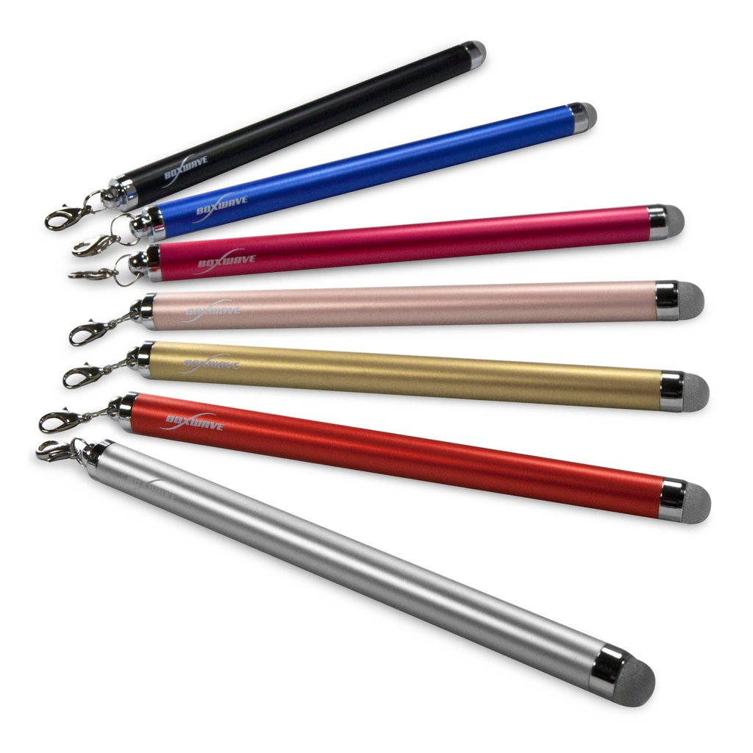
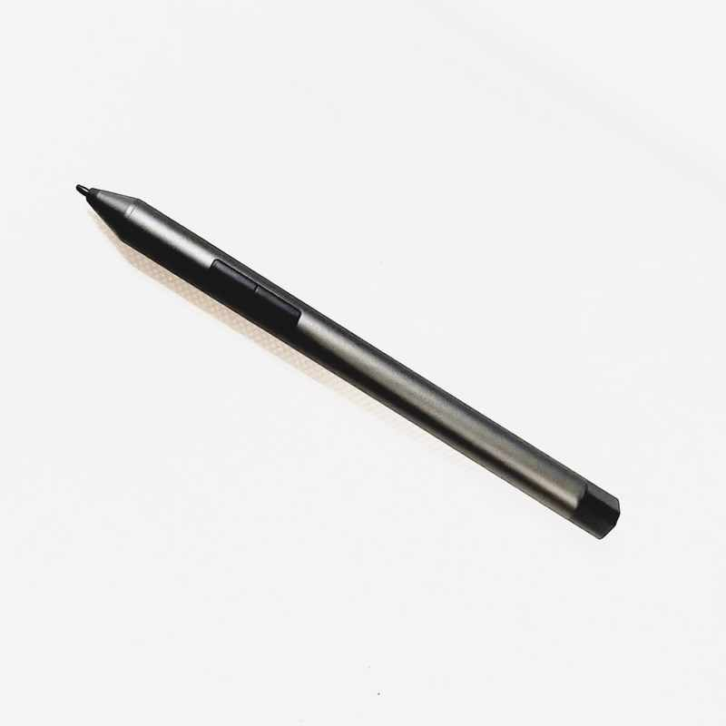
Stylus

Slide 17
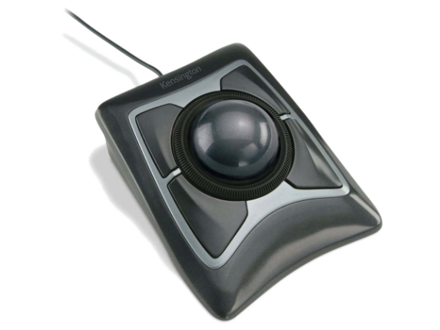
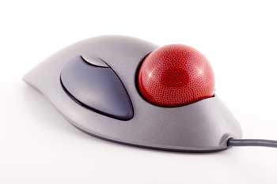
Track Ball
Track ball is an input device that is mostly used in notebook or laptop computer, instead of a mouse.
This is a ball which is half inserted and by moving fingers on the ball, the pointer can be moved.

Slide 18
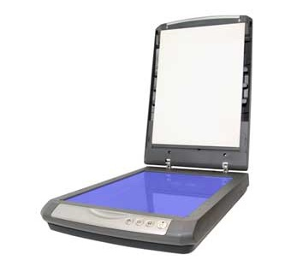
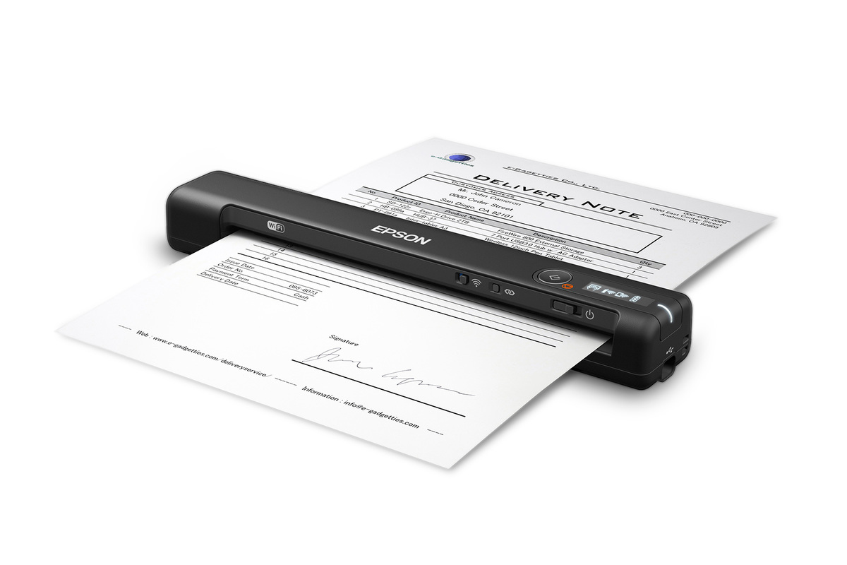
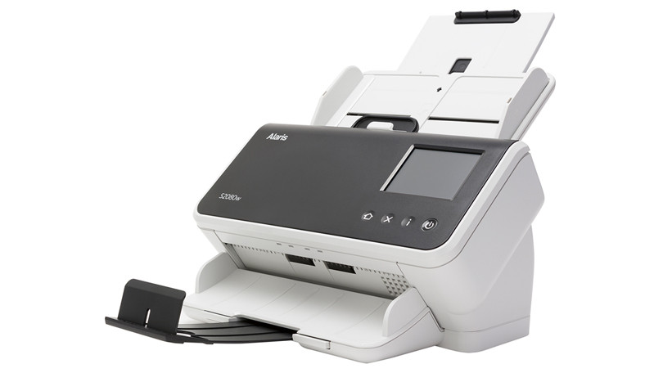
Scanner
Scanner is an input device, which works more like a photocopy machine.
It is used when some information is available on paper and it is to be transferred to the hard disk of the computer for further manipulation.

Slide 19
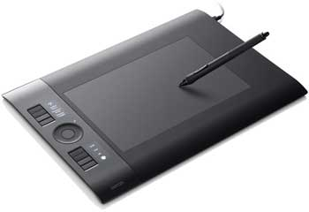
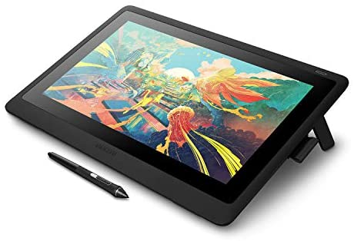
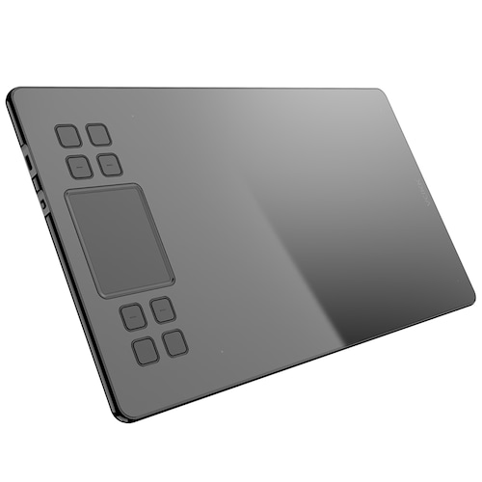
Digitizer
Digitizer is an input device which converts analog information into digital form.
Digitizer is also known as Tablet or Graphics Tablet as it converts graphics and pictorial data into binary inputs.

Slide 20
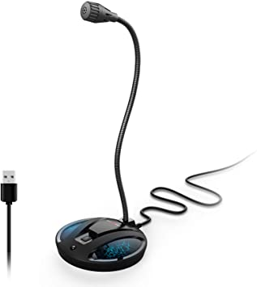
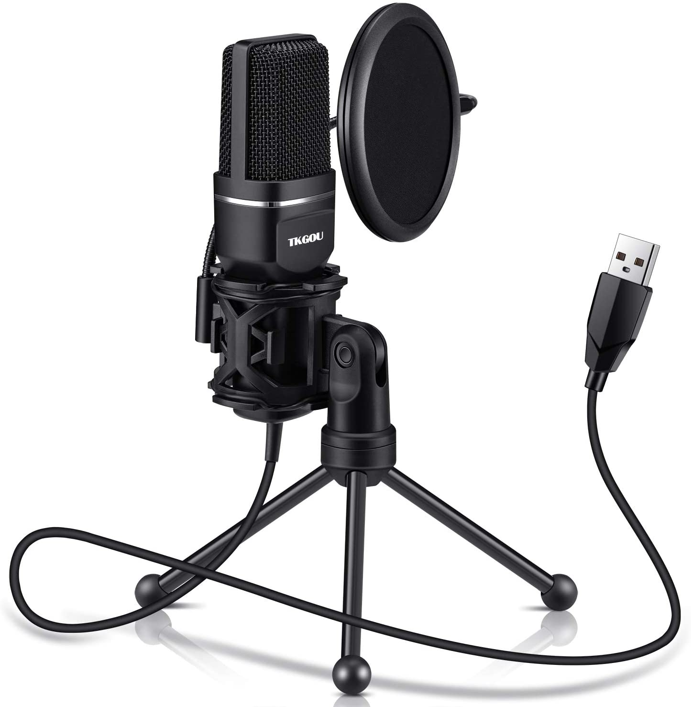
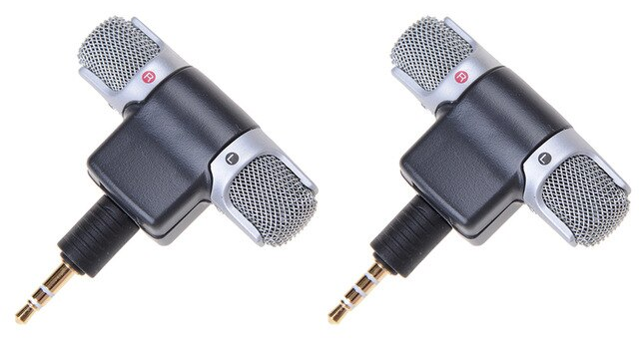
Microphone
Microphone is an input device to input sound that is then stored in a digital form.
The microphone is used for various applications such as adding sound to a multimedia presentation or for mixing music.

Slide 21
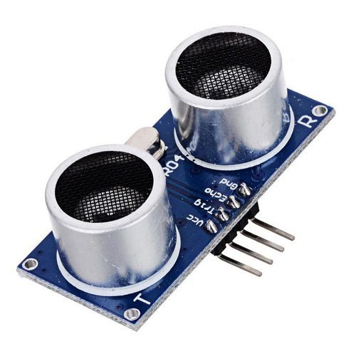
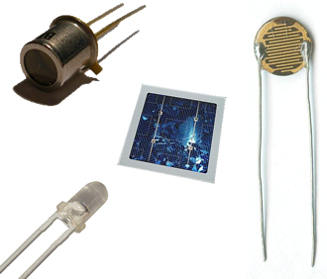
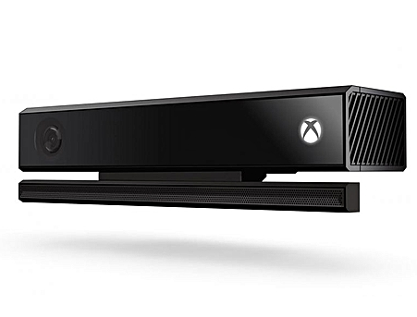
Sensors
A sensor is a device, module, or subsystem whose purpose is to detect events or changes in its environment and send the information to other electronics, frequently a computer processor.

Slide 22
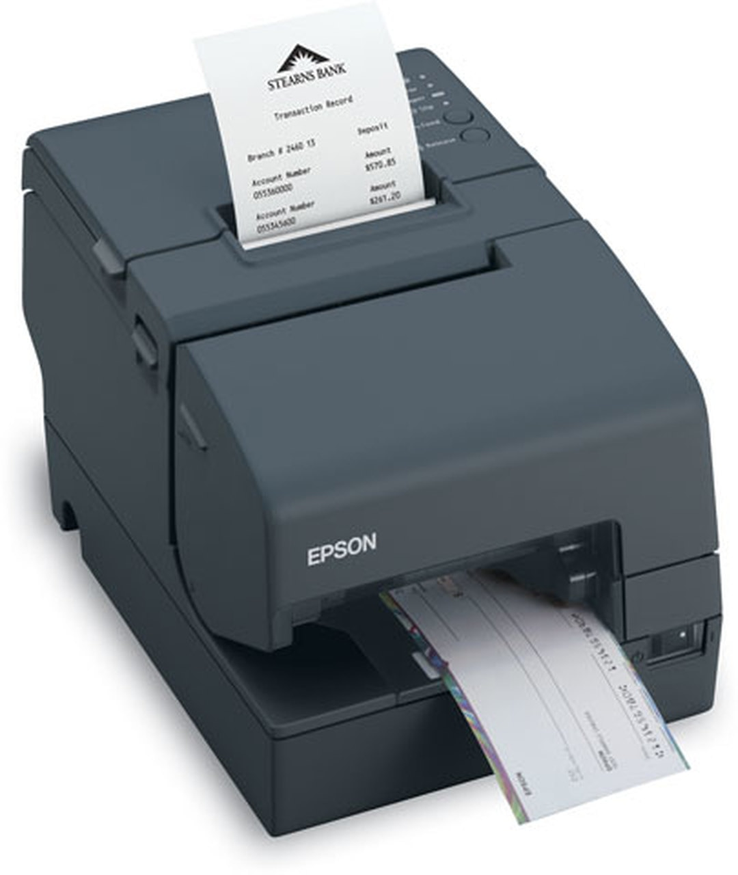
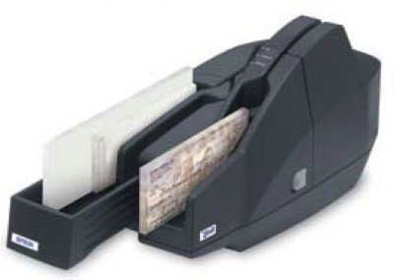
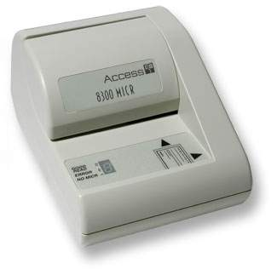
Magnetic Ink Card Reader (MICR)
MICR input device is generally used in banks as there are large number of cheques to be processed every day.
The bank's code number and cheque number are printed on the cheques with a special type of ink that contains particles of magnetic material that are machine readable.

Slide 23
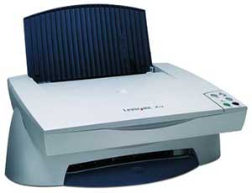
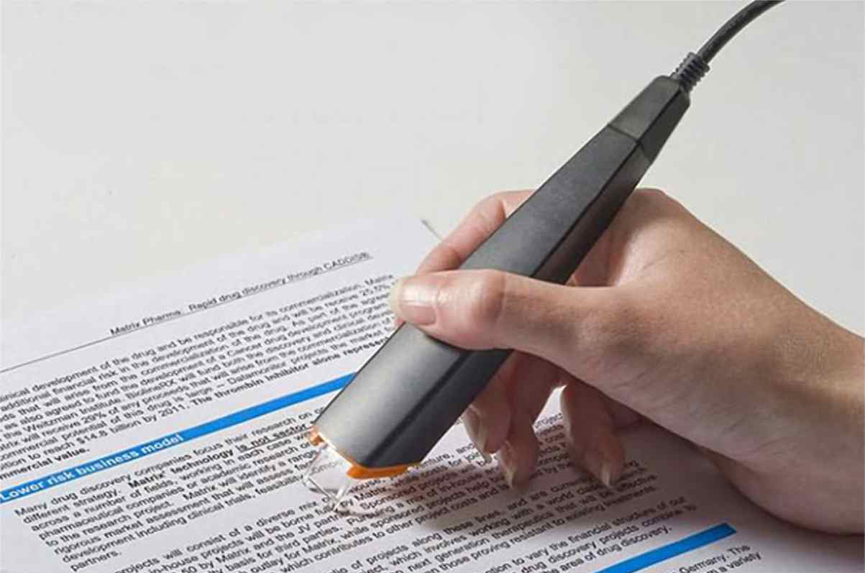
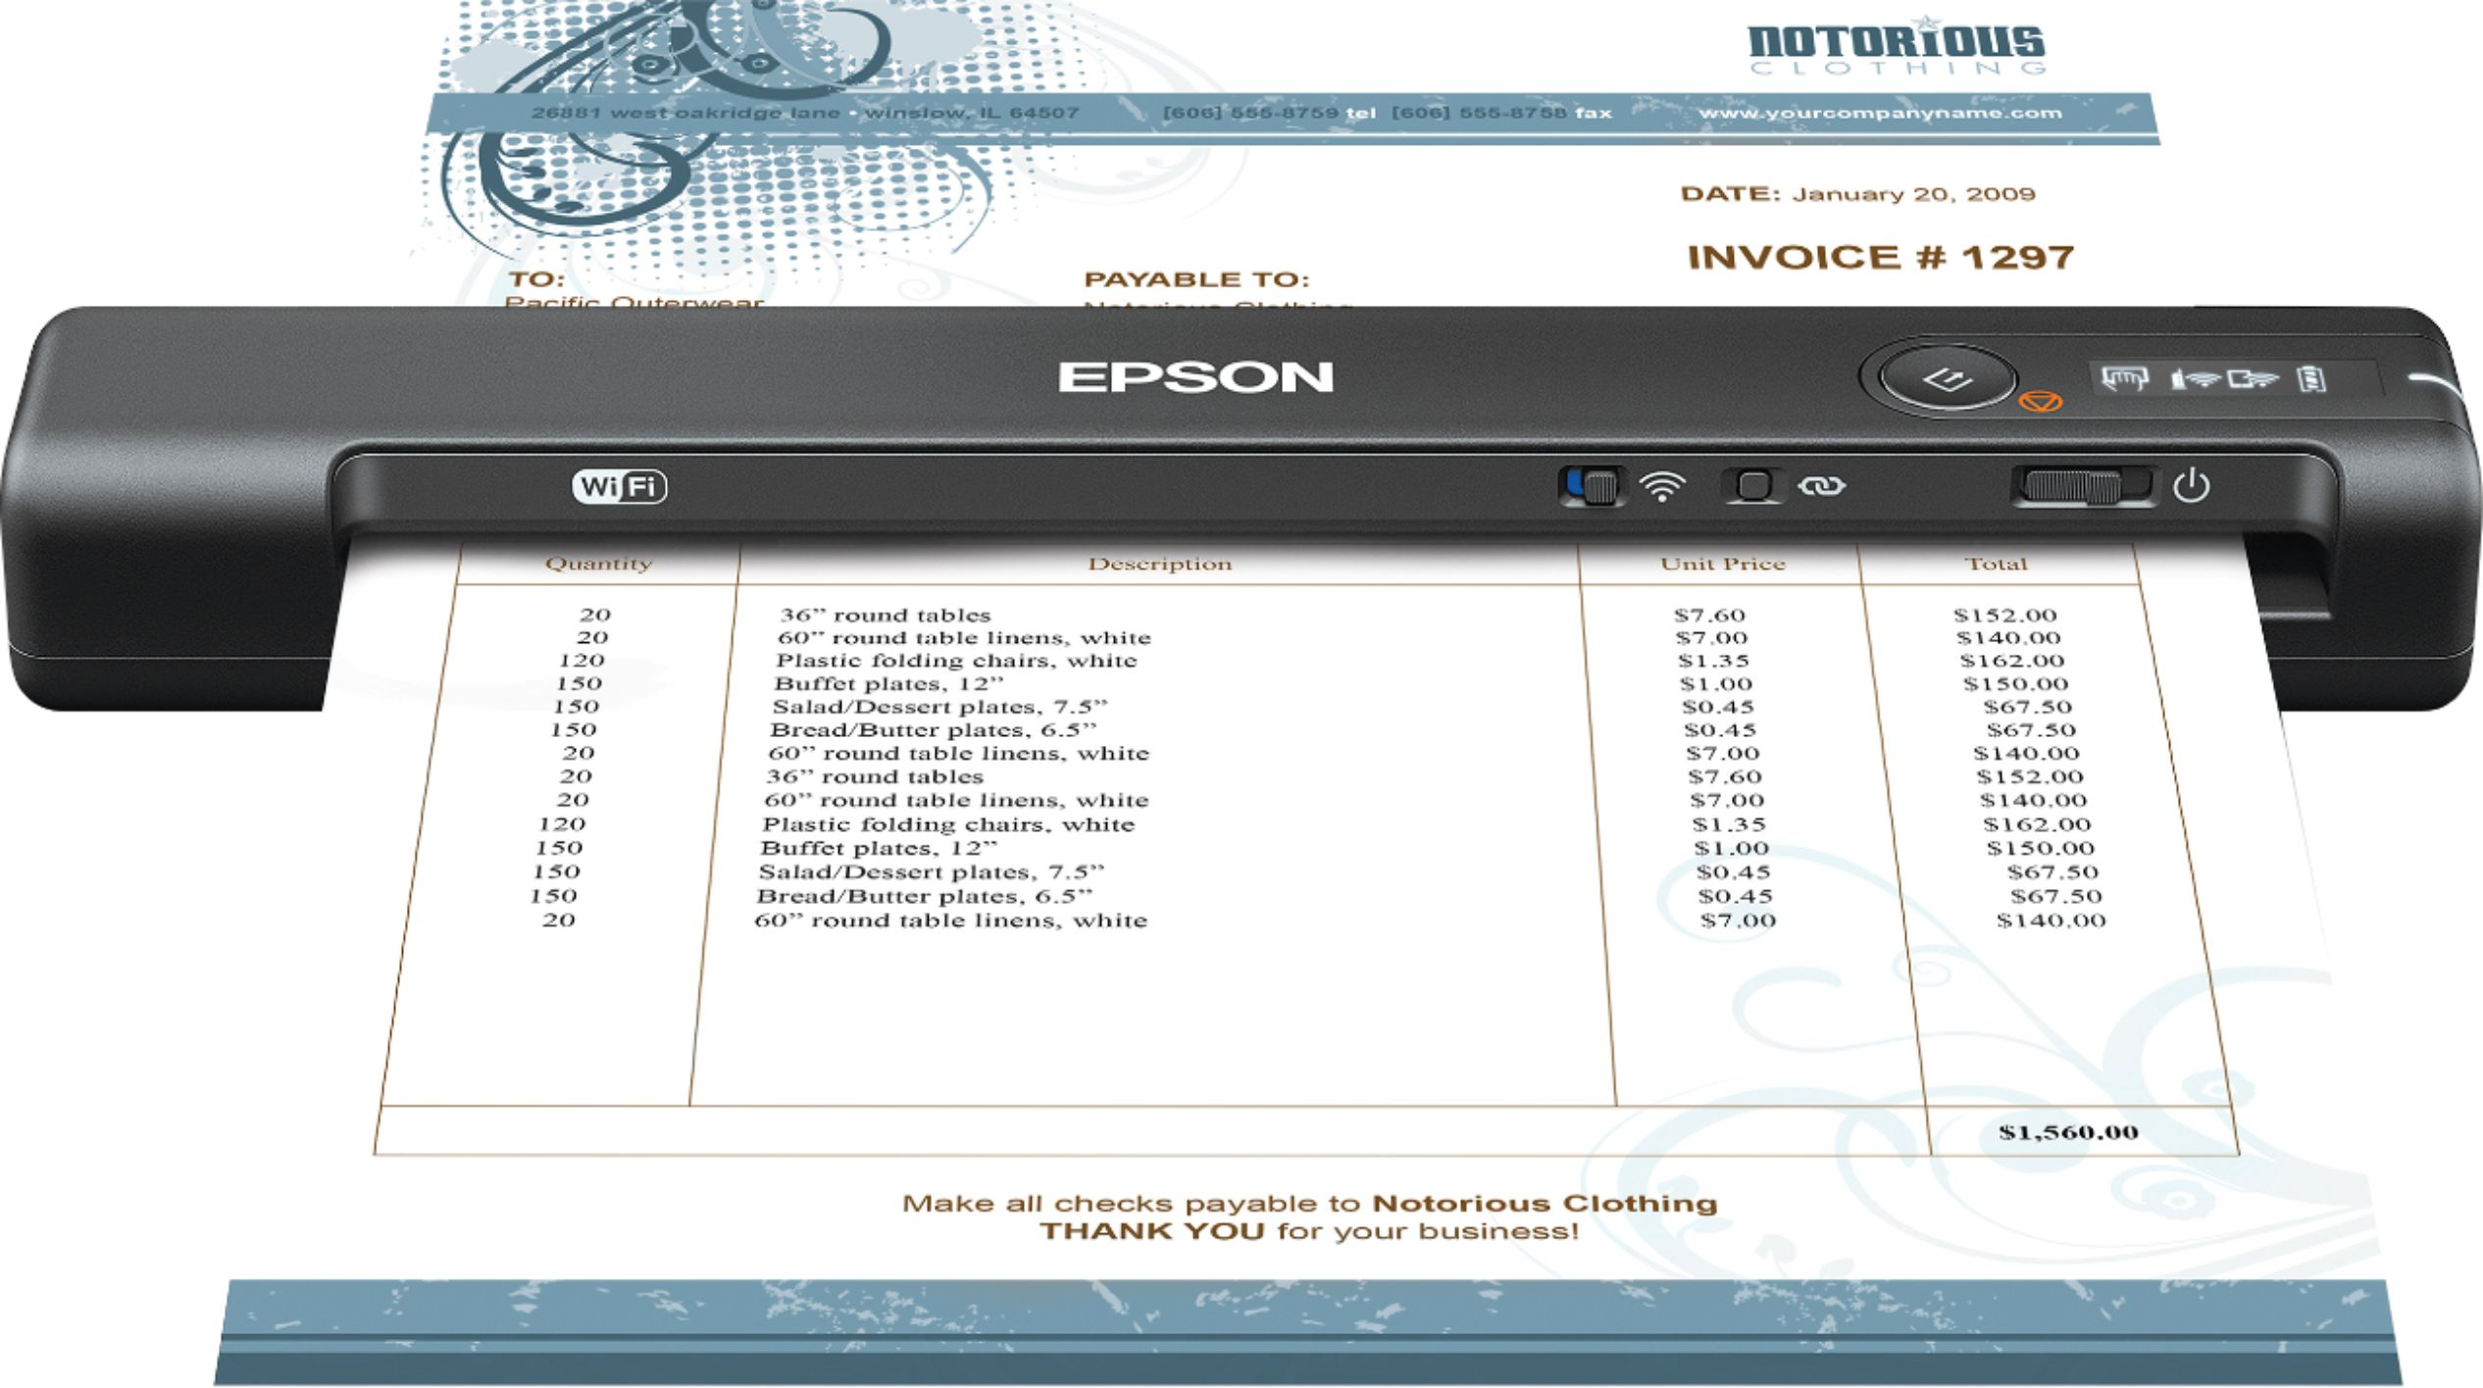
Optical Character Reader (OCR)
OCR is an input device used to read a printed text.
OCR scans the text optically, character by character, converts them into a machine readable code, and stores the text on the system memory.

Slide 24
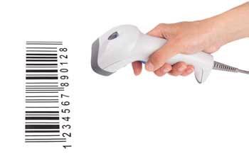

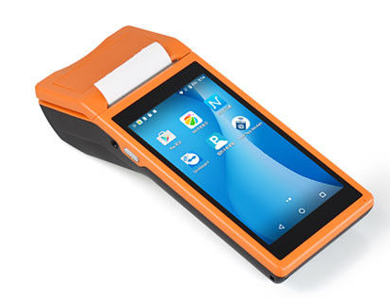
Bar Code Readers
Bar Code Reader is a device used for reading bar coded data (data in the form of light and dark lines).
Bar coded data is generally used in labelling goods, numbering the books, etc.

Slide 25
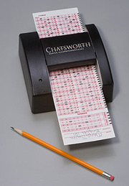
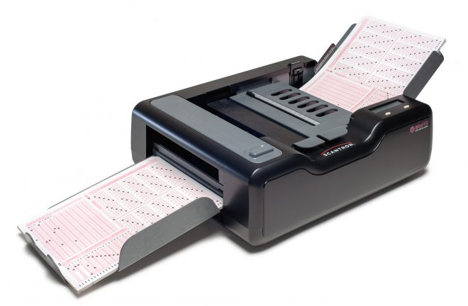
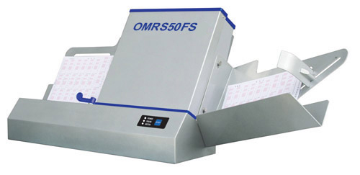
Optical Mark Reader (OMR)
OMR is a special type of optical scanner used to recognize the type of mark made by pen or pencil.
It is used where one out of a few alternatives is to be selected and marked.

