Slide 1
INTRODUCTION To INFORMATION TECHNOLOGIES
BTO1111 Information Technology in Education
Week 2
Dr. M. Fatih ERKOÇ

Slide 2
Introduction
Increasing the role of technology in daily life.
Increasing the amount of information and digital data.
Knowledge and data are the main key concepts.
Gap between contemporary business and schools.
Teachers of today should prepare to provide technology-based learning opportunities
The most effective forward leap has been for applying IT (information Technology) in the higher education since 1990
Notes:
We know that the role of technology in our daily life increases day by day. As a result, it is a fact that the amount of technological information and digital data has also increased.
Today knowledge and information are the main keys of obtaining the productivity, competition, wealth and comfort. So countries have concentrated on approaches for increasing the gaining of better-quality education. In order to develop the human capital, it is necessary to look at our schools and education and see if our education is progressing in step with the world that is changing and developing quickly.
The international society for technology in educational (ISTE)* emphasizes that the teachers of today should prepare to provide technology-based learning opportunities for the students.
In fact, preparation for applying the technology and awareness of technology to enhance the quality of the students learning should be one of the teacher's basic skills [2].

Slide 3
Definition of Information Technologies
Create, process, store, secure and exchange of these electronic data.
Akpınar (2001) defines information technology as the use of engineering and management techniques in the collection, processing, storage, and publication of information and social, economic and cultural structures related to theese techniques.
Notes:
Information technology (IT) is the use of any computers, storage, networking and other physical devices, infrastructure and processes to create, process, store, secure and exchange all forms of electronic data.

Slide 4


Component of Information Technology
1. Physical equipments (hardware)
2. Virtualization and management or automation tools, operating systems and applications (software).

Slide 5
Importance and Role of IT in the Education
Students access the out-of-class information.
Increase of students’ motivations for learning.
Virtual tutorial program,
Possibility of expediting the process of information dissemination,
Various recognizable and repeatable learning sources,
More flexible structure,
Information search etc.

Slide 6
Properties of Education System in IT Age
What is worthy of knowing and what is necessary is stoned.
The teacher helps the student to obtain, select, evaluate and store the information by the use of vast scope of sources.
Printed books and magazienes vs. online books and magazines.
Students learn their lessons by using technical tools in less time (!!!).

Slide 7
Reflections of IT and Information Society
Enriching spare time
Enabling teleworking.
Providing new opportunities for raising national productivity and competitive atmosphere.
Increasing employment.
Life-long education (!!!).

Slide 8
History of Technology in Education
Watch this video
youtube.com/watch?v=UFwWWsz_X9s
and write a reflection about this video.

Slide 9
Tell me… show me… Involve me…
Tell me and I’ll forget
show me and I may remember
involve me and I’ll understand

Slide 10
Bloom’s Taxonomy
Developing taxonomy of pedogogical goals in 1956.
Bloom’s Taxonomy involved three domains:
Cognitive,
Affective,
Psychomotor.
Cognitive domain assumed that learning of higher levels depends on the learning of knowledge and skills in the lower levels

Slide 11
Core Idea of Bloom’s Taxonomy
We must remember a concept before we can understand it.
We must understand a concept before we can apply it.
We must be able to apply a concept before we analyze it.
We must have analyzed a concept before we can evaluate it.
We must have remembered, understood, applied, analyzed, and evaluated a concept before we can create.

Slide 12
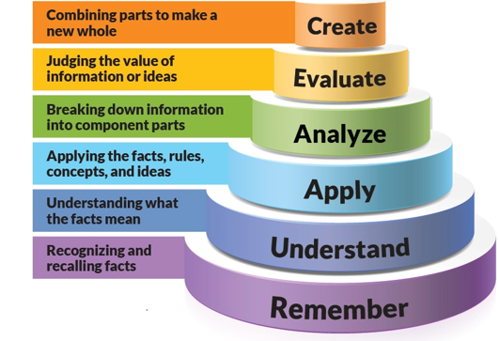
The Pyramid of Levels of Bloom’s Taxonomy

Slide 13
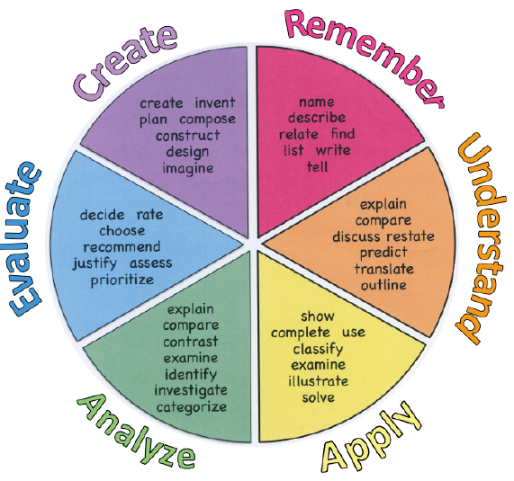
Bloom’s Verb Wheel

Slide 14
Creating Pedagogical Goal
In general, to formulate a pedagogical goal you must use the following three elements:
An action verb in the infinitive (from Bloom’s verb wheel)
Content (data, concepts, procedures, processes, attitude… )
Circumstances (level of domain, media used, scope)
A well formulated pedagogical goal could be: “To analyze the quality procedures used to evaluate higher education”.

Slide 15
Creating Pedagogical Goal Example
You are an English teacher of 20 students who have never studied English before. Your first pedagogical goal is teaching numbers 1-10. According to formulation:
You can choose a verb from level 1 of Bloom’s Taxonomy: remember. For instance "name".
You should add the content: "the numbers from one to ten in English".
You don’t need any circumstances for these issue.
Your formulated pedagogical goal is: “Today, our goal is to name
the numbers from one to ten in English”.

Slide 16
Remember And Understand New Knowledge
Remember previously learned information, such as data (names, dates, numbers, facts…) or concepts (principles, methods, theorems,…).
Third president of Turkey: Celal Bayar (name)
Date of the Ankara War: 1402 (Dates)
Electrical power formula: P=i x V (principles)
Pedagogical Goal Example: “To memorize the letters of the alphabet” or “To name the main characters of the story”.

Slide 17
Remember And Understand New Knowledge…
To demonstrate an understanding of the facts. It could be a sequence in a procedure, or processes.
The “comprehension” level is appropriate for students who have learnt something, and now they have to prove they have understood it.
A pedagogical goal would be: “To give an example of adding two numbers” or “To summarize the story in your own words in three lines”.

Slide 18
Apply and Analyze Knowledge and Competences
To apply knowledge to actual situations.
The “application” level is appropriate for students who already understand some knowledge, and they have to start applying it.
A pedagogical goal for them would be: “To solve this Math problem by using one addition” or “To write a different ending in which the main character of the story changes his behavior so that he is now less shy”.

Slide 19
Apply and Analyze Knowledge and Competences…
To break down objects or ideas into simpler parts and find evidence to support generalizations.
The “analysis” level is appropriate for students who already understand some knowledge, they know how to apply it and now they need to analyze it to be able to do generalizations.
A pedagogical goal for them would be: “To solve this Math problem explaining the techniques used and how they have been applied together” or “To diagnose the illness of the patient according to the data provided”.

Slide 20
Evaluate and Create
To compile component ideas into a new whole or propose alternative solutions.
This level is appropriate for students who already understand some knowledge, they know how to apply it, how to do an analysis and, now they need to evaluate the knowledge and think of other possibilities.
A pedagogical goal for them would be: “To devise the optimum combination of techniques to solve each problem on the list provided” or “To find a better solution to the problem than the one provided”.

Slide 21
Evaluate and Create…
To make and defend judgments based on internal evidence or external criteria.
This level is appropriate for students who already understand some knowledge, they know how to apply it, how to do an analysis, how to evaluate it, and now they need to create their own knowledge.
A pedagogical goal for them would be: “To propose a new technique to solve the problem given”.

Slide 22
You can’t be my teacher…
https://www.youtube.com/watch?v=0VSymMbMYHA
Notes:
Are you going to teach me in a school? Are you going to make me sit in a desk all day? Is this what you are going to use to teach me with? Is this what you are going to use to teach me with? (echo) Do you know how to use a computer? Do you know how to use a computer? (echo) Are you a teacher? Are you my teacher? Are you going to teach me using the internet? Are you going to teach me how to be safe on the internet? Do you know what goes on on the internet? Are you sure you are my teacher? Are you sure you are my teacher? (echo) Are you going to learn how to use the technology? I am a digital native. Do computers scare you? Are you afraid to use them? Have you been on facebook? Have you been on twitter? Have you been surfing? Do you even know what is on the internet? Are you going to be my teacher? Or just that textbook? Because I want to know... what the world has to offer And if you are not on the internet... and know nothing about computers. you can't be my teacher! I said you can't be my teacher. Make room for somebody who knows how to use the internet. Do you think I am going to be ready? Do you think I am going to be ready? Do you think you are preparing me for the world that I have to live in? Do you think I am going to be ready? That's your job! That's your job! (echo)

Slide 23
Exercise 1
According to Bloom’s Taxonomy, categorize these verbs as educational goals in one of the six levels of the taxonomy:
Understand
Translate
Compose
Cite
Estimate
Know
Apply
Synthesize
Notes:
Understand, 2; Translate, 3; Compose, 5; Cite, 1; Estimate, 6; Know, 1; Apply, 3;
Synthesize, 5.

Slide 24
Exercise 2
Watch the video presented on the next slide and write the top ten reasons for using technology in education according to that video.
Prepare your papers and pens, please.
Get ready!!!

Slide 25
Exercise 2...
https://www.youtube.com/watch?v=9DVdIq2c3Jw
Notes:
–– Students love it.
–– It engages key components of learning.
–– Professional development.
–– Makes life easier for teachers.
–– Improves test scores.
–– Help students with low attention spans.
–– Learn from the experts.
–– Encourages completion of homework.
–– Saves money.
–– Remove obstacles.

Slide 26
Exercise 3
Watch the video presented on the next slide…

Slide 27
Exercise 3…
https://www.youtube.com/watch?v=rvyP-cwpHN8

Slide 28
Exercise 3…
Think about reasons why you could follow the call to action and write a paragraph (min. 300 words) which reflect your opinion.

Slide 29
Assignment
Formulate a pedagogical goal for each one of Bloom’s taxonomy levels for the area of knowledge in which you teach (or would like to teach).

