Slide 1


DeKalb Chinese School Beginner Class Jingwan Li(Yilia)

Slide 2
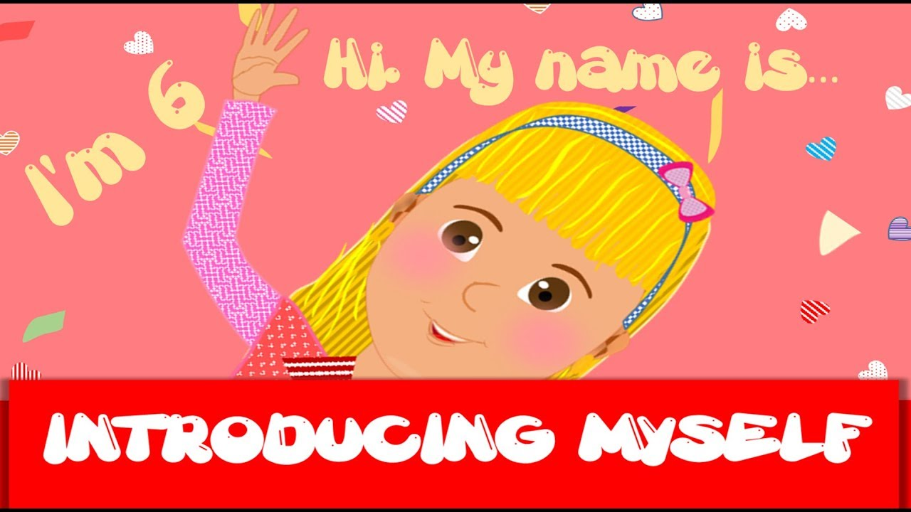

Slide 3
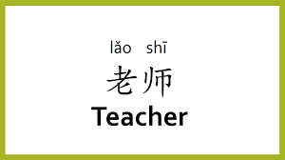
Notes:
李 is my surname, 老师 is my occupation
In your class, how you call your teacher? Their first name?
In Chinese, teacher is a honorific, which can show your respect to someone
In Chinese class, we cannot say teacher’s full name, which is not respect. We use surname and this occupation

Slide 4
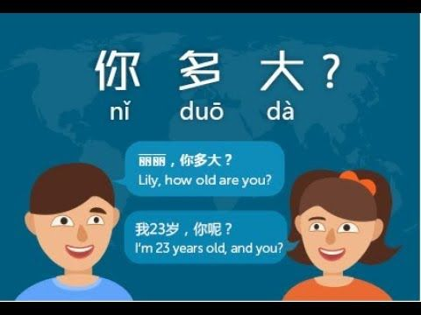
Notes:
In china, we do not ask adult about their age, especially for a women. Why?

Slide 5
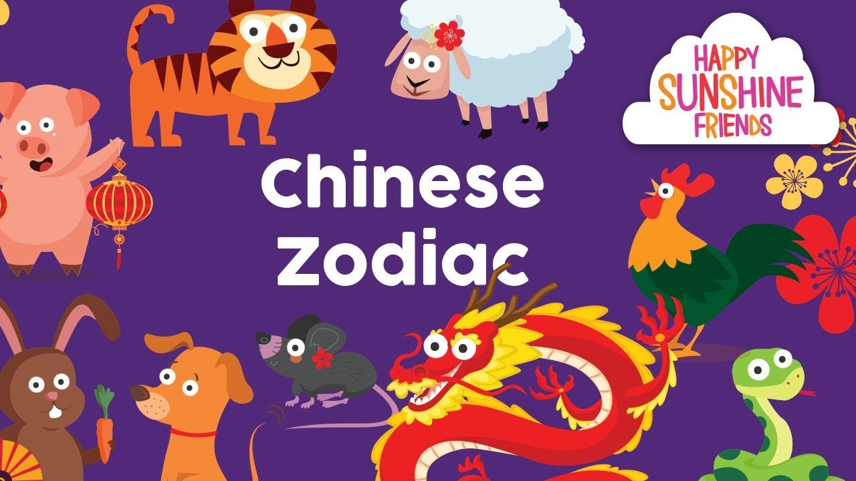
Notes:
How many Chinese Zodiac do we have? 12
Tell me some

Slide 6
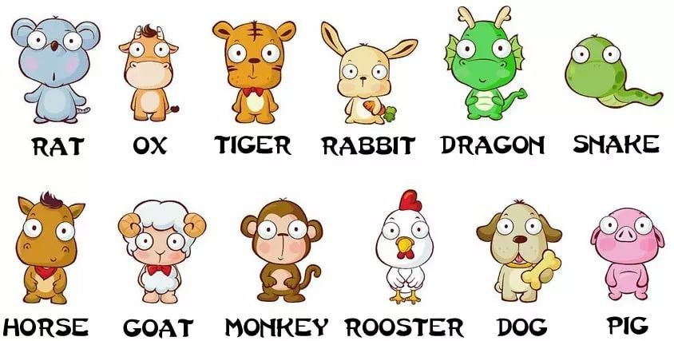
https://www.ted.com/talks/megan_campisi_and_pen_pen_chen_the_myth_behind_the_chinese_zodiac/transcript?language=zh-cn#t-1936
https://www.astrosofa.com/horoscope/calculate-chinese-zodiac-sign

Slide 7

Know China Before Learning Chinese
What is the full name of China?
People’s Republic of China
What is the population of China?
1.3 billion
How many ethnic groups in China?
56
How to say Chinese in Chinese?
https://www.youtube.com/watch?v=V5uJ3qkzO0Q&list=PLZ27m2K2W5n4Bg3Ko9keodBx_JD_IigOp

Slide 8
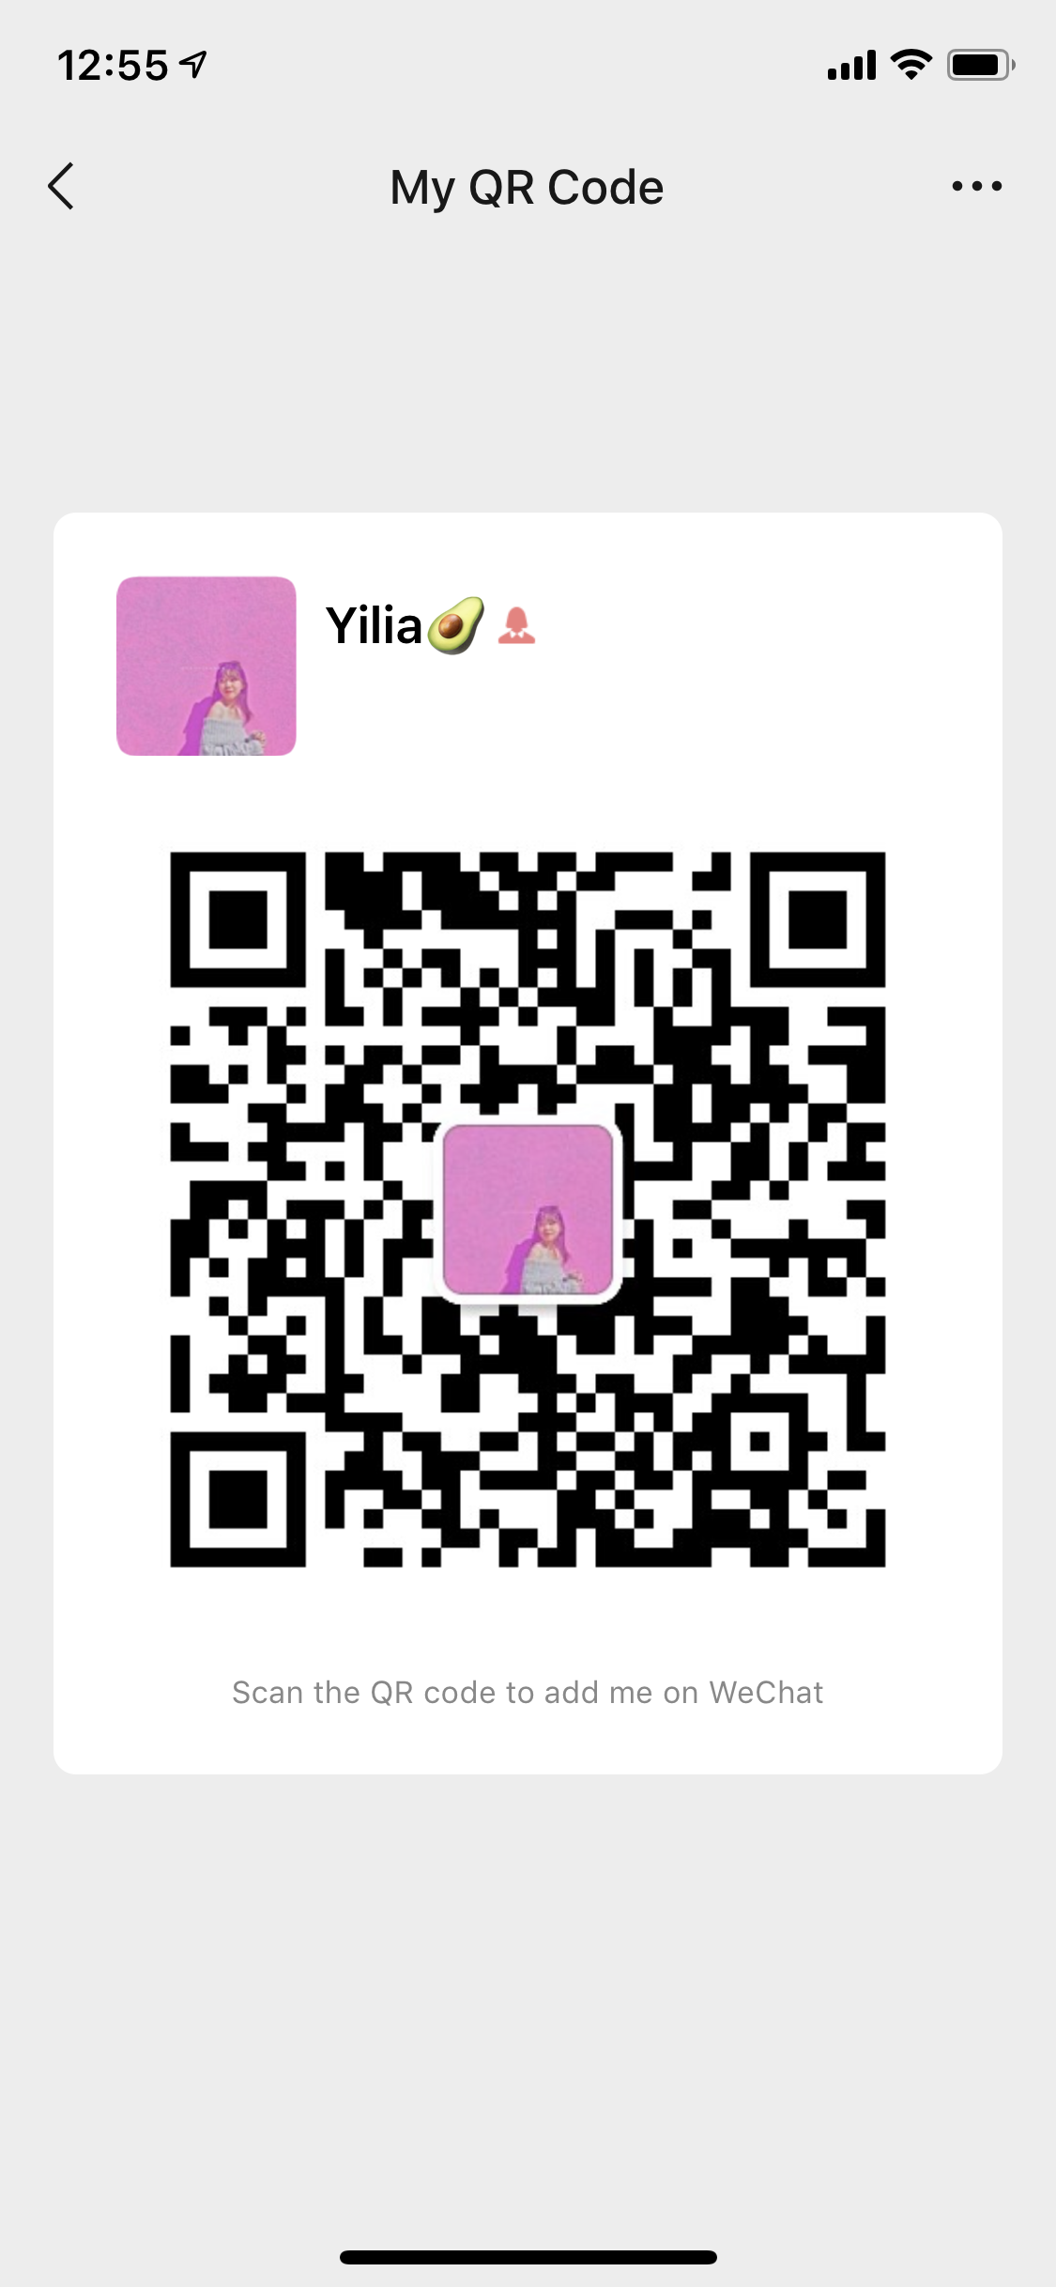

Jingwan Li / Yilia 312-593-5282
1. Download WeChat
2. Sign up
3. Scan my QR code

