Slide 1

Daily Expression
DeKalb Chinese School Jingwan Li

Slide 2

你好 /nǐ hào/ Hello
再见
/zài jiàn/
Goodbye

Slide 3

早上好 / zǎo shàng hǎo/ Good Morning

Slide 4

老师好 /lǎo shī hǎo / Hello Teacher
同学们好
/ tóng xué men hǎo /
Hello Everyone

Slide 5

跟我读 / gēn wǒ dú / Read after me
再说一遍
/ zài shuō yī biàn /
Once again please

Slide 6

上课了 /shàng kè le/ class begin
休息一下 /xiū xi yī xià/ Take a break

Slide 7
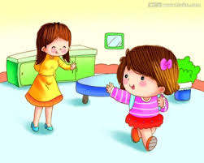
下课了 /xià kè/ Class is over

Slide 8

谢谢 / xiè xiè / Thank you
不客气 /bú kè qì /
You are welcome

Slide 9
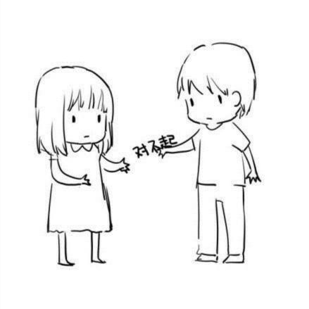
对不起 /duì bù qǐ/ I am sorry
没关系 /méi guan xi/ No problem

Slide 10
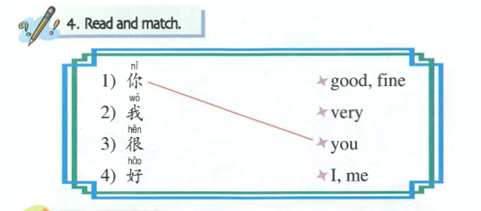

Slide 11

中国
/zhōng guó/
China

Slide 12

中国
/zhōng guó/
China

