Slide 1
Disney’s Reviews Analysis
Team 5
Members: Yilin Ye, Xin Li, Tianying Zhao

Slide 2
Content
Background
EDA
Logistic Regression & Text Classification
Sentiment Analysis

Slide 3
Background & Goals
The dataset includes 42,000 reviews of 3 Disneyland branches - Paris, California and Hong Kong, posted by visitors on TripAdvisor.
We are trying to:
Explore the correlation between comments and ratings
Looking for the difference between each branch

Slide 4
Data
Name: DisneylandReviews
Format: CSV
Size: 32.06 MB
Columns:
Review ID: unique id given to each review
Rating: 1 to 5
Year Month: when the reviewer visited the theme park
Reviewer Location: country
Review Text: comments made by visito
Branch: location of Disneyland Park

Slide 5
Data
Missing Values:
Year_Month: 6.13%
Drop duplicated Review IDs:
42,656 → 42,636

Slide 6
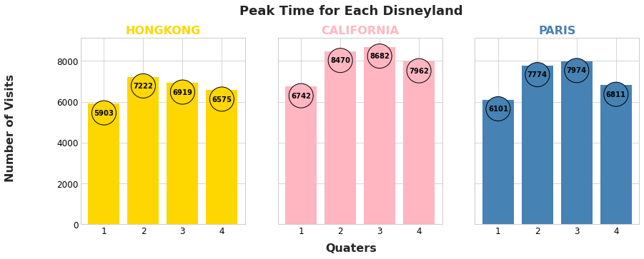
EDA - Peak Time

Slide 7
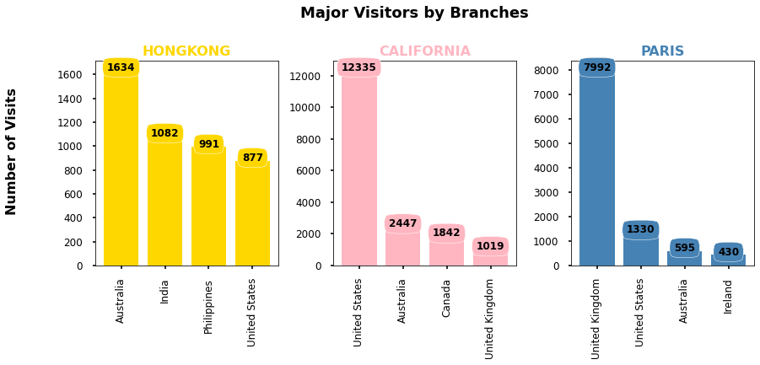
EDA - Major Groups

Slide 8
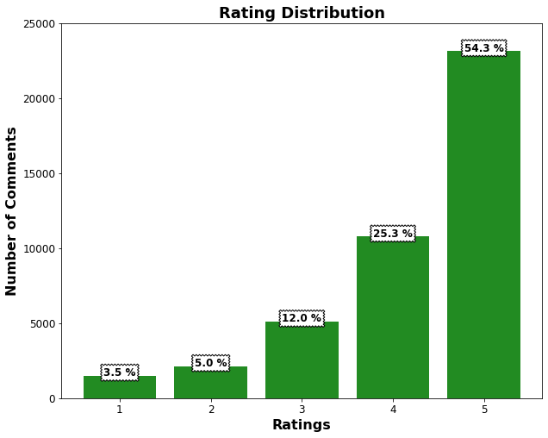
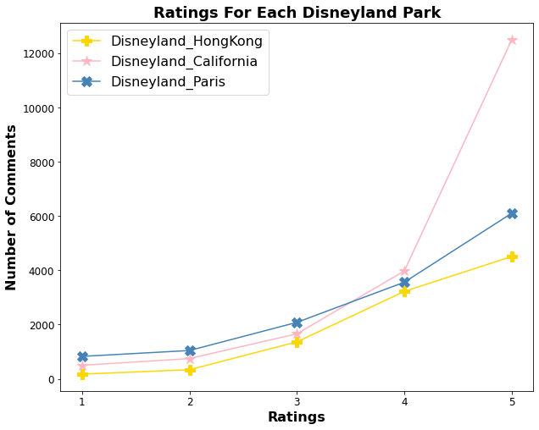
EDA - Rating

Slide 9
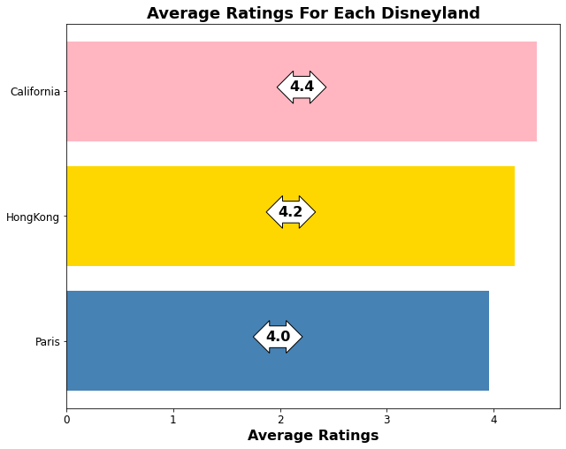
EDA - Rating

Slide 10
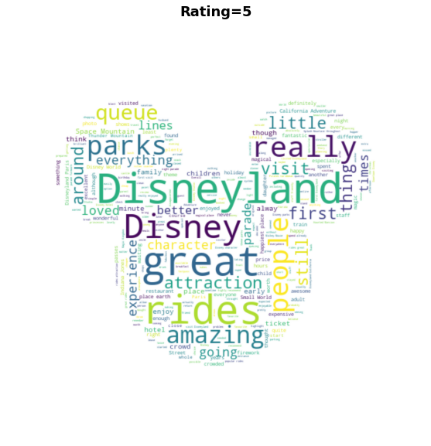
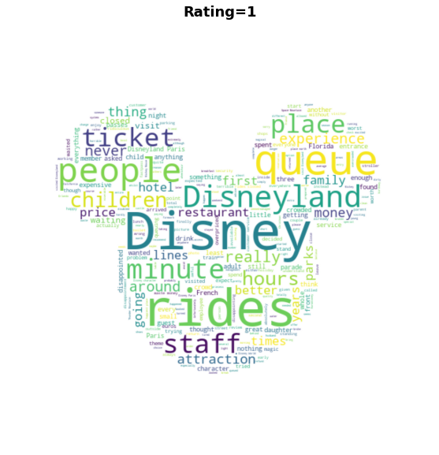
EDA - Rating: 5 vs 1

Slide 11
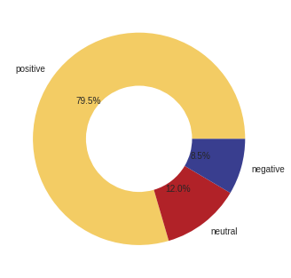
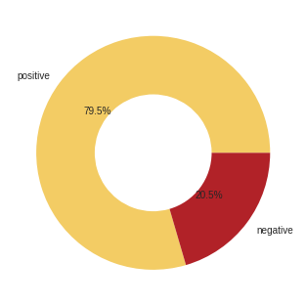
Modeling: Rating Classification
Multi-Class Classification
Binary Classification
1-2: Negative, 3: Neutral, 4-5: Positive
1-3: Negative, 4-5: Positive

Slide 12
Modeling: TF-IDF
Term Frequency, Inverse Document Frequency
How useful a word is to a sentence.
Helps us understand the importance of a word in a sentence
How useful a word is to a document
Helps us understand the importance words with more frequencies in a document.
Robust against the misspelled word.
Ex: Important, Improtant

Slide 13
Modeling: TF-IDF
Word | Count
going | 3
today | 2
to | 2
I | 2
… | …
TF | IDF
0.3 | log(3/3)
0.2 | log(3/2)
0.2 | log(3/2)
0.2 | log(3/2)
… | …
Document 1: It is going to be a sunny day.
Document 2: Today I am going outside.
Document 3: I am going to gym today.

Slide 14
Model: Logistic Regression
 | Precision | Recall | F1-score | support
Positive | 0.9 | 0.78 | 0.83 | 10049
Negative | 0.44 | 0.67 | 0.53 | 26223
Accuracy |  |  | 0.75 | 12672
Macro Avg | 0.67 | 0.72 | 0.68 | 12672
Weighted Avg | 0.8 | 0.75 | 0.77 | 12672
 | Positive | Negative
Positive | 7816 | 2233
Negative | 873 | 1750

Slide 15
Sentiment analysis
Why important
It is alway better to know how the customer thought
Rating scale for each person is different
Step
Data processing
Feed into the model

Slide 16
Data processing & modeling
Pipelines & Data transformation
Lower case by tokenizer
Stop words removal
Concat back
Remove punctuations
NLTK(Natural Language Toolkit)
Polarity scores
-1 ~ 1

Slide 17
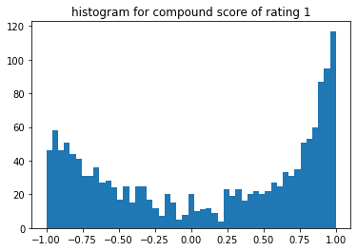
Sentiment score distribution for rating 1

Slide 18
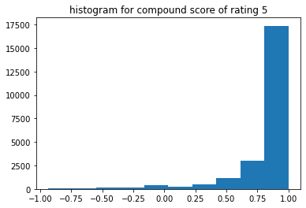
Sentiment score distribution for rating 5

Slide 19
Example 1: top scores in rating 1
I am writing this with a heavy heart having visited this attraction practically every year at Easter for the past 10 years. In fact, we were so disappointed by our experience this time that we probably won't be going back. WHY?With three kids, all under the age of 12, we go there for the rides. However, the following were all closed last week:Practically everything at FRONTIERLAND including:1. Big Thunder Mountain (Fastpass)..... And the total (9) equates to about a third of the park!And to compound this, with tickets for access to both parks, the Rock 'n' Roller Coaster (Faspass) at Walt Disney Studios were closed too! …. This Easter was unusually quiet. However, despite this, those who were there were queuing for less rides open, so queues were as long as they usually are…

Slide 20
Example 2: lowest scores in rating 5
Went for five days with the kids. Hate queuing. Hate paying over the odds. Hate marketing machines. Hate the poor food selections.Take a water bottle with you. Or buy a bottle. The refill for the rest of your stay at the drink fountains. We had a hot week and it was a godsend. Don't miss the closing ceremony or the parade: the smile on my kids faces bring tears to your eyes and make the who cost queuing worthwhile.Fabulous staff.

Slide 21
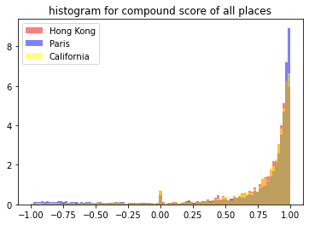
Will the sentiment score yield the same result as ratings?

Slide 22
Future Steps
Get additional data
This dataset is only from Tripadvisor
Try more model options
Other than term Frequency, Inverse Dense Frequency

Slide 23
Any Questions?

