Slide 1
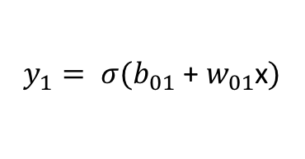

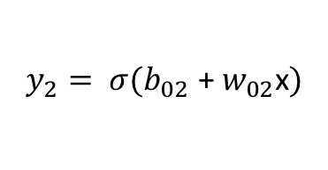
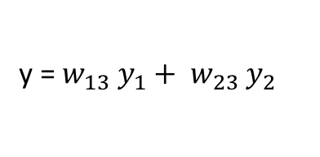
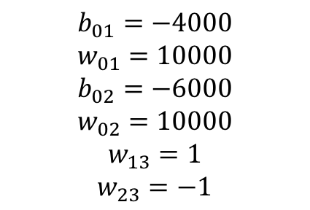

$b_{01}$ + $w_{01}$x
$$y_{1}= σ(b_{01}\text{ + }w_{01}\text{x})$$
x
y = $w_{13} y_{1}+ w_{23} y_{2}$
$$b_{01}=−4000$$
$$w_{01}=10000$$
$$b_{02}=−6000$$
$$w_{02}=10000$$
$$w_{13}=1$$
$$w_{23}=−1$$
$b_{02}$ + $w_{02}$x
$$y_{2}= σ(b_{02}\text{ + }w_{02}\text{x})$$

Slide 2
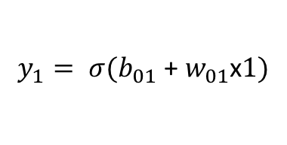

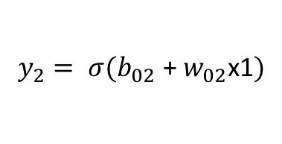
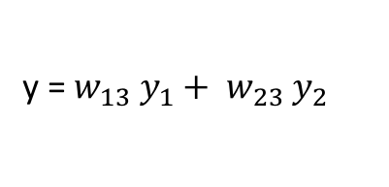
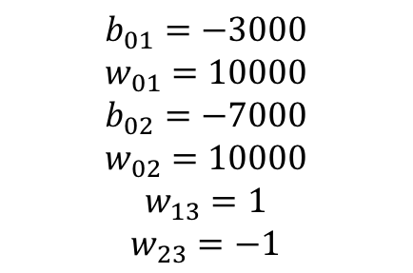

$b_{01}$ + $w_{01}$x1
$$y_{1}= σ(b_{01}\text{ + }w_{01}\text{x}1)$$
x1
y = $w_{13} y_{1}+ w_{23} y_{2}$
x2
$b_{02}$ + $w_{02}$x1
$$y_{2}= σ(b_{02}\text{ + }w_{02}\text{x}\text{1})$$
$$b_{01}=−3000$$
$$w_{01}=10000$$
$$b_{02}=−7000$$
$$w_{02}=10000$$
$$w_{13}=1$$
$$w_{23}=−1$$

Slide 3
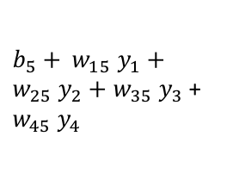
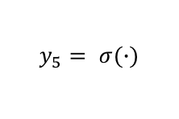
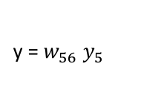
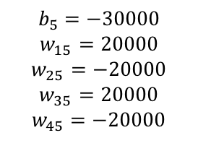
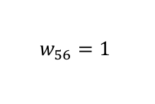
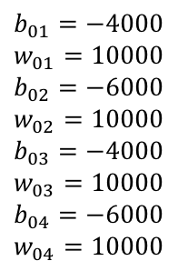

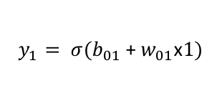

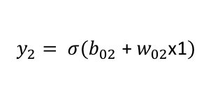

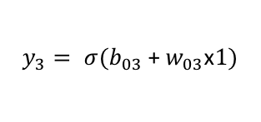

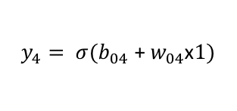
$$b_{01}=−4000$$
$$w_{01}=10000$$
$$b_{02}=−6000$$
$$w_{02}=10000$$
$$b_{03}=−4000$$
$$w_{03}=10000$$
$$b_{04}=−6000$$
$$w_{04}=10000$$
$b_{01}$ + $w_{01}$x1
$$y_{1}= σ(b_{01}\text{ + }w_{01}\text{x}1)$$
$$b_{5}=−30000$$
$$w_{15}=20000$$
$$w_{25}=−20000$$
$$w_{35}=20000$$
$$w_{45}=−20000$$
x1
$$w_{56}=1$$
$b_{02}$ + $w_{02}$x1
$$y_{2}= σ(b_{02}\text{ + }w_{02}\text{x}\text{1})$$
$b_{5}+ w_{15} y_{1}+w_{25} y_{2}+$ $w_{35} y_{3}$ + $w_{45} y_{4}$
$$y_{5}= σ(∙)$$
y = $w_{56} y_{5}$
$b_{03}$ + $w_{03}$x2
$$y_{3}= σ(b_{03}\text{ + }w_{03}\text{x}1)$$
x2
$b_{04}$ + $w_{04}$x2
$$y_{4}= σ(b_{04}\text{ + }w_{04}\text{x}1)$$

