Slide 1
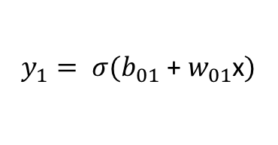

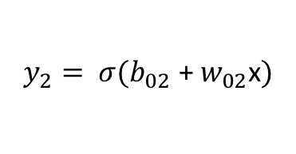
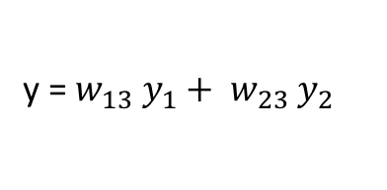
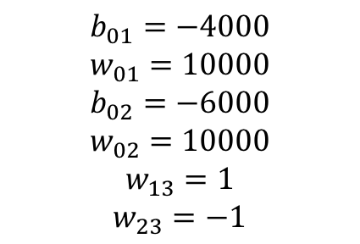

$b_{01}$ + $w_{01}$x
$$y_{1}= σ(b_{01}\text{ + }w_{01}\text{x})$$
x
y = $w_{13} y_{1}+ w_{23} y_{2}$
$$b_{01}=−4000$$
$$w_{01}=10000$$
$$b_{02}=−6000$$
$$w_{02}=10000$$
$$w_{13}=1$$
$$w_{23}=−1$$
$b_{02}$ + $w_{02}$x
$$y_{2}= σ(b_{02}\text{ + }w_{02}\text{x})$$

Slide 2
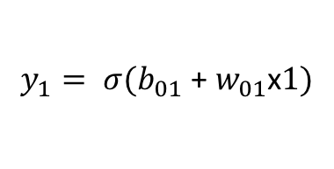

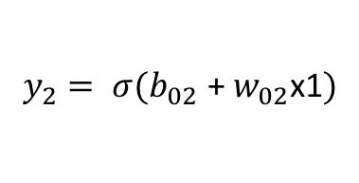
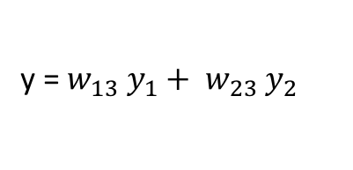
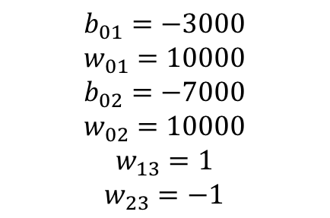

$b_{01}$ + $w_{01}$x1
$$y_{1}= σ(b_{01}\text{ + }w_{01}\text{x}1)$$
x1
y = $w_{13} y_{1}+ w_{23} y_{2}$
x2
$b_{02}$ + $w_{02}$x1
$$y_{2}= σ(b_{02}\text{ + }w_{02}\text{x}\text{1})$$
$$b_{01}=−3000$$
$$w_{01}=10000$$
$$b_{02}=−7000$$
$$w_{02}=10000$$
$$w_{13}=1$$
$$w_{23}=−1$$

