Slide 1
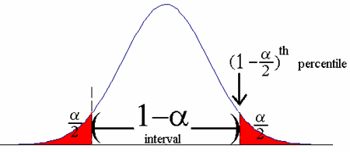
P for Values less than 0.05 have the lower probability belonging to general population
general population
Sample

