Slide 1
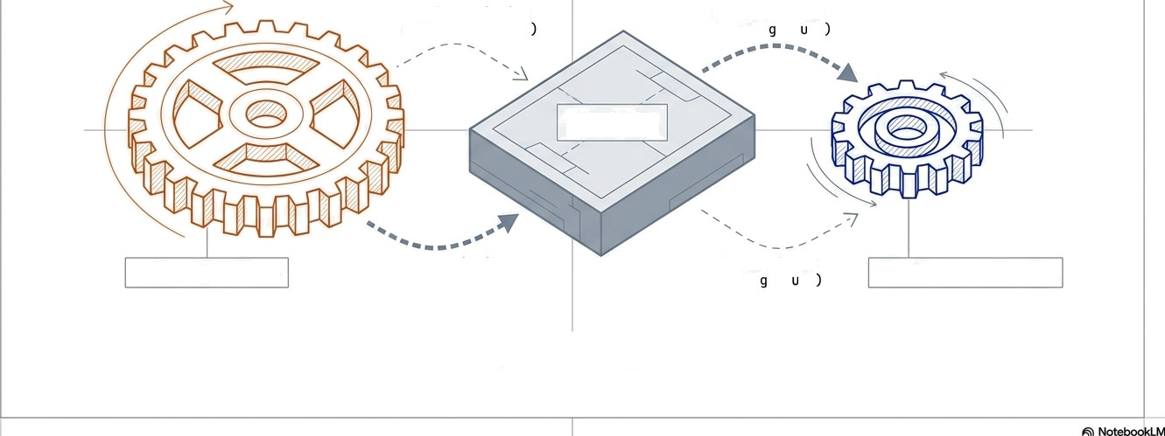
Asynchronous Model Governance & Registry Architecture
Decoupling long-running training cycles from real-time scoring in heterogeneous model environments.
8ode\. Version ing
6 Metadata (Push
Model Art lfact
6 Conf1 (P TT
Registry
Training Cycle
Model Versioning
6 I\etadata (Push}
Model Art if act
6 Conf1 (P t\.
Real-Time Scoring
For ML0ps and Data Engineering teams managing
mixed portfolios of Single and Clustered models.

Slide 2
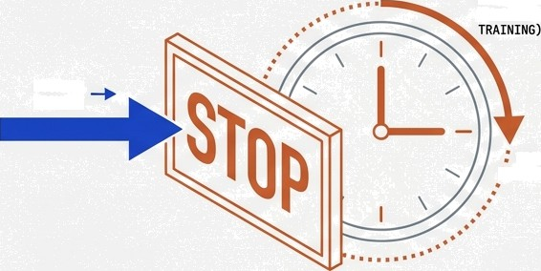
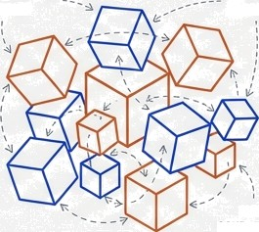
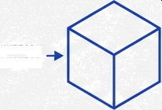
The Friction Between Training Velocity and Scoring Availability
”
0
1 The Latency Bottleneck
The Heterogeneity Challenge
REGION—SPECIFIC
ppICIN$
L0N0 DUFIATION (\YAIT FNC FOR
I4ULTIPLE VERSIONS
SCORING QEQUE8T
UNIFORM REQUEST
SYNC C0¥PLEEITY
SIf/GLE I\0DEL CLUSTER I\ODEL
Complexity increases when managing ‘Cluster’ models—groups of models serving a single use case (e.g., region-specific pricing). Synchronising their updates without a registry pattern invites versioning errors.
When pipeline coupling is tight, scoring requests stall while waiting for training completion. This creates unacceptable latency in production environments.
Scoring must never wait for Training.
The objective is to isolate the inference layer from the volatility and duration of the training layer.

Slide 3








High-Level Architecture: The Registry as an Asynchronous Bridge
Training Zone (Asynchronous)
Model Registry (State Store)
Inference Zone
(Real-time)
PUSH
(mite)
POLL
(Read)
AÑO
The Training Pipeline pushes artifacts when ready.
The Inference Service polls for artifacts on a schedule.
t•
" !
Inference services consume ’Artifacts’, not ’Pipelines’. This guarantees zero latency impact during training.
“ Nc'tebookLM

Slide 4

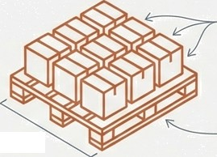

Strategy for Heterogeneous Model Artifacts
S.ingle Model Approach
Standard 1:1 mapping. One training job produces
MODEL ARTIFACT
1:1 Mapping
one artifact. Versioning is linear (e.g., v1 -+ v2).
v1 -+ v2 -+ v3
Cluster Model Approach
‘Model Group’ Logic
The Registry tracks a ”GroupID*.
All sub-models (e.g., region-specific or segment-specific models) share a RunID'.
RunID
(e.g., region-specific or segment-specific models)
CLUSTER
ARTIFACT
Rule: The Cluster is versioned as a single atomic unit. If one sub-model fails training, the whole cluster version is rejected to maintain consistency.
GnoupID ”
Grouplo
Inference services consume ‘Artifact, Artifacts’. This guarantees ’zero latency during training.

Slide 5


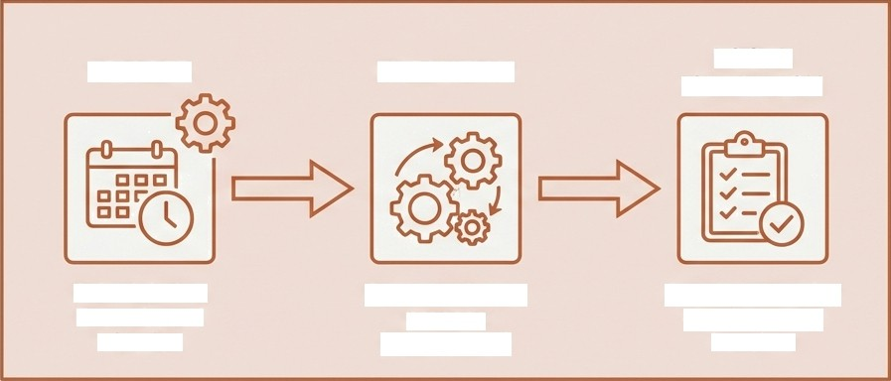




Phase 1: Asynchronous Training & Validation
TRAINING ZONE (ASYNCHRONOUS)
PRODUCTION ENVIRONMENT (UNAFFECTED)
LOCAL VALIDATION
TRIGGER
EXECUTION
Scheduled or Event-based initiation
Compute-heavy process (Hours/Days)
Accuracy metrics check against baseline
PRODUCTION SCORING SERVICE
Serving stable version
CRITICAL NOTE: This phase is strictly isolated. Even if training takes 48 hours, the Production Scoring service continues serving the previous stable version without interruption.

Slide 6


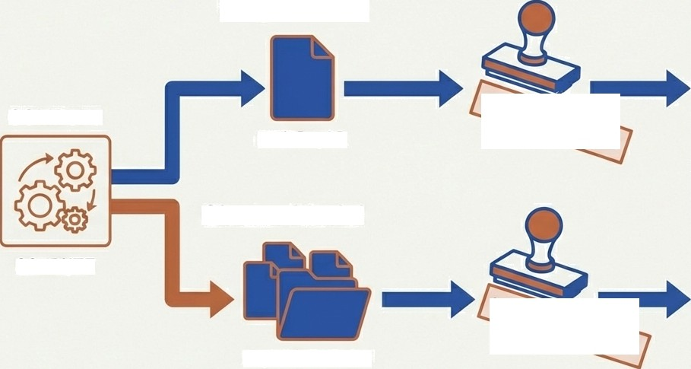
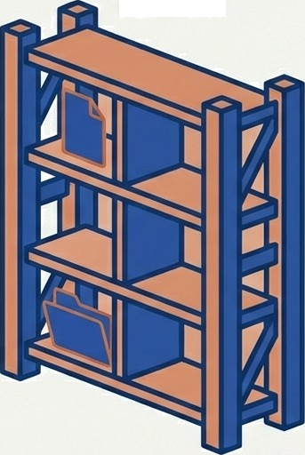



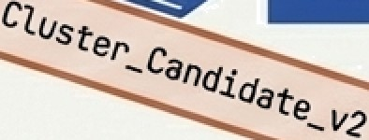

Phase 2: Registration and Semantic Tagging
Single Model
REGISTRY
COMPUTE
nodes. pkl
Cluster Model
C08PUTE
Experiment_ID
State Definition: The model is now in the Registry but tagged as
§stag1ng or §cand1date. It is not yet visible to the Scoring service.
“-”

Slide 7
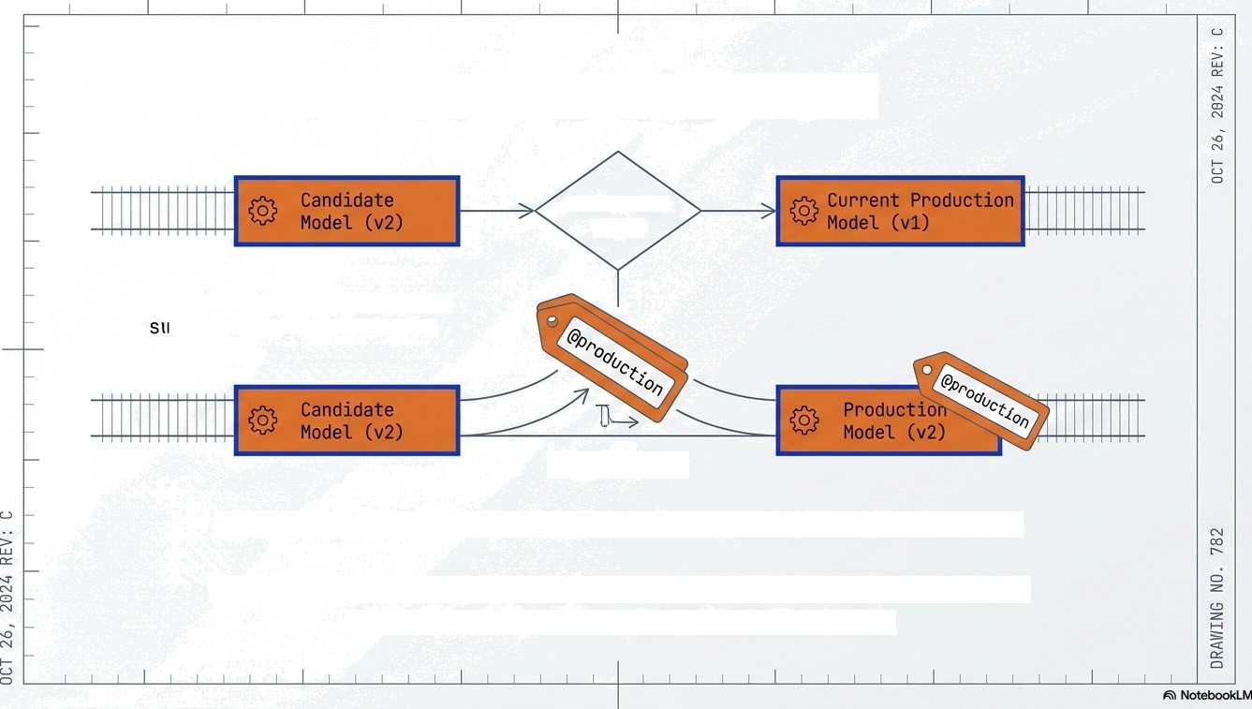
Phase 3: The Promotion Gate
Evaluation
Logic
Inneuting that ' h&up’ never oev: a half-baked model.
Tag Switch
Atomic Operation: The tag switch happens in milliseconds.
This ensures that "Scoring" never sees a half-baked riodel.
It sees v1 one second, and v2 the next.

Slide 8
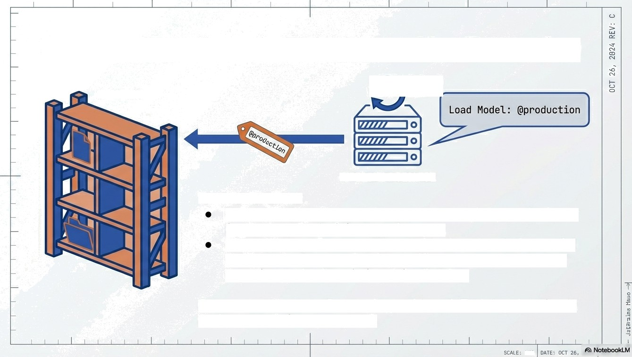
Phase 4: Scoring via Reference, Not Execution
Refresh
REGISTRY
”M
Poll
INFERENCE SERVICE
Text Mechanism:
Reload Policy: The service pollls the registry periodically (e.g., every 5 mins) for tag changes.
Zero Latency: Because the service downloads the model
artifact •6e/a e• switching traffic, user requests never
experience the ”tra1n1ng t:tme” delay.
Outcome statement: Decoupling achieved. Training duration is irrelevant to inference speed.

Slide 9
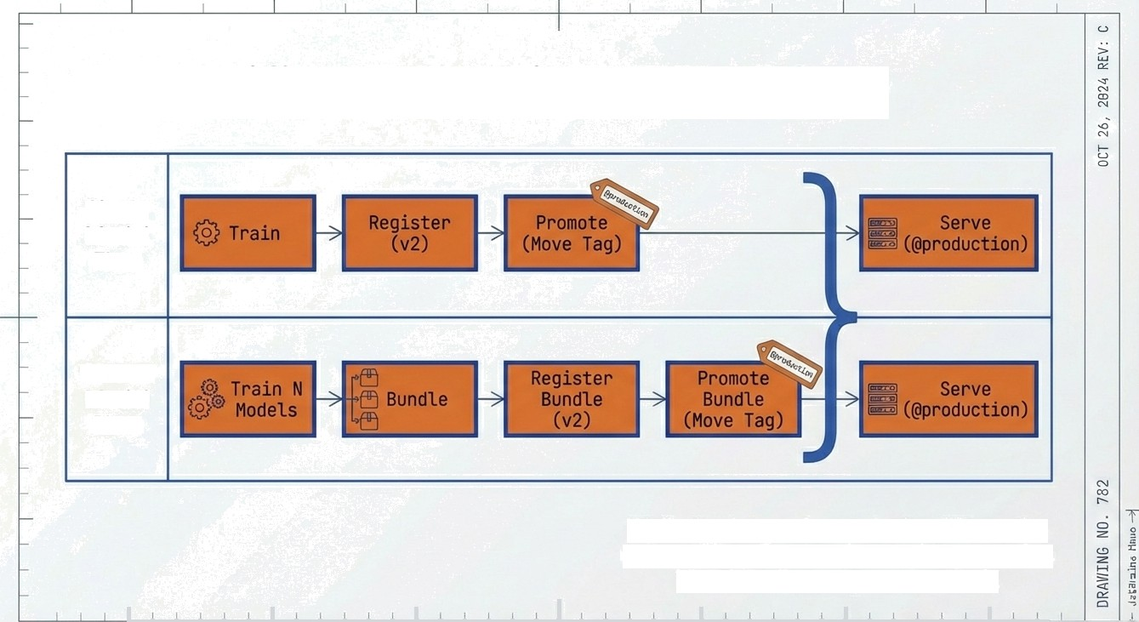
The Unified Operational Workflow
Single Model Flow
Cluster Model Flow
While the internal complexity differs, the external interface to the Registry remains identical: Load pproduct1on”.
”
SCAŁE:
tfTS
DATE; OCT 28+

Slide 10
Safety Mechanisms & Rollback Strategy
Training Timeout
Training Pipeline
Bad Deployment / Rollback
Undo
Inference Service
If long-running training hangs, the Scoring service remains on the old version indefinitely.
Service continuity is preserved.
The Registry acts as a time machine, allowing instant reversion to the last known good state.
,

Slide 11

Proposed Registry Metadata Schema
i
I
Field | Description & Example
hode1_Nane | Unique identifier for the machine learning model (e.g., "Pn1c1ng Engine").
Version | Semantic versioning of the model artifact (e.g., "v1.2. 4").
Type | Classification of the model deployment unit ("Single" or "Cluster").
Group ID | UUID linkîng related cluster members (e.g., "a1b2c3d4-e5f6-789ô-g1h2- 3jSk5l6m7n8").
Stage | Current deployment environment/status ("Staging", "Production", "Archived").
Source Run | Link to the training executïon logs and parameters (e.g., "runs/train_202¢1ô28 1ô3ô/").
î
,.
. .
Standardising thèse fields allows for automated governance scripts and dashboarding.
-

Slide 12



Implementation Golden Rules
Never Block Inference.
Inference reads from Registry tags, never listens to Training pipelines.
Atomicity for Clusters.
A cluster is valid only if a// sub-models are valid. Register them as a set.
Tags over IDs.
Hardcode your inference service to look for §production, not specific version numbers (e.g., v23).
Keep it Simple.
Use the same registry pattern for both single and cluster models to reduce maintenance overhead.
0
,
SCAN E NF5 DATE

