Slide 1
VISUAL PROGRAMMING WEEK 1

Slide 2
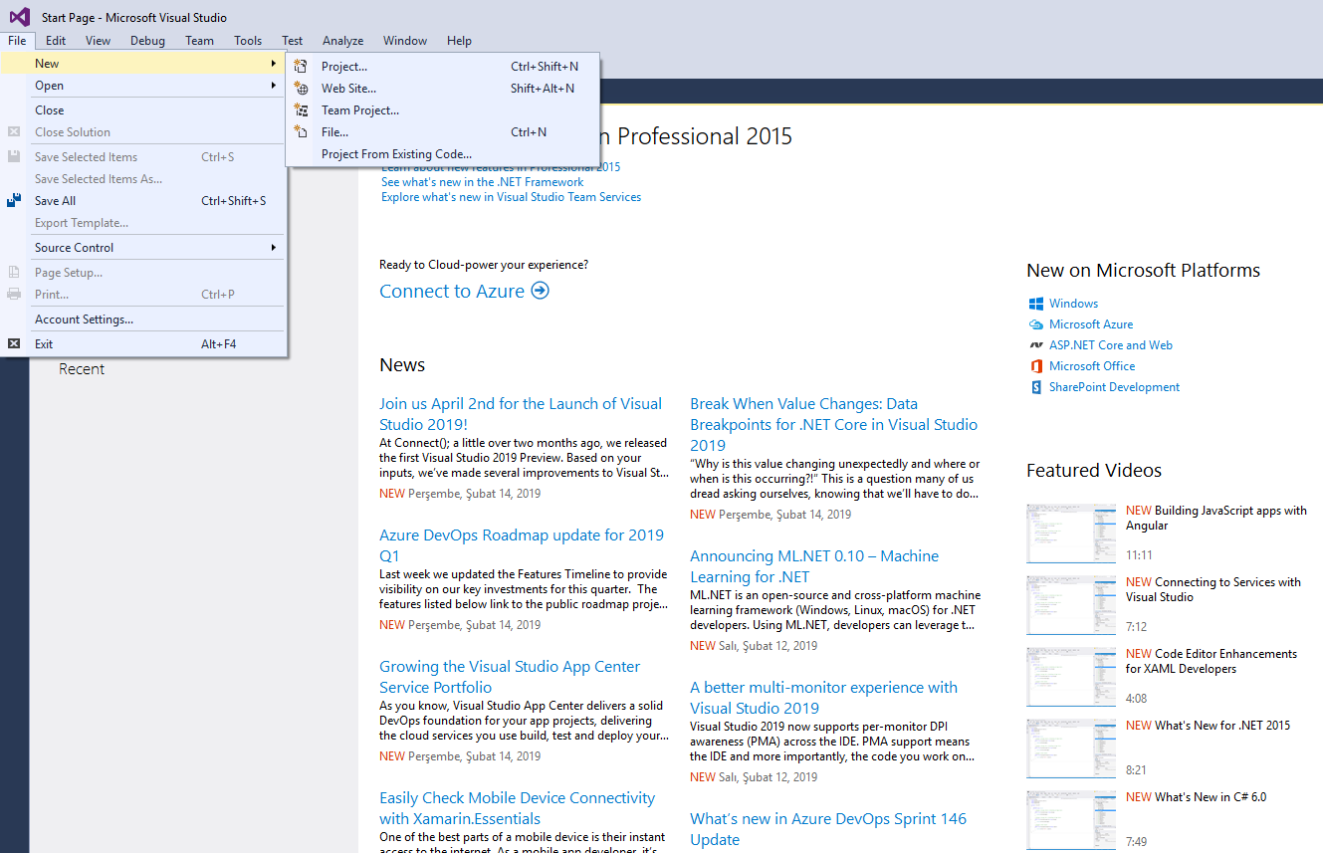
C# first program-console application
File-New-Project after opening Visual Studio

Slide 3
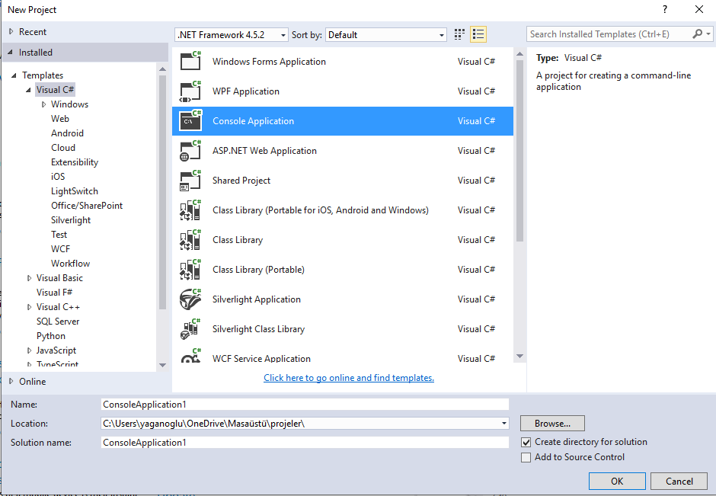
C# first program
In the window that opens, we first select the console application.

Slide 4
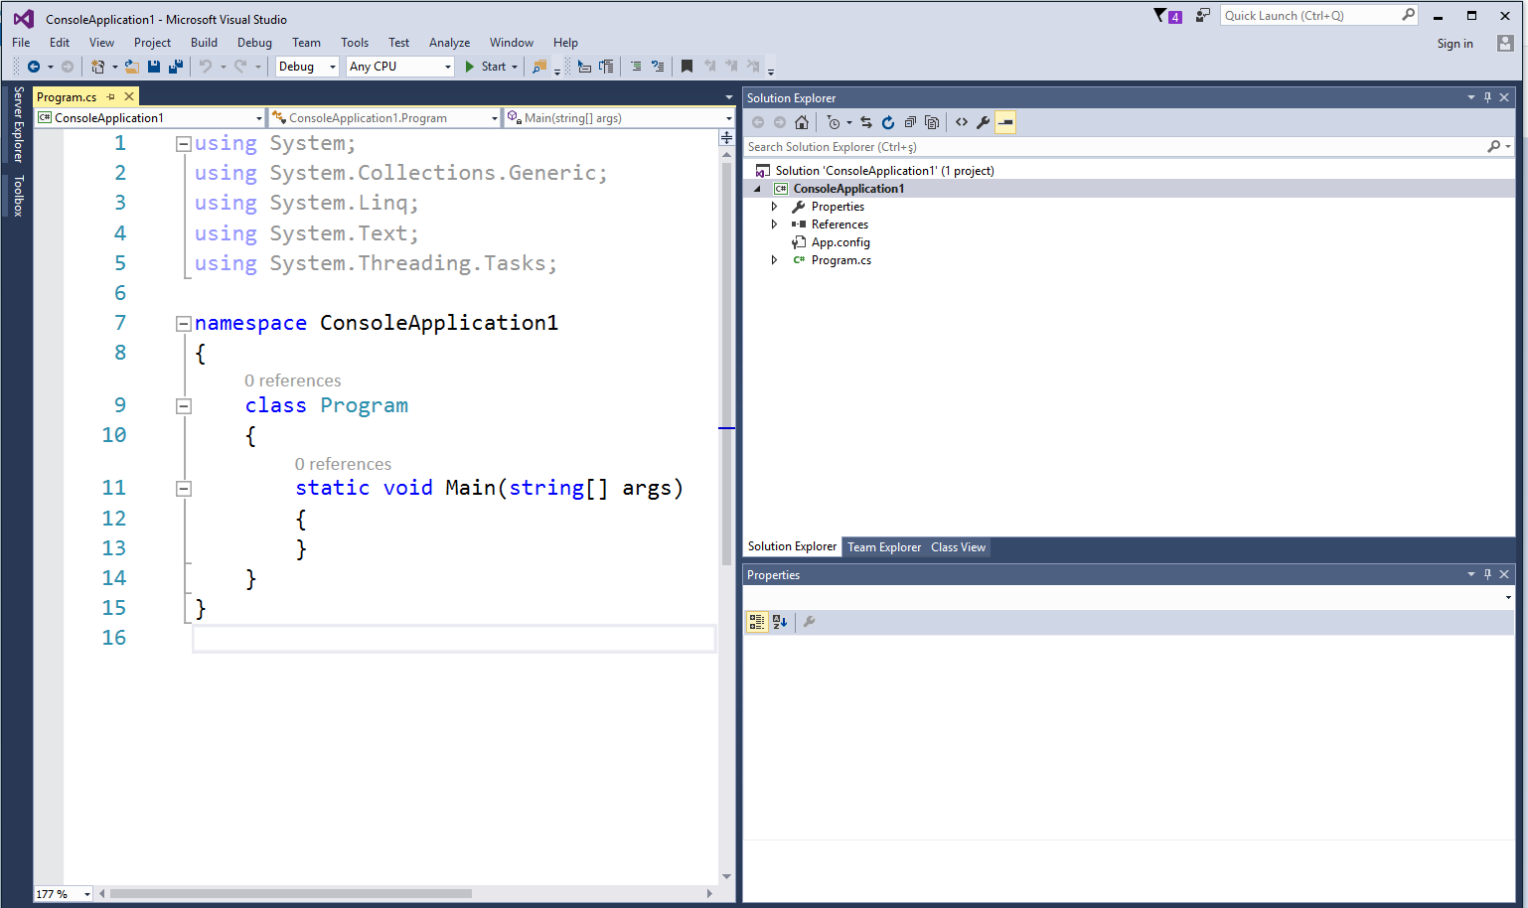
C# first program
The screen that will appear:

Slide 5
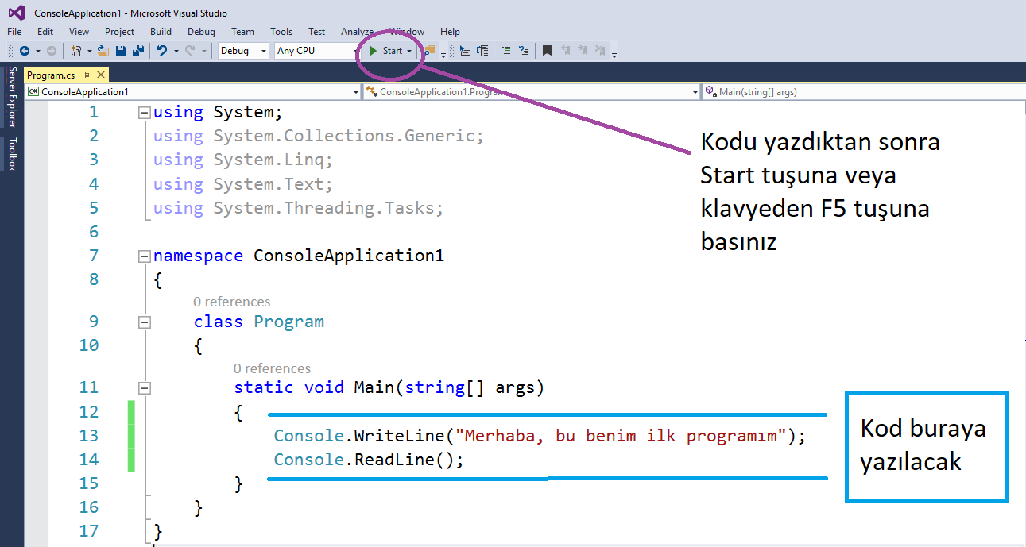
C# first program
After writing the code press Start here or F5 from the keyboard
Write the code here
Notes:
using System;
using System.Collections.Generic;
using System.Linq;
using System.Text;
using System.Threading.Tasks;
namespace ConsoleApplication1
{
class Program
{
static void Main(string[] args)
{
Console.WriteLine("Merhaba, bu benim ilk programım");
Console.ReadLine();
}
}
}

Slide 6
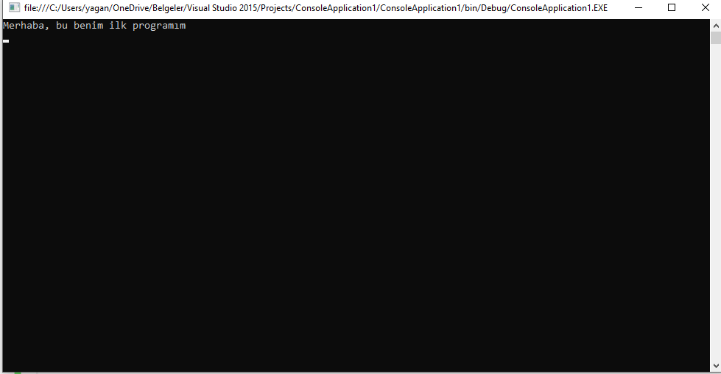
C# first program
The text we want has appeared on the console screen. If we press the enter key, the program will terminate…

Slide 7
C# first program
How do we run the program again?
How do we open the project?
Where is the project saved?

Slide 8
C# first program detailed review
Console.WriteLine("Merhaba, Bu benim ilk programim");
Class
Method
Parameter
Console.ReadLine();
Class
Method
does not take parameters

Slide 9
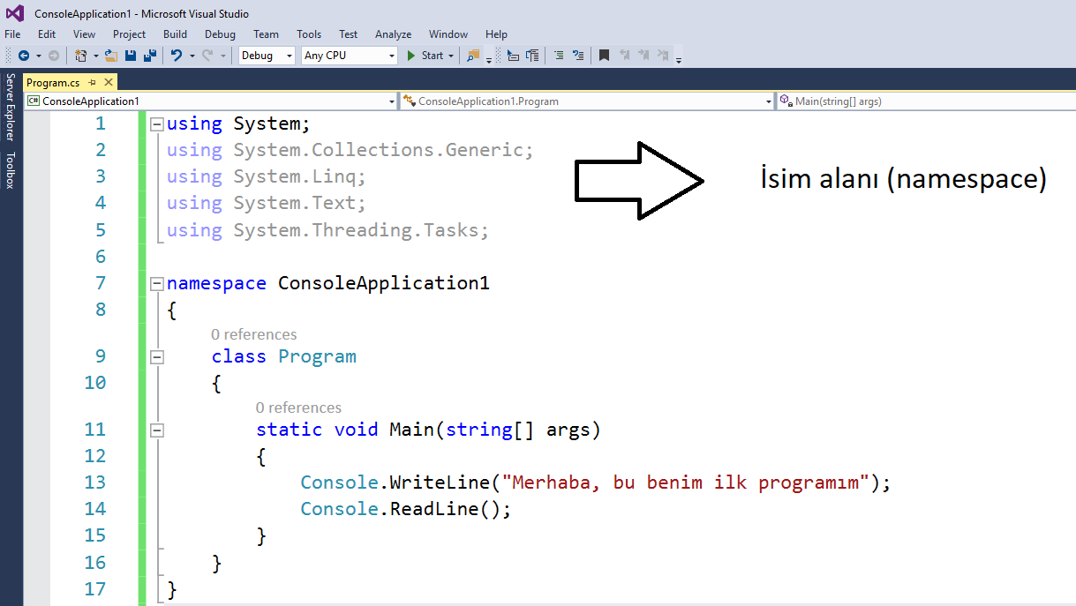
C# first program detailed review
Everything in C# is a class. Each class has several elements that do work. Elements that do work are called methods or functions . C# language is a tool used to develop software on the .NET platform. We have the opportunity to make use of the .NET class library. One of the features that makes .NET and C# powerful is the .NET platform has thousands of hierarchically organized easy-to-access classes. One of them is the Console class.
Namespace

Slide 10
C# first program detailed review
Namespace
There are a number of basic types and classes that the infrastructure we call .NET Framework offers us or programmers using other programming languages. In order to organize all these classes and types well, .NET frequently uses the concept of namespace. That is, class libraries in .NET are language-independent.
Namespaces are used with the using keyword in C# and declared to the compiler so that we can use the data types and classes in the .NET Framework class library . In other languages, these namespaces are declared differently to the compiler, but the main thing is to get the right to use the .NET Framework class libraries.
Now let's delete the lines starting with using in our program and run the program.

Slide 11
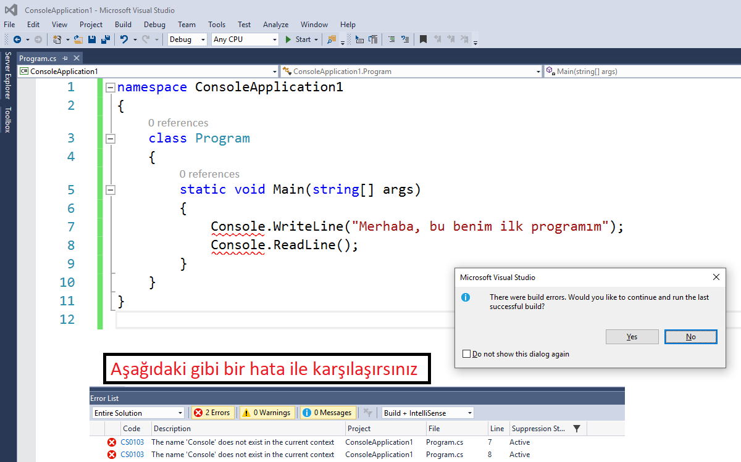
C# first program detailed review
You will see an error like below

Slide 12
C# first program detailed review
Namespace
Instead of specifying the namespaces from the beginning, you can alternatively write your code by specifying the namespaces.
System.Console.WriteLine("Merhaba, Bu benim ilk programim");
System.Console.ReadLine() ;
Declaring classes in this way is an undesirable method. Because in cases where many nested namespaces are defined, our source code is lengthened by typing namespaces unnecessarily.
This both impairs readability and wastes time for the programmer.

Slide 13
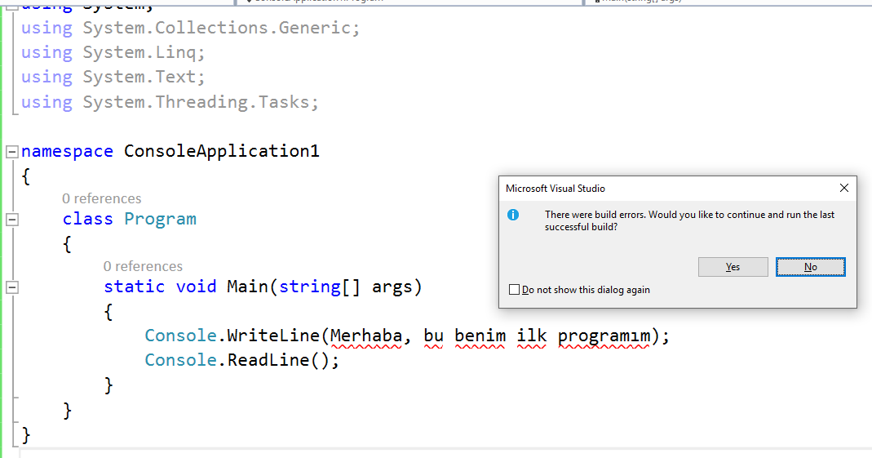
C# first program detailed review
Double Quotation Mark "
Console.WriteLine("Merhaba, Bu benim ilk programim");
What happens if we remove the quotation marks?
Console.WriteLine(Merhaba, Bu benim ilk programim);

Slide 14
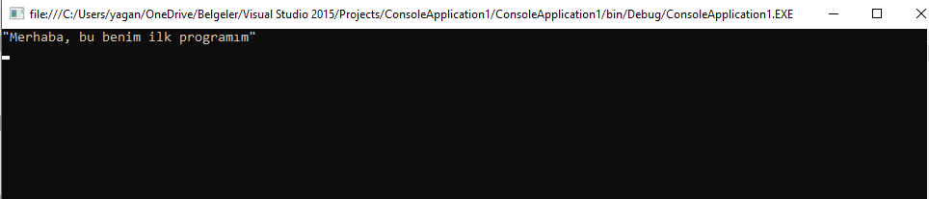
C# first program detailed review
Double Quotation Mark "
In programming languages, a character means a letter, number, punctuation mark, or a symbol. The String, on the other hand, means the string formed by the characters coming together. A variable consisting of strings is specified with double quotes in C#.
Assignment1 : Write the console application that outputs "Hello, this is my first program" as a screen output. Quotation marks will appear on the screen.
Notes:
"\"Hello, this is my first program\""

Slide 15
C# first program detailed review
Semicolon ;
Forgetting to add a semicolon to the end of any C# statement will cause our program to give error.
blank line
It makes the program easier to read and understand.
Blank lines are ignored by the compiler.

Slide 16
C# first program detailed review
Do the following lines of code give an error?
Console.WriteLine("Merhaba, Bu benim ilk programim")
//doesn’t work, no semicolon ;
Console.
WriteLine("Merhaba, Bu benim ilk programim");
// no error
Console.WriteLine("Merhaba,
Bu benim ilk programim");
//Doesn't work. A string must be a single line

Slide 17
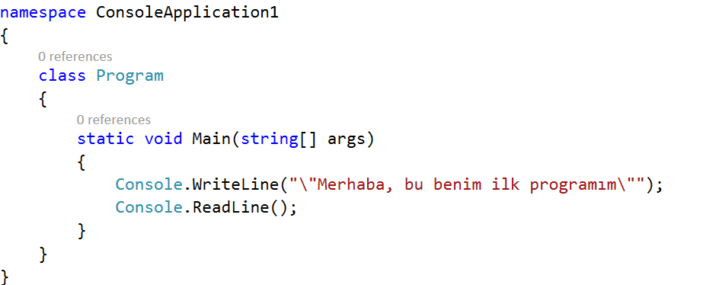
C# first program detailed review
All C# console applications start by executing the Main function.
A C# application without the Main function is unthinkable.
The first letter of the word Main, M, should always be capitalized. (Note that C# is case-sensitive.)
Normal parentheses after the word Main indicate the existence of a function (method).
Methods do specific work and usually return a value.
The void keyword specifies that the Main function returns no value.

Slide 18
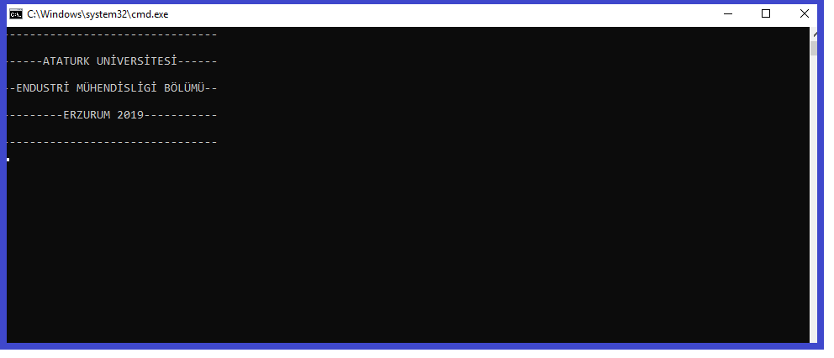
example
Perform the code with the screen output as in the picture, only by using the writeline method.

Slide 19
Example Code
Console.WriteLine("--------------------------------");
Console.WriteLine(" ");
Console.WriteLine("------ATATURK UNİVERSİTESİ------");
Console.WriteLine(" ");
Console.WriteLine("--ENDUSTRİ MÜHENDİSLİGİ BÖLÜMÜ--");
Console.WriteLine(" ");
Console.WriteLine("---------ERZURUM 2019-----------");
Console.WriteLine(" ");
Console.WriteLine("--------------------------------");
Console.ReadLine();

Slide 20
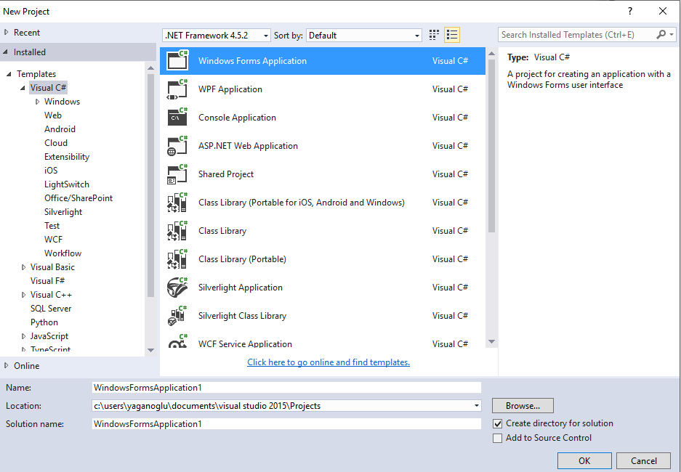
C# first program visual application
File-new-project

Slide 21
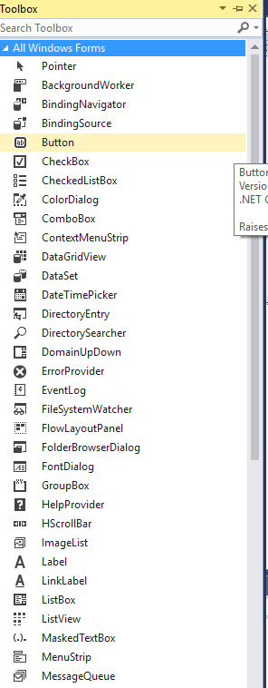
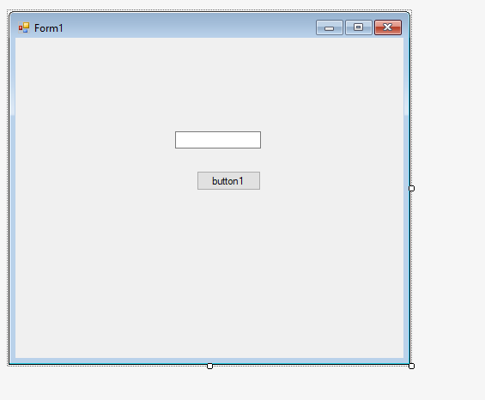
C# first program visual application
Drag and drop a button and a textbox to Form1

Slide 22
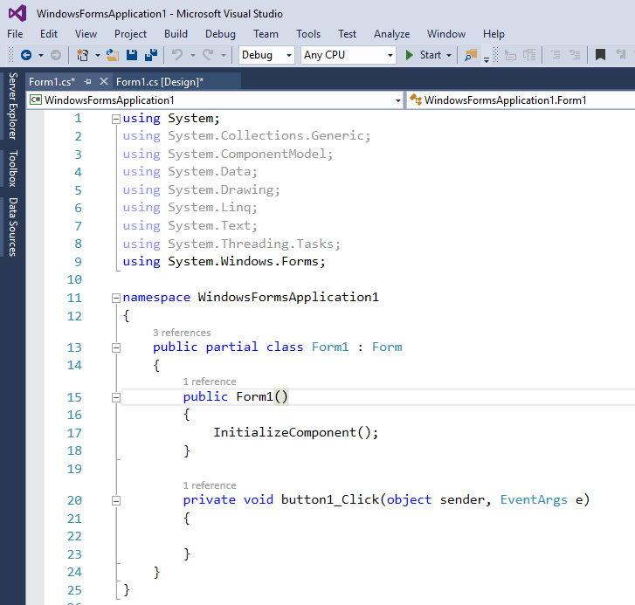
C# first program visual application
When we double click button1: we access the click event of the button. So when we click the button, we write what we want the program to do here.

Slide 23
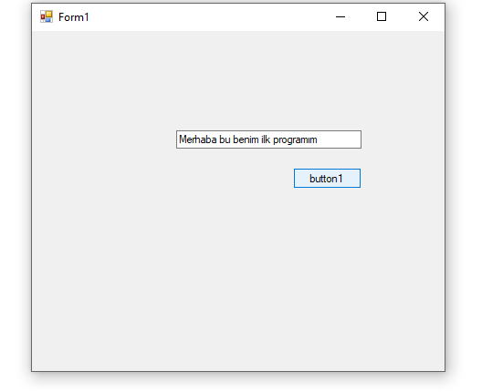
C# first program visual application
We want a text to be written in the textbox when the button is clicked in our program. Below is the image that will appear when the written code and the program run.
private void button1_Click(object sender, EventArgs e)
{
textBox1.Text = "Merhaba Bu benim ilk programım";
}

Slide 24
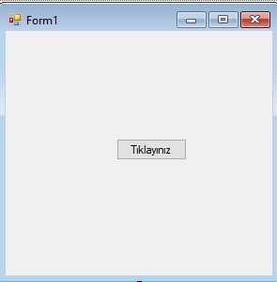
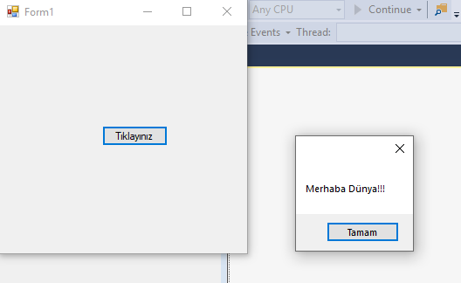
using C# MessageBox
private void button1_Click(object sender, EventArgs e)
{
MessageBox.Show("Merhaba Dünya!!!");
}
Notes:
using System;
using System.Collections.Generic;
using System.ComponentModel;
using System.Data;
using System.Drawing;
using System.Linq;
using System.Text;
using System.Threading.Tasks;
using System.Windows.Forms;
namespace WindowsFormsApplication2
{
public partial class Form1 : Form
{
public Form1()
{
InitializeComponent();
}
private void button1_Click(object sender, EventArgs e)
{
MessageBox.Show("Merhaba Dünya!!!");
}
}
}

Slide 25
Example:2-1
If we want to visualize the application a little more. For a C# project with the project name ornek_2_1
Requirements
3 buttons on the form, 1 textbox
Text on button1: write to textbox
Text on button2: delete
Text on button3: close
Textbox background color is red
The color of the text on the textbox is yellow
When button1 is pressed, we will write the message we want on the textbox.
When button2 is pressed, the text on the textbox will be deleted and
When button 3 is pressed, the program will be closed.

Slide 26
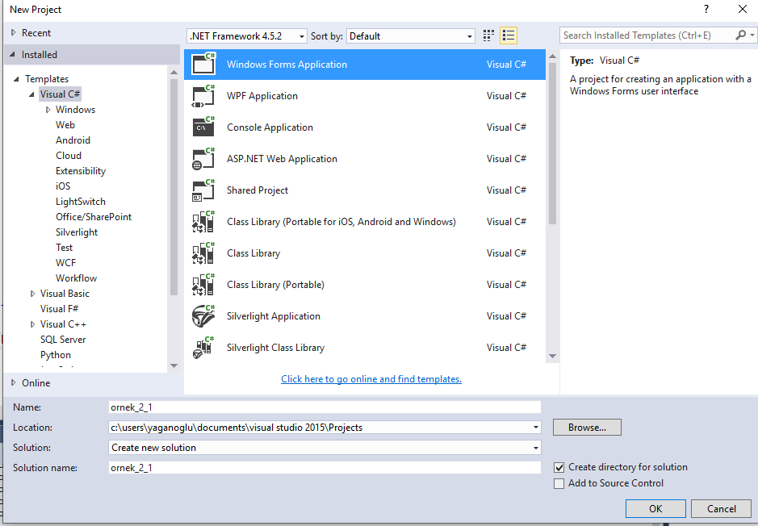
Example:2-1
Let's go step by step according to what is requested. First of all, we create a new project named Ornek_2_1.

Slide 27
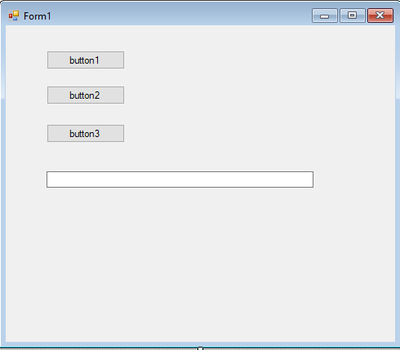
Example:2-1
We drag and drop 3 buttons and 1 textbox from the toolbox on the form.
Note: If we want to change the button names during the design phase, we can change the text property of the button using the properties window. However, we want the button names to change after the program is running, that is, while the form is being loaded. Double-click anywhere on the form that is empty.

Slide 28
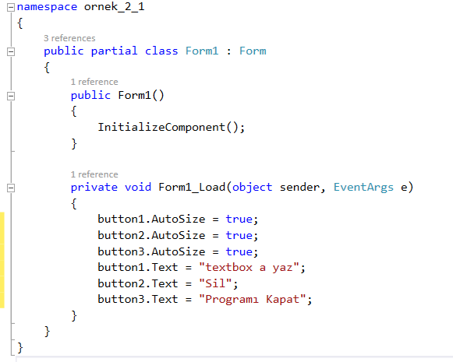
Example:2-1
On the screen that appears, we write the situations that we want to occur when the form is loaded.
button1.AutoSize = true; (automatically arranges size of button according to the size of text on the button)
button1.Text = "textbox'a yaz"; (changes the text property of the button)
Notes:
button1.AutoSize = true;
button2.AutoSize = true;
button3.AutoSize = true;
button1.Text = "textbox a yaz";
button2.Text = "Sil";
button3.Text = "Programı Kapat";

Slide 29
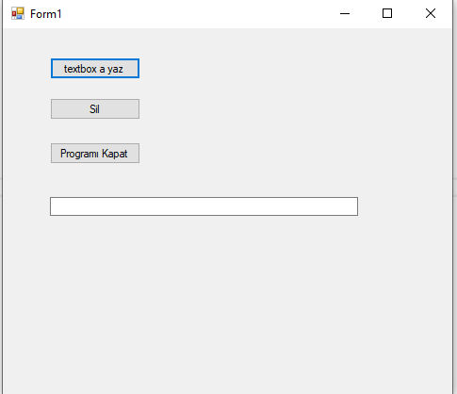
Example:2-1
If we run our trial program:
Before
After
Now let's double-click button1 and set the textbox properties to the desired state;

Slide 30
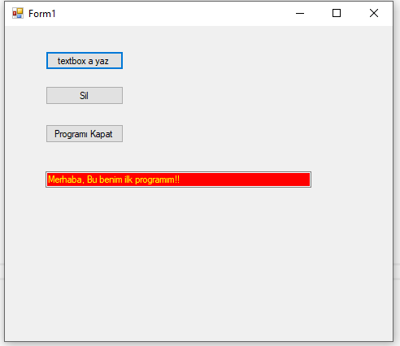
Example:2-1
Codes we need to write in button1's click event
private void button1_Click(object sender, EventArgs e)
{
textBox1.Text = "Merhaba, Bu benim ilk programım!!";
textBox1.ForeColor = Color.Yellow;
textBox1.BackColor = Color.Red;
}
In this state, since no code is written on the button that says “Sil” and the button that says “Programı Kapat”, nothing happens when these buttons are pressed.

Slide 31
Example:2-1
Now let's write the necessary codes for button2 and button3.
private void button2_Click(object sender, EventArgs e)
{
textBox1.Text = "";
}
private void button3_Click(object sender, EventArgs e)
{
this.Close();
}
The code in button2 deletes the text, and this.Close() in button3 closes the form. What line of code would be written if you wanted button2 to change the textbox's background color from red to white?
Notes:
using System;
using System.Collections.Generic;
using System.ComponentModel;
using System.Data;
using System.Drawing;
using System.Linq;
using System.Text;
using System.Threading.Tasks;
using System.Windows.Forms;
namespace ornek_2_1
{
public partial class Form1 : Form
{
public Form1()
{
InitializeComponent();
}
private void Form1_Load(object sender, EventArgs e)
{
button1.AutoSize = true;
button2.AutoSize = true;
button3.AutoSize = true;
button1.Text = "textbox a yaz";
button2.Text = "Sil";
button3.Text = "Programı Kapat";
}
private void button1_Click(object sender, EventArgs e)
{
textBox1.Text = "Merhaba, Bu benim ilk programım!!";
textBox1.ForeColor = Color.Yellow;
textBox1.BackColor = Color.Red;
}
private void button2_Click(object sender, EventArgs e)
{
textBox1.Text = "";
}
private void button3_Click(object sender, EventArgs e)
{
this.Close();
}
}
}

Slide 32
Variables
 |  |  | 33,6 | “Demirci”
 |  |  |  |  |  | True
 |  |  |  |  |  | 3.11.2009
Variable
They are the memory areas we use to keep the values ​​we want in the computer's memory .
x=33,6;
Lname=“Demirci”;
ConnectionString=“RecordDataBase.mdb”;
Result=True/False;
SpecialDay=3.11.2009;
They can be used inside an expression or as a parameter.
MessageBox.Show(“Hi Mister ” + Lname);
If(x<50){IncreaseSize()};
CalculateMyAge(SpecialDay,Now);
Lenght=Form1.Width;
txtUsersurname.Text = Lname;

Slide 33
Variables
Data Types
C# type | Common language runtime type structure | Uzunluk (Byte) | Value range
sbyte | System.SByte | 1 | Integer between – 128 and 127
byte | System.Byte | 1 | Integer between 0 and 255
short | System.Int16 | 2 | Integer between – 32768 and 32767
ushort | System.UInt16 | 2 | Integer between 0 and 65535
int | System.Int32 | 4 | Integer between – 2147483648 and 2147483647
uint | System.UInt32 | 4 | Integer between 0 and 4294967295
long | System.Int64 | 8 | Integer between – 9223372036854775808 and +9223372036854775807
ulong | System.UInt64 | 8 | Integer between 0 and 18446744073709551615
decimal | System.Decimal | 12 | 1.0x10⁻ ²⁸ - 7.9 x10²⁸
float | System.Single | 4 | 1.5x10⁻⁴⁵ ⁻ 3.4x10³⁸
double | System.Double | 8 | 5.0 x 10⁻ ³²⁴ - 1.7 x 10³⁰⁸
char | System.Char | 2 | Tek karakter, Integer olarak tutulur (between 0 and 65535 (‘a’, ‘?’, ‘7’,’-’)
string | System.String | - | Karakterler dizisi (karakter sınır yoktur) “halil”, “123”
bool | System.Boolean | 1 | true ve false

Slide 34
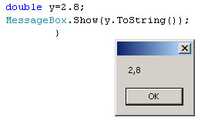
Variables
Most commonly used types
int x;
can be:
x = 0, 1, 10000, -4323, 100, 2147483647
double y;
can be:
y = 0,0, 1.5, 3.14, 0.0000005, -23232.0
string z;
can be:
z = “”, “mehmet”, “3.sınıf”, “3.14”, “23 ocak 2003”,
“C:\Program Files\Microsoft\odev.doc”
bool t;
can be:
t = true or false
can’t be (there shall be no quotes):
t = “false”
Using period (1.2) or comma (1,2) as separator for decimal numbers varies from machine to machine and is not specific to C#. We'll use a period, but you can see commas on the screen!

Slide 35
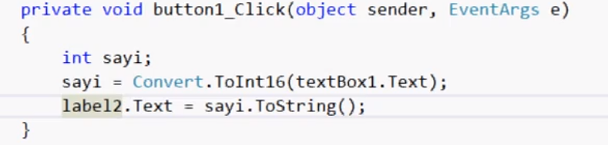
Variables
How to Use Variables?
First you need to define it (specifying its name and type)
{
int myInteger;
string myString;
Then the value has to be assigned , you can use this value later
myInteger = 17;
myString = “My Age =”;
Messagebox.Show(myString + myInteger); }
A variable that is not initialized cannot be read! Gives Error
string myString;
Messagebox.Show(myString); X ERROR
Notes:
Label-Buton
string metin;
metin = "Merhaba dünya";
label1.Text = metin;
string adsoyad, meslek;
adsoyad = "Endüstri Mühendisi";
meslek = "Öğretmen";
label1.Text = adsoyad;
label2.Text = meslek;

Slide 36
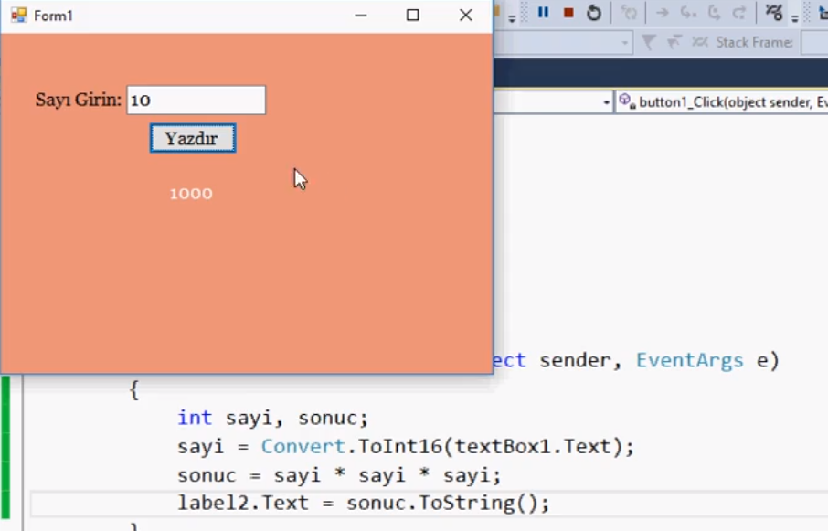

Slide 37
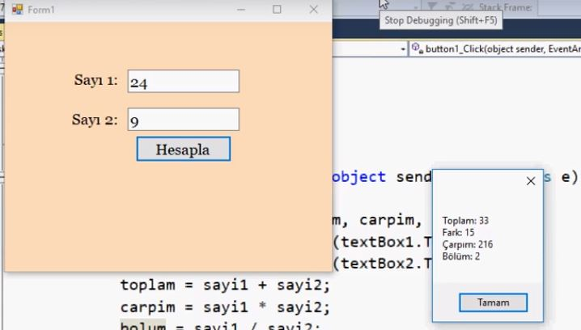
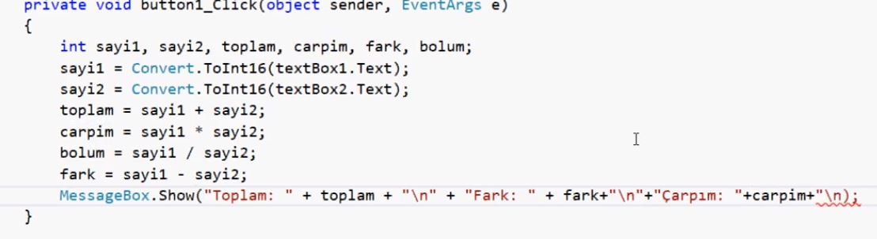

Slide 38
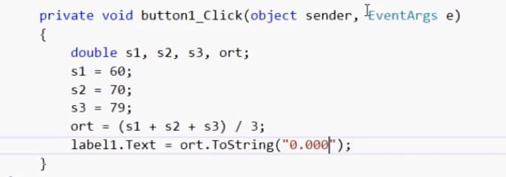

Slide 39
Variables
Naming Conventions
The first character must be a letter, underscore character, or the "@" character
A-Z, a-z, _, @
Subsequent characters can be letters, numbers, or underscore characters
A-Z, a-z, 0-9, _
ClassSize, Screen1024, File_Extension, _RootPath, @DriveLetter
There are two different traditional naming conventions:
camelCase: firstStudent, classCourseHour (First word starts small, other words start capital)
PascalCase: FirstStudent, ClassCourseHour (capitalize all words)
Name functions and methods using verbs CloseDialog(), StartRecord(), PlayMusic()

Slide 40
Variables
Variable Declaration Examples
More than one variable can be defined in the same line
int age, birthYear, numberOfStudents;
double interestRate = 0.89;
float interestRate = 0.89, discountRate;
char myChar = ‘A’;
string myBloodType=“A”;
int numberOfStudents=100;
bool IsUserNameCorrect = false;
bool IsMusicFileFound = true;

Slide 41
Variables
Variables are valid in the blocks they are defined in!
private void btnHesapla_Click(object sender, EventArgs e)
{
int age=0; // local
MessageBox.Show(“age= " + age); //runs
MessageBox.Show(“your weight= " + weight); //runs
}
int weight =0; // global
private void btnGoster_Click(object sender, EventArgs e)
{
MessageBox.Show("age= " + age); //gives error
MessageBox.Show(“your weight= " + weight); //runs
}
Local Variables: Variables defined in a block (function, method, loop) are called local variables .
Global Variables: Variables defined in the outermost block, not inside any function or loop. They are valid in all other functions.
Block
closed!

Slide 42
Variables
Variables are also valid in sub-blocks of the blocks in which they are defined.
private void btnHesapla_Click(object sender, EventArgs e)
{
int age=0;
MessageBox.Show("age=" + age); //runs
if(age>35)
{
MessageBox.Show(age); //runs
}
}
private void btnGoster_Click(object sender, EventArgs e)
{
MessageBox.Show("age=" + age); //still gives error
}
Sub block

Slide 43
Variables
Variables are valid in the sub-blocks of the blocks they are defined in , and are invalid in the upper blocks.
private void btnHesapla_Click(object sender, EventArgs e)
{
int age=0;
MessageBox.Show("age=" + age); //runs
if(age>35)
{
MessageBox.Show(age); //runs
int bornYear = 2015 – age;
MessageBox.Show(bornYear); //runs
}
MessageBox.Show(bornYear); //gives error
}
private void btnGoster_Click(object sender, EventArgs e)
{
MessageBox.Show("age=" + age); //still gives error
}

Slide 44
Variables
Data Type Conversions (Casting)
Converting from one data type to another
implicit conversion: It is done without using any conversion operator. It is done in cases where there is no data loss
int x = 10;
double y = 50.45;
y = x; // y becomes 10.0
explicit conversion: The conversion is done using an operator according to the type. It is done smoothly even if there is data loss.
int x = 10;
double y = 50.45;
x = y; // error
Implicit conversion
int x = 10;
double y = 50.45;
x = Convert.ToInt32(y); //x becomes 50
Other conversion functions
…=Convert.ToInt32(2.34);
…=Convert.ToDouble(100);
…=Convert.ToString(13.14);
…=Convert.ToByte(23.09);
Conversion function
Notes:
<Make DEMO with and wihout functions

Slide 45
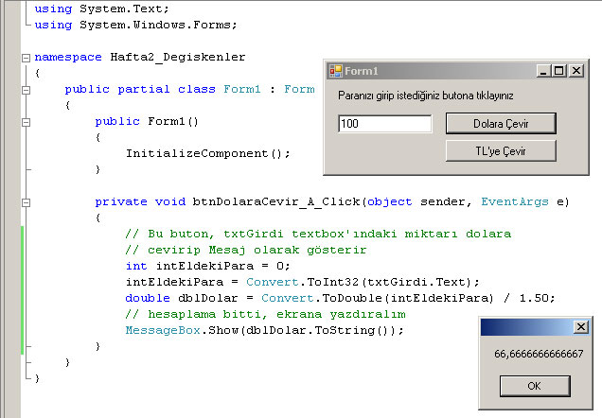
Variables

Slide 46
Variables
in brief:
int, double, string, bool are variable types
x,y,z intAge, strFullName, dbDolar are variable names
Convert.ToInt32(), Convert.ToDouble(), x.ToString() are conversion functions/operators
intSayi = (int)dblBaskaSayi; // double → int (only valid between numeric types!)
float fDegisken1=(float)Ldegisken2; // Long → float (only valid between numeric types!)
Variables are valid in the blocks they are defined in and in sub-blocks of that block.
Local and Global variables

Slide 47
Variables
Question: Define a local variable to hold the name of a file.
Question: Define a local variable with an initial value of 1000 to hold an integer.
Question: Define a global variable that holds the number pi
Question: Define a variable whose initial value is false.
Question: Define local variables for the program that finds the sum of an integer and a decimal number.

Slide 48
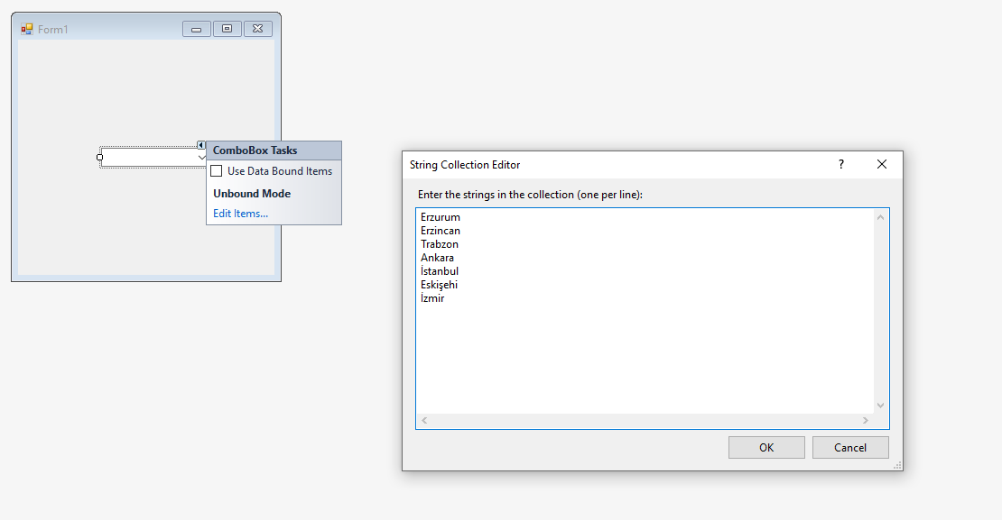
Using C# ComboBox

Slide 49
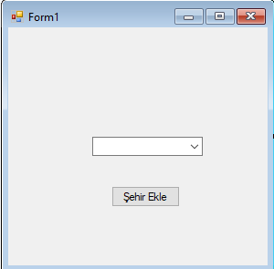
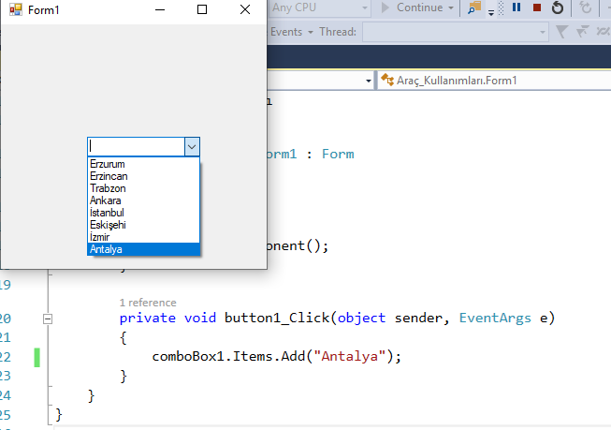
Using C# ComboBox
private void button1_Click(object sender, EventArgs e)
{
comboBox1.Items.Add("Antalya");
}

Slide 50
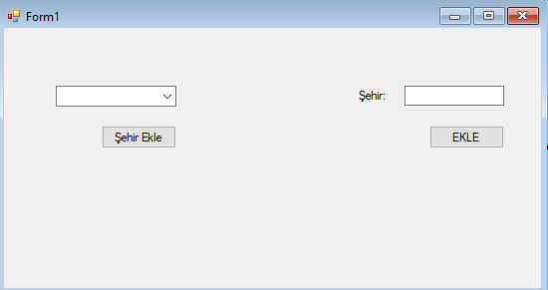
Example
Add the text we entered in the text box to the ComboBox.
private void button2_Click(object sender, EventArgs e)
{
comboBox1.Items.Add(textBox1.Text);
}

Slide 51
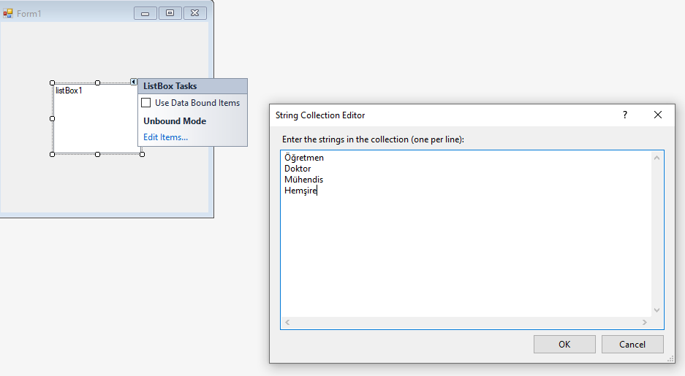
Using C# ListBox

Slide 52
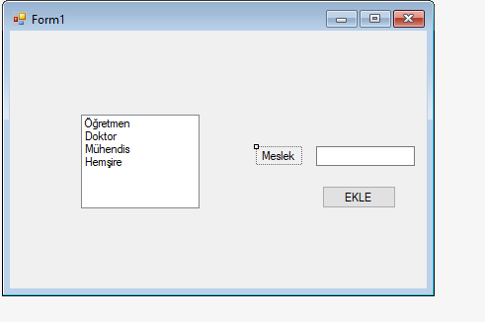
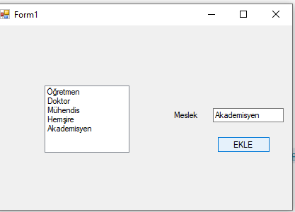
Using C# ListBox
Write the code that adds what is written in the Text Box to the ListBox when the button is pressed.
private void button1_Click(object sender, EventArgs e)
{
listBox1.Items.Add(textBox1.Text);
}

