Slide 1
GE Stock Performance analysis under MACD
Between 10/1/2012 to 9/30/2016
Yilong Zhao
10/15/2016

Slide 2
Model
Package: fArma
“armaFit” -> “armaSearch”
to find the lowest AIC
ARIMA(5,0,2) -> AR(2)
# ar1 ar2 intercept
#0.0309305 -0.0554146 0.0003908
Resource: http://www.quintuitive.com/2012/08/22/arma-models-for-trading/

Slide 3
Performance measure
Effective annual rate of return (EAR)
Total return^(1/ # of years)

Slide 4
Outcome
GE:
Bootstrap on average:
# of roundtrip | Total return | EAR | Winning rate | Max drawdown
35 | 27.56% | 6.27$ | 60% | 17.69%
# of roundtrip | Total return | EAR | Winning rate | Max drawdown
38.91 | 52.83% | 10.41$ | 73.37% | 20.20%

Slide 5
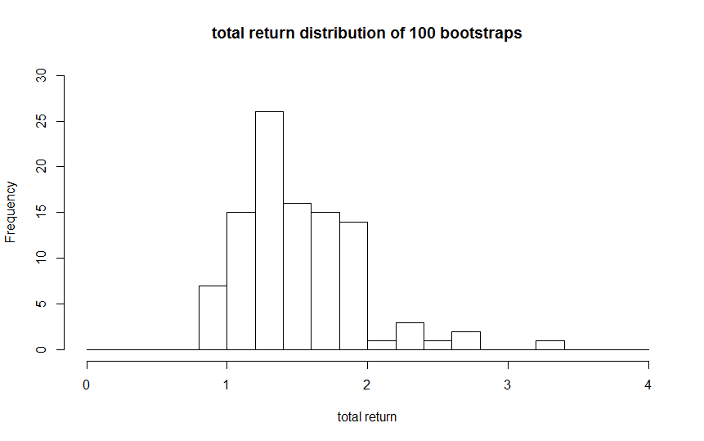
Outcome (cont`d.)
t-test, p-value < 2.2e-16

