Slide 1


Priming Study with
Spanish-English Bilinguals
STAT 427: Project Presentation
Presenters:
Yilun Fu, Yuhang Gong, Chunjiang Li, Zixuan Wang
04/28/2022

Slide 2

Introduction
STAT 427 Statistical Consulting

Slide 3
Introduction
What is Priming Effect?
Priming is the psycholinguistic phenomenon whereby exposure to a linguistic structure increases the likelihood of reusing that same structure in subsequent production.
Keywords:
Psycholinguistics
Increased likelihood
Reuse recently experienced STRUCTURES
Examples:
Today’s presentation is given by Group 7
Projects are graded by the professor
STAT 427 Statistical Consulting
Notes:
structural priming, also known as syntactic priming, or structural repetition
structural priming provides evidence for a production process that uses structural abstractions during grammatical encoding.

Slide 4
Introduction
Experiment Design
Goal:
Examine how priming works in three different groups of Spanish-English bilingual speakers
Groups:
Monolingually-raised Spanish speakers
First-generation Hispanic immigrants
Heritage speakers of Spanish
- influence from English
+ influence from English
STAT 427 Statistical Consulting

Slide 5
Introduction
Overview of Individual Variables
Bilingual Language Profile (BLP) – questionnaire
Score from -218 to +218
Negative score: English dominant | Positive score: Spanish dominant
Frequency of language use (language_use) – questionnaire
Spanish & English
Mean length of utterance (MLU) – narrative
Spanish & English
Words per minute (Words_Min) – narrative
Spanish & English
Vocabulary diversity (VOCD) – narrative
Spanish & English
STAT 427 Statistical Consulting

Slide 6
Introduction
Overview of Categorical Variables
Subjects
124 subjects
- 60 for Monolingually-raised speakers
- 24 for First-generation immigrants
- 40 for Heritage speakers
Groups
Monolingual
First-gen
Heritage
Phases
Pre-test
Treatment
Post-test
STAT 427 Statistical Consulting

Slide 7
Introduction
Overview of Categorical Variables
Constructions (in Spanish)
ACC
SPE
Modes
Within
Cross
Target
Yes: priming effect happens
No: priming effect does not happen
N_Items
180 in total / per participant
60 for each experiment
20 for each test under one experiment
STAT 427 Statistical Consulting

Slide 8
Introduction
Research Questions
1. Is the priming effect stronger with the ACC or with the SPE construction?
Experiment | Construction | Mode | Language | Tasks
Experiment 1 | ACC | Within | Spanish > Spanish | Pre-test, treatment, post-test
Experiment 2 | SPE | Within | Spanish > Spanish | Pre-test, treatment, post-test
Experiment 3 | SPE | Cross | English > Spanish | Pre-test, treatment, post-test
Each test has 20 items
60 for one experiment
STAT 427 Statistical Consulting

Slide 9
Introduction
Research Questions
2. Is the priming effect stronger in within-language mode or in cross-linguistic mode?
Experiment | Construction | Mode | Language | Tasks
Experiment 1 | ACC | Within | Spanish > Spanish | Pre-test, treatment, post-test
Experiment 2 | SPE | Within | Spanish > Spanish | Pre-test, treatment, post-test
Experiment 3 | SPE | Cross | English > Spanish | Pre-test, treatment, post-test
STAT 427 Statistical Consulting

Slide 10
Introduction
Research Questions
3. Which individual variables are associated with a strong priming effect?
Bilingual Language Profile (BLP)
Frequency of language use (language_use)
Mean length of utterance (MLU)
Words per minute (Words_Min)
Vocabulary diversity (VOCD)
STAT 427 Statistical Consulting

Slide 11
Methodology
STAT 427 Statistical Consulting

Slide 12
Methodology
Methods Used in Exploratory Data Analysis
Chi-Square test
VIF(Variable Inflation Factors)
Correlation test
Methods Used in Modeling
Generalized linear mixed model fit by maximum likelihood
Stepwise Regression
Methods Used in Power Analysis
Power analysis
STAT 427 Statistical Consulting

Slide 13
Methodology
Chi-square Test
Determine if two categorical variables have a significant correlation between them
chisq.test(data) is a function used to perform the test.
H0: The two variables are independent.
H1: The two variables relate to each other.
We reject the null hypothesis if the p-value that comes out in the result is less than a predetermined significance level, which is 0.05 usually, then we reject the null hypothesis.
STAT 427 Statistical Consulting

Slide 14
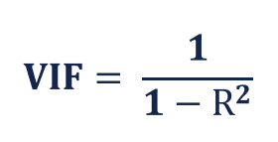
Methodology
VIF (Variable Inflation Factors)
Multicollinearity occurs when two or more independent variables are highly correlated with one another in a regression model. It will mislead the individual effects of the independent variables on the dependent variable
VIF to detect if collinearity exists
VIF score of an independent variable represents how well the variable is explained by other independent variables. It means the closer the value is to 1, the higher the value of VIF can be and the more likely the multicollinearity will occur with the particular independent variable.
STAT 427 Statistical Consulting

Slide 15
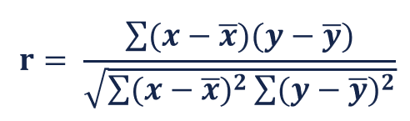
Methodology
Correlation Test
evaluate the association between two or more variables.
The famous method is Pearson correlation.
If the p-value is less than 0.05, then the correlation between x and y is significant.
STAT 427 Statistical Consulting

Slide 16
Methodology
Generalized Linear Mixed Model Fit by Maximum Likelihood
Generalized linear mixed models (or GLMMs) are an extension of linear mixed models to allow response variables from different distributions, such as binary responses.
Alternatively, GLMMs can be applied as an extension of generalized linear models (e.g., logistic regression) to include both fixed and random effects (hence mixed models).
And fitting GLMMs via maximum likelihood (as via AIC) involves integrating over the random effects. In fact, those integrals cannot be expressed in analytical form.
We can use various approximate methods, one of the famous form is Laplace approximation.
STAT 427 Statistical Consulting

Slide 17
Methodology
Stepwise Regression
Stepwise regression is the step-by-step iterative construction of a regression model that involves the selection of independent variables to be used in a final model.
It involves adding or removing potential explanatory variables in succession and testing for statistical significance after each iteration.
The forward selection approach starts with nothing and adds each new variable incrementally, testing for statistical significance.
The backward elimination method begins with a full model loaded with several variables and then removes one variable to test its importance relative to overall results.
STAT 427 Statistical Consulting

Slide 18
Methodology
Power Analysis
Power is defined as the probability of not making a Type II error. Mathematically, power is 1 – β.
The power of a hypothesis test is between 0 and 1; if the power is close to 1, the hypothesis test is very good at detecting a false null hypothesis.
Power is commonly set at 0.8, but may be set by the researchers to be greater.
we use pwr.f2.test(u, v, f2, sig.level) to test for the general linear model
u, is the number of coefficients you'll have in your model (minus the intercept).
v, is the number of error degrees of freedom: v = n-u-1
f2, is the effect size, equal to R^2/(1-R^2)
in Generalized mixed-effect models, we use r.squaredGLMM() to calculate pseudo-R-squared
STAT 427 Statistical Consulting

Slide 19
Research Question 1
Is the priming effect stronger with the ACC or with the SPE construction?
STAT 427 Statistical Consulting

Slide 20
RQ1: Exploratory Data Analysis
Overview of Categorical Variables
subject
group
monolingual/first-gen/heritage
phase
pre-test
treatment
post-test
construction
ACC
SPE
mode
within: Within-language priming
cross: Cross-language priming
target
n_item
Experiment | Construction | Tasks | Language mode
Priming experiment 1 | ACC | Pre-test, treatment, post-test | Spanish > Spanish (within)
Priming experiment 2 | SPE | Pre-test, treatment, post-test | Spanish > Spanish (within)
Priming experiment 3 | SPE | Pre-test, treatment, post-test | English > Spanish (cross)
The first step is to filter the dataset with only within mode.
STAT 427 Statistical Consulting

Slide 21
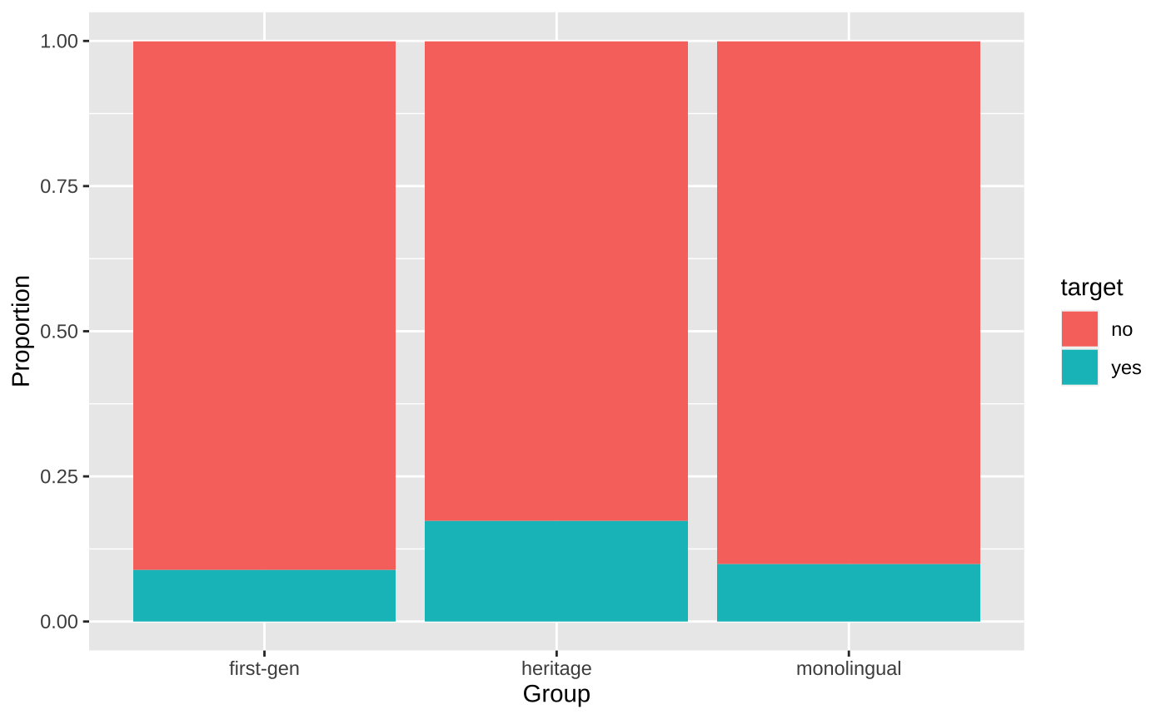
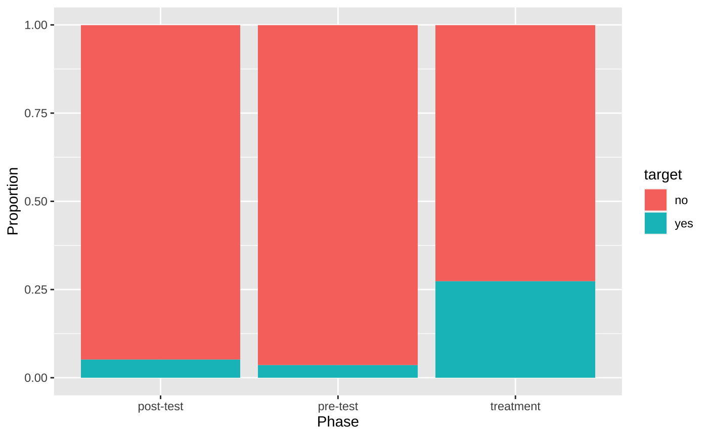
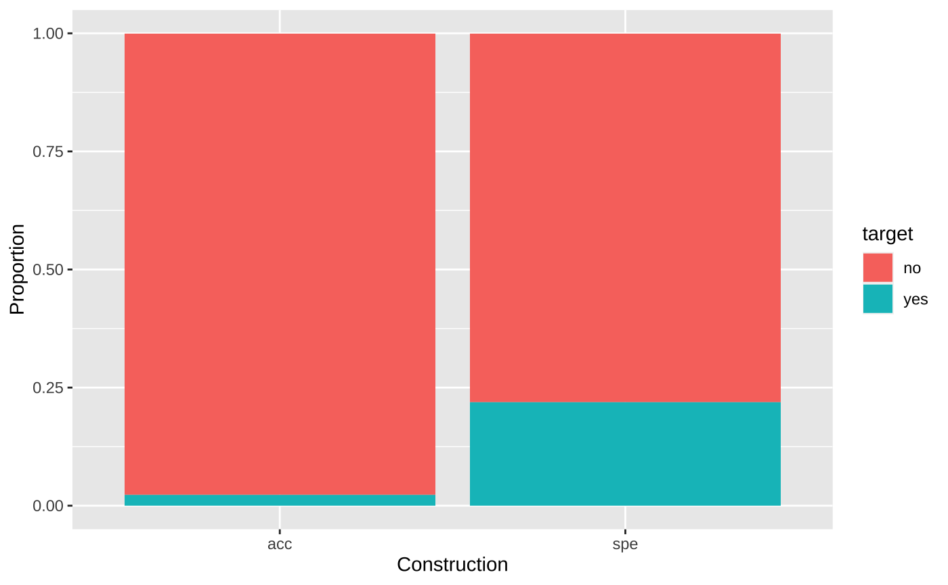
RQ1: Exploratory Data Analysis
Proportional Contingency Plot and Chi-squared Test
target vs. group
target vs. phase
target vs. construction
p-value of Chi-squared test:
p-value = 0.0002042
p-value < 2.2e-16
p-value < 2.2e-16
STAT 427 Statistical Consulting

Slide 22
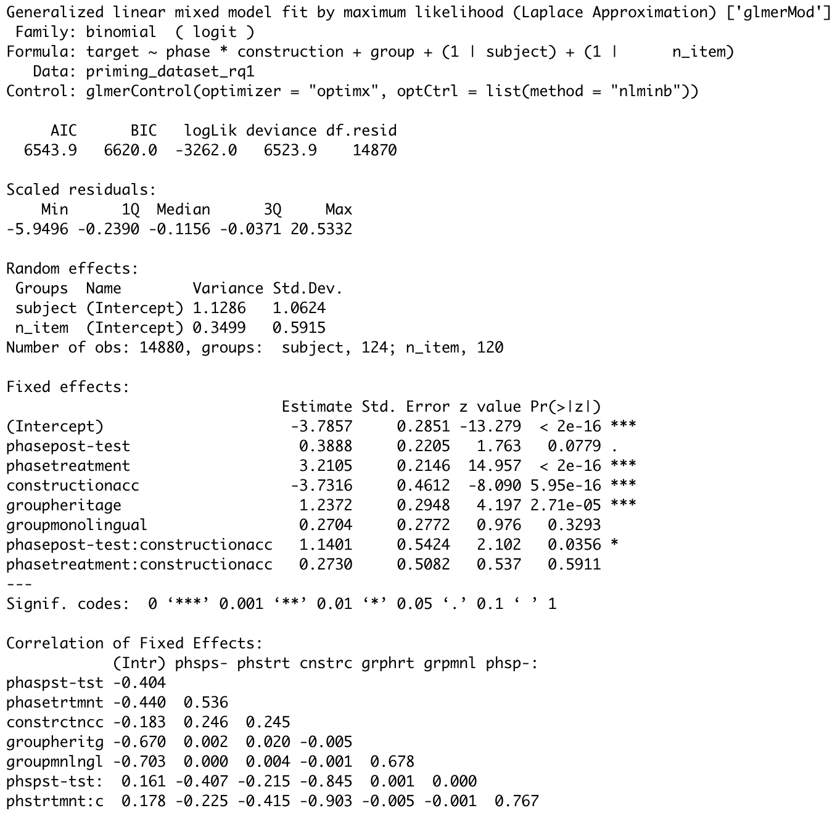
RQ1: Data Modeling – Generalized Linear Mixed Model
GLMM Result
Significant parameters at level of 0.05: intercept, phasetreatment, constructionacc, groupheritage and the interaction of phasepost-test and constructionacc, which overall matches the results we observed from exploratory data analysis.
The coefficient of constructionacc is -3.7316 and indicates that the priming effects are less likely to happen when using ACC construction compared to SPE construction
The power of the analysis is 99.9994%, which indicates that the analysis we have done is credible.
STAT 427 Statistical Consulting

Slide 23
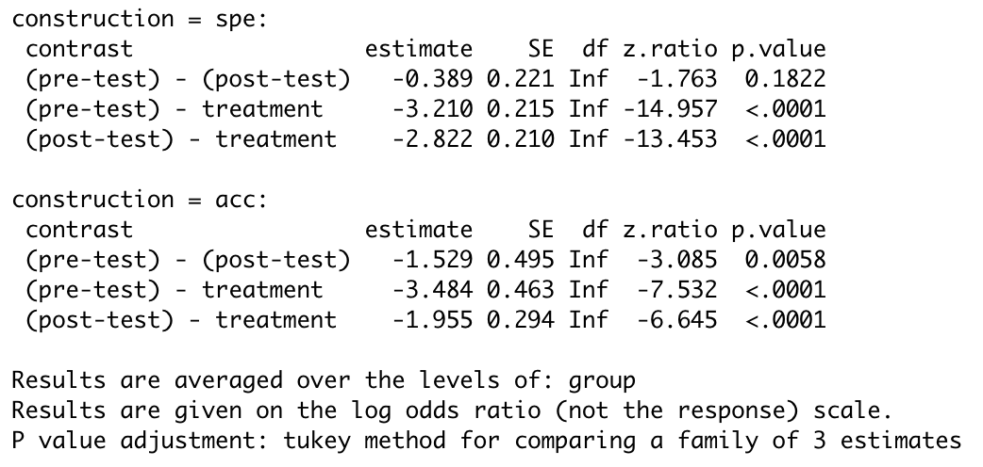
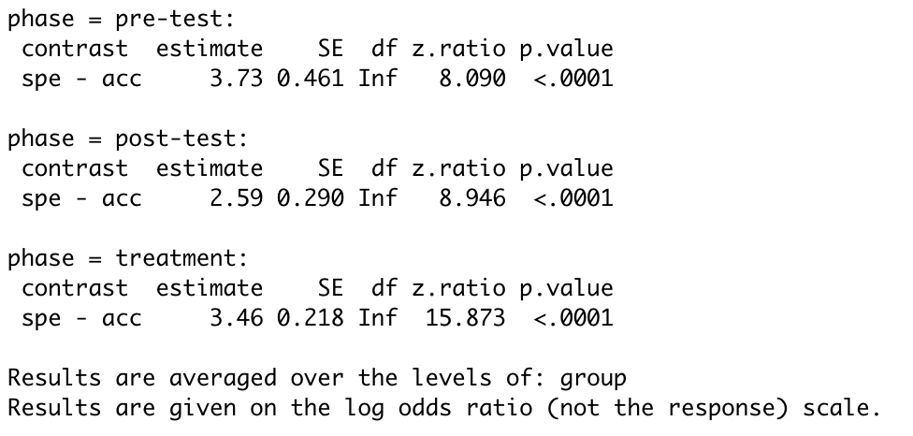
RQ1: Data Modeling – Generalized Linear Mixed Model
Estimate Marginal Means
There is significant difference for (pre-test) - treatment and (post-test) - treatment when construction is SPE
There is significant difference for (pre-test) - treatment and (post-test) - treatment when construction is ACC
There is significant difference for acc– spe in every phase
Estimate marginal means by construction
Estimate marginal means by phase
STAT 427 Statistical Consulting

Slide 24
Research Question 2
Is the priming effect stronger in within-language mode or in cross-linguistic mode?
STAT 427 Statistical Consulting

Slide 25
RQ2: Exploratory Data Analysis
Overview of Categorical Variables
subject
group
monolingual/first-gen/heritage
phase
pre-test
treatment
post-test
construction
ACC
SPE
mode
within: Within-language priming
cross: Cross-language priming
target
n_item
Experiment | Construction | Tasks | Language mode
Priming experiment 1 | ACC | Pre-test, treatment, post-test | Spanish > Spanish (within)
Priming experiment 2 | SPE | Pre-test, treatment, post-test | Spanish > Spanish (within)
Priming experiment 3 | SPE | Pre-test, treatment, post-test | English > Spanish (cross)
The first step is to filter the dataset with only SPE construction.
STAT 427 Statistical Consulting

Slide 26
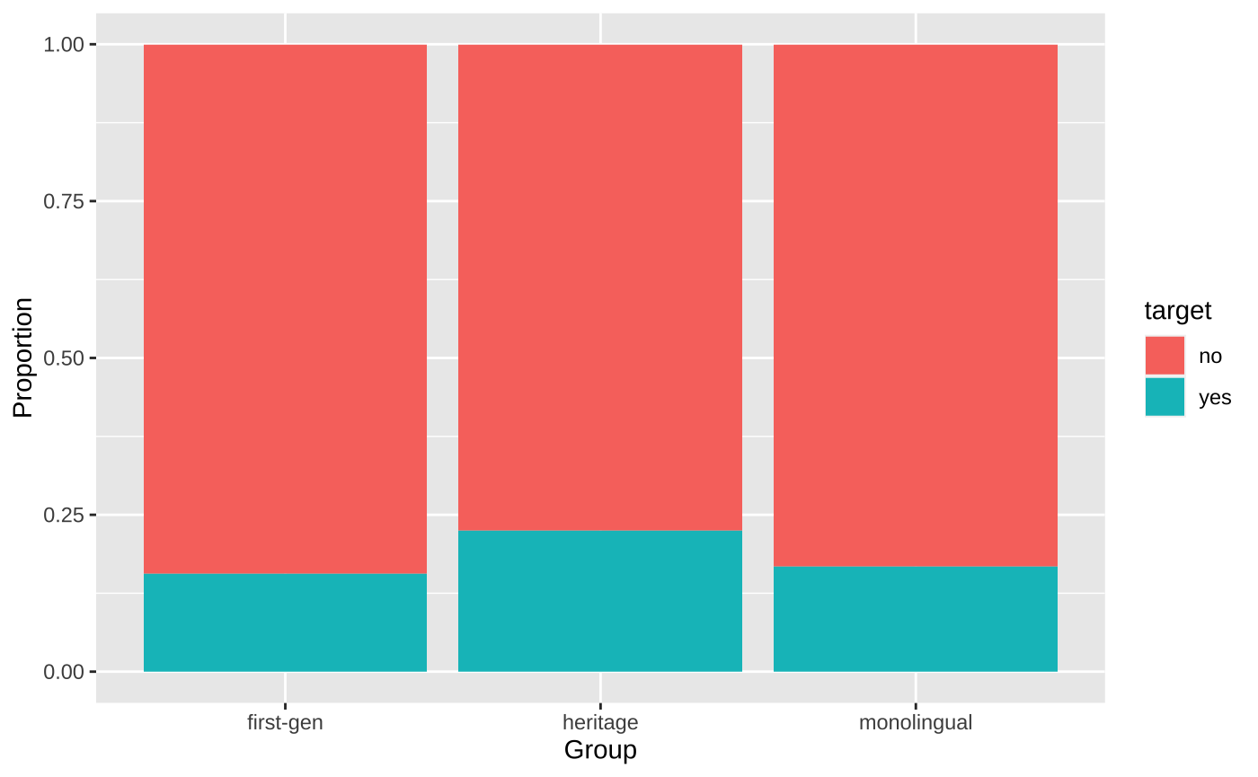
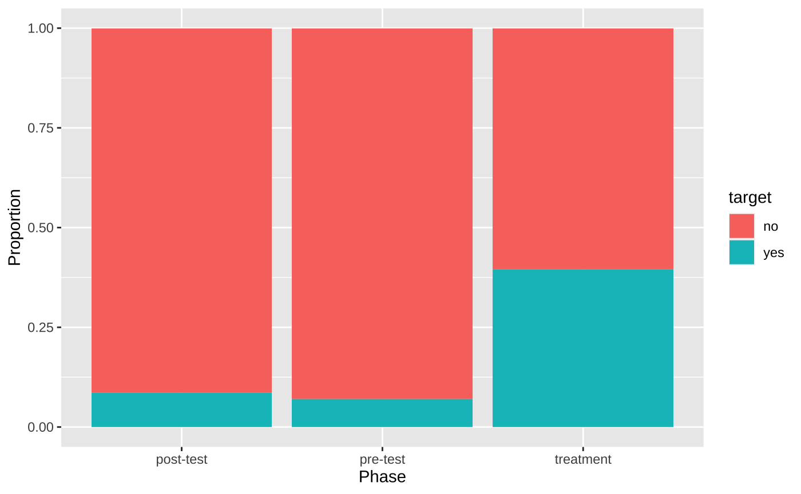
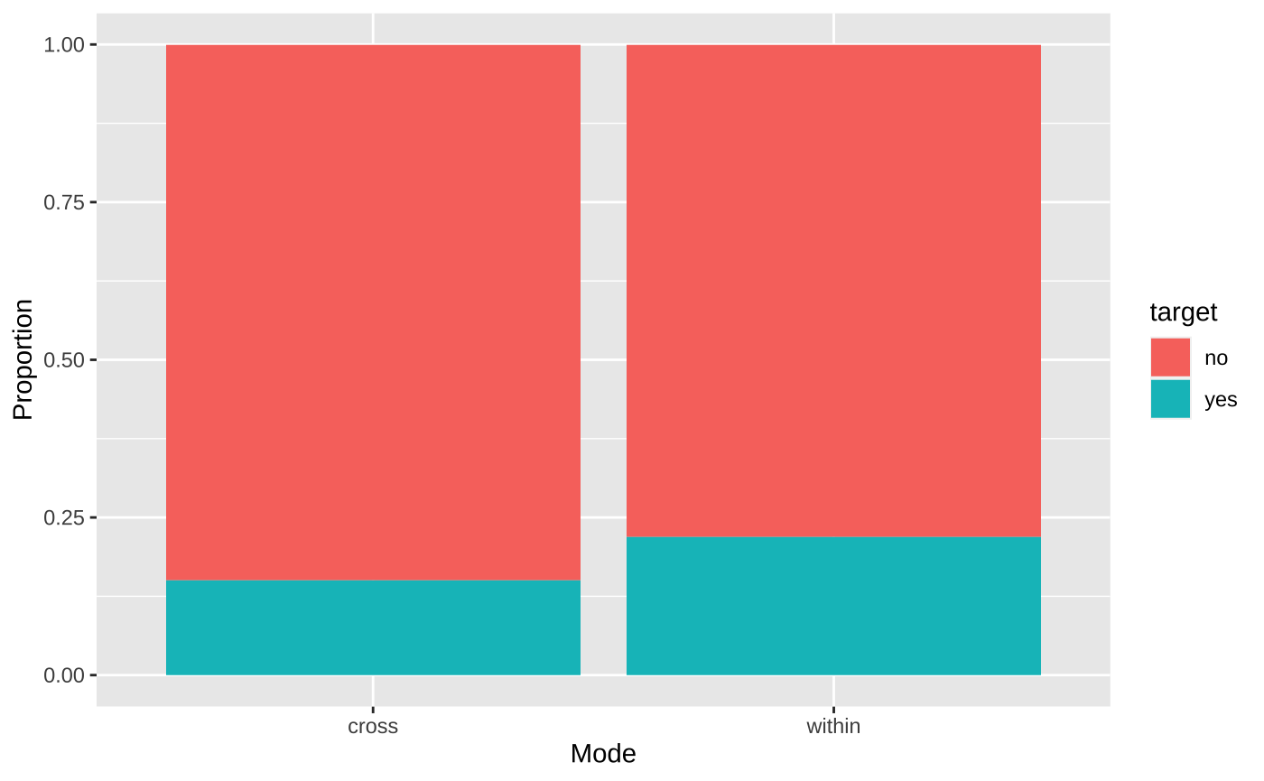
RQ2: Exploratory Data Analysis
Proportional Contingency Plot and Chi-squared Test
target vs. group
target vs. phase
target vs. mode
p-value of Chi-squared test:
p-value = 0.002321
p-value < 2.2e-16
p-value = 0.0002103
STAT 427 Statistical Consulting

Slide 27
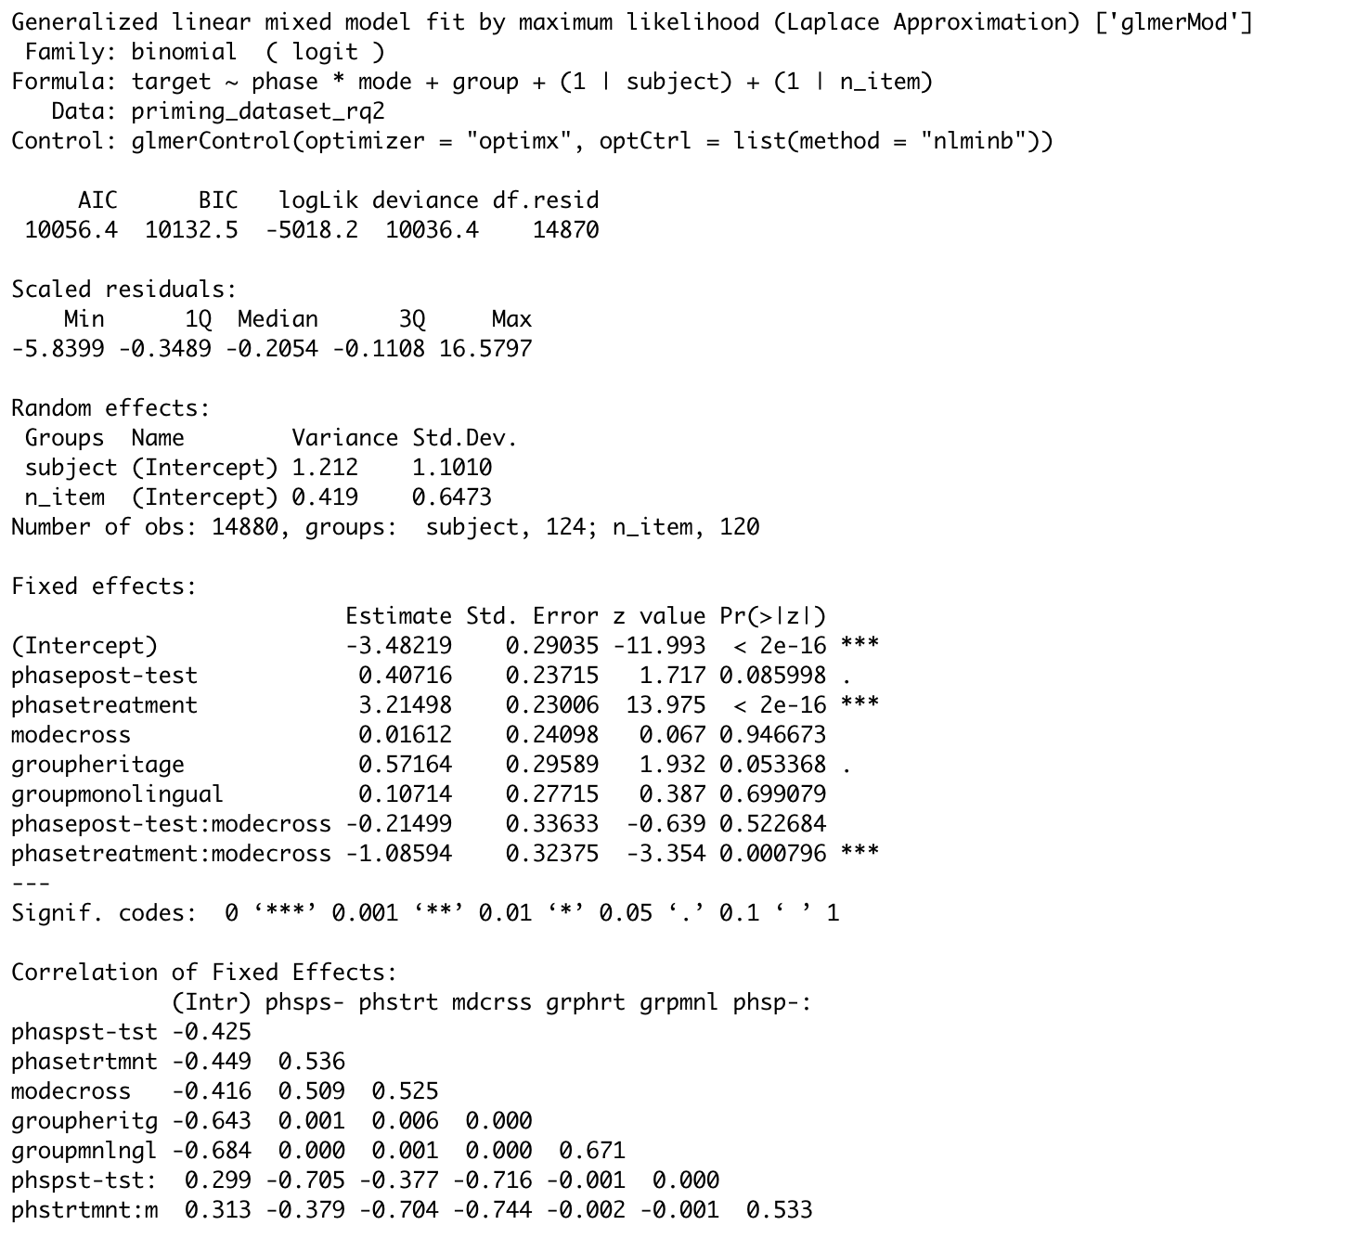
RQ2: Data Modeling – Generalized Linear Mixed Model
GLMM Result
Significant parameters at level of 0.05: intercept, phasetreatment, and the interaction of phasetreatment and modecross.
The modecross itself is not significant but the interaction of phasetreatment and modecross is significant. The coefficient is -1.08594, which indicates that in the treatment phase of the experiment, priming effects are less likely to happen in cross mode compared to within mode.
The power of the analysis is 95.647%, which indicates that the analysis we have done is credible.
STAT 427 Statistical Consulting

Slide 28
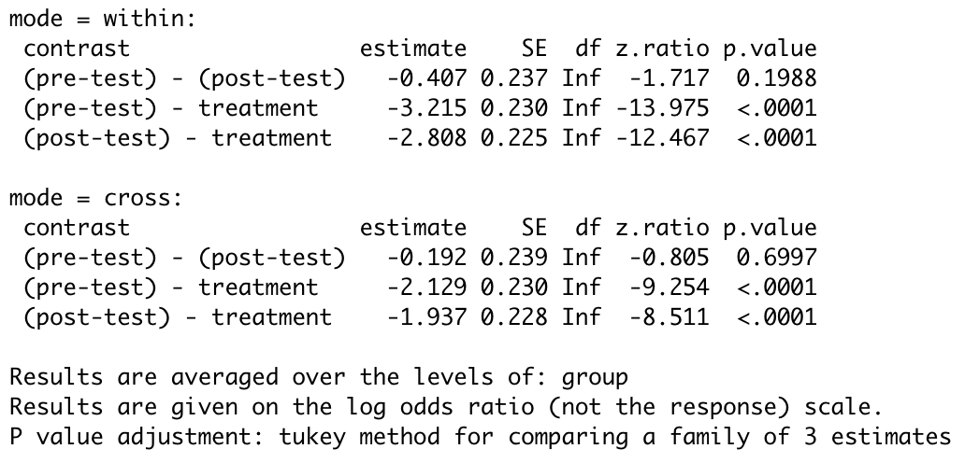
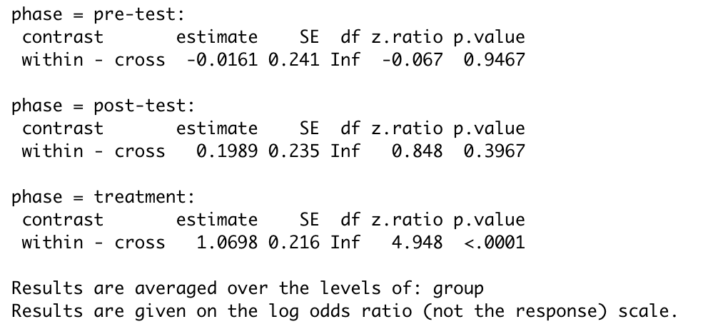
RQ2: Data Modeling – Generalized Linear Mixed Model
Estimate Marginal Means
There is significant difference for (pre-test) - treatment and (post-test) - treatment when mode is within
There is significant difference for (pre-test) - treatment and (post-test) - treatment when mode is cross
There is significant difference for within - cross when phase is treatment
Estimate marginal means by mode
Estimate marginal means by phase
STAT 427 Statistical Consulting

Slide 29
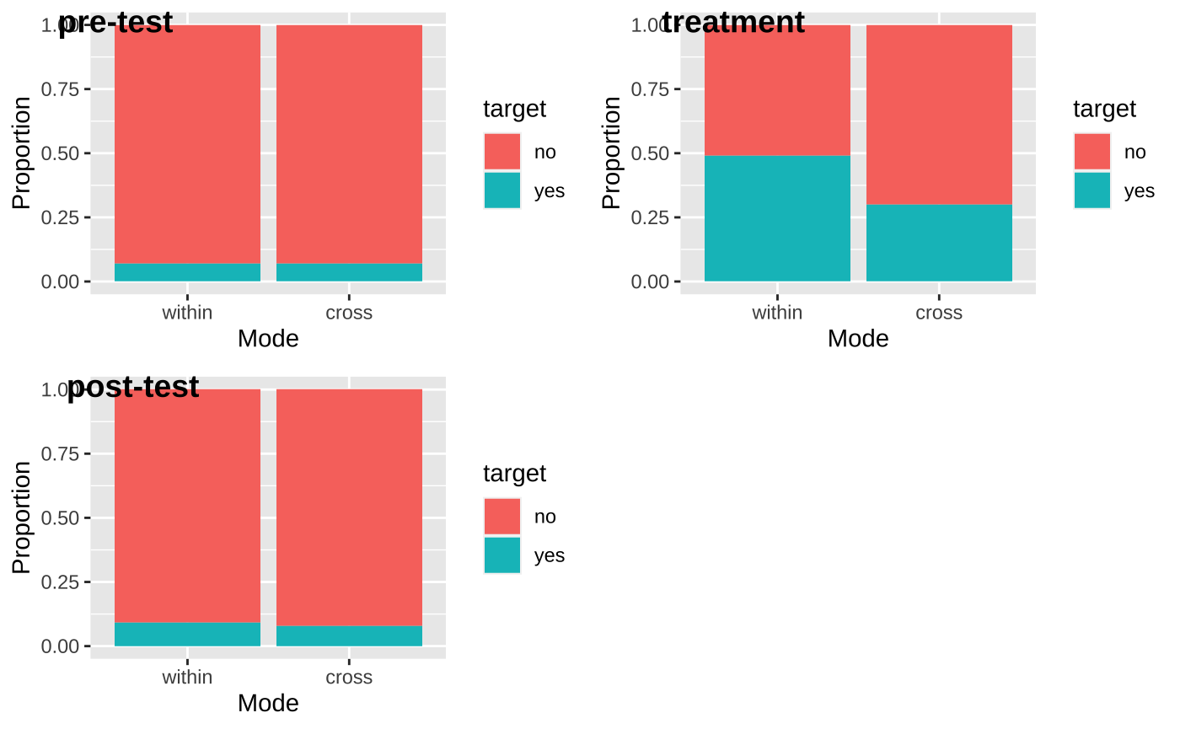
RQ2: Data Modeling – Generalized Linear Mixed Model
Explanation on the Effect of Mode
Notice that the modecross itself is not significant but the interaction of phasetreatment and modecross is significant.
We can see that the effect of mode on target is not significant neither when phase is pre-test nor post-test. However, the effect of mode on target is significant when phase is treatment. So in this way, the interaction between mode and phase should be taken into consideration in our model.
STAT 427 Statistical Consulting

Slide 30
Research Question 3
Which individual variables are associated with a strong priming effect?
STAT 427 Statistical Consulting

Slide 31
RQ3: Exploratory Data Analysis
Overview of Individual Variables
Bilingual Language Profile (BLP) – questionnaire
Score from -218 to +218
Negative score: English dominant | Positive score: Spanish dominant
Frequency of language use (language_use) – questionnaire
Spanish & English
Mean length of utterance (MLU) – narrative
Spanish & English
Words per minute (Words_Min) – narrative
Spanish & English
Vocabulary diversity (VOCD) – narrative
Spanish & English
STAT 427 Statistical Consulting

Slide 32
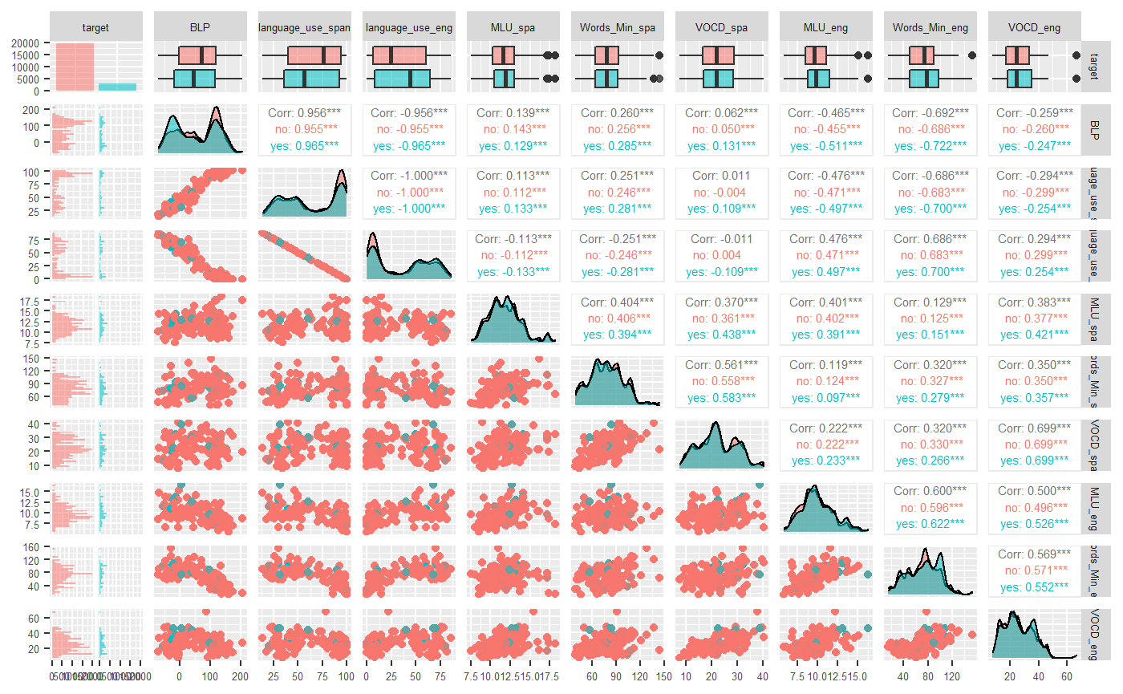
RQ3: Exploratory Data Analysis
Pairplot Analysis
Language_use_eng is exact correlated with Language_use_span. (Remove Language_use_eng )
Language_use_span is strongly positively correlated with BLP. (Collinearity Problem)
No obvious range or distribution differences can be found for most of the predictors.
Many predictors do not follow a normal distribution.
STAT 427 Statistical Consulting

Slide 33
RQ3: Exploratory Data Analysis
Mean Differences between Target:yes and Target:no
No obvious mean differences between target:yes and target:no can be found for most of the predictors.
target | BLP_mean | language_use_span_mean | MLU_spa_mean | Words_Min_spa_mean | VOCD_spa_mean | MLU_eng_mean | Words_Min_eng_mean | VOCD_eng_mean
no | 60.20 | 67.00 | 11.80 | 79.00 | 22.60 | 9.79 | 71.09 | 25.58
yes | 48.70 | 62.60 | 11.90 | 77.90 | 22.30 | 10.11 | 74.38 | 26.31
STAT 427 Statistical Consulting

Slide 34
RQ3: Data Modeling – Linear Regression Model
Response Variable Transformation
The original binomial response variable is converted into continuous response variable.
The transformed dataset contains 124 rows.
Original Dataset
subject | n_item | target | BLP | language_use_span | MLU_spa
101 | 1 | no | -7 | 34 | 9
101 | 2 | no | -7 | 34 | 9
101 | 3 | no | -7 | 34 | 9
101 | 4 | no | -7 | 34 | 9
101 | 5 | yes | -7 | 34 | 9
Transformed Dataset
subject | target_mean | BLP | language_use_span | MLU_spa
101 | 0.2 | -7 | 34 | 9
STAT 427 Statistical Consulting

Slide 35
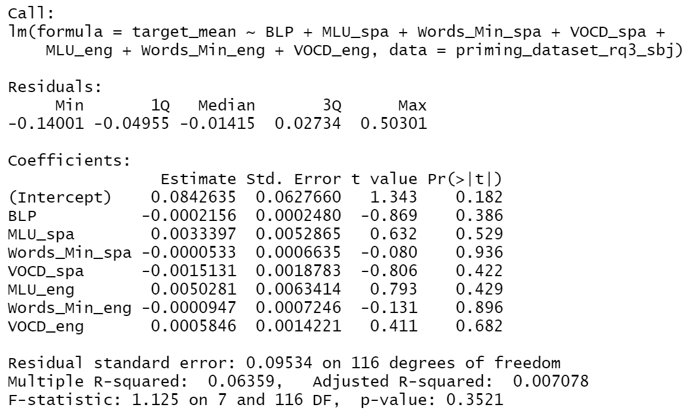
RQ3: Data Modeling – Linear Regression Model
Linear Regression Result
Language_use_span is removed to avoid collinearity problem.
None of the parameters are significant， which overall matches the results we observe from exploratory data analysis.
The VIF score for all the remaining parameters are smaller than 10.
VIF Scores for the Remaining Predictors
BLP | MLU_spa | Words_Min_spa | VOCD_spa | MLU_eng | Words_Min_eng | VOCD_eng
3.86 | 1.66 | 2.77 | 2.69 | 2.13 | 5.12 | 3.05
STAT 427 Statistical Consulting

Slide 36
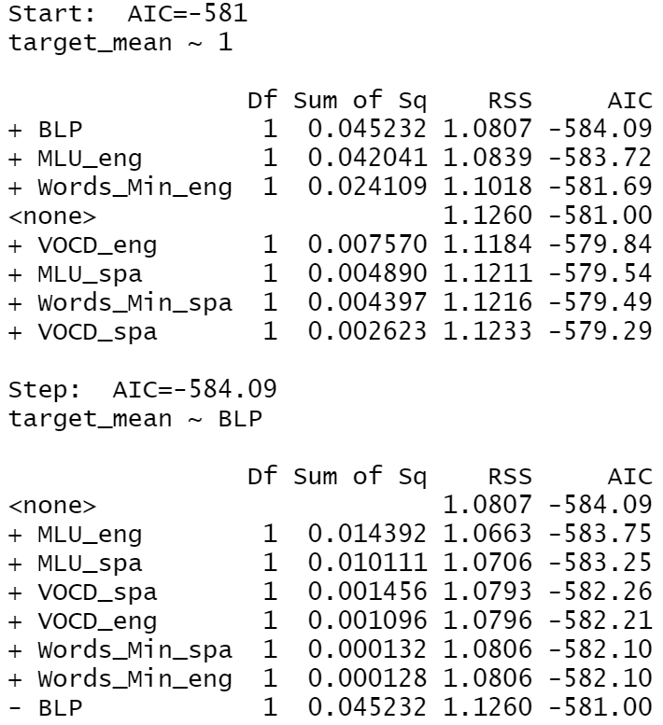
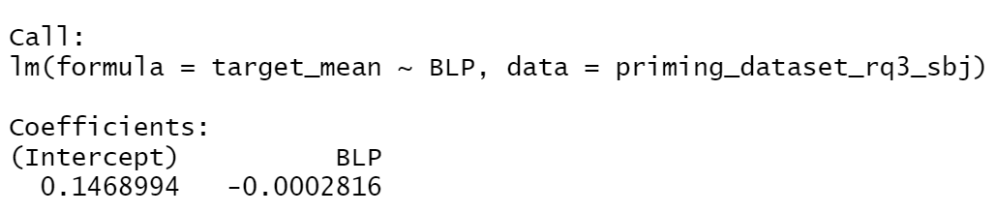
RQ3: Data Modeling – Linear Regression Model
Stepwise Variable Selection
The null model is set to be target_mean ~ 1; the full model is set to be the same as the previous linear regression model.
The result of the stepwise variable selection indicates that BLP is the only selected variable, which matches the results we observed from exploratory data analysis.
STAT 427 Statistical Consulting

Slide 37
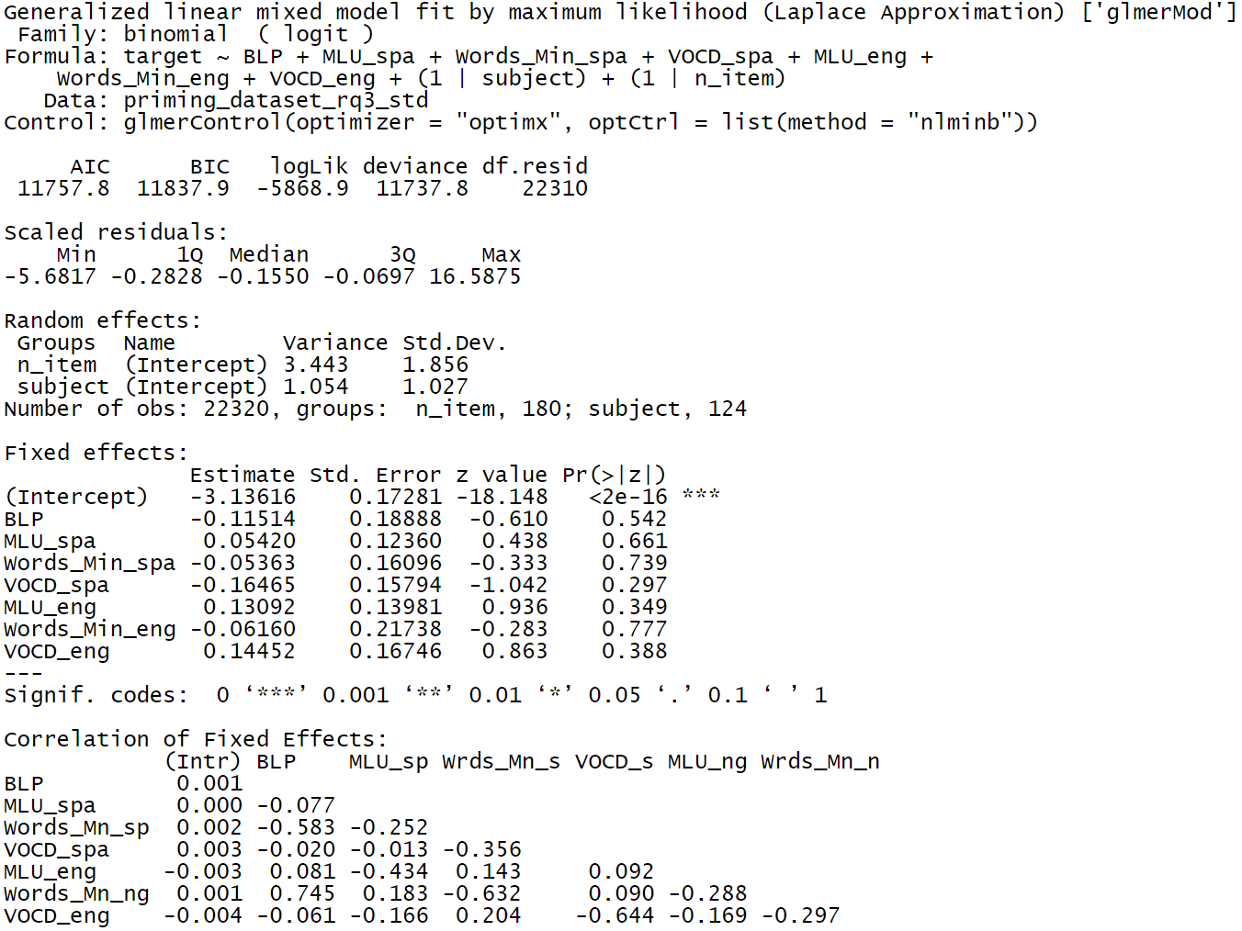
RQ3: Data Modeling – Generalized Linear Mixed Model
GLMM Result
Language_use_span is removed to avoid collinearity problem.
The GLM model is fit by maximum likelihood using the original data
None of the parameters are significant， which overall matches the results we observe from exploratory data analysis.
The VIF score for all the remaining parameters are smaller than 10.
The power of the analysis is 7.59%
VIF Scores for the Remaining Predictors
BLP | MLU_spa | Words_Min_spa | VOCD_spa | MLU_eng | Words_Min_eng | VOCD_eng
3.90 | 1.65 | 2.78 | 2.71 | 2.13 | 5.15 | 3.07
STAT 427 Statistical Consulting

Slide 38
Summary
STAT 427 Statistical Consulting

Slide 39
Summary
Conclusion
RQ1: Is the priming effect stronger with the ACC or with the SPE construction?
The priming effects are less likely to happen when using ACC construction compared to SPE construction
RQ2: Is the priming effect stronger in within-language mode or in cross-linguistic mode?
The modecross itself is not significant but the interaction of phasetreatment and modecross is significant.
Only in the treatment phase of the experiment, priming effects are less likely to happen in cross mode compared to within mode.
RQ3: Which individual variables are associated with a strong priming effect?
None of the parameters are significant
STAT 427 Statistical Consulting

Slide 40
Thank You!
Q&A
STAT 427 Statistical Consulting

