Slide 1

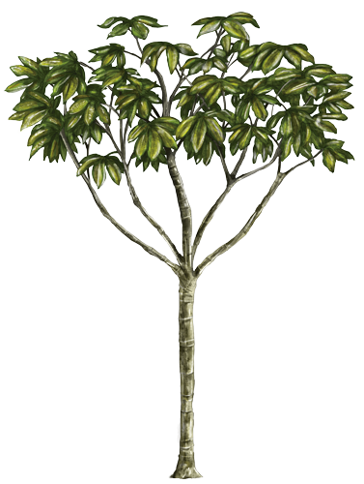
Project Cecropia Demo
Yilun “Allen” Chen
07/10/2019

Slide 2
Contents
PART 01
Introduction
PART 02
Functionalities
PART 03
Features & Performance
PART 04
Real-time Demo

Slide 3


Introduction
What is Cecropia?
A Subsystem for SlothBot
Data Collection
Data Processing
Data Visualization

Slide 4
Functionalities
Data Collection
Data Processing
Data Visualization

Slide 5
Data Collection and Processing
Cecropia Server
Visitor
Robots
MongoDB Database

Slide 6
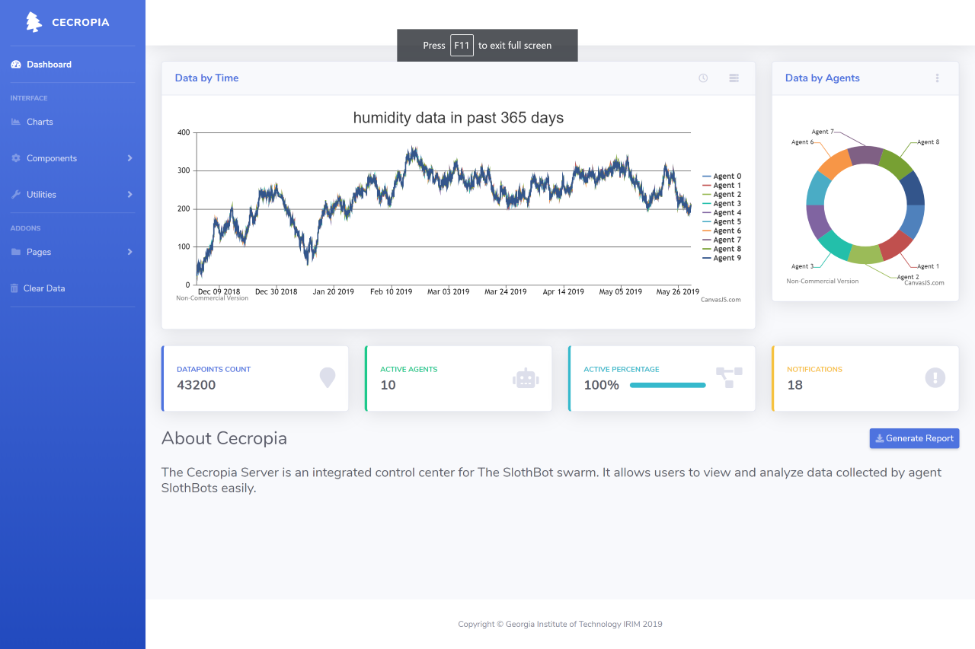
Figure. GUI screenshot of the system
Data Visualization

Slide 7
Features
Deployability
Flexibility
Energy-Efficient
Connection Safety
Mass Data Processing
Expandability

Slide 8
Mass Data Handling Performance

Slide 9



Expandability
Export Data to Excel Form
Database with better Performance
Network Connection Check on Robots

Slide 10
05/20
Add your title
Deployed the server along with MongoDB onto local WiFi network.
05/29
Built GUI of the server. Users can now select what kind of data to display in desired timespan.
06/04
Deployed Data Visualization system with CanvasJS.
Design Roadmap

Slide 11
Real-time demonstration

Slide 12
Project Cecropia Demo
Yilun “Allen” Chen
07/10/2019

