Slide 1
YOLOV3PrefetchTargetGenerator
1: 最匹配
0: 背景或不够好
-1: 足够好但非最优
YOLOV3DynamicTargetGeneratorSimple

Slide 2
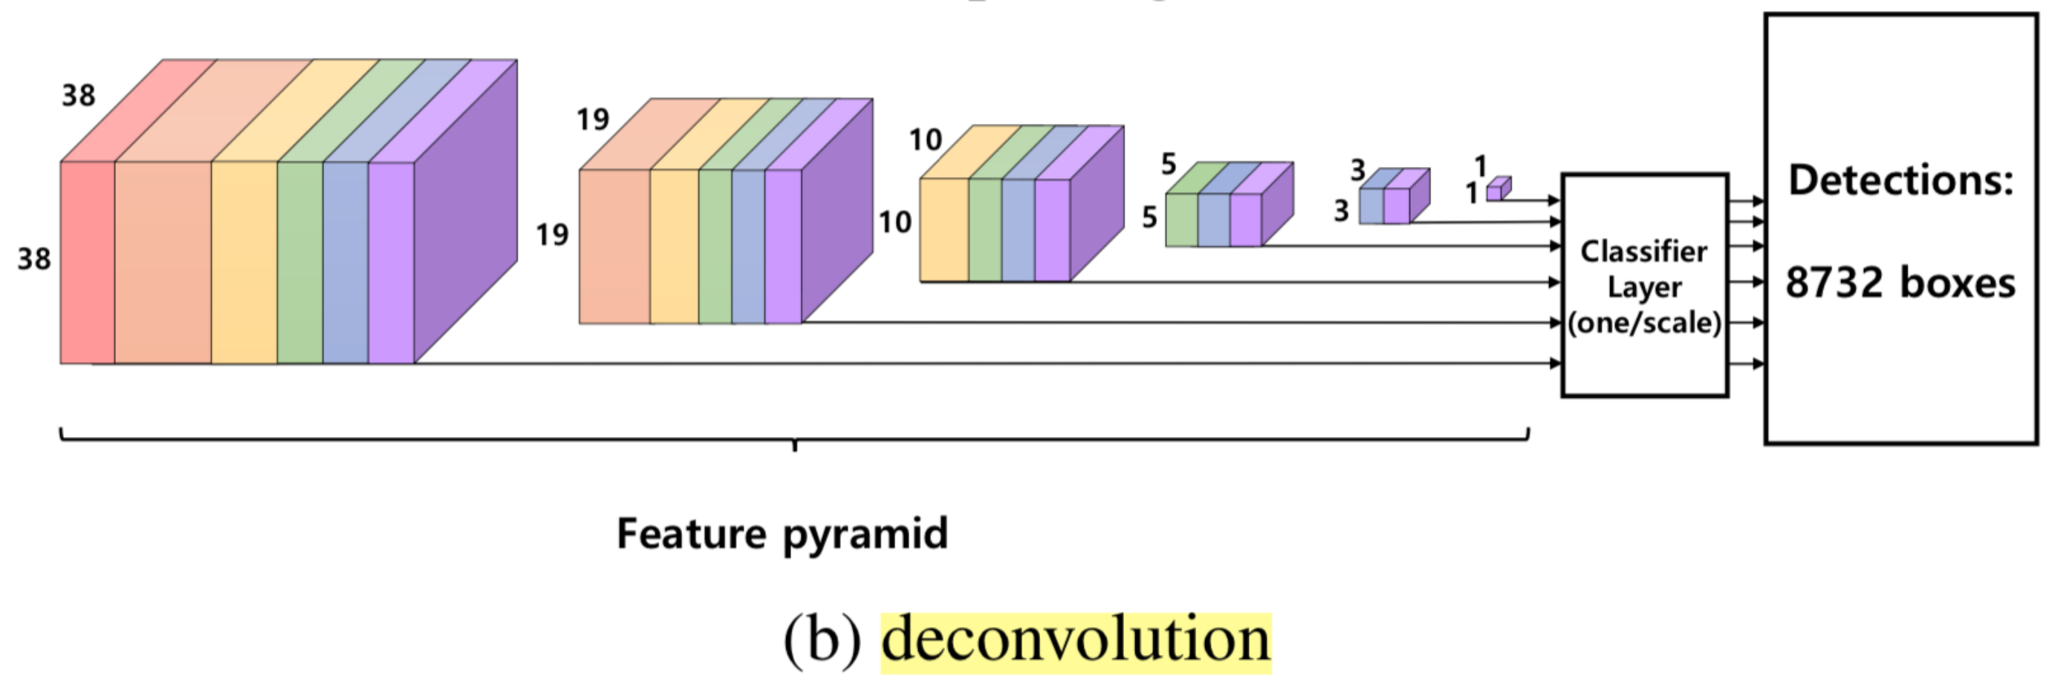
Trans_Conv 2x2
concat
Conv from the low layer of same size

