Slide 1
running riscv-linux using qemu
RV64B：胡亦旻 1300011764 沈科杰 1400012797 徐品 1400012940

Slide 2
qemu for riscv
文本
https://github.com/riscv/riscv-qemu
steps：Build —> Obtain Image —>Run QEMU

Slide 3
bUILD QEMU
文本
make install: get binary file qemu-system-riscv64
then use this to load a image

Slide 4
Obtain image
文本
base image:vmlinux
https://github.com/riscv/riscv-linux/tree/priv-1.9
bbl: berkerly boot loader
https://github.com/riscv/riscv-pk/
initramfs?

Slide 5
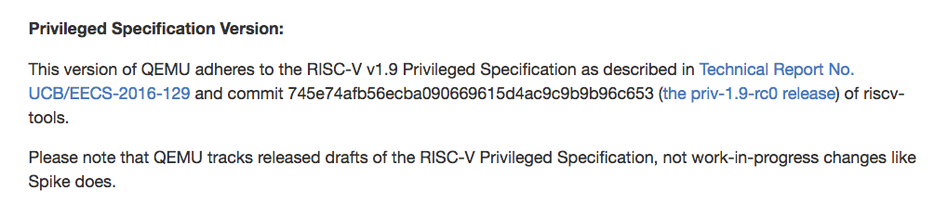
How to compile vmlinux&bbl
文本
riscv-gnu-toolchain
https://github.com/riscv/riscv-gnu-toolchain/
Version!! Match the commit in priv-1.9-rc0

Slide 6
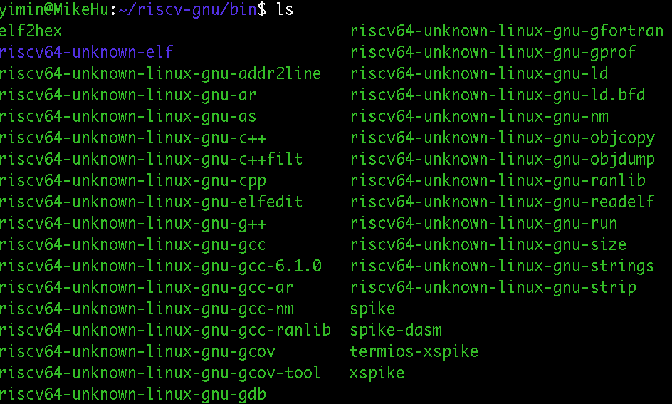
riscv-gnu-toolchain
文本
complie this first, you will get:

Slide 7
kernel image with boot loader
文本
according to riscv-linux, get a vmlinux
compile riscv-pk, use vmlinux as a payload for bbl
then you get bbl (riscv-pk/build/bbl)
try to run qemu using bbl, but no initramfs, kernel panic

Slide 8
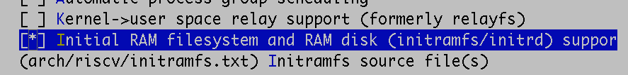
Create initramfs for bbl
文本
compile it into kernel image
arch/riscv/initramfs.txt
install a busybox into initramfs as well (set static & compiler)

Slide 9
initramfs.txt
文本
dir /bin 755 0 0
file /bin/busybox tmp/bin/busybox 755 0 0
file /bin/hello tmp/bin/hello 755 0 0
dir /etc 755 0 0
file /etc/inittab tmp/etc/inittab 755 0 0
dir /usr 755 0 0
dir /usr/bin 755 0 0
dir /usr/sbin 755 0 0
dir /sbin 755 0 0
dir /dev 755 0 0
nod /dev/console 644 0 0 c 5 1
nod /dev/null 644 0 0 c 1 3
dir /proc 755 0 0
slink /init /bin/busybox 755 0 0
help to create initfamfs.cpio.gz

Slide 10
inittab
文本
::sysinit:/bin/busybox --install
::sysinit:/bin/mount -t devtmpfs devtmpfs /dev
::sysinit:/bin/mount -t proc proc /proc
/dev/console::sysinit:-/bin/busybox ash

Slide 11
make & run
文本
finally get bbl include boot loader, vmlinux & initramfs with busybox!
qemu-system-riscv64 -kernel bbl -nographic
use toolchain to compile a static hello world and load it into bin
then you can run hello!

Slide 12

THanks !

