Slide 1


Data: From Patient to Health Record
COMP3050 -
Individual Dissertation Single Honours
Yiming LI (scyyl3)
Supervised by Dr. Boon Giin LEE
Notes:
Hello, My name is Yiming LI. The title of my final year project is Data: from patient to health record.

Slide 2
Acknowledgments
This project could not have been completed without the help from my supervisor - Dr. Boon Giin LEE, who has helped me along the way and motivated me throughout the project development.
Also, thanks to Tianlang Tan, Chengtao Luo and Jingwen Zhou, who also cooperated their Final Year Projects with Dr. Boon Giin LEE. I learned a lot from them as peer experiences.
Notes:
This project could not have been completed without the help from my supervisor. Thank you to Bryan, Tianlang, Chengtao and Jingwen, helping me a lot along the way.

Slide 3
Content
Background & Motivation
Related Work
Design
Project Requirements & Specifications
Implementation
Result & Additional work
Summary
8.1 Reflection
8.2 Future work
Notes:
The content of this presentation is divided into seven sections. First, I will introduce the background of Electronic Health Record and the motivation of this project. Next, I will outline the related work followed by the system design and project requirements and specifications. After that, I will show you the implementation that was taken in developing the system as well as the results. Then, I will demonstrate additional work of this project. Finally, I will discuss on the reflection and future consideration on this project.

Slide 4
Background
Electronic Health Record (EHR)
a collection of patients’ health record and health status throughout their whole life for clinical purposes.
Advantage
Disadvantage
Uniform the medical record format [1]
Efficient entry and retrieval of relevant patient information [4]
Reliable remote data access
Searchable digital database
Integrated patient records [2]
Manual input
Distraction from diagnosis [4]
Notes:
The Electronic Health Record (EHR) serves as a collection of patients’ health record and health status throughout their whole life for clinical purposes. It is a computer information system which has lots of benefits comparing to paper work.
However, The greatest disadvantage of EHR system is the manual input. Doctors were required to type in all the information into the computer manually. Not all the doctors were good at using keyboard and mouse. Also, it will distract doctors from diagnosing patients or interacting with patients.

Slide 5
Background
Electronic Health Record (EHR)
1031 publications in the USA v.s. 173 publications in China [6]
The Chinese government set a goal to ensure the universal usage of EHR among the whole population in most of the hospitals and clinics by the end of 2020. [3]
Doctors spent between 37% - 49% of their working hours on clerical tasks. [5]
Notes:
The current situation of EHR is that it was a relatively new emerging and promising field in China. During 2008-2017, there were 1031 publications on EHR in the USA while there were only 173 publications in China [13]. A 2016 study estimated that doctors spent between 37% to 49% of their working hours on these clerical work [5]. These works are time-consuming and distracting. In that situation, serious mistakes could happen when filling in EHR manually.

Slide 6
Motivation
Develop an automated report generation system, which could translate real time voice input or audio files into plain text and process and extract key information to fill in the EHR form automatically.
To liberate doctors from tedious clerical work and reduce the likelihood of human errors occurring.
Notes:
Therefore, based on the background research, traditional EHR system is inefficient and distracting for the doctors. In this case, I decided to build an automated report generation system, which is feasible to translate real time voice or audio files into plain text. After that, it should process that piece of text and extract key information from it to fill in the EHR form automatically. In this way, it can liberate doctors from clerical work, improve the efficiency and reduce the number of mistakes made by doctors.

Slide 7
Related Work
Automated Report Generation System
Iflytek [7] decided to develop an EHR support system to synchronously record the voice into patients’ medical record, when doctors communicate with the patient.
Unfinished
No developed AI-based EHR system in China.
Notes:
Currently, there is only one similar system description that can be found in China. Iflytek [14] announced a plan to develop this kind of system years ago, but there is no further information about that system. In this case, it is regarded as an unfinished system, which is still under development. Therefore, there does not exist any developed EHR support system in China. To allow such a system to record the voice into patients’ EHR, when doctors simultaneously communicate with the patient, Voice Recognition and Natural Language Processing are required.

Slide 8
Related Work
Voice Recognition
Baidu Voice Recognition [8]
Google Voice Recognition [9]
Iflytek Voice Recognition [7]
A pre-trained model
Supports the self-training model
Register for an access key
40000 times limitation
…
Highly integrated
Better structure of addresses, dates…
No authentication
…
High accuracy for Chinese recognition
Register for an access key
Add IP into whitelist
…
Notes:
So, next part is to research on voice recognition methods. Three typical Chinese voice recognition methods are provided by Baidu, Google and Iflytek. All of these methods provide is a pre-trained model. The main differences are that Baidu voice recognition requires authentication and has limitation on numbers of usage, while Google voice recognition is highly integrated and easy to use without authentication and any other limitations. Iflytek voice recognition is almost the same as Baidu voice recognition, but it additionally requires an IP whitelist.

Slide 9
Related Work
Natural Language Processing (NLP)
English-based [11]
Chinese Based
MedLEE
MetaMap
KnowledgeMap
cTAKES
HiTEX
MedTagger
…
Jieba [10]
(Chinese for “stutter”)
Notes:
Then, for NLP methods, there are lots of NLP libraries based on English, such as MetaMap and, cTAKES… while there is little Chinese based NLP libraries. The best and the most famous Chinese NLP library is called Jieba (Chinese for “stutter”). It includes all the functionalities that English NLP has. Keyword Extraction, Part of Speech Tagging, Tokenize are the main functions in Jieba library.

Slide 10

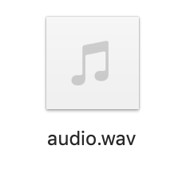
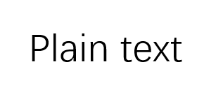
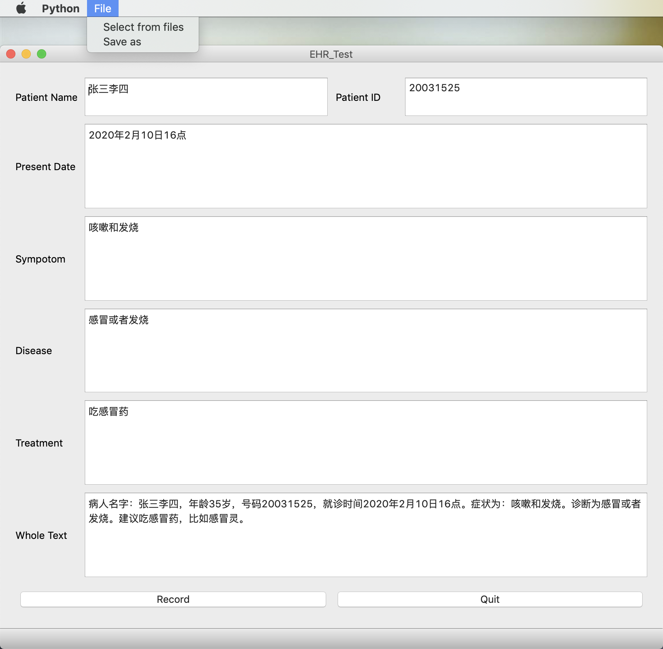
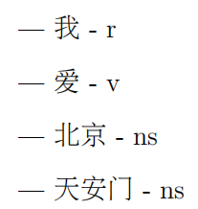
Design
1.Record
2. Voice recognition
Voice record device
Audio files
Plain text
3. NLP
4. Extraction
EHR form
Tagged words
Notes:
The initial design of the system consists of 5 stages and 4 steps. To allow the real time voice recognition, a record device is required to record the speech into an audio file. Then, the audio file will be transformed into plain text by voice recognition methods. After that, NLP methods are needed, especially part-of-speech method. It will tag each words or phrases with its property, which means whether it is a verb or a noun or something else. Finally, a trigger word based extraction method will be included to fill the corresponding information into the EHR forms.

Slide 11
Project Requirements & Specifications
1. The application can be started and used by doctors.
2. The application must be able to record real time speech.
3. The application must include option to load audio files from local computer.
4. The application must be able to convert voice inputs into text outputs.
5. The application must be able to analyze raw text and fill the corresponding information
into EHR form.
6. The application must be available for users to manually modify the EHR form.
7. The application should include option to save the generated EHR form to local directory.
8. The application can be closed and ended by doctors.
Notes:
Based on the system design, I started to list the requirements and specifications of this project. This system is a desktop-based system. Python is used to develop this system because it provides useful libraries and is easy to use. QtDesigner is also used to create an user interface. The functional requirements listed here defined the basic tasks of this project.

Slide 12
Implementation
1. Record
Import speech_recognition
Open the microphone
Reduce the noise
Create a wav file
Write into the file.
Notes:
I started the implementation with the voice record. This part was relatively easy. By importing speech_recognition library, it invoked in-build functions to open the microphone and reduce the noise. After that, a wav file was created and the speech was saved into it.

Slide 13
Implementation
2. Voice Recognition
Baidu Voice Recognition
Google Voice Recognition
Set client ID and private key
Load audio file
Request Baidu AI server
Recognize the speech
Get the result from return values
Load audio file
Download the recognition model
Recognize the speech
Get the result from return values
Notes:
Then, Baidu voice recognition method and Google voice recognition method were implemented. Baidu voice recognition recognized the speech on the server so that a request was made and authentication was required. Google voice recognition downloaded the pre-trained model to local directory, and then recognized the speech. The accuracy of these two methods were compared in the result.

Slide 14
Implementation
3. NLP
Import Jieba
Add own dictionary
Decompose the text into words and phrases in normal mode / paddle mode
Tag words and phrases with part of speech
Notes:
After the speech was recognized into plain text, the text was decomposed into words and phrases by NLP methods in Jieba library. The challenge was that, in Chinese, two words could have meanings respectively and it could have another meaning when these two words are combined together as a phrase. In that case, a dictionary is used to manually define some of the phrases and two modes of sentence cutting methods were implemented.

Slide 15
Implementation
4. Extraction
Define trigger words
Classify the words and phrases based on trigger words
Compare the final result of two modes
Get the intersection of two results
Fill into EHR
Notes:
After the sentence was cut and part of speech was tagged, trigger words were defined and searched in the list of words. Once the trigger words matched any of the words in the sentence, the rest of sentence would be regarded as information related to that corresponding trigger word, until the full stop was met in normal mode. However, in paddle mode, punctuations were ignored, so that all the words after the trigger word and before the next trigger word would be regarded as information related to that corresponding trigger word. In other words, there would be two different results from two modes for each trigger word. Finally, the intersection of these two results were filled into EHR.

Slide 16
Implementation
4. Others
Audio file format transform algorithm
Crawler algorithm for data collection
Sentence similarity comparison algorithm
Save EHR to local directory
…
Notes:
Apart from those four main functionalities, there were several other algorithms that were implemented in this project. The audio file format transform algorithm can transform mp3 file into wav file. The crawler algorithm can grab the disease category information from online clinical websites. The sentence similarity comparison algorithm has three kinds of calculation methods to give the result of the accuracy of voice recognition methods. Also, there is an algorithm that allow doctors to save the EHR to local directory.

Slide 17
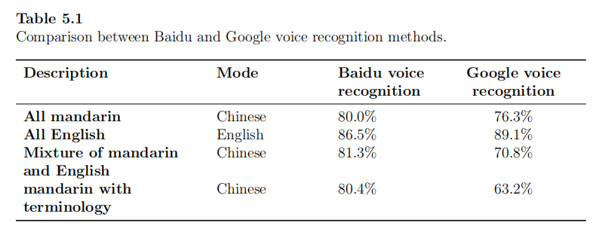
Result
Accuracy of Voice Recognition
Notes:
This table demonstrated the result of Baidu voice recognition method and Google voice recognition method for both Chinese and English language speech. It could be clearly observed that Baidu voice recognition method showed better result on mandarin and Google voice recognition method showed better result on English. Because this project targets to the Chinese EHR system, Baidu voice recognition method was selected. The Chinese language recognition by Baidu voice recognition achieved over 80% accuracy.

Slide 18
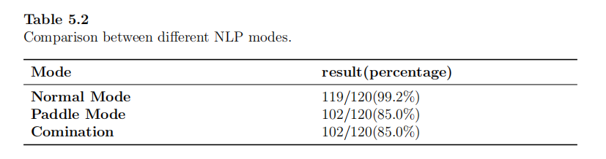
Result
Accuracy of sentence cutting and key information extraction
Notes:
After the implementation of NLP methods in two different modes, the results were counted as whether the cells in the form contain correct information. As mentioned before, paddle mode will ignore the punctuation, so it has unclear boundary between sentences. In that case, the accuracy of paddle mode is lower than normal mode. The combination result is the intersection of results from two modes. These incorrect cases happened in paddle mode would also lead to the wrong result in final result. However, it is still better to use the intersection of two results because normal mode contains irrelevant information in each cell. By intersecting with another mode, these irrelevant information can be removed.

Slide 19
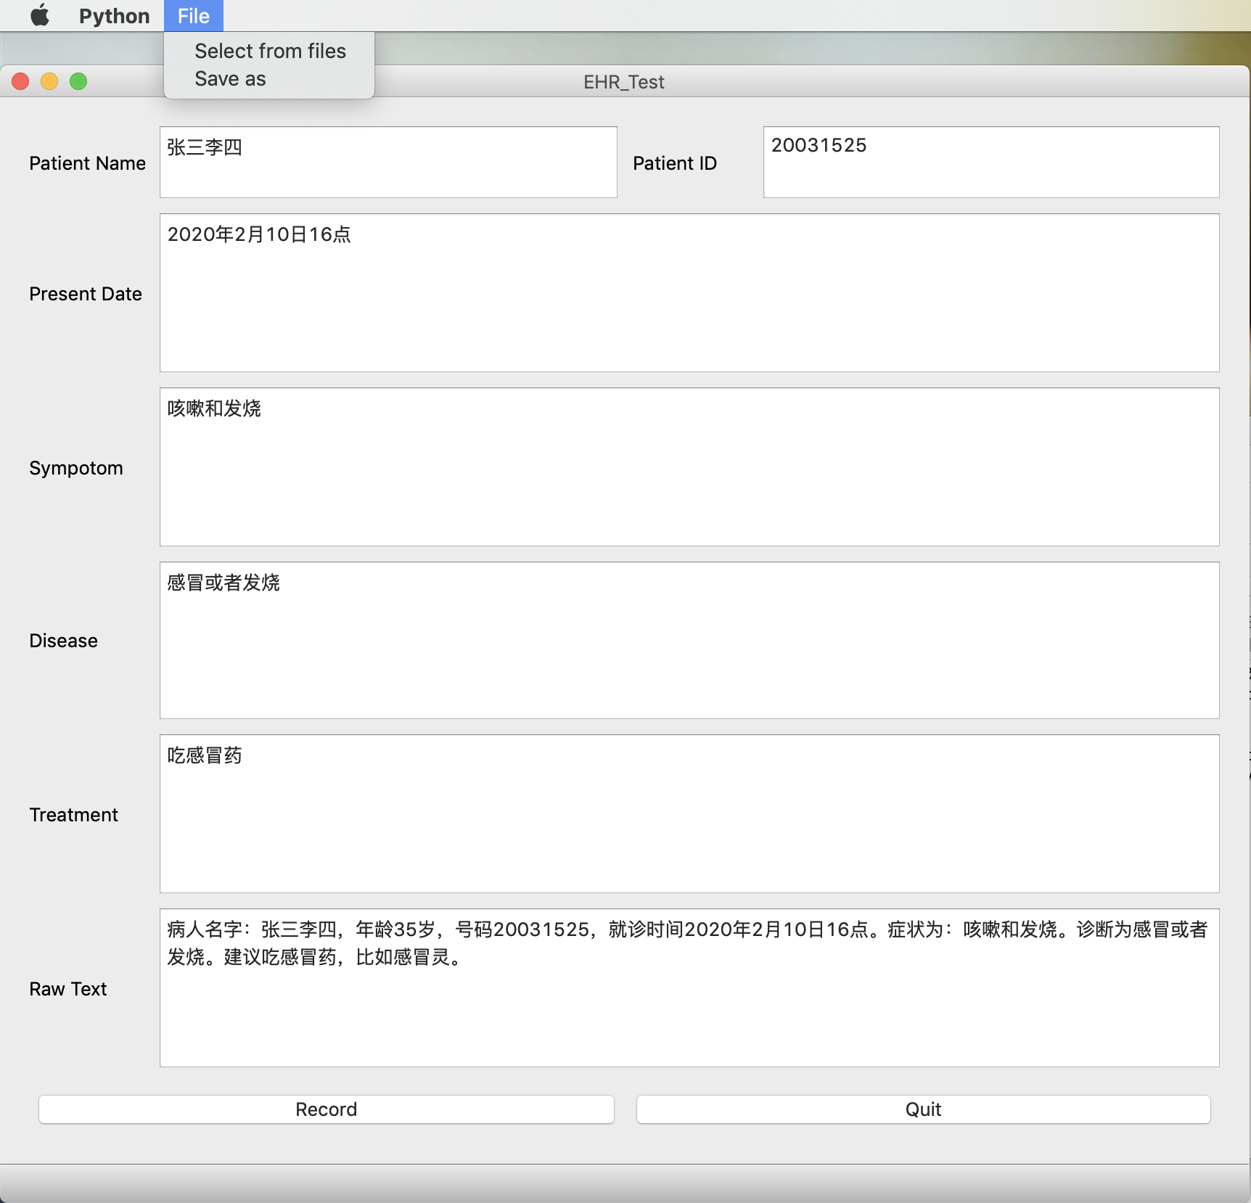
Result
UI
Notes:
This is the user interface created for this system.

Slide 20
Additional Work
Long/Short Term Memory (LSTM) [12]
To predict the disease type based on the symptom description.
No existing dataset
The accuracy is around 20%
Need more time to collect samples and improve the algorithm
Notes:
After finishing the original aims and objectives, additional work was included to use LSTM to predict the disease type based on the symptom description. Because that there was no public symptom description dataset in China, the dataset used in this project was manually collected from different websites. The current size of dataset was insufficient to train the network at this stage. Possible improvement approach would be included in future work.

Slide 21
Reflection
Achievement
An automatic EHR generation system which can transform voice input into plain text as well as process and extract key information to fill into EHRs. By using this system, it can improve the efficiency and quality on processing clerical works. Doctors did not need to manually fill in the EHRs and could concentrate on diagnosing patients.
Project management
The time management of this project is slightly faster than the original plan. All the deadlines were met and nothing was missed or lost throughout the whole project development. Additional work was included to explore the feasibility of smart-based EHR system.
Notes:
This project delivered an automatic EHR generation system which can transform voice input into plain text as well as process and extract key information to fill into EHRs. By using this system, it could support doctors and improve the efficiency and quality on processing clerical works. Doctors did not need to manually fill in the EHRs and could concentrate on diagnosing patients.
The time management of this project is slightly faster than the original plan. All the deadlines were met and nothing was missed or lost throughout the whole project development. Additional work was included to explore the feasibility of smart-based EHR system.

Slide 22
Future Work
Improvement
Noise reduction
Trigger word based extraction
Intersection of two results
Extension
Collect more symptom description data samples
Improve the LSTM network
Give the confidence rates of each possible diseases
…
Notes:
For the future work, improvement and extension on current system can be considered, including further noise reduction, AI-based information extraction, disease prediction and so on. By these approaches, a smart-based EHR system can support doctors filling the EHR as well as diagnose the patients.

Slide 23
Reference
1. T. Shu, H. Liu, F. R. Goss, W. Yang, L. Zhou, D. W. Bates, and M. Liang, “Ehr adoption across china’s tertiary hospitals: A cross-sectional observational study,” International Journal of Medical Informatics, vol. 83, no. 2, pp. 113 – 121, 2014.
2. Y. A. Kumah-Crystal, C. J. Pirtle, H. M. Whyte, E. S. Goode, S. H. Anders, and C. U. Lehmann, “Electronic health record interactions through voice: a review,” Applied clinical informatics, vol. 9, no. 3, p. 541, 2018.
3. J. Owusu-Marfo, Z. Lulin, H. A. Antwi, and M. O. Antwi, “Electronic health records adoption in china’s hospitals: A narrative review,” 2019.
4. J. King, V. Patel, E. W. Jamoom, and M. F. Furukawa, “Clinical benefits of electronic health record use: national findings,” Health services research, vol. 49, no. 1pt2, pp.392–404, 2014.
Notes:
This is the reference list and this is the end of my presentation. Thank you for your listening.

Slide 24
Reference
5. T. D. Shanafelt, L. N. Dyrbye, C. Sinsky, O. Hasan, D. Satele, J. Sloan, and C. P.
West, “Relationship between clerical burden and characteristics of the electronic
environment with physician burnout and professional satisfaction,” in Mayo Clinic
Proceedings, vol. 91, no. 7. Elsevier, 2016, pp. 836–848.
6. X. Chen, Z. Liu, L. Wei, J. Yan, T. Hao, and R. Ding, “A comparative quantitative study of utilizing artificial intelligence on electronic health records in the usa and china during 2008–2017,” BMC Medical Informatics and Decision Making, vol. 18, 12 2018.
7. Iflytek.com, “Iflytek voice ehr system,” https://www.iflytek.com/health/zlwyl, accessed Dec 10, 2020.
8. Baidu.com, “Baidu voice recognition api,” https://ai.baidu.com/tech/speech, accessed Dec 10, 2020.

Slide 25
Reference
9. Google.com, “Google voice recognition api,” https://pypi.org/project/SpeechRecognition/
, accessed Dec 10, 2020.
10. Jieba, “Jieba Python api,” https://github.com/fxsjy/jieba, accessed Dec 10, 2020.
11. Y. Wang, L. Wang, M. Rastegar-Mojarad, S. Moon, F. Shen, N. Afzal, S. Liu, Y. Zeng, S. Mehrabi, S. Sohn, and H. Liu, “Clinical information extraction applications: A literature review,” Journal of biomedical informatics, vol. 77, pp. 34–49, 2018.
12. Y. Yu, X. Si, C. Hu, and J. Zhang, “A review of recurrent neural networks: Lstm cells and network architectures,” Neural Computation, vol. 31, no. 7, pp. 1235–1270, 2019.

